Slide 1
Regional material at English lessons
Was done by the pupils
of 8th grade of Amginsky secondary school №1
after V. G. Korolenko Cuzmina Shura,
Dmitrieva Maya

Slide 2
The aim is:
immortalize the memory of teacher- participance of World War II
to attract the pupils interest to English by regional material

Slide 3
The tasks of our report are:
to acquaint with archive materials of museum and collect them
to translate into English for using at the lessons
to improve our English
to create the presentation for further work

Slide 4
The vital question is that the next year we will celebrate the 65th jubilee of great Victory and besides this year will be devoted to teachers that’s why we have chosen this theme.

Slide 5
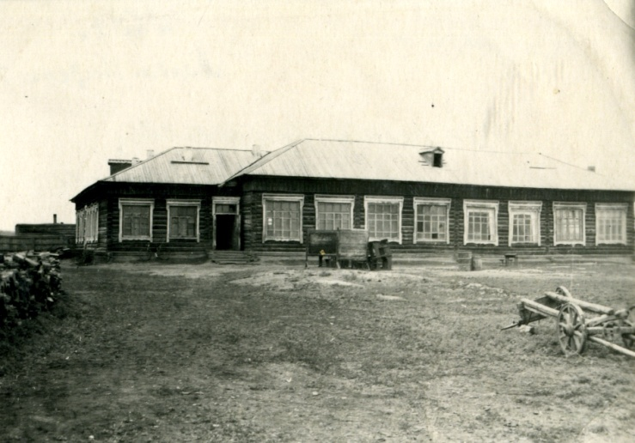
Amginskaya secondary school during Word War II
The teacher always were in the first rows destiny decisive events in people and country life.
Many teachers were called to the rows of Red Army from Amginsky Secondary school.
6

Slide 6
Vasiliev Innokentiy Nikolaevich, primary school teacher.
Ivanov Nikolay Pavlovich, math teacher.
Ivanov Ivan Illarionovich.
Kaydalov Georgiy Fomich.
Klimontov Vasiliy Lukich, primary school teacher.
Nemchinov Petr Nikolaevich, primary school teacher
Nikitin Taras Eremeevich.
Okorokov Ivan Ivanovich, primary school teacher.
Onufriev Semen Petrovich, primary school teacher.
Pahomov Aleksey Dmitrievich, primary school teacher.
Romanov Innokentiy Ivanovich, physics teacher.
Yakovlev Petr Ionovich, primary school teacher.

Slide 7
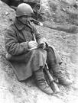
During the war the teachers from front asked their pupils with confident in Victory, called pupils and teachers to mobilize all power on fighting with enemies. There is a letter of A.M. Mikhaylov , geography, biology, chemistry teacher, called to Red Army in 1942 in the museum of our school. In his letter he calls the pupils of his school to be disciplined and study well.

Slide 8
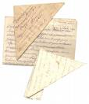
And there are front letters of Kaydalov, Nemchinov in the archives of our school. And this letters were printed in the newspaper «Socialist Yakutia» in 1942. In their letters they called pupils to study well and promised to come back with Victory.
Some teachers came back and began to work at school.

Slide 9
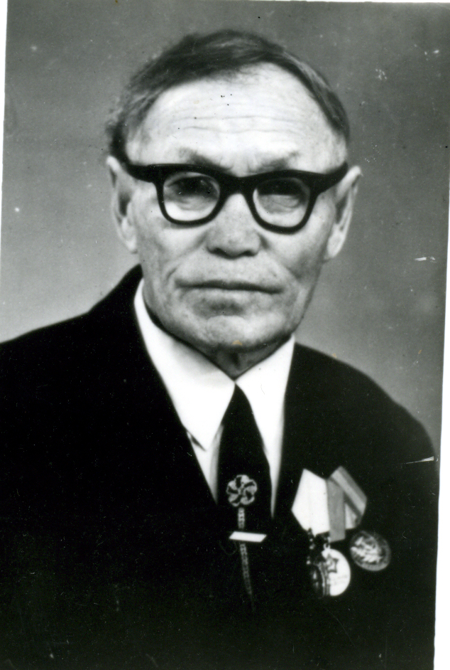
Ivanov Ivan Illarionovich
He was born in 1907 in Tchakyr village. Since 1937 he was working as a teacher of Yakut and literature. His pedagogical creative work was highly marked.

Slide 10
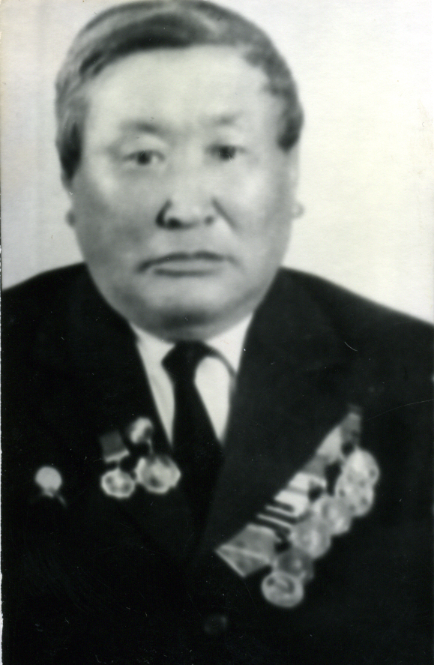
Ivanov Nikolay Pavlovich.
Was born in 1917. In 1934 he worked in Abaginsky school as a teacher. Since 1948 to 1963 he worked as a math teacher and as a leader of Amginsky secondary school and then he was an inspector and head of Department of Education.

Slide 11
Kaydalov Geogrey Fomich was born in 1903 in Olyokminsky ulus.
Since 1931 he worked as a teacher in Amginsky ulus, and in 1942 he began to work as a military commissar in Amginsky secondary school
After the War he lived in Abuga vinage and had been working for 31 years as a teacher.

Slide 12
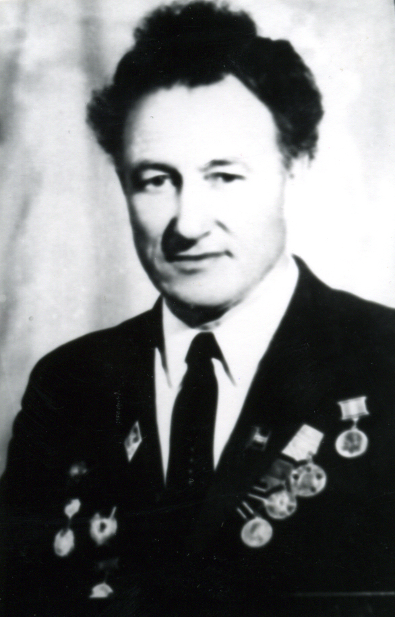
Klimontov Vasiliy Lukich
was born in 1919. Since 1937 was a teacher of Amginsky school. After War he continned to work at Amginsky school.
Memory about teacher – participiants of world War second is piously kept in Amginsky secondary school №1 after Corolenko, who has fighted not sparing their life for the lake of piece in the world.
We know how did they win and we will always remember the teacher who give his life for Motheriand.

Slide 13
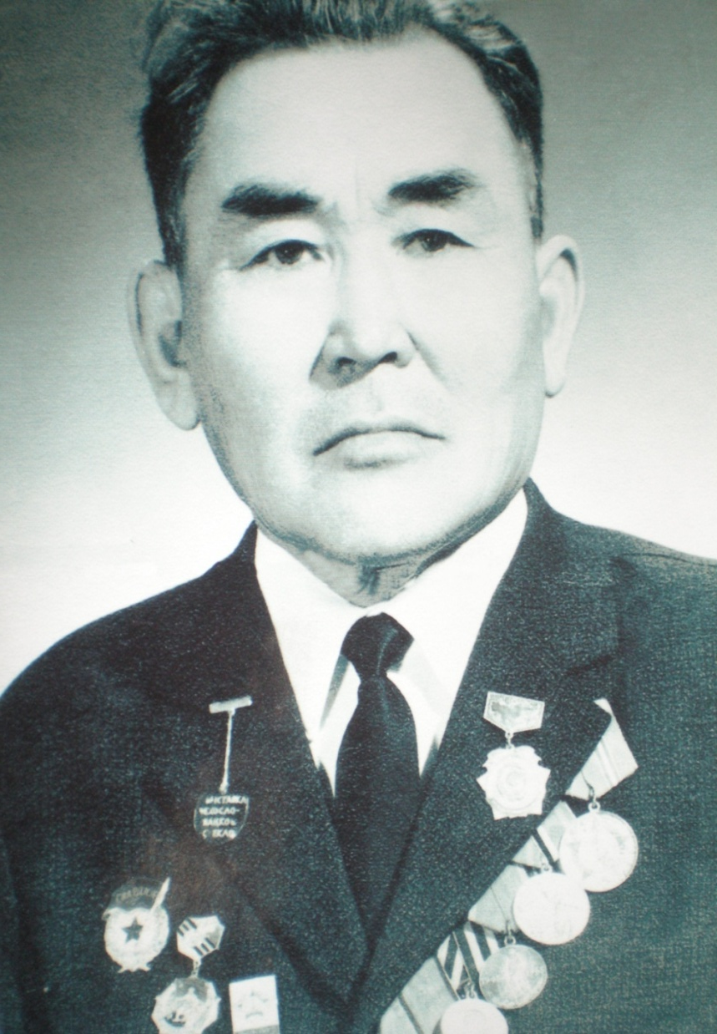
Onufriev Semen Petrovich was born in 1917 . He began his pedagogical work in 1935, was a teacher of Yakut national military school. After War he come back to his profession and during 1945-52 he was a leader of primary school, and the teacher of Betunsky school.

Slide 14
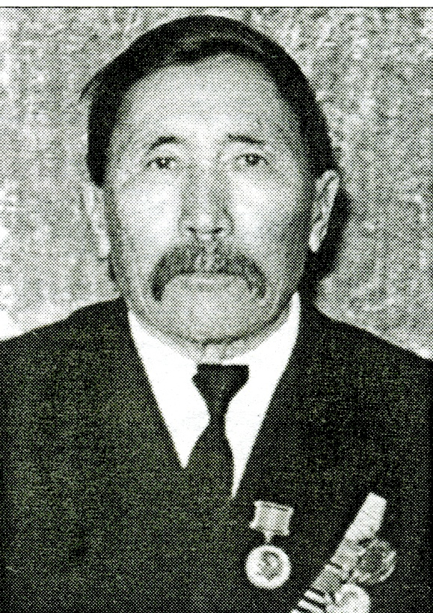
Nemchinov Petr Nikolaevich
was born in 1904. He was a participate of Civil and World War II. He worked as music and physical culture teacher.
After War he had worked as a member of Party till 1960.

