Slide 1
Holidays and Special Days in the USA

Slide 2
New Year’s Day is January 1.
People begin celebrating on December 31. They have parties through the night.
In Time Square, in New York, at a minute before midnight, a lighted ball goes down from one of the buildings.

Slide 3
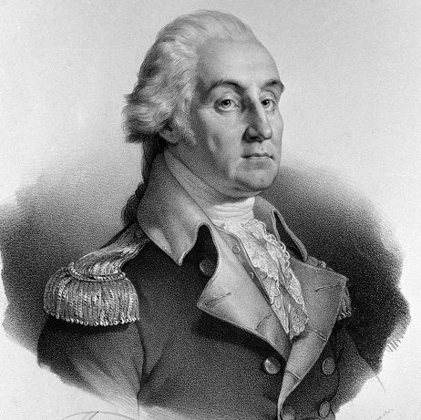
George Washington’s Birthday is February 22
George Washington (1732-1799) was the first president of the USA. During the War of Independence he took command of the Continental Arm for eight years, until the colonies won their independence from Britain.

Slide 4
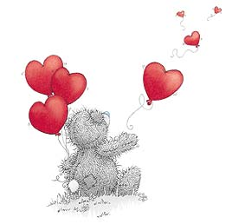
St Valentines Day is February 14
On that day most people send “valentines”, candy or roses to people they love. Valentines are greeting cards to the from of hart, or they have hearts, the symbol of love, on them.

Slide 5
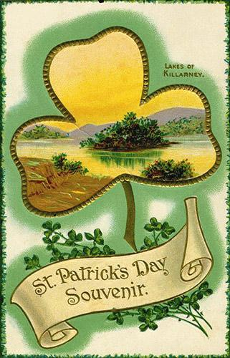
St Patrick’s Day is March 17
Irish Americans remember St Patrick,
the patron saint of Ireland. People wear green. It means the beginning of spring. There are parades. People sign and dance, wear Irish clothes and eat Irish food.

Slide 6
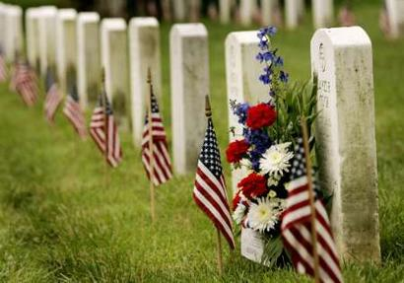
Memorial Day is the last Monday in May
Americans remember the US soldiers who died in wars. People visit cemeteries and put flowers on graves.

Slide 7
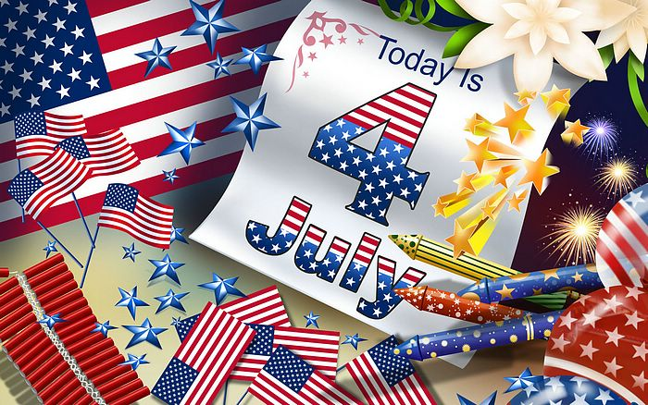
Independence Day is July 4. It is the United States’ birthday.

Slide 8
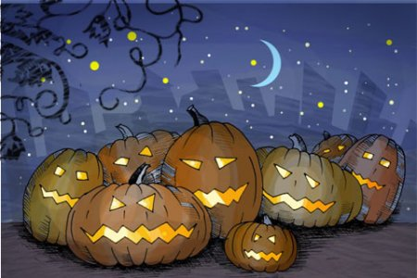
Halloween is October 31
The Celts believed that on this day ghosts walked the earth and mingled with the living. At night people dressed up in costumes and tried to look like the souls of the dead.

Slide 9
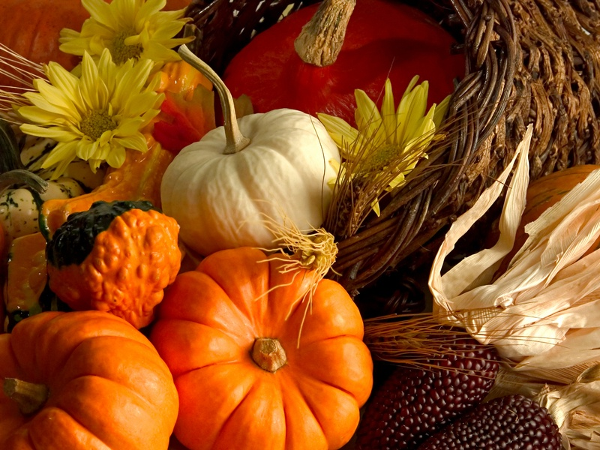
Thanksgiving Day is the fourth Thursday in November
Families get together and have a big dinner. They eat turkey and pumpkin pie.

Slide 10
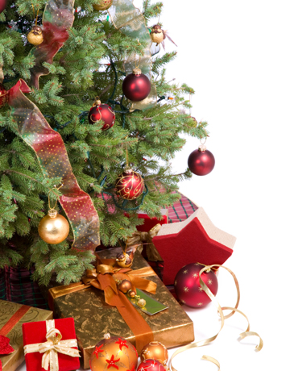
Christmas is December 25
Christians celebrate the birth of Jesus Christ. People decorate a Christmas tree, and Santa Claus brings presents to children.

