Slide 1
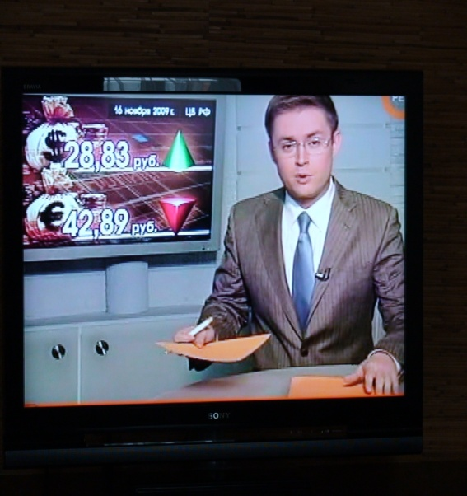
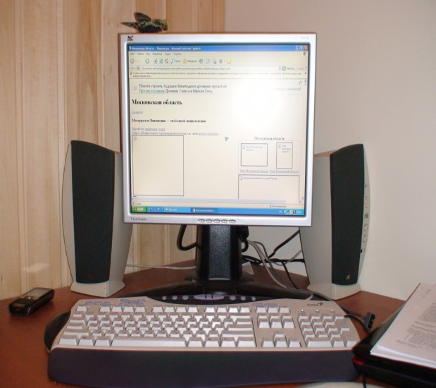
MASS MEDIA

Slide 2
Answer the questions:
1) What mass media do you know?
2) Which is the most popular of them? Why?
3) What newspapers and magazines do you know? Which of them do you read?

Slide 3
4) Do you watch a lot of television?
5) What do you usually watch on TV?
6) Do you often listen to the radio? Where do you usually do it?
7) What do you often look for in the Internet?

Slide 4
- film - comedy - serial - talk show - sports programme - documentary - news - political discussion - quitz show - pop-music concert - cartoons - ballet - soap opera - series of documentaries about the animal world
CHECK YOUR VOCABULARY
- фильм
- комедия
- сериал
- ток шоу
- спортивная программа
- документальный фильм
- новости
- политическая дискуссия
- викторина
- концерт поп музыки
- мультфильмы
- балет
- мыльная опера
- документальный сериал о мире животных

Slide 5
Complete the sentences with the words
My father always watches … news on television.
In Moscow TV programmes are … from Ostankino.
Non-commercial television doesn’t show any … .
Today the news is … by my favourite newscaster.
Besides national newspapers there are … newspapers read by many people.
Many people say too much … is shown on the screen.
Listen to your dad and don’t … him.
Unfortunately more and more people become … to stupid TV programmes.
“Who wants to be a millionaire?” is a typical TV … .
I have always wanted to watch Walt Disney … .
current
broadcast
advertisment
presented
local
violence
interrupt
addicted
quitz
cartoons

Slide 6
Use the right form of the verb in passive:
1) When I came home a new interesting cartoon (to show) on TV.
When I came home a new interesting cartoon was being shown on TV.
(Past Progressive Passive)
2) More and more people (to teach) with the help of television in the future.
More and more people will be taught with the help of television in the future. ( Future Simple Passive)
3) When we entered the room, the television (to turn on) and my parents were watching the news.
When we entered the room, the television had been turned on and my parents were watching the news. (Past Perfect Passive)

Slide 7
4) A lot of TV programmes (to devote) to politics.
A lot of TV programmes are devoted to politics.
(Present Simple Passive)
5) This soap opera (to broadcast) many times. We don’t want to watch it again.
This soap opera has been broadcast many times. We don’t want to watch it again. (Present Perfect Passive)
6) The first television service (to open) in Britain in 1956.
The first television service was opened in Britain in 1956.
(Past Simple Passive)
7) Nowadays new television technologies (to develop).
Nowadays new television technologies are being developed.
(Present Progressive Passive)

