Slide 1
Tourism
Tourism is the business activity connected with providing accommodation, services and entertainment for people who are visiting a place for pleasure .

Slide 2
Tourism
Pilot, tour guide, resort rep, receptionist, restaurant manager, tourist information officer, travel agent, check-in staff, interpreter,
flight-attendant,

Slide 3
Tourism
Have you ever been abroad?
What countries have you visited?
When was it?
Where did you stay?
Who did you go with?
How long did you stay there?
Did you like the country?

Slide 4
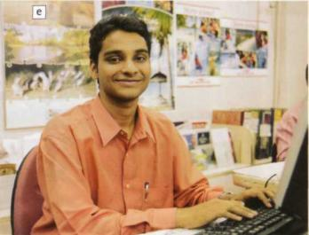
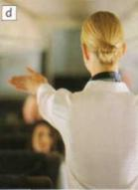
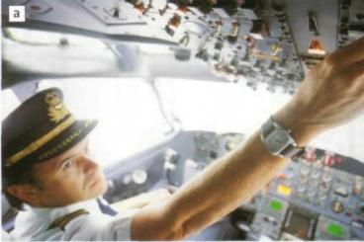
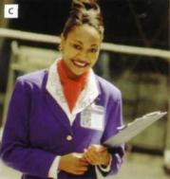
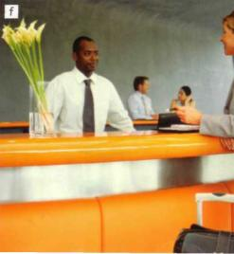
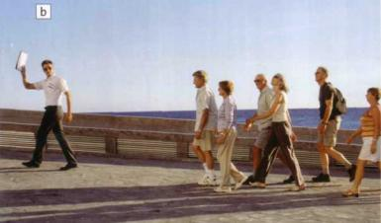
Tourism

Slide 5
Tourism
Calm , nervous, disorganized, scruffy, friendly, lazy, creative, practical, flexible, smart, confident, extrovert ,shy , hard-working, unfriendly, organized

Slide 6
Tourism
Calm-nervous
Extrovert-shy
Friendly-unfriendly
Hard-working - lazy
Organized-disorganized
Smart-scruffy

Slide 7
Tourism
Look at these four jobs in the tourist industry. Which one would you most like to do and why?
Hotel receptionist
Restaurant manager
Tour leader
Tourist information officer

Slide 8
Tourism
Alex
I work in the centre of Bangkok, at railway station. My job is to advise tourist about accommodation, transport, and sightseeing. It takes a lot of energy- you need to be patient and friendly. I really like helping people to have a nice time in my city, but it is very tiring.
Monika
I work six days a week, including evenings. In this job you need to be well organized, and efficient. I plan the menus with the chef, handle the day –to-day running of the business, do the accounts, and manage a team of ten. The only part of the job I don’t like is dealing with customers’ complaints.
Ramon
What I like about my job is that every day is different. I am part of a team and we all get on well. I have to check guests in and out of the hotel , take reservations, and sort out problems. I enjoy dealing with people. For a job like this you need to be sociable and to be diplomatic.
Kate
When I am a tour, I am my own boss, and I really enjoy that. You need to be calm and resourceful for this job. Basically, I am responsible for making sure that the tour goes smoothly and that people enjoy their holiday. I check the transport arrangements, tell people what is happening each day, and deal with any problems. The only negative thing is
that it’s a big responsibility.

Slide 9
Tourism
Read the information again. Complete the notes.
Person Job Responsibilities
Alex ________ advises travellers about accomodation
Monika ______________ ____________________________
Kate ______________ _____________________________
Ramon ______________ _____________________________

Slide 10
Tourism
Write the correct name.
a. _____ doesn’t like dealing with complaints.
b. _____ likes helping people to have a nice time in his/her city.
c. _____ likes being his/her own boss.
d. _____ doesn’t like rude people.

Slide 11
Tourism
Find two words in the text in the histories that describe the personal qualities you need for each job.
Job Qualities
1.Tourist information officer patient ___________
2. Restaurant manager _____ ___________
3. Hotel receptionist _____ ___________
4. Tour leader _____ ___________

Slide 12
Tourism
Work in pairs. Choose a job from the stories. Imagine it is your job, think about:
what you do every day
the personal qualities you need
Describe the job to your partner and ask her to guess what it is.

Slide 13
Home assignment:
ex. p.

Slide 14
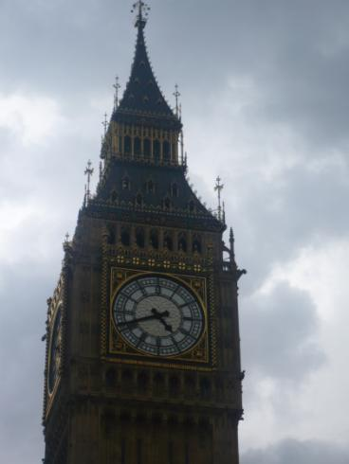
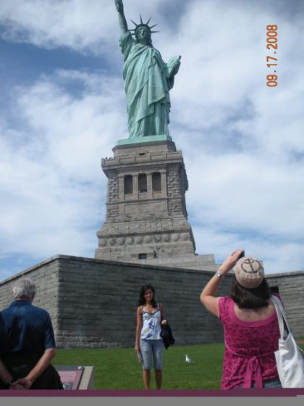
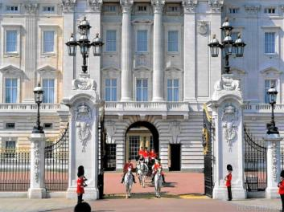
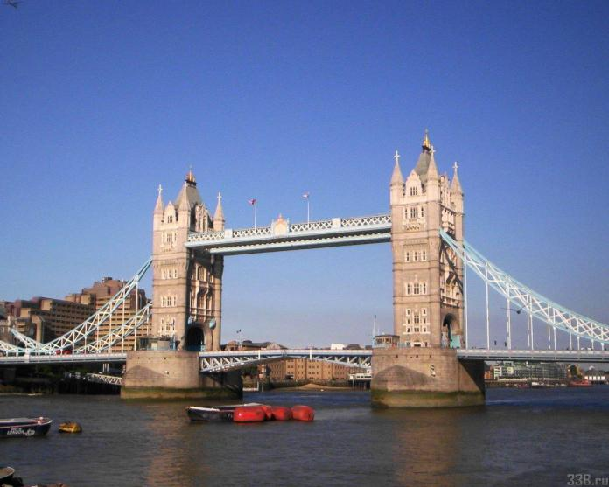
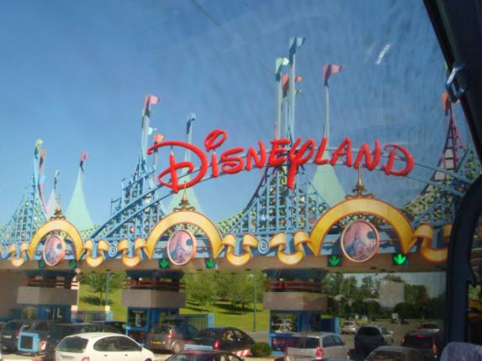
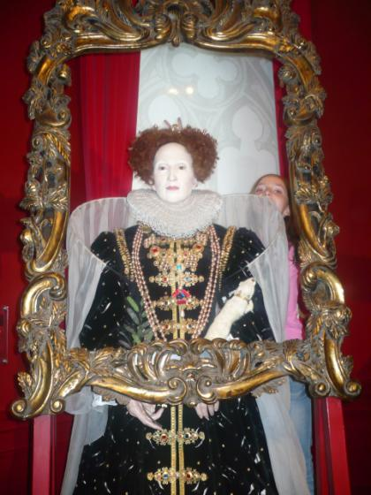
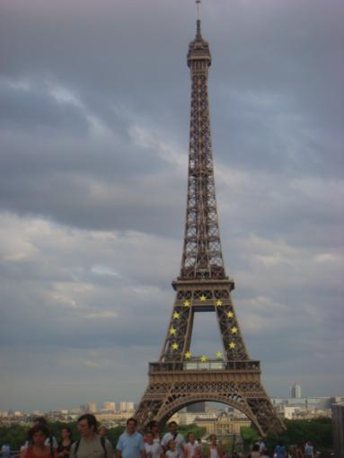
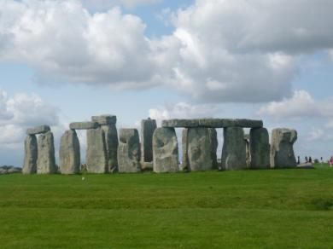
HAVE A NICE DAY!

