Slide 1
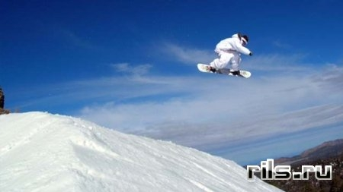
Экстремальные виды спорта.
Урок английского языка в 9 классе

Slide 2
Extreme Sports.
Bungee jumping;
Extreme mountain biking;
Extreme skiing;
Ice-canyoning;
Ice diving;
Skysurfing;
Snowboarding;
Snowrafting;
White water rafting.

Slide 3
Exercise 1.
Which sport do you think is the most dangerous? Why?
Have you ever tried any of these extreme sports? Which ones? What was it lake?
Which sports would you like to try? Why?

Slide 4
Exercise 2
Read the Strategies.
LISTENING STRATEGIES; Preparation
Before you listen, always look for clues that will help you understand what you are going to listen to (e.g. the title, captions, pictures, etc.).
Read the questions carefully to help you listen for specific/relevant information.
Use your knowledge of the world to try to predict answers to the questions.
Guess the answers which you can, then check when you are listening.

Slide 5
Exercise 3.
Use the Strategies to answer the questions.
People do extreme sports in order to feel ... a excited, b nervous, с happy.
Extreme sports have become popular in the last… a 5 years, b 10 years, с 20 years.
People usually bungee jump from ...
a aeroplanes, b high buildings, с bridges.
In skysurfing people do mid-air ...
a gymnastics, b dancing, с swimming.
Skysurfing has similarities with ... a skiing, b surfing, с canoeing.
Snowrafting is ...
a quite dangerous, b very dangerous, с not very dangerous.
For white water rafting you need ...
a a big river. b a warm river. c a mountain river.
Ice divers …
a swim under the ice. b walk on the bottom of lakes. c walk upside down under the ice.

Slide 6
Exercise 4.
Listen to two people talking about extreme sports. Complete the table.
Sports | Mary | John
likes
Doesn’t like
Would like to try
Wouldn’t like to try

Slide 7
Exercise 5.
Preferences.
+ ’ing’ or noun + to + infinitive
I ¹ _________ bungee jamping. I ²______________ to try skysurfing.
I ³_______________ to do snowrafting.
I ⁴ __________ doing boring sports. I ⁵_______________ to stay at home.
I ⁶ __________ winter sports.
I ⁷ ___________ going skiing.
I ⁸ ___________ snowboarding.
I ⁹ ___________ slow sports. I ¹⁰ ______________ to go ice diving.

Slide 8
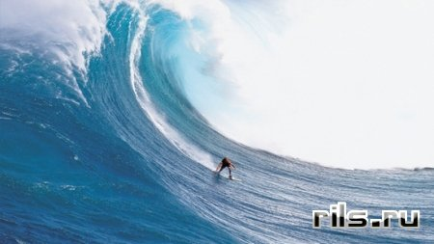

Slide 9
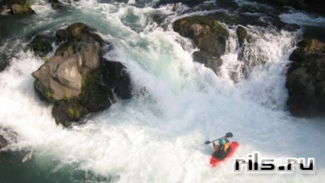
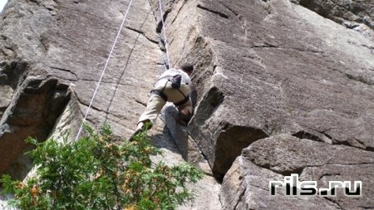

Slide 10
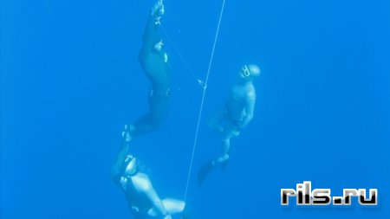
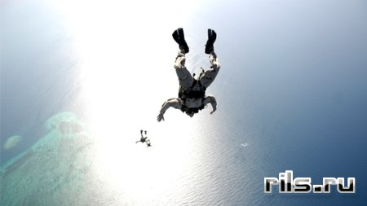
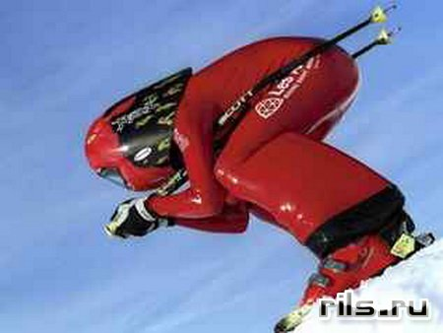

Slide 11
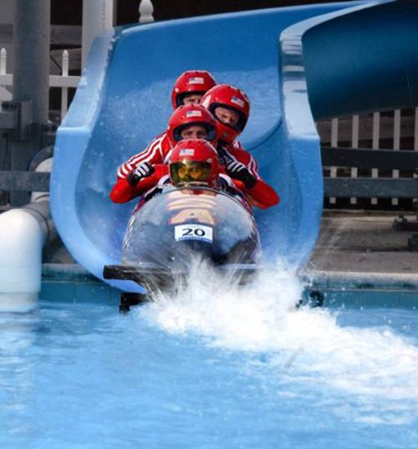

Slide 12
