Slide 1
CLOTHING

Slide 2
Read the words
[ ð ] This
That
Another
Clothes

Slide 3
Weather and Clothes There is No Bad Weather, There are Bad Clothes
It’s warm | It’s rainy | It’s cold | It’s hot
trousers | a raincoat | a warm jacket | a T-shirt
jeans | a jacket | a fur coat | shorts
a shirt | a cap | an overcoat | light shoes
a sweater | boots | a hat | sandals
a skirt | umbrella | gloves
a blouse a waistcoat |  | mittens a scarf
trainers |  | boots
 |  | high boots

Slide 5
Adjectives
Positive | Comparative | Superlative
expensive | ? | ?
? | cheaper | ?
? | ? | the best
? | worse | ?
crazy | ? | ?
? | wetter | ?
? | ? | the most difficult
? | drier | ?
wonderful | ? | ?
bright | ? | ?
? | ? | the newest
? | older | ?
wise | ? | ?
? | cleverer | ?
silly | ? | ?
? | ? | the fattest
thin | ? | ?

Slide 6
Compare people, animals, objects
Nelly's brother is clever but his sister is…
A tortoise is slow. It is… than a dog
My dolls are not very nice. Your dolls are…
The potatoes are not very good. Buy some… potatoes.
That woman isn‘t very beautiful. My sister is…
The big brown monkey is not very funny.
The small grey monkey is…
7. This banana is bad, but that banana is…

Slide 7
Compare
old
large
short
expensive
80 pounds
50 pounds
cheap
10 pounds
25 pounds

Slide 8
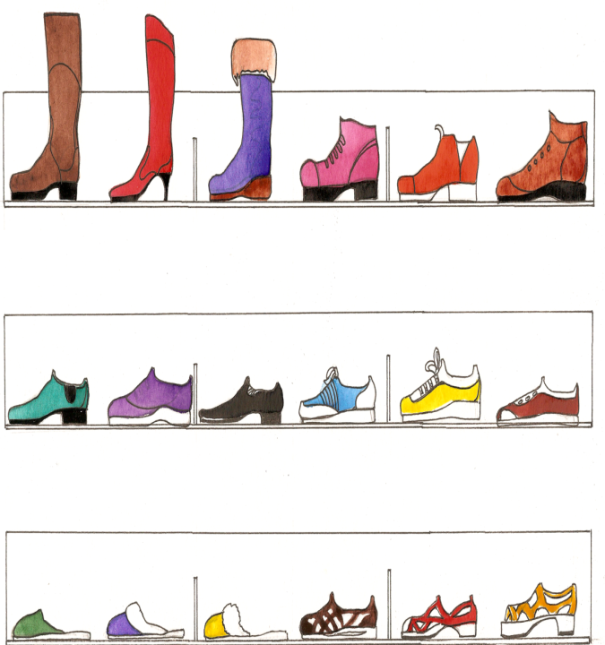
Footwear

Slide 9
Read and guess the word
The first letter of "sweater“,
The second letter of “shop“,
The third letter of “slippers“,
The fourth letter of “skirt“,
The fifth letter of “tights“.
What is it?

Slide 10
Find a mistake and and write correctly:
dryer, hoter, wonderfuller,
badder, slowwer, lightter,
the goodest

