Slide 1
What do
the following
pictures show?

Slide 2
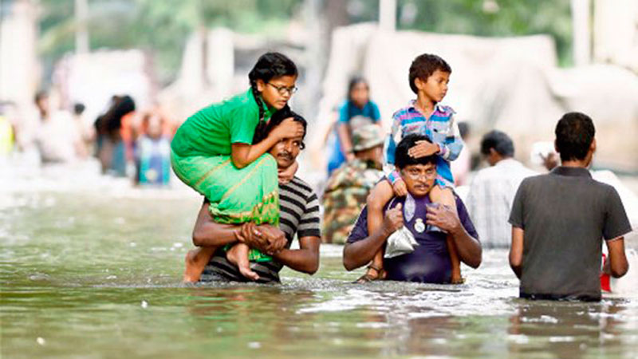
The picture shows
people helping
victims of flood.

Slide 3
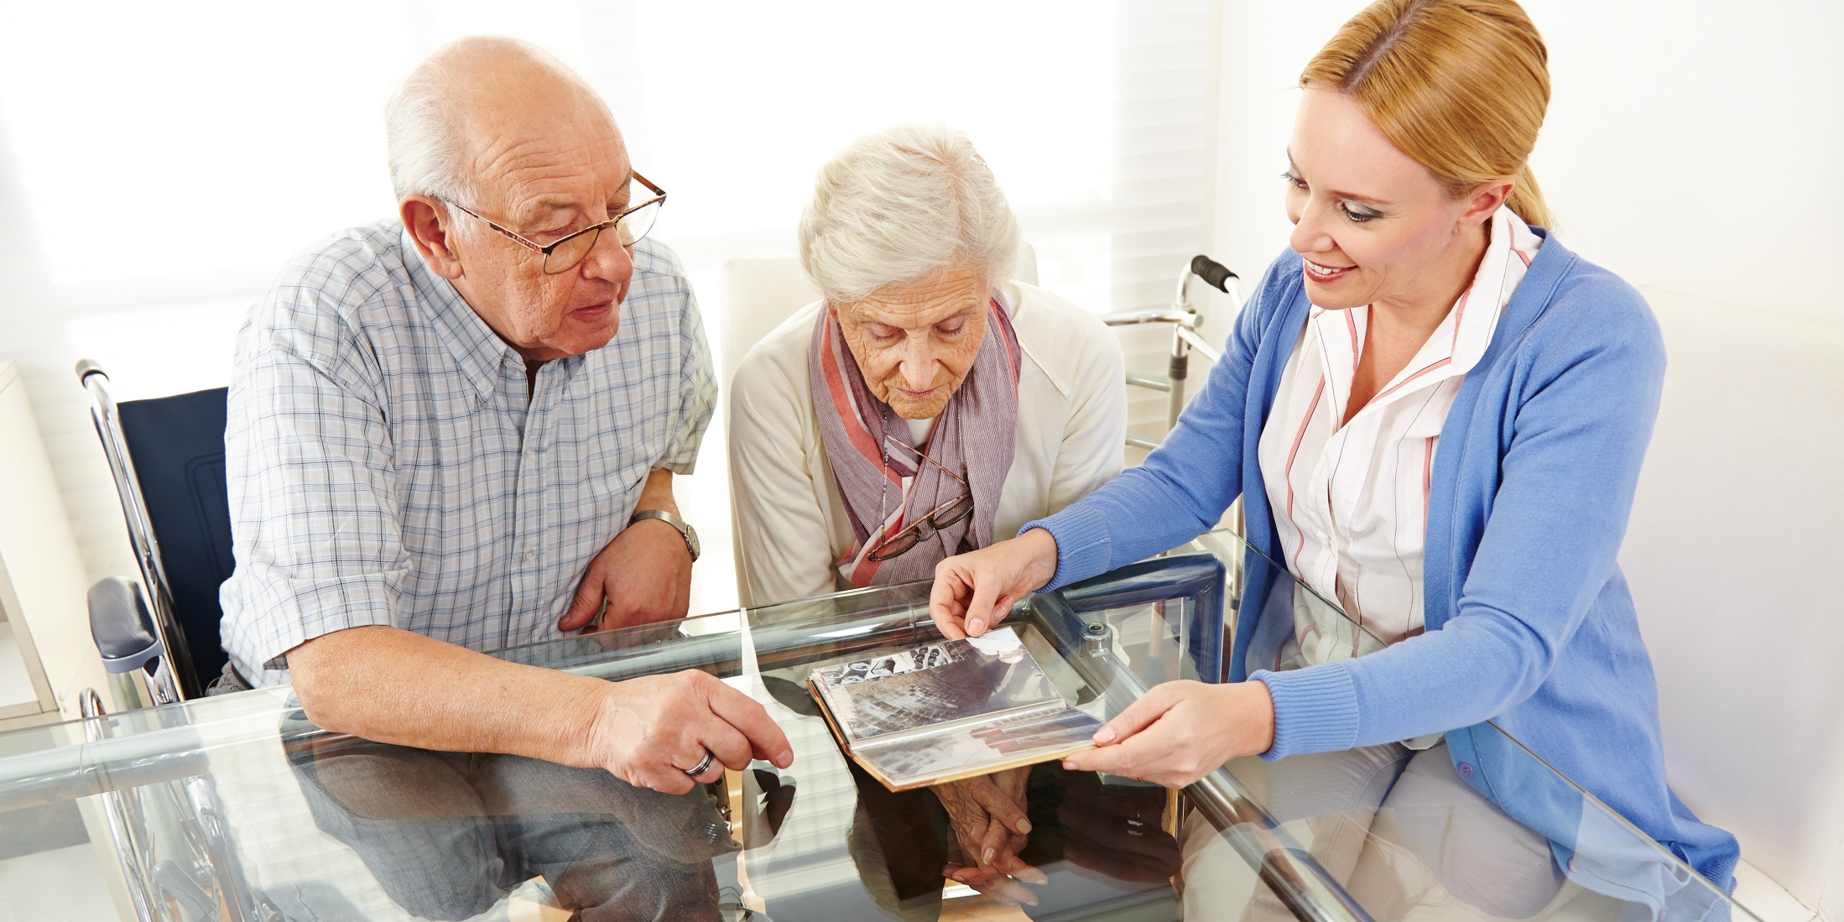
visiting senior citizens

Slide 4
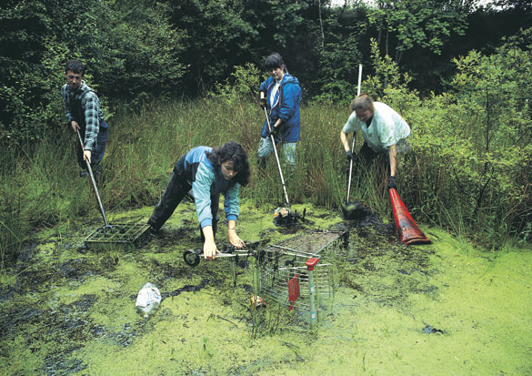
cleaning up a pond

Slide 5
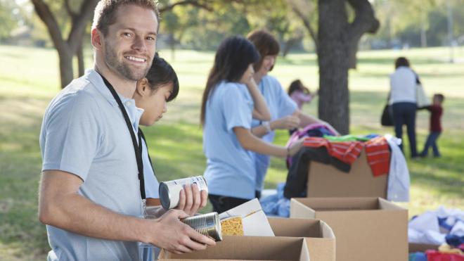
collecting
humanitarian aid

Slide 6
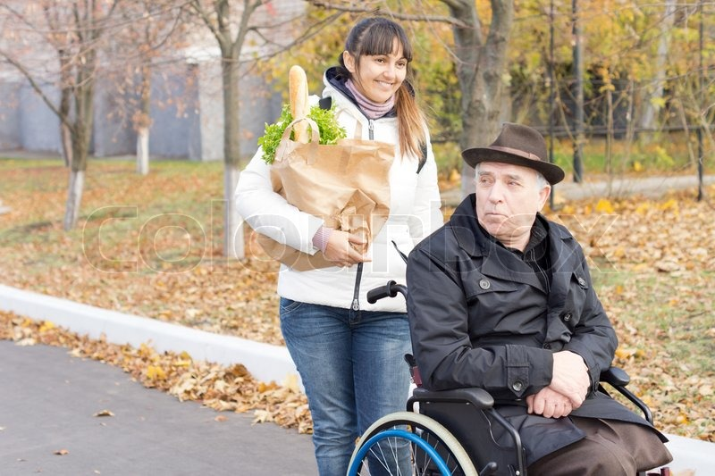
helping a disabled
senior citizen

Slide 7
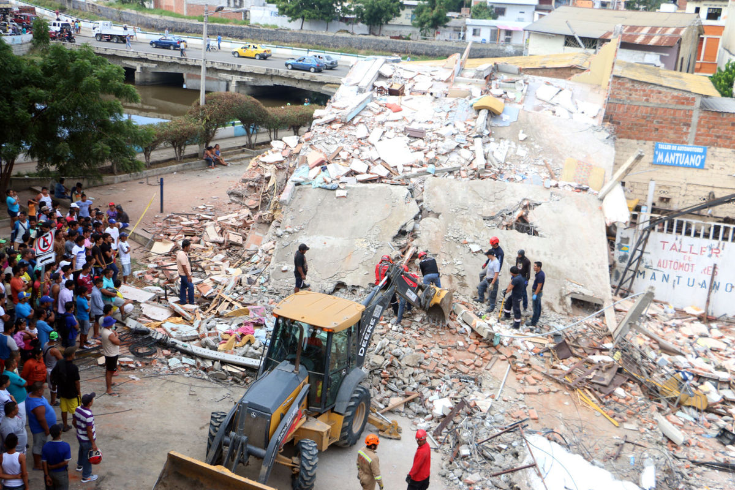
helping victims
of an earthquake

Slide 8
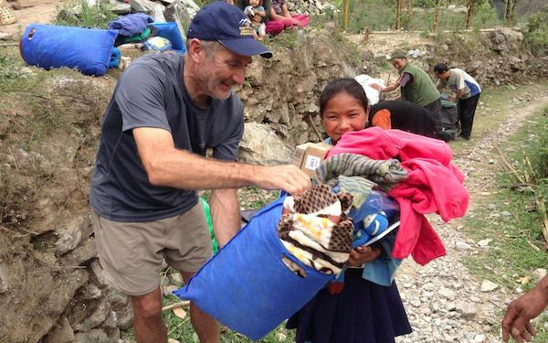
giving supplies
to victims of
an earthquake

Slide 9
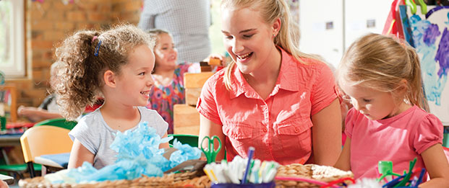
working
with children

Slide 10
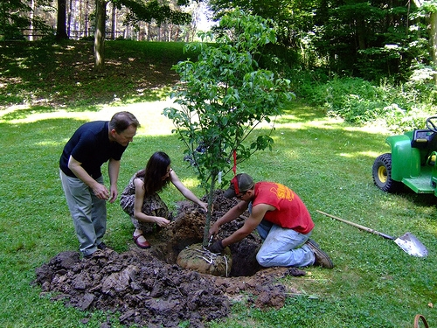
planting trees

Slide 11
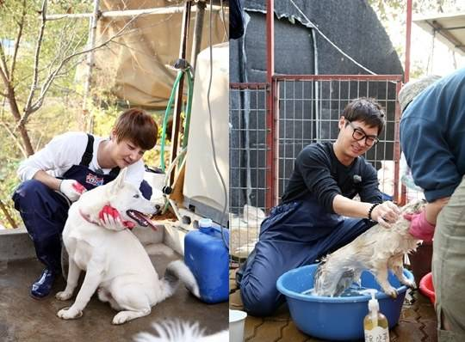
helping people
at an animal shelter

Slide 12
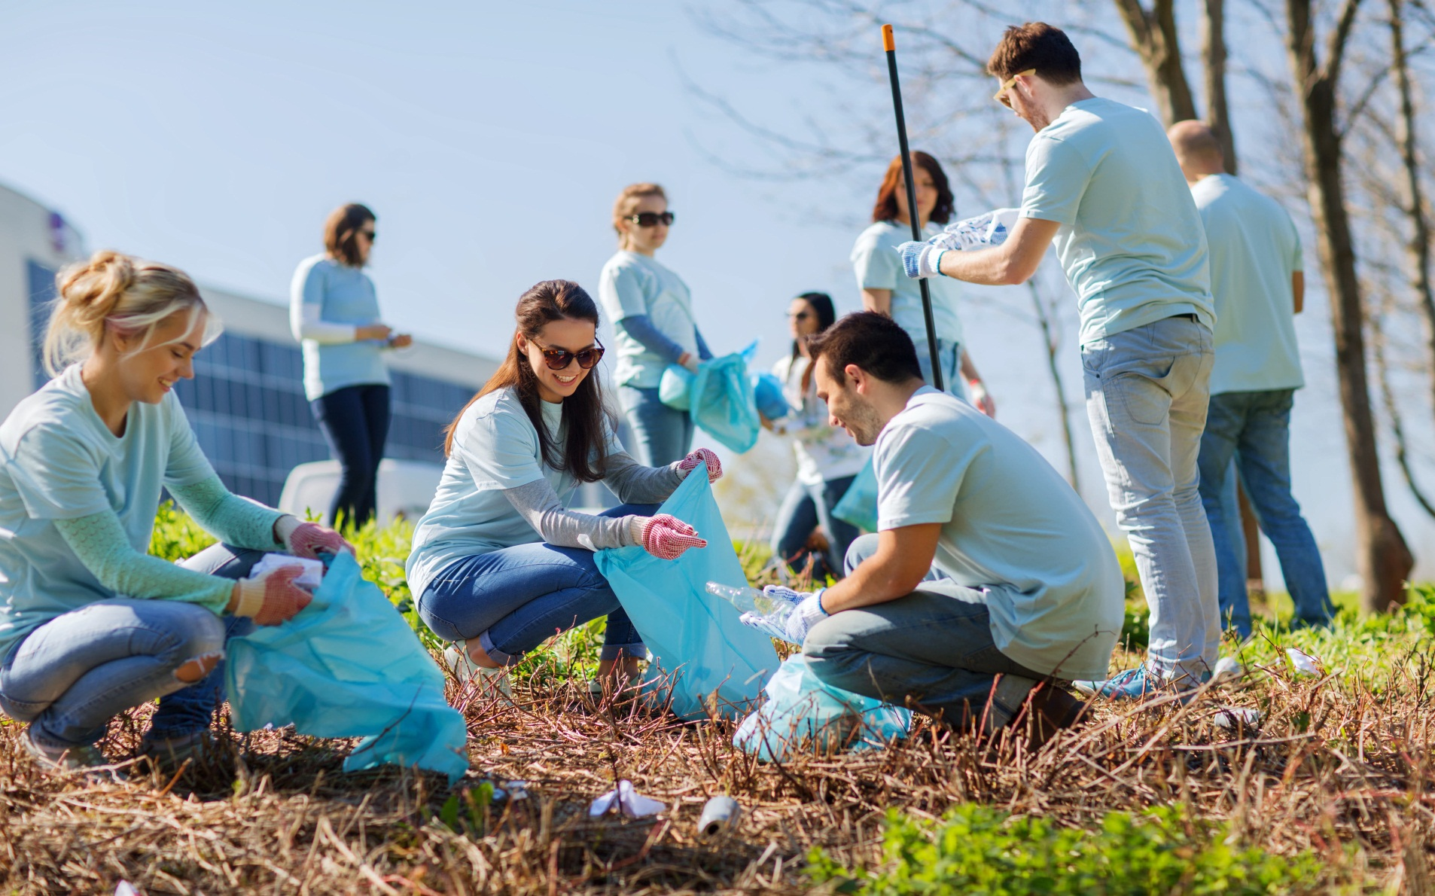
collect
collecting rubbish
outside

Slide 13
Who are these people?

Slide 14
Ask and answer
the questions, please!

Slide 15
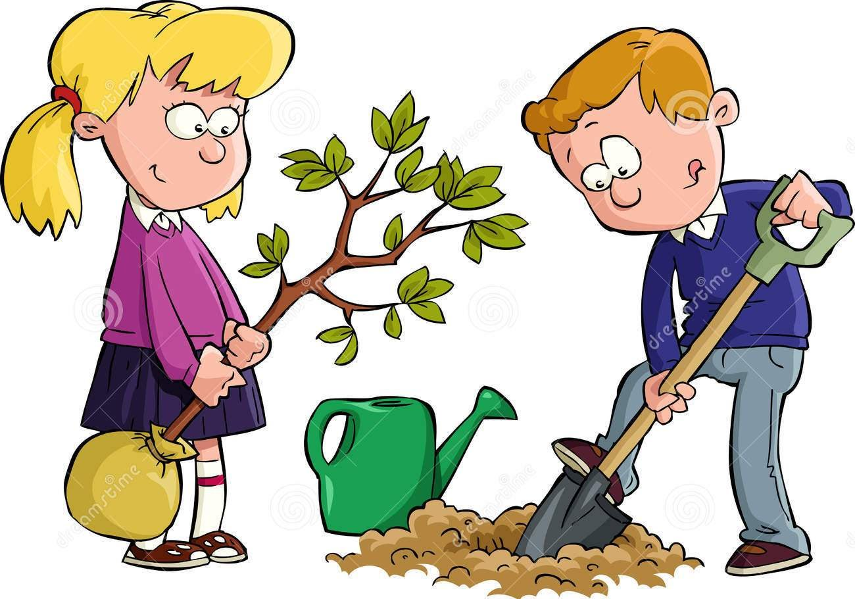
Have you ever … V3/V-ed?

Slide 16
Have you ever … V3/V-ed?

Slide 17
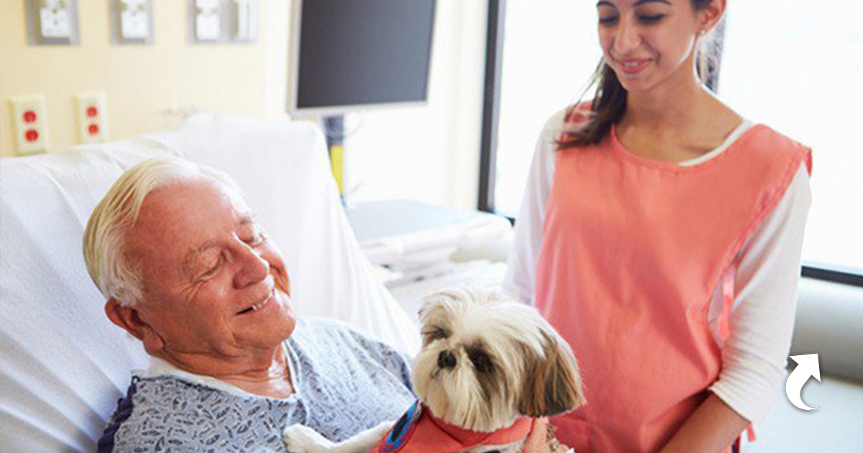

Slide 18
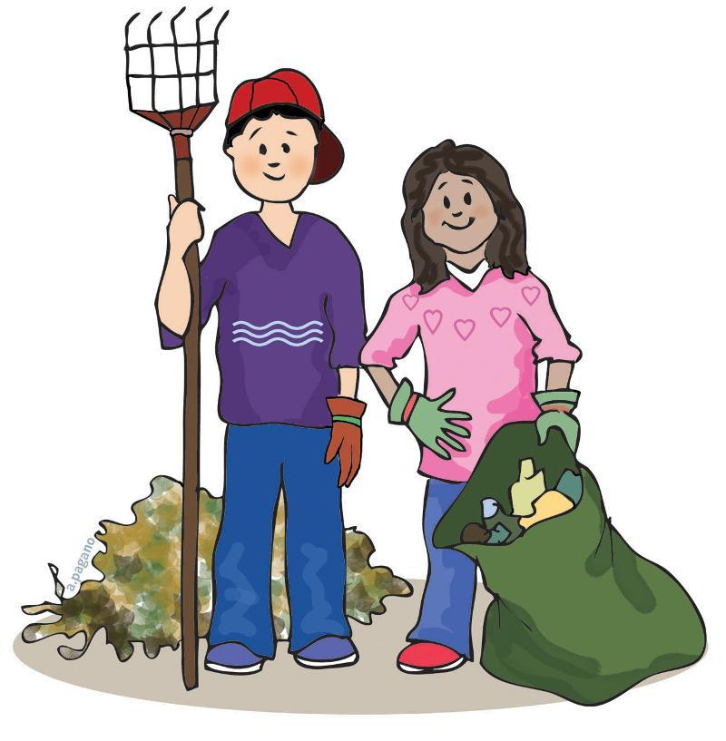
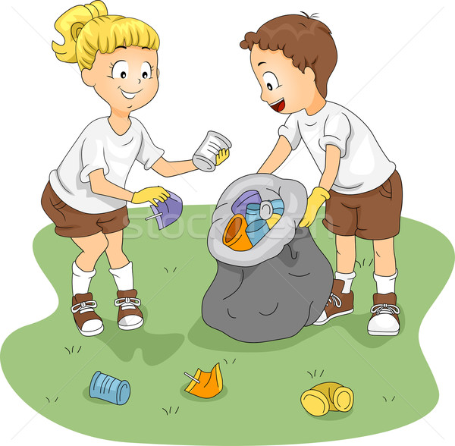
Have you ever …
V3/V-ed?

Slide 19
Have you ever …
V3/V-ed?

