Slide 1
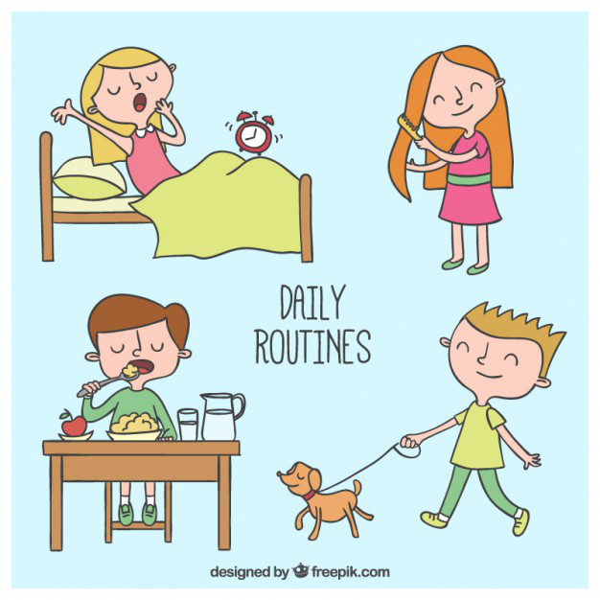
Daily life

Slide 2
DAILY LIFE
Read and match (прочитай и найди соответствия)
in the morning | вечером
in the afternoon | делать домашнюю работу
in the evening | приходить
brush teeth | идти в школу
have supper | мыть руки
have breakfast | смотреть телевизор
come home from school | обедать
have lunch / dinner | ужинать
get up | делать упражнения
go to bed | чистить зубы
do homework | днём
wash hands | утром
read a book | умываться
wash face | вставать
watch TV | читать книгу
do exercises | завтракать

Slide 3
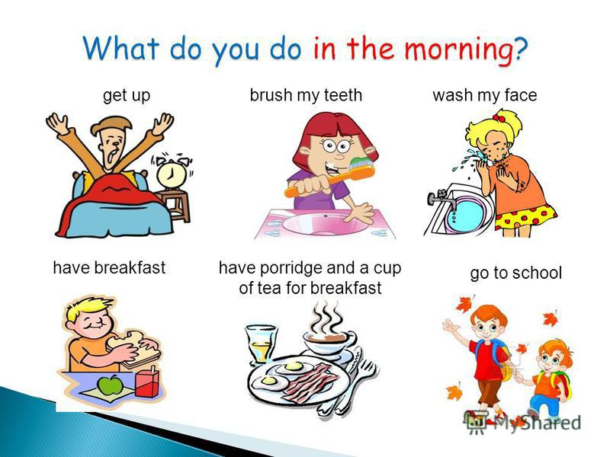

Slide 4
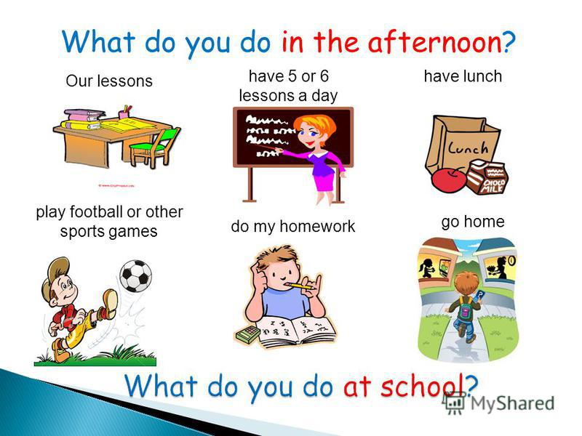

Slide 5
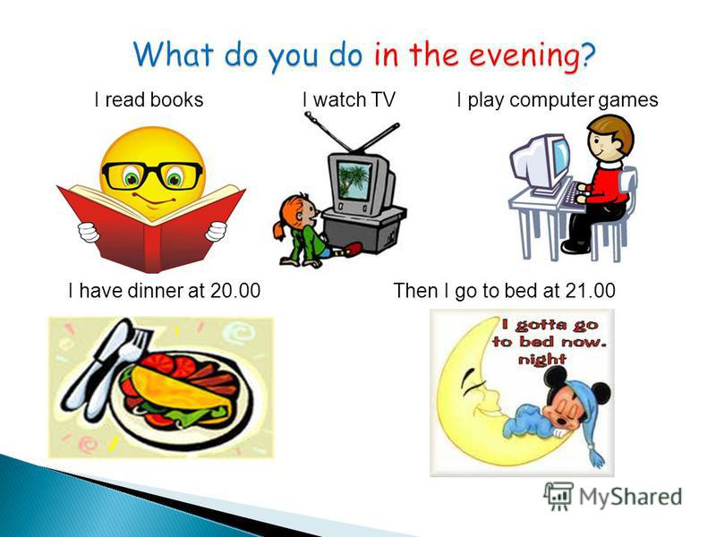
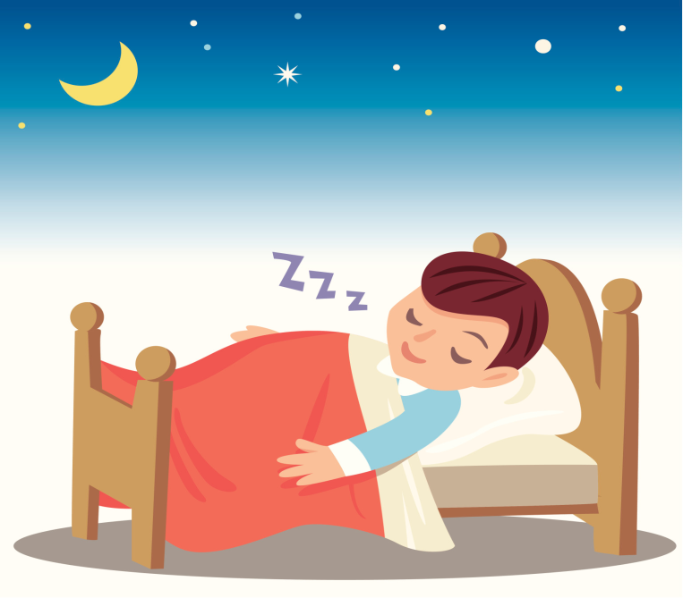

Slide 6
watch TV to have lunch in the afternoon go to bed get up have breakfast in the evening have lunch do homework brush teeth in the morning do exercises go to school
1. Переведи на английский язык:
1) Идти в школу
2) Делать домашнюю работу
3) Вставать
4) Чистить зубы
5) Делать упражнения
6) Завтракать
7) Утром
8) Вечером
9) Идти спать
10) Ужинать
2. Переведи предложения:
1) I get up, brush my teeth, have breakfast and go to school.
2) In the evening I do my homework, have supper and go to bed.

Slide 7
Вопросительные слова:
What – что
When – когда
Where - куда
Choose the right word (what, when, where):
… do you usually get up?
… do you usually have for breakfast?
.. do you come home from school?
…do you go after school?
…do you do in the evening?

Slide 8
Choose the right word: what, when, where
…does your sister get up?
…does she do then?
…does she come home from school?
…does she usually do at 3 o’clock?
…does she go to the swimming pool?

Slide 9
Agree or disagree:
You agree. – Yes, it is true
You disagree – No, it isn’t true / It is fault.

Slide 10
Look at the picture. Agree or disagree:

Slide 11
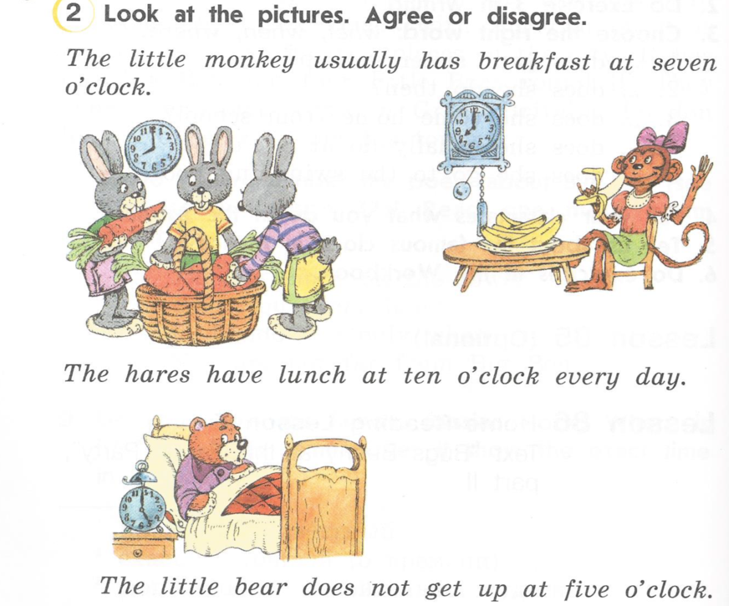
Ask some questions with what, when, do, does

Slide 12
Tell about your daily life:
When do you usually get up?
When do you have breakfast?
What do you usually have for breakfast?
When do you go to school?
When do you come home from school?
What do you usually do in the evening?
What time do you go to bed?

Slide 13


Reflection
I like our lesson !
I don’t like our lesson !

Slide 14
Homework
Give a talk about your daily life

