Slide 1
Features of Russian national cuisine
практический урок с применением метода кейсов
Мелешко О.Г.,
учитель МБОУ «Лицей «Сигма» г. Барнаул

Slide 2
Let's invite the guests
1
Let's make a shopping list
2
Russian dishes
CONTENT
3
Let's have some rest
4
Best menu
5
Home duties
6

Slide 3
Let's invite the guests
1

Slide 4
Let's invite the guests
Before the lesson
Write invitation cards
Use the information
Who: The Ivanovs
To: friends and grandparents
Adress: Barnaul, Petrova 286 Street, flat №3
Event: Birthaday party
Time: 5 pm on Saturday
In the lesson
Choose the best card

Slide 5
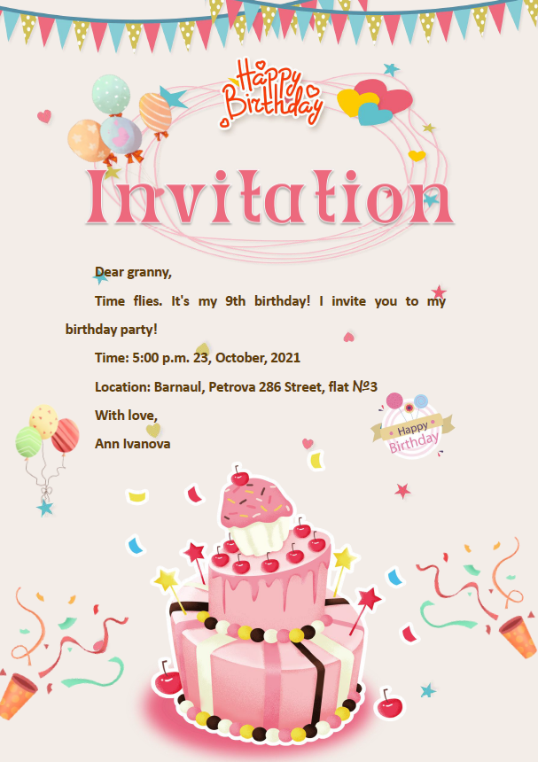
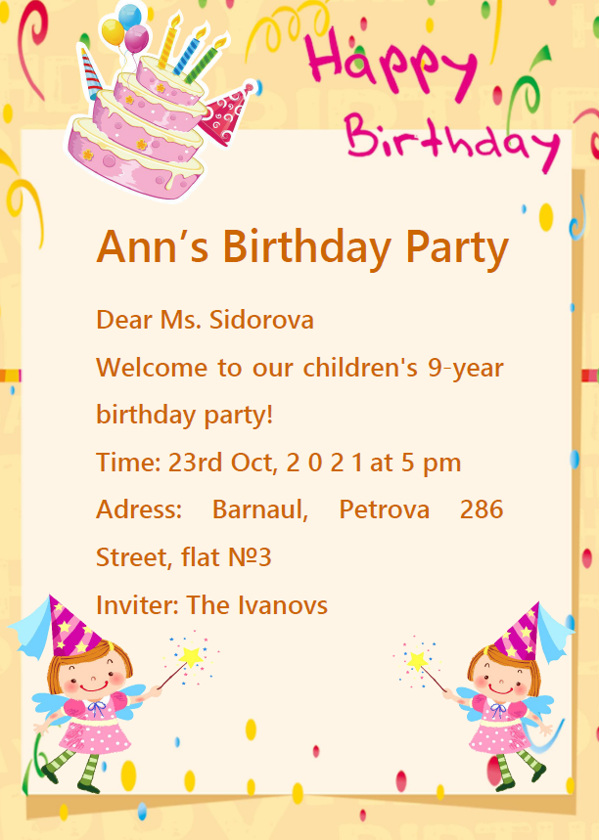
Some of our invitation cards

Slide 6
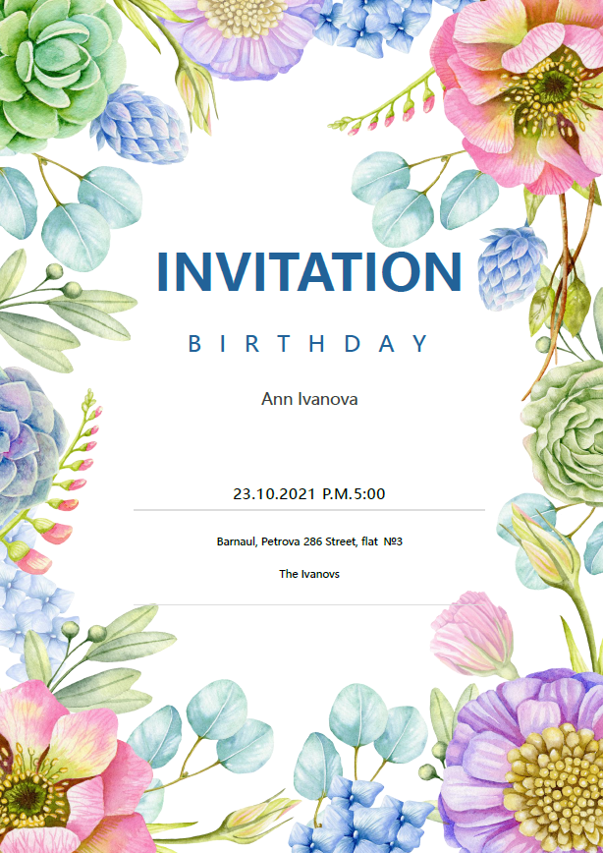
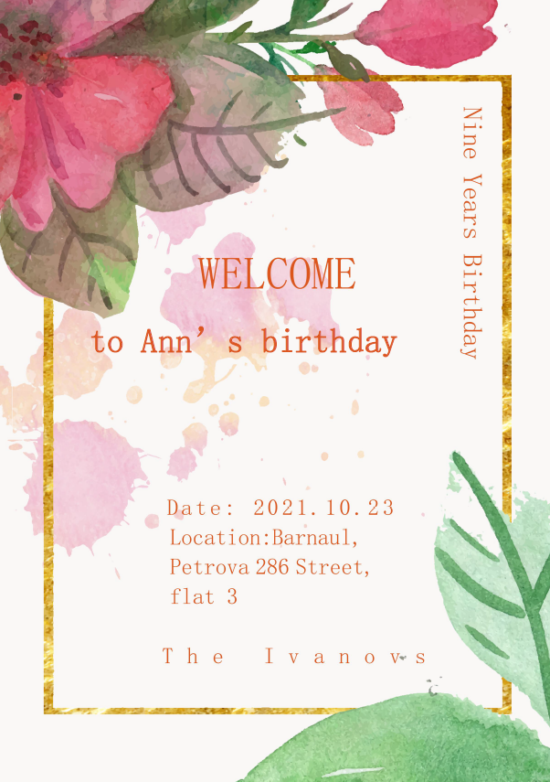
Some of our invitation cards

Slide 7
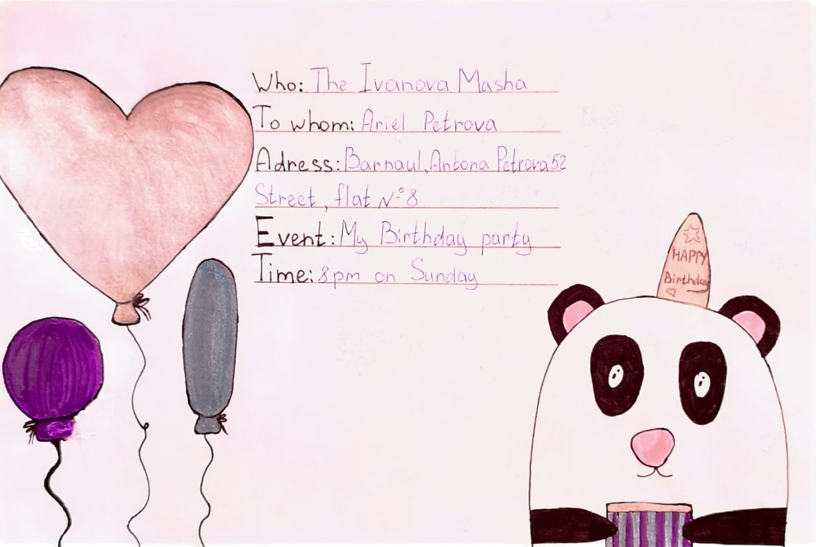
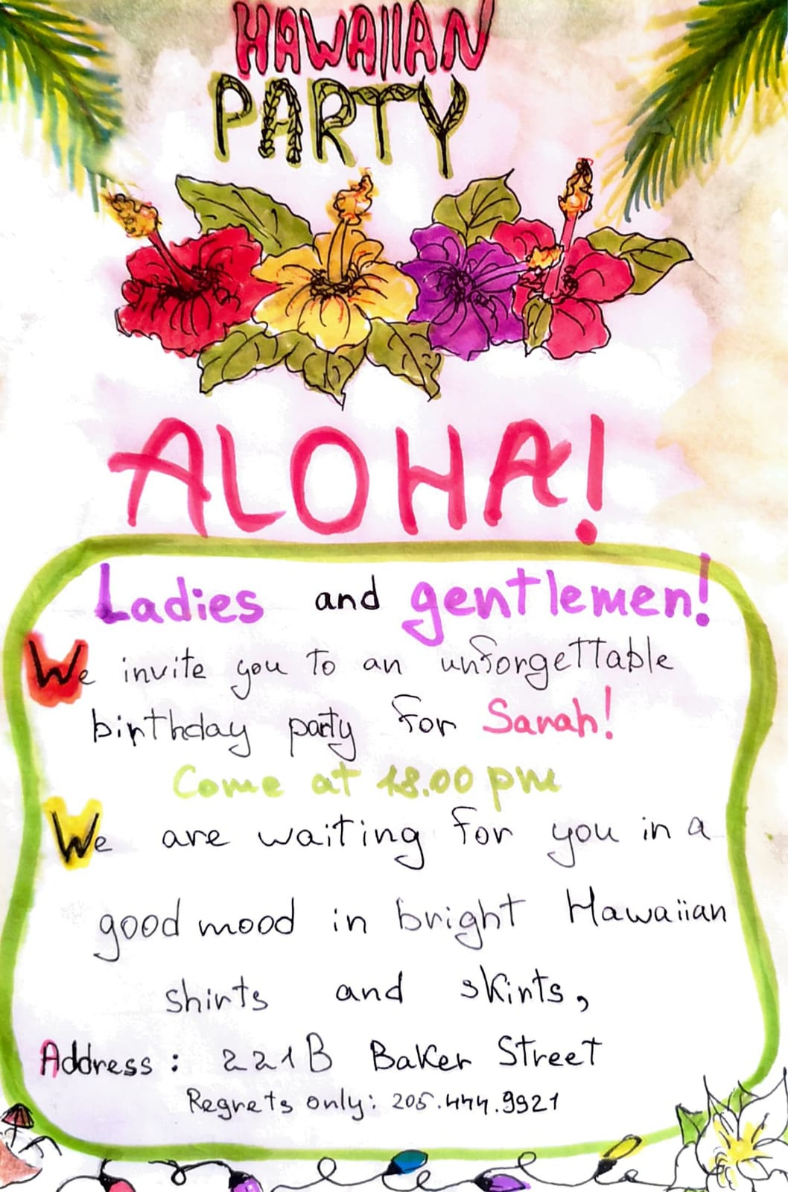
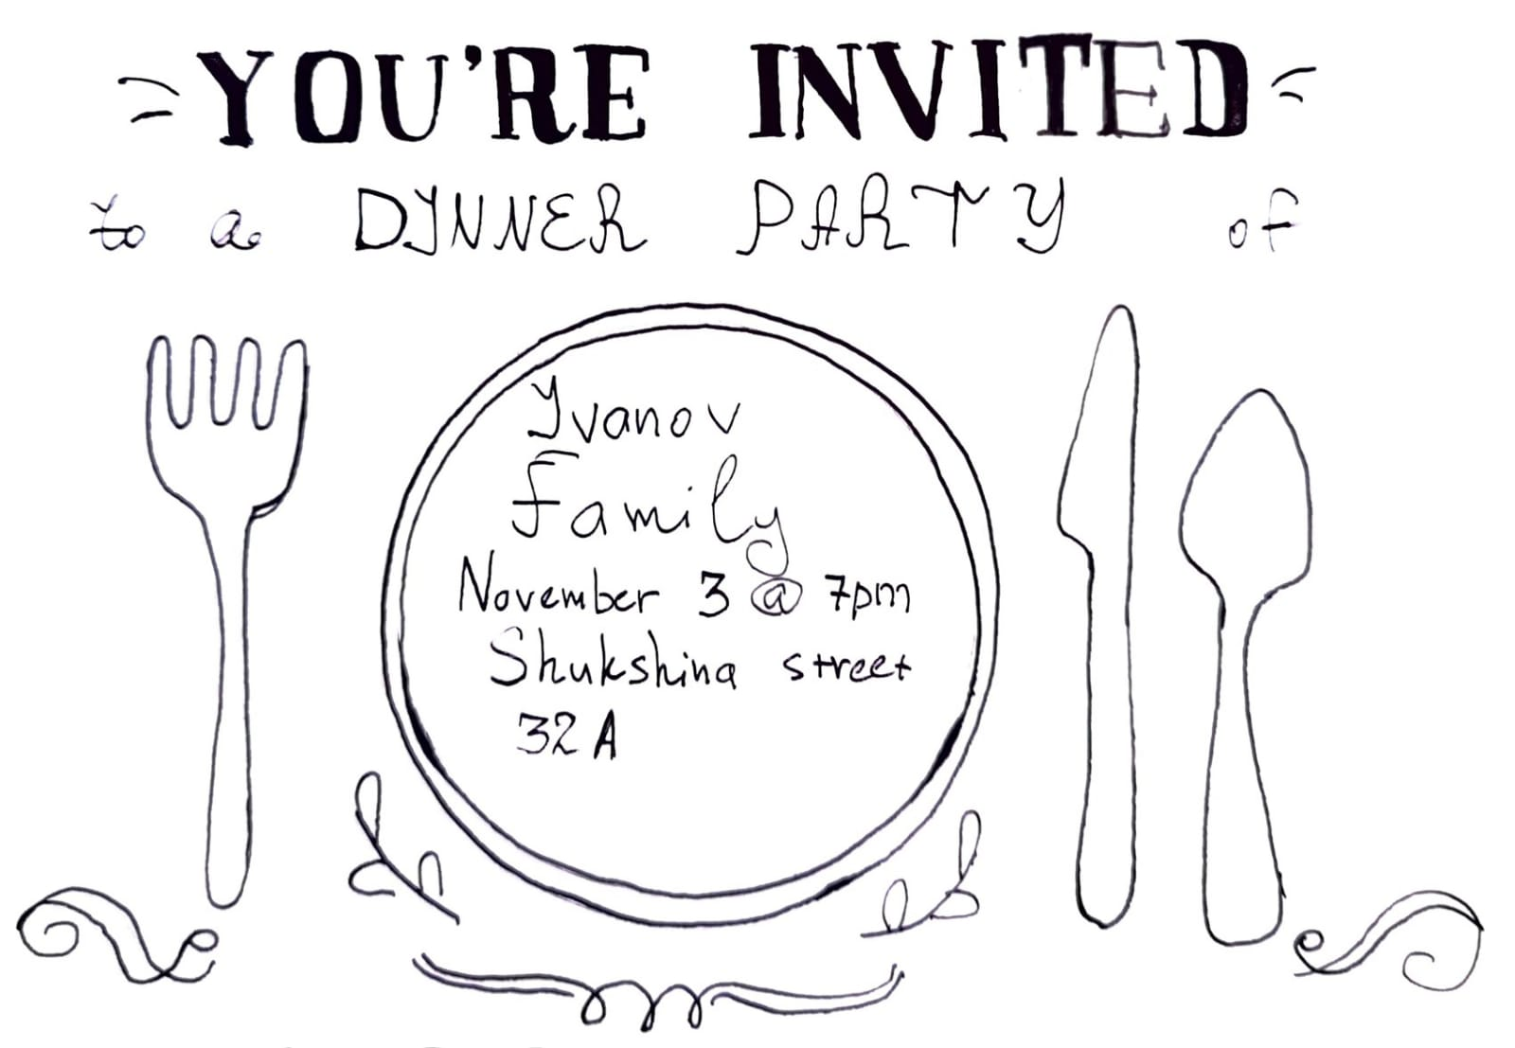
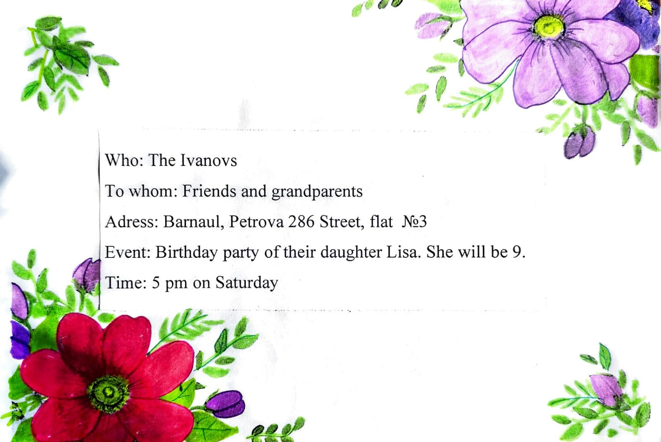
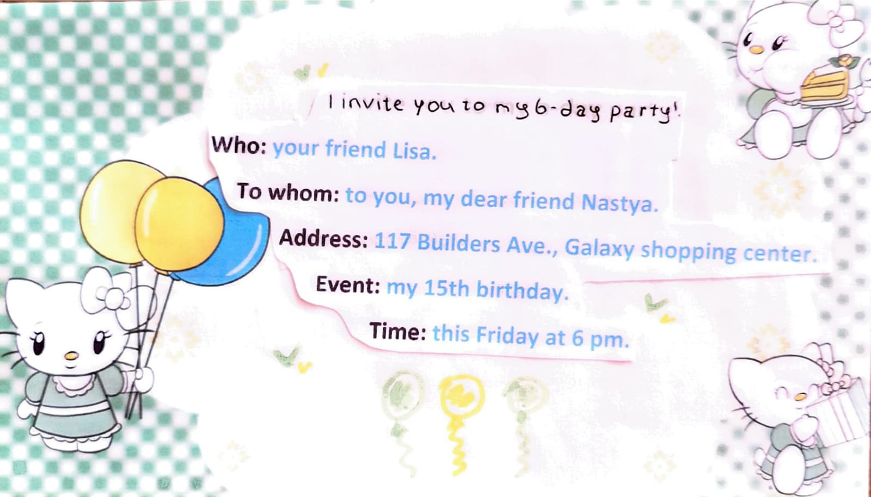
Some of our invitation cards

Slide 8
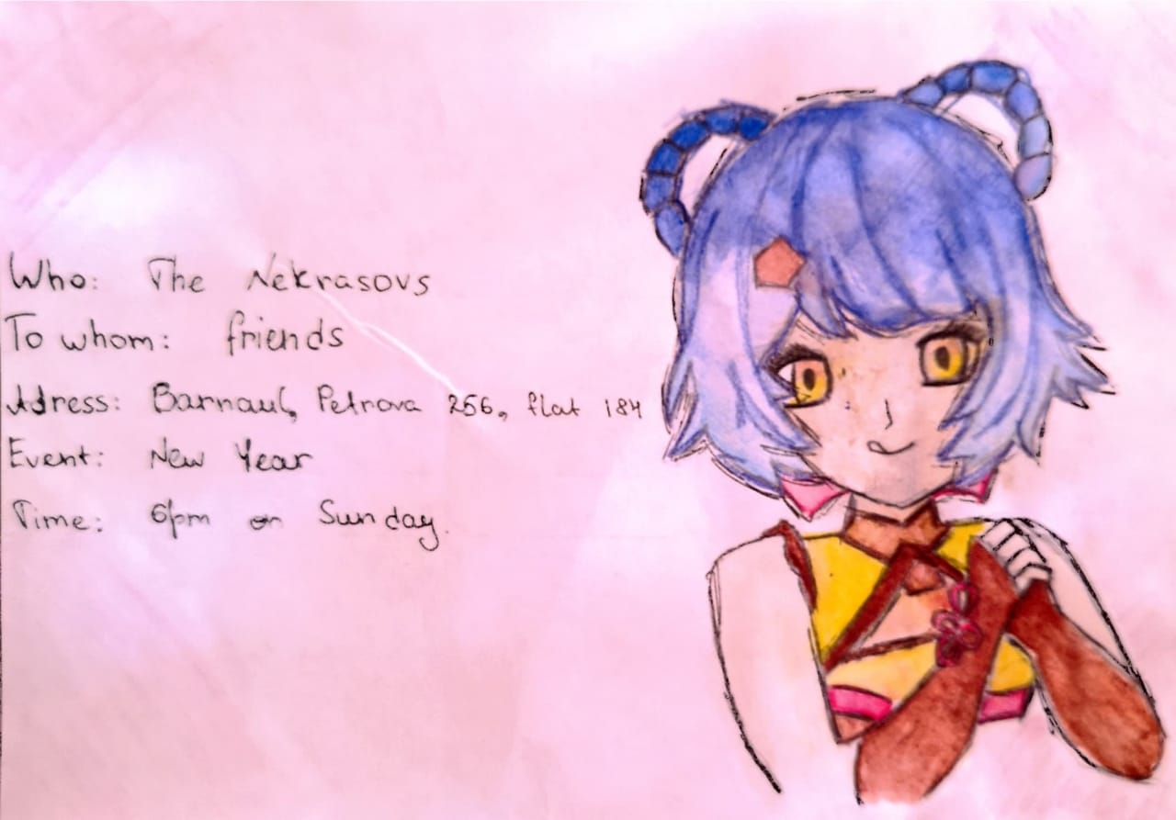
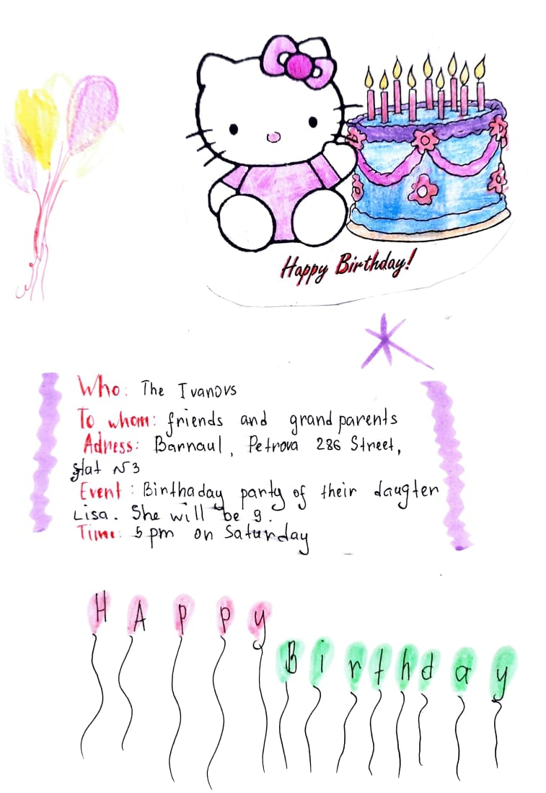
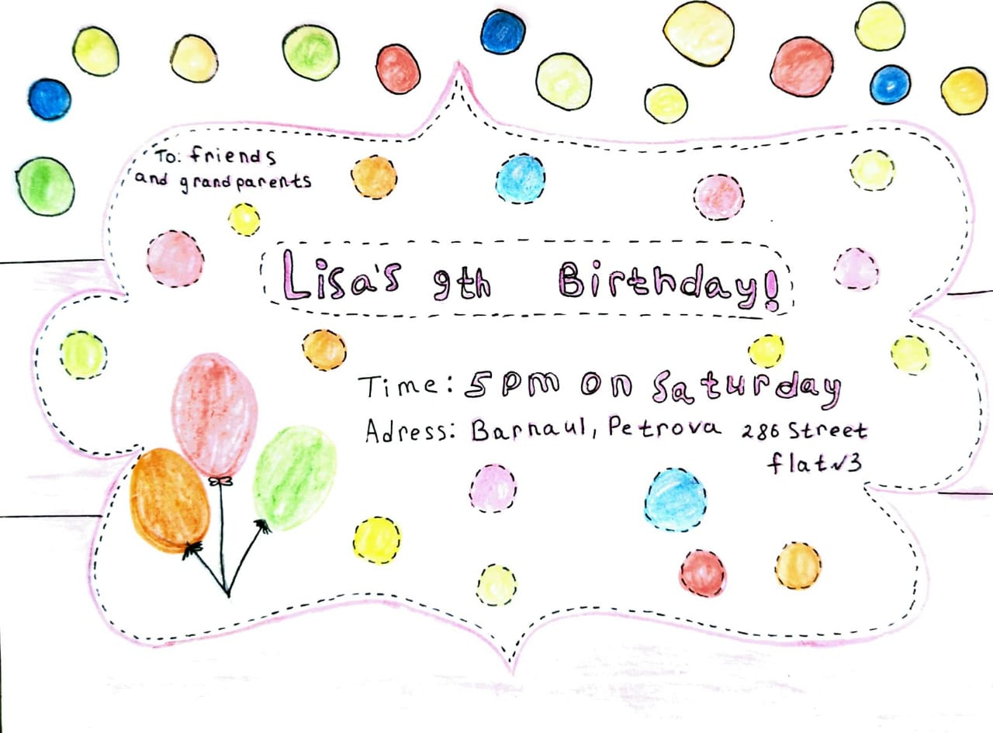
Some of our invitation cards

Slide 9
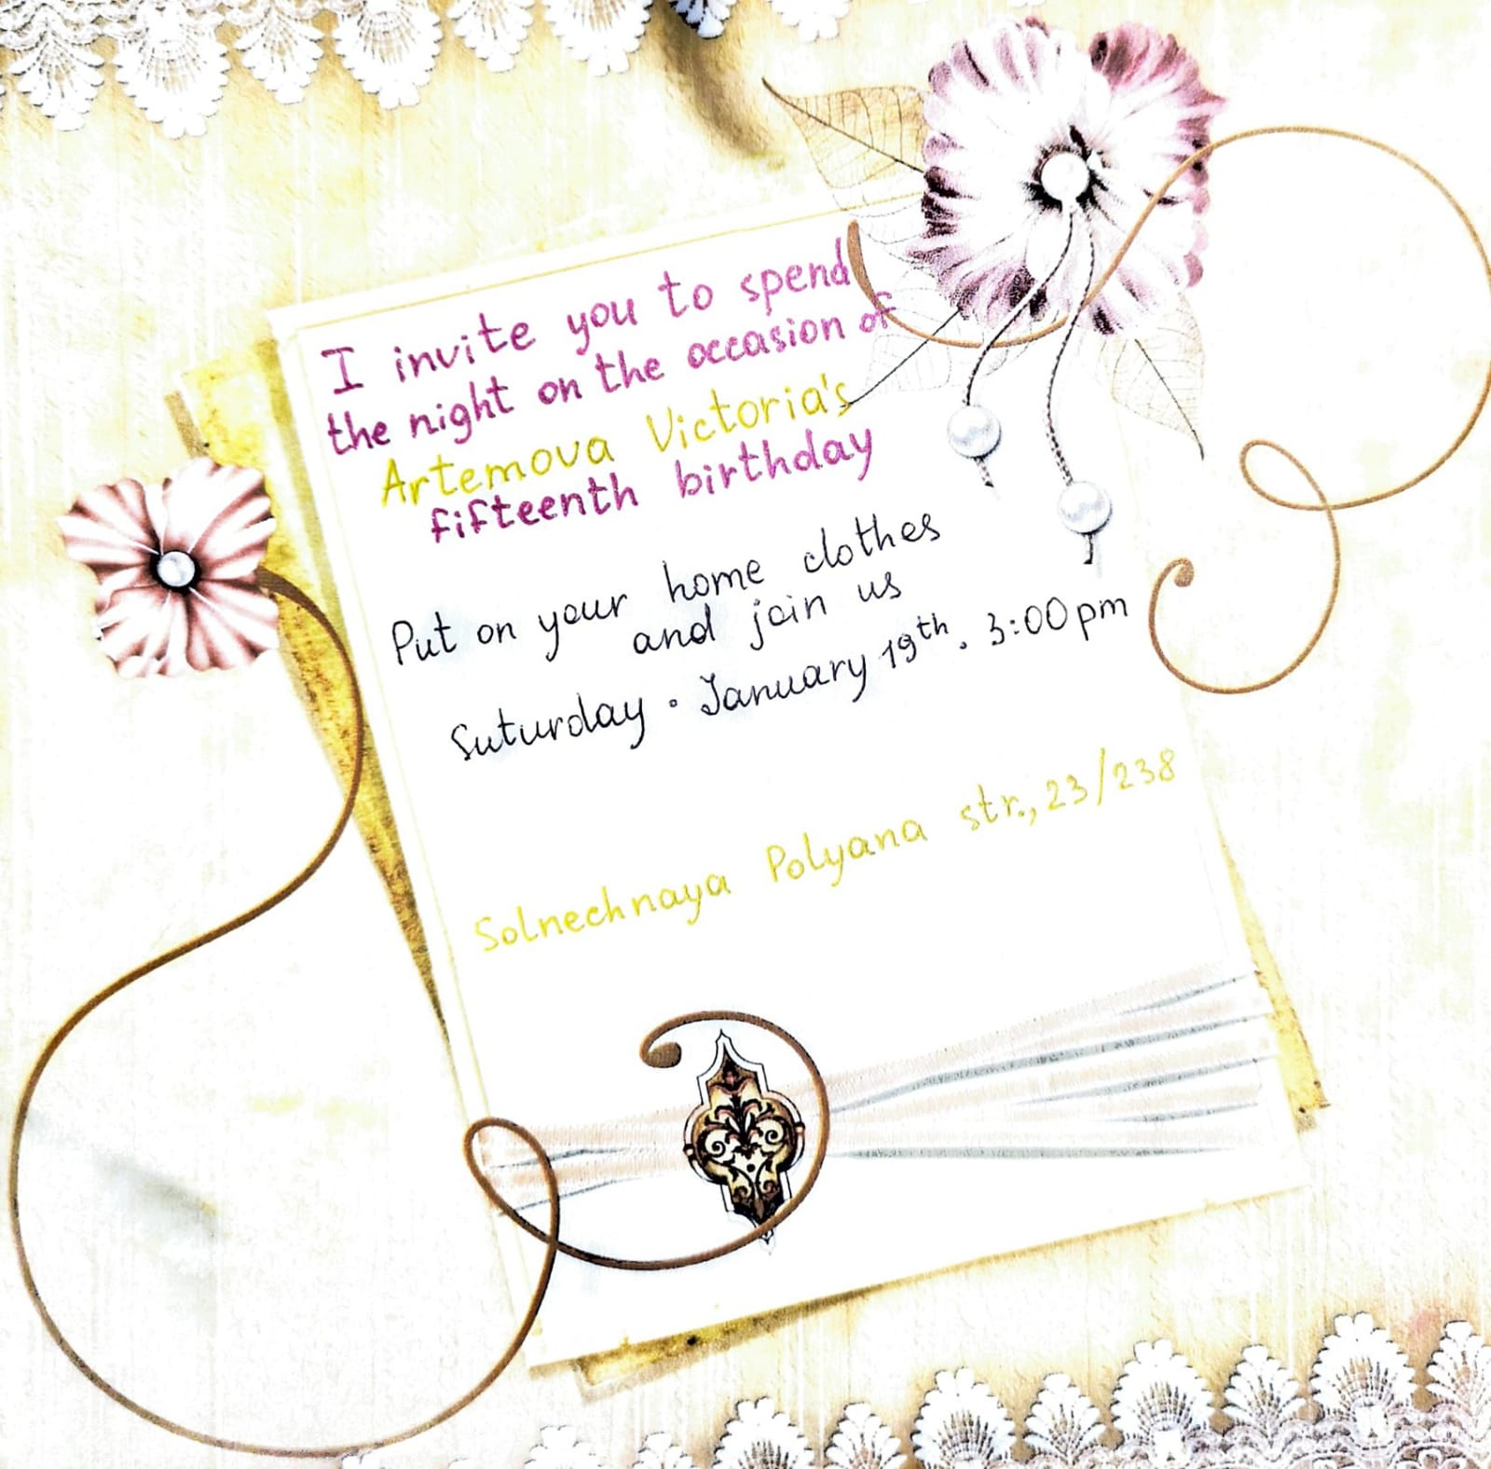
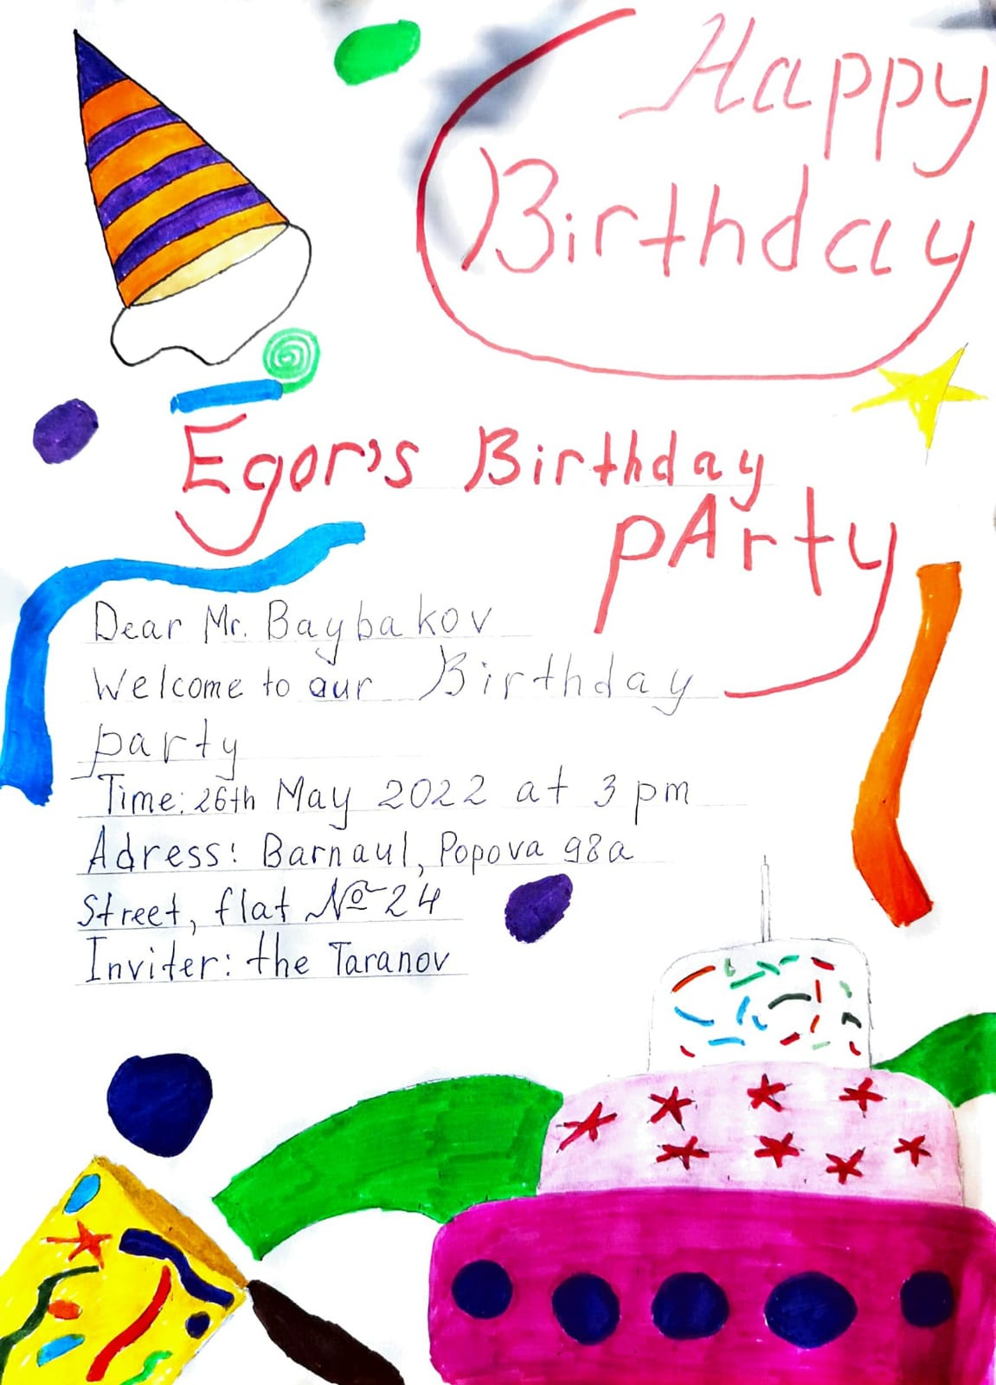
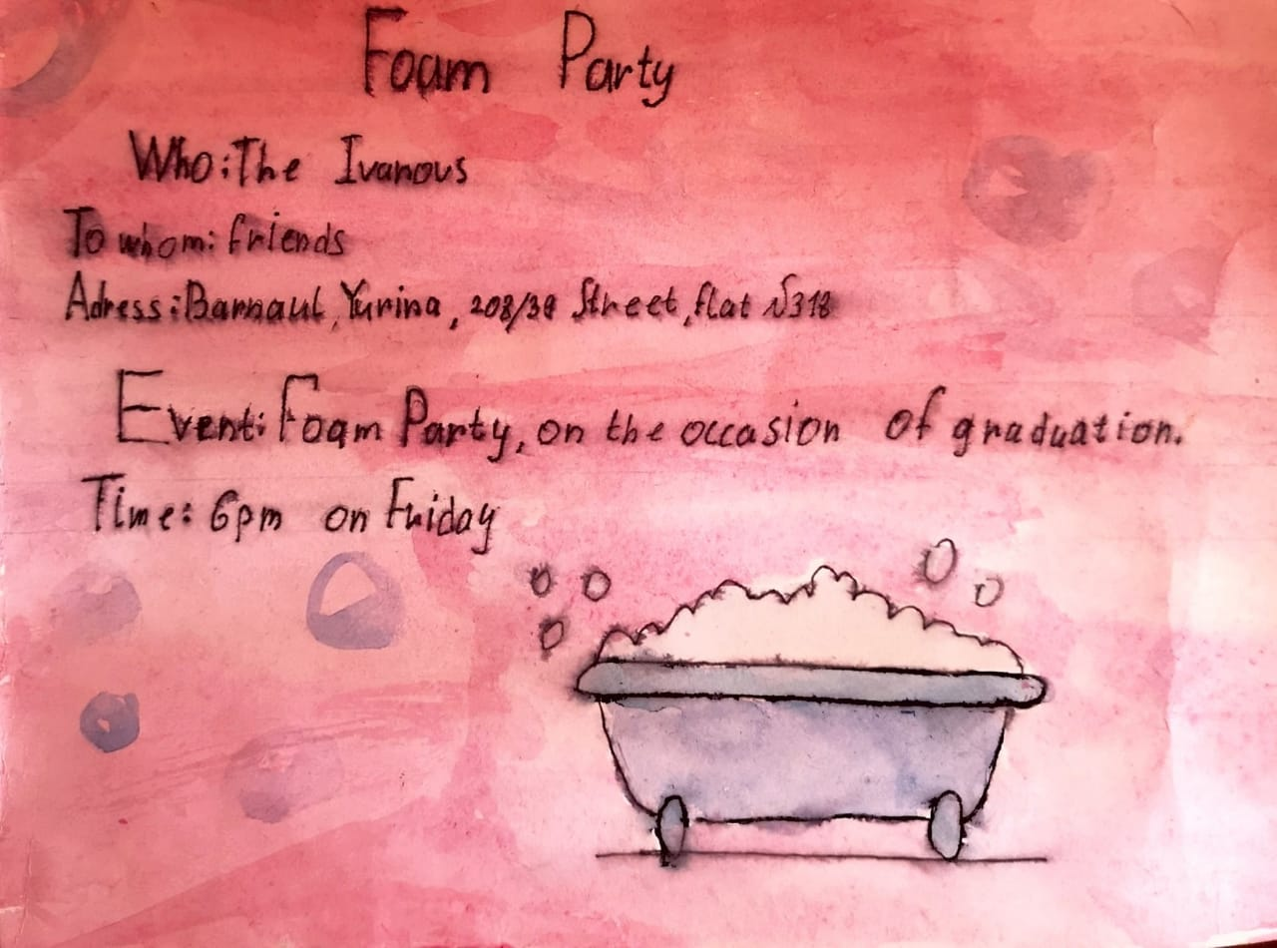
Some of our invitation cards

Slide 10
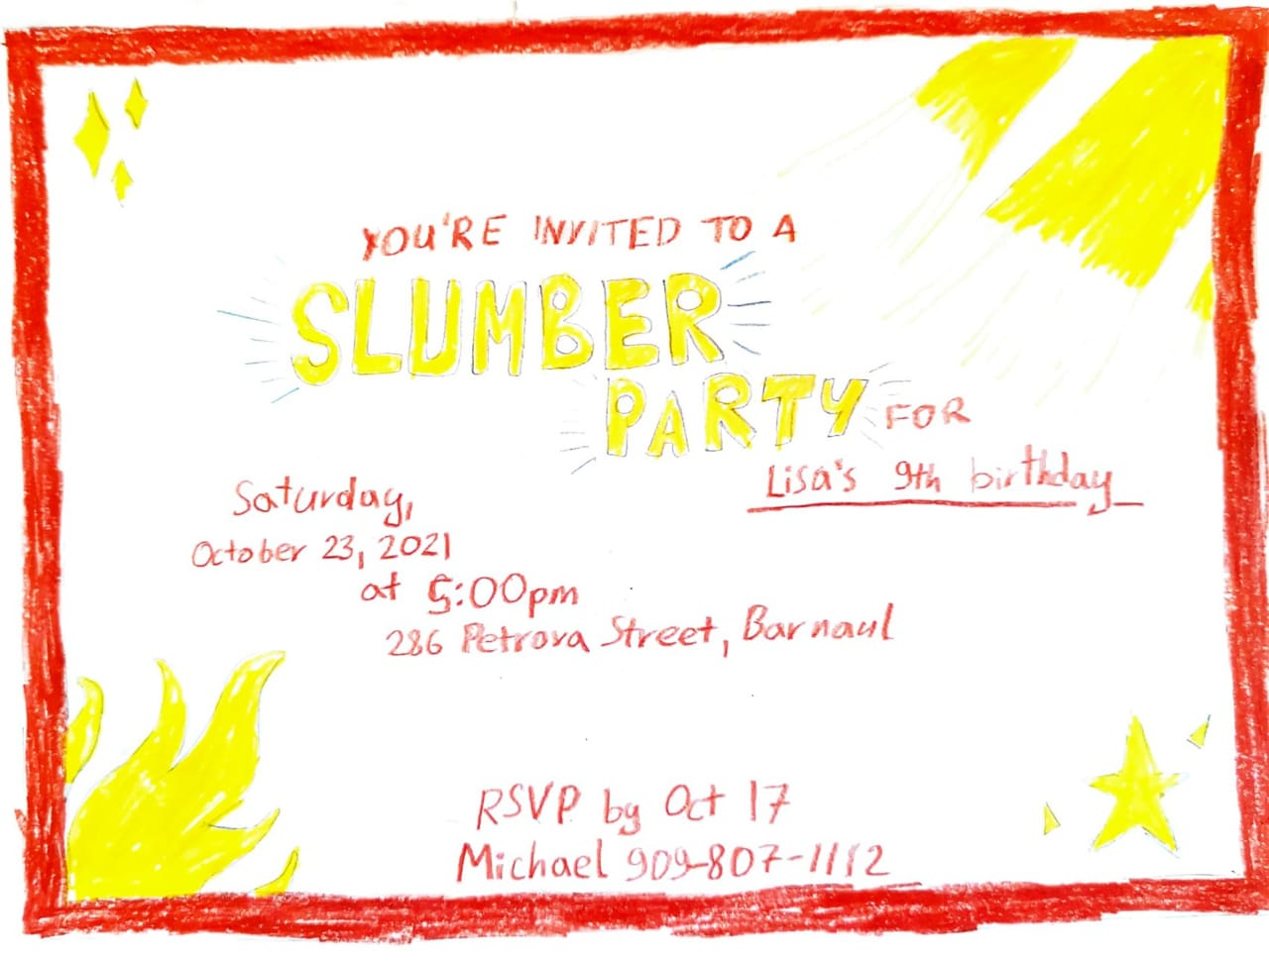
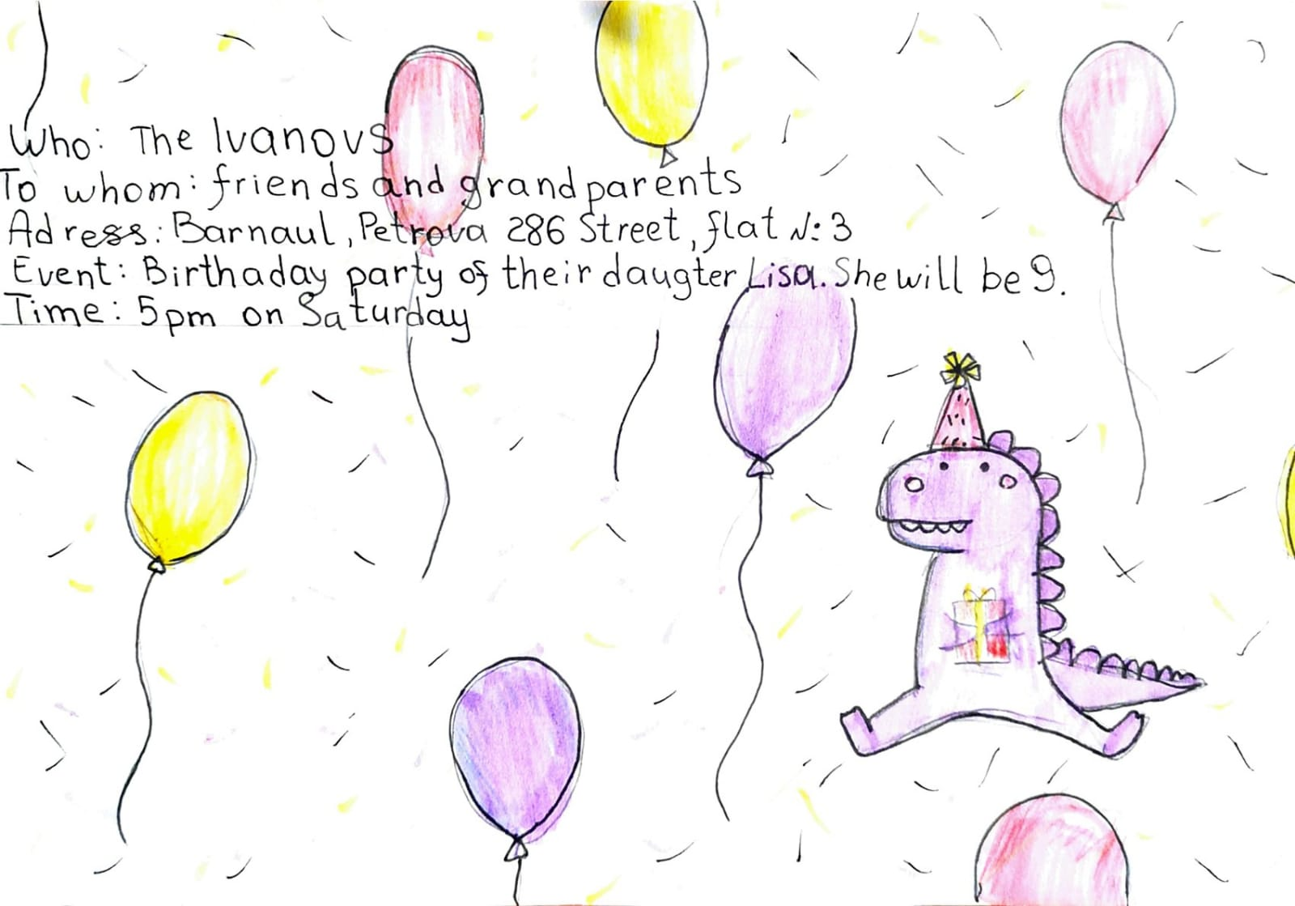
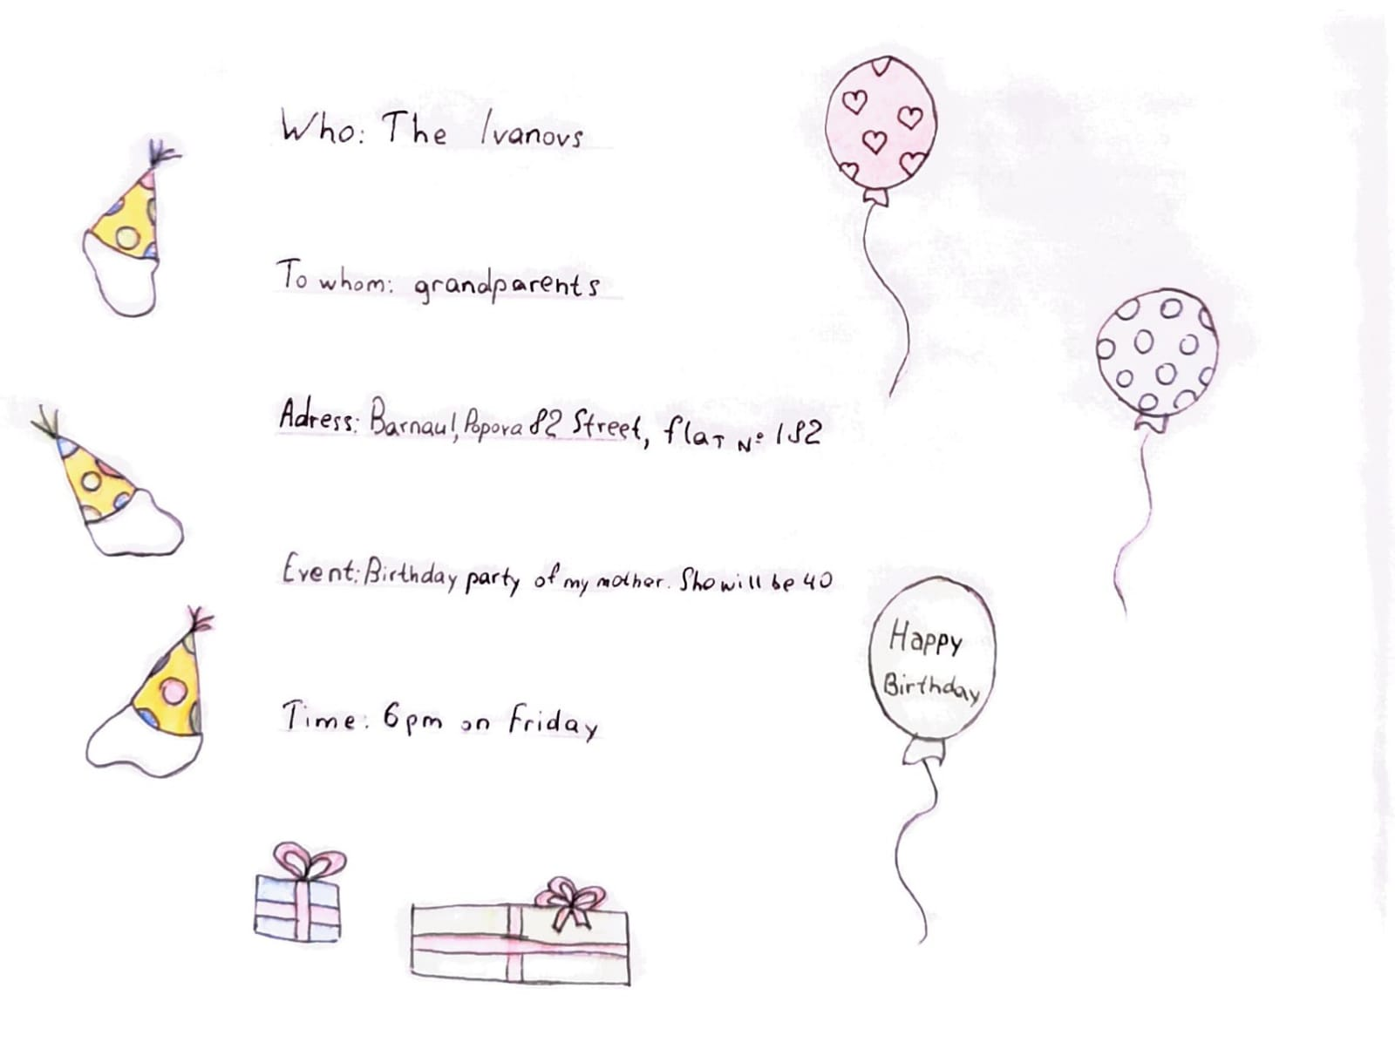
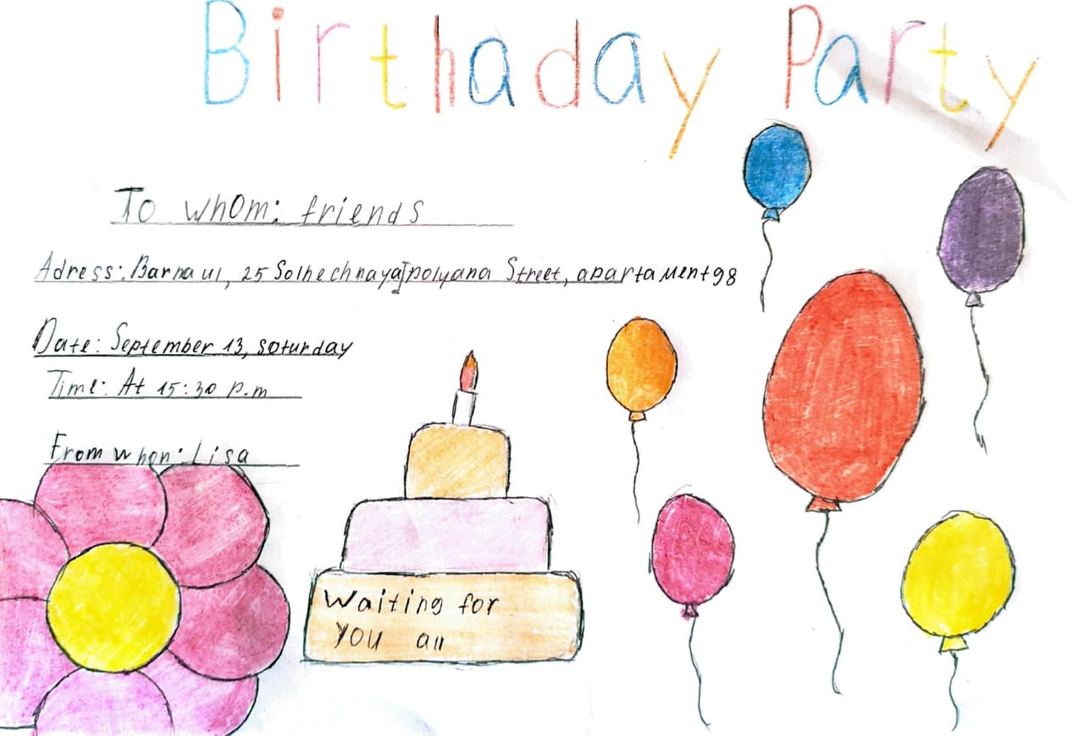
Some of our invitation cards

Slide 11
Let's make a shopping list
2

Slide 12
Let's make a shopping list!
Make your shopping lists.
Whose shopping list is the longest?

Slide 13
Russian dishes
3

Slide 14
Russian dishes
Solve the puzzle

Slide 15
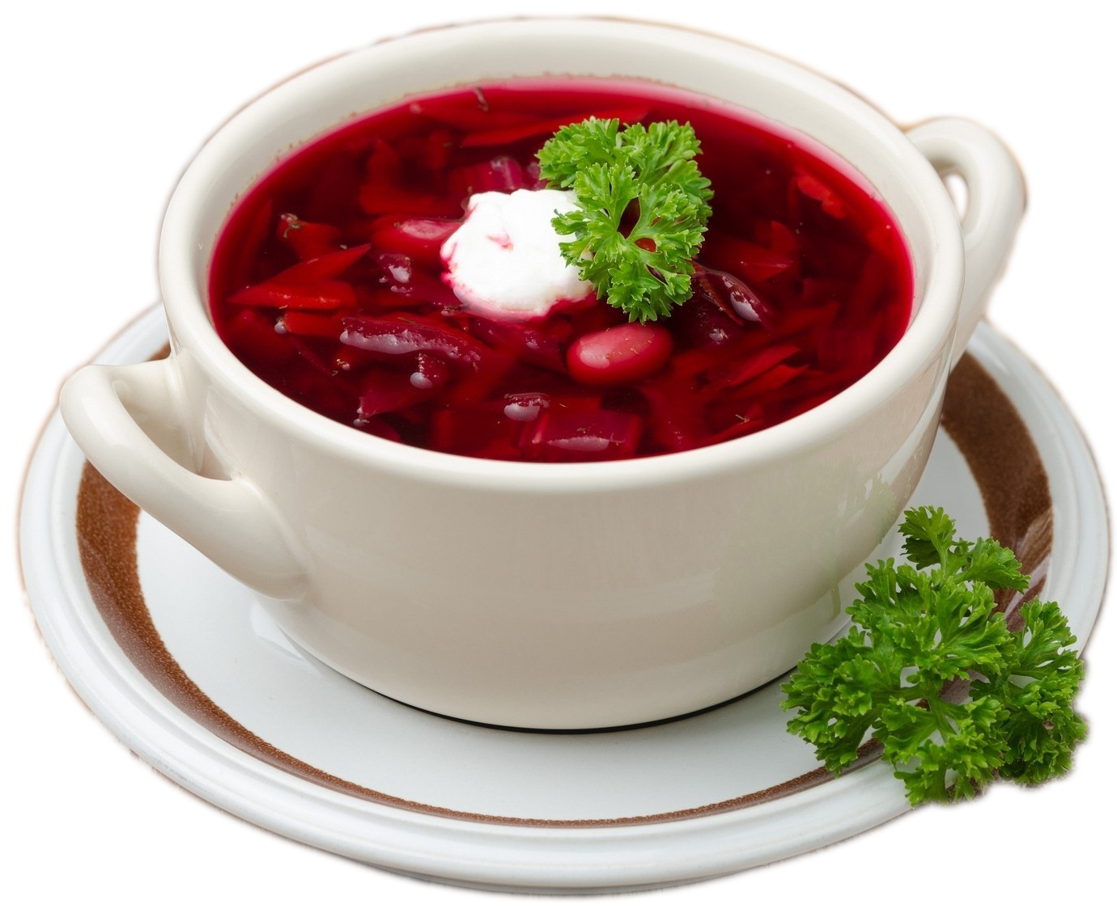
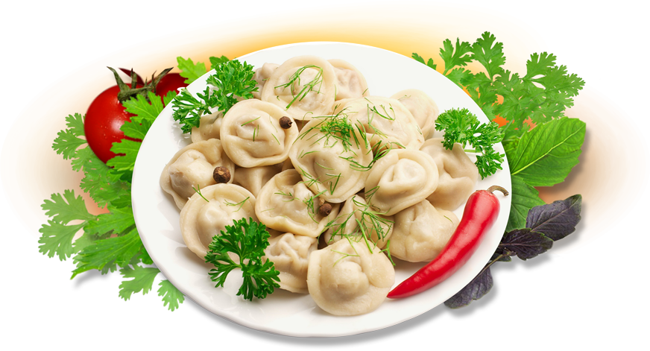
0.Okroshka
1.Salo
2.Draniki
3.Kefir
4.Tworog
5.Smetana
6.Vinaigrette
7.Kissel
8.Blini
9.Kasha
10.Shashlyks
11.Golybtsi
12.Shchi
13.Pelmeni
Russian dishes
0.Okroshka
1.Salo
2.Draniki
3.Kefir
4.Tworog
5.Smetana
6.Vinaigrette
7.Kissel
8.Blini
9.Kasha
10.Shashlyks
11.Golybtsi
12.Shchi
13.Pelmeni
the answers

Slide 16
Let's have some rest
4
Relaxation for your eyes

Slide 17
Relaxation for your eyes
Look left.
Look right.

Slide 18
Relaxation for your eyes
Look up.
Look down.

Slide 19
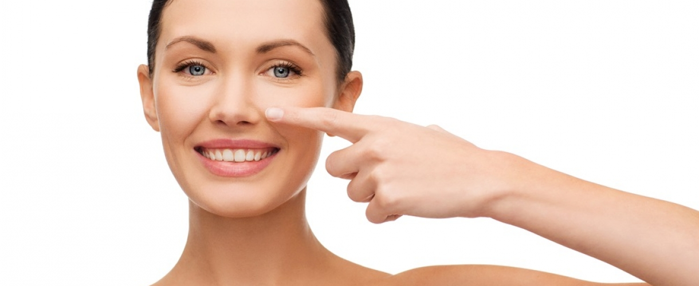
Relaxation for your eyes
Look around.
Look at your nose.

Slide 20
Relaxation for your eyes
Look at that rose.
Close your eyes.

Slide 21
Your eyes are happy again!
Open, wink and smile.

Slide 22
Best menu
5

Slide 23
Best menu
Before the lesson
1
Make cookbooks.
In the lesson
Make your menu.
2

Slide 24
Home duties
6

Slide 25
Home duties
Open the brakets and say what the Ivanovs have done before the guests come. Use Present Perfect or Present Perfect Continuous.
It’s 4.30 pm. The Ivanovs are ready to greet the guests. The mother 1. (cook) the dinner. She is very tired because she 2. (cook) for 3 hours. The father 3. (clean) the house. He doesn't like to do it and he is very sad. He 4. (clean) for 4 hours! The son 5. (walk) the dog and the daughter 6. (lay) the table.
Now the Ivanovs are ready to greet their guests!

Slide 26
Let's check!
1.has cooked
2.has been cooking
3.has cleaned
4.has been cleaning
5.has walked
6.has laid

Slide 27
How do you feel now?
7

Slide 28
Answer the questions
1. Are you happy?
2. Do you like your Enlish lesson?
If your answer is yes,
draw «+» in your
heart cards.

Slide 29
Thank You

