Slide 1
Captains’ contest

Slide 2
What did Guppy offer to buy Tony Jobling?

Slide 3
Lunch

Slide 4
What 2 things does the Doctor always take with him?

Slide 5
Sonic screwdriver, psychic paper

Slide 6
Who gives a letter for Romeo to whom?

Slide 7
Friar Laurence to Friar John

Slide 8
Why did students write excuse notes?

Slide 9
Students wrote excuse notes because they didn’t want their parents to know they hadn’t been to school

Slide 10
Where did Jane Austen live when she was twenty years old?

Slide 11
She lived in the small country village

Slide 12
Which two people did Tulkinghorn invite to dinner?

Slide 13
Mr Snagsby and Mr Bucket

Slide 14
What does TARDIS look like?

Slide 15
A British police box

Slide 16
Why does Romeo break into the vault?

Slide 17
He wants to die by Juliet

Slide 18
Why did the inspector like Mr. McCourt’s idea?

Slide 19
The inspector liked Mr. McCourt’s idea because it got the students writing

Slide 20
What was Jane Austen’s dream?

Slide 21
To be a writer

Slide 22
Who was wearing a dark coat in Tulkinghorn’s office?

Slide 23
Miss Hortense

Slide 24
What is Clara’s usual job?

Slide 25
She is a teacher

Slide 26
Why does Juliet kiss Romeo’s mouth?

Slide 27
Because it can still have some poison on it

Slide 28
Why was Kevin Dunne a difficult student?

Slide 29
Kevin Dunne was a difficult student because his teachers didn’t understand him

Slide 30
Why isn’t Eliza with her husband?

Slide 31
He was killed in France

Slide 32
Where did Esther find Jo?

Slide 33
At Jenny’s house

Slide 34
What and where does Rigsy paint?

Slide 35
Graffiti in Bristol

Slide 36
Does Friar Laurence make medicine and poison out of plants?

Slide 37
Yes

Slide 38
Why are teachers tired after Open School Day?

Slide 39
Teachers are tired after Open School Day because all the parents want to talk to them

Slide 40
Why do Cassandra and Robert have to wait to get married?

Slide 41
Because Robert must first go to the West Indies

Slide 42
What was the first thing Esther saw when she could see again?

Slide 43
A small flame from a lamp

Slide 44
Does Clara live in London?

Slide 45
Yes

Slide 46
Does Romeo want to get married to Juliet on Friday?

Slide 47
No, he wants to get married that afternoon

Slide 48
Andrew: 1) hated all the teachers 2) loved Mr. McCourt 3) was June’s son

Slide 49
3) was June’s son

Slide 50
Where is Judge Langlois sending Tom to?

Slide 51
To Tom’s other relatives in Hampshire

Slide 52
George was in custody for the ………………

Slide 53
….…murder of Mr Tulkinghorn

Slide 54
Are faces painted on the underpass walls?

Slide 55
No, backs

Slide 56
Who says this? ‘When people run too fast they fall over.’

Slide 57
the Friar

Slide 58
Who was Alberta Small?

Slide 59
Mr MacCourt’s wife

Slide 60
Why did Jane pick up her pen and bottle of ink?

Slide 61
……. because she didn’t want to forget an idea for her story

Slide 62
What did wise men say about Court of Chancery?

Slide 63
Whatever harm is done to you, do not think of coming here!

Slide 64
What did last Lord of Chancellor say about the decision of Jarndyce and Jarndyce?

Slide 65
… when potatoes rained from the sky

Slide 66
How old was Mr Richard Carstone at the beginning of the story?

Slide 67
He was 19 y.o.

Slide 68
Where did Mrs Jellyby work to help poor people?

Slide 69
In Borrioboola Gha

Slide 70
What was Lady Dedlock surname before marriage?

Slide 71
Barbary

Slide 72
What is the address of the favourite place of Mr McCourt?

Slide 73
Fourty-second Street Library in New York

Slide 74
Why did Mr McCourt think that Rachel Blaustein couldn’t write poems?

Slide 75
Mr McCourt thought that Rachel Blaustein couldn’t write poems because her life was perfect and she had nothing to write about

Slide 76
What clothes did Bob always wear?

Slide 77
A white shirt open at the neck, a grey jacket, short pants, thick grey socks, yellow builders’ boots

Slide 78
What is the name of the book that Bob should read to pass a big test?

Slide 79
Gilgamesh

Slide 80
What colour was Tom Lefroy’s coat when he came to the Austins for the first time?

Slide 81
Green

Slide 82
What was Tom Lefroy’s relatives doing when he lost in the forrest?

Slide 83
They were hunting

Slide 84
How many times did Jane and Tom dance?

Slide 85
3 times

Slide 86
What happened with Tom Lefroy after the breakup with Jane Austin?

Slide 87
He married a rich woman, became a lawer, sat in a parliament, became Ireland’s most important judge

Slide 88
What happened with Jane Austin after the breakup with Tom Lefroy?

Slide 89
She wrote 6 books, never married, died at the age of 41

Slide 90
How many cm is the TARDIS?

Slide 91
15 cm

Slide 92
What name does Clara make up to introduce herself?

Slide 93
Dr Oswald

Slide 94
Who was the boss of workers at the Community Payback?

Slide 95
Fenton

Slide 96
What ear does Clara should put the earphone?

Slide 97
Right ear

Slide 98
What is TARDIS?

Slide 99
Time machine

Slide 100
Why can’t the aliens make the door 3-dimencial?

Slide 101
… because it never was, it was a good picture

Slide 102
What was the name of the director of the film Romeo and Juliet which was shot in 1968?

Slide 103
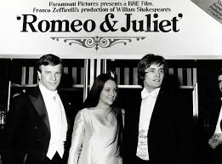
Franko Zeffirelli (Romeo – Leonard Whiting Juliet – Olivia Hussey)

Slide 104
What famous actor played Romeo?

Slide 105
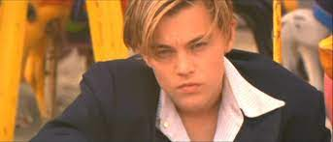
Leonardo DiCaprio

Slide 106
When must Paris marry Juliet?

Slide 107
On Thursday

Slide 108
How old is Juliet?

Slide 109
She will be 14 y.o. in July

Slide 110
What helps Clara not to stop a train?

Slide 111
A hairband

Slide 112
What is the name of the fair which is held every summer in book Becoming Jane?

Slide 113
The Leverton Fair

Slide 114
What is the name of Tom Lefroy’s daughter?

Slide 115
Jane

Slide 116
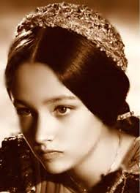
Why didn’t Juliet die inside the vault?

Slide 117
Juliet didn’t die inside the vault because she was put on a kind of table with no cover.

Slide 118
What do Romeo and the Friar think of Romeo’s punishment?

Slide 119
The Friar thinks that banishment isn’t that bad because the usual punishment for his crime is death. For Romeo, banishment is worse than death.

Slide 120
What doesn’t Mercutio know?

Slide 121
Mercutio doesn’t know that Romeo has married Juliet and that Tybalt is now a relative of his. Romeo isn’t weak, as Mercutio thinks, he’s just got married, he’s very happy and he doesn’t feel like fighting.

Slide 122
What’s happened after Romeo and Juliet’s death?

Slide 123
They will hang paintings of Romeo and Juliet in a building in the town square. The two families will stop fighting and be friends

Slide 124
How many dead bodies do they find at the end of the story about Romeo and Juliet?

Slide 125
There are four bodies: Tybalt, Paris, Romeo, Juliet

Slide 126
Who started the fight according to Benvolio? Is it true?

Slide 127
Benvolio says that Tybalt started the fight but it was not true, it was Mercutio. Tybalt says to Mercutio, ‘I’m not interested in fighting you, sir.’ Tybalt wants to fight Romeo.

Slide 128
Why does Friar Laurence marry Romeo and Juliet?

Slide 129
He hopes the marriage will end the terrible hate between their two families

Slide 130
Name the Montague servants

Slide 131
Abram - a servant of the family Balthasar – Romeo’s servant

Slide 132
Name the Capulets servants

Slide 133
Peter – Lord Capulet’s servant Sampson and Gregory – the family servants

Slide 134
What is the name of Paris’s servant?

Slide 135
Servant

Slide 136
What is the name of Prince of Verona?

Slide 137
Escalus

Slide 138
What was Jane Austin married brother’s name?

Slide 139
Edward

Slide 140
Where did Judge Langlois send a man in the court?

Slide 141
For stealing pigs the man was sent to Australia for the rest of his life

Slide 142
Who is Jenny in the book Bleak House?

Slide 143
Jenny is a brick-maker’s wife (lost 6 babies)

Slide 144
How did John Jarndyce call the room where he was in a bad mood?

Slide 145
Growlery

Slide 146
What was the previous name of Bleak House?

Slide 147
The Peaks House

Slide 148
How many sons did Mrs Rouncewell have?

Slide 149
2 sons: one is a businessman, the other (George) is a soldier

Slide 150
What is the name of the law-writing and copying shop in Cook’s Court?

Slide 151
Snagsby’s office Materials

Slide 152
What was the final resting place of Nemo?

Slide 153
Krook’s Rag and Bottle Market

Slide 154
How many years did Miss Hortense work for Lady Dedlock?

Slide 155
5 years

Slide 156
What is the name of Mr Woodcourt?

Slide 157
Alan

Slide 158
Who is Mr Smallweed?

Slide 159
A money-lender

Slide 160
Where was Mr Woodcourt given a position?

Slide 161
Mr Woodcourt was given a position in the north of England

Slide 162
Who was Nancy Chu’s most admired person?

Slide 163
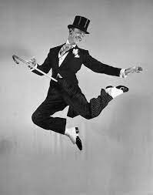
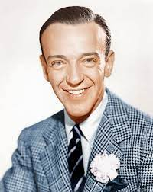
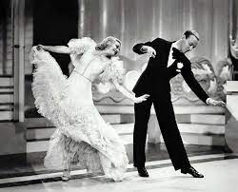
Fred Astaire

Slide 164
What was the name of the beloved poet of Nancy Chu’s mother?

Slide 165
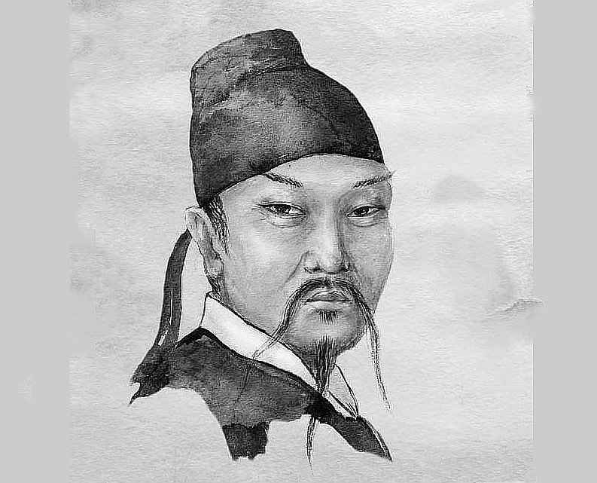
Li Po

Slide 166
When was Charles Dickens born?

Slide 167
in 1812

Slide 168
‘They’re hiding in the pictures of the dead’

Slide 169
Doctor Who

Slide 170
The TARDIS couldn’t understand the aliens’ language at first because …

Slide 171
… it was very strange and different.

Slide 172
Fenton didn’t care about the men who died because …

Slide 173
… they were criminals on Community Payback.

Slide 174
The TARDIS landed in Bristol because …

Slide 175
… the aliens were stealing energy from it.

Slide 176
What is the MI5?

Slide 177
British Secret Police

Slide 178
Who disappeared first in the story of Doctor Who. Flatline?

Slide 179
Mr Heath

Slide 180
Does Paris think Juliet is sad about Tybalt’s death?

Slide 181
Yes

Slide 182
When and where was William Shakespeare born?

Slide 183
in 1564 in Stratford-Upon-Avon, England.

Slide 184
‘I spend a lot of time in this room when I’m in a bad mood.’

Slide 185
Mr Jarndyce

Slide 186
Jo wanted to know if the … was coming when he was dying.

Slide 187
light

Slide 188
Where was the packet of letters found in the story of Bleak House?

Slide 189
In Mr Tulkinghorn’s office.

Slide 190
Where was the new will found? …………………………………

Slide 191
In Mr Krook’s property.

Slide 192
How long had Esther been married to Allan at the end of the book?

Slide 193
Seven years.

Slide 194
Was Esther the first person to touch Lady Dedlock’s dead body?

Slide 195
Yes

Slide 196
………………… was the housekeeper at Sir Leicester’s home.

Slide 197
Mrs Rouncewell

Slide 198
………………… had a Law-Writing and Copying shop.

Slide 199
Mr Snagsby

Slide 200
……….. and Tony Jobling discovered Krook’s burnt body.

Slide 201
Mr Guppy

