Slide 2
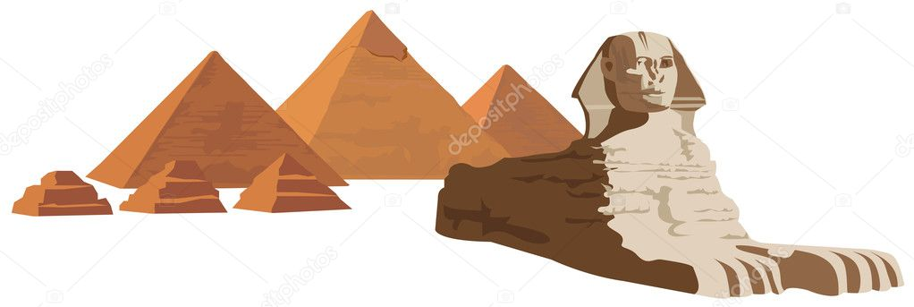
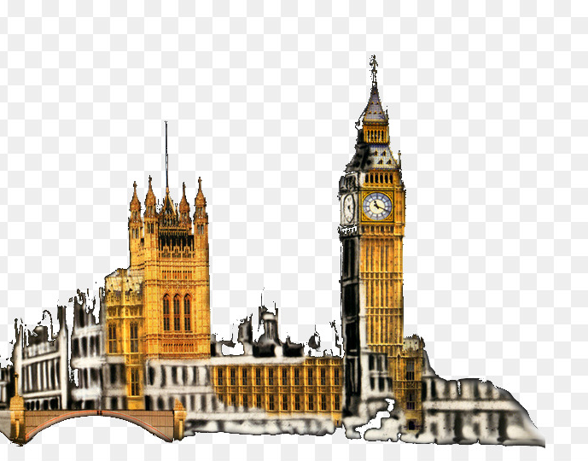
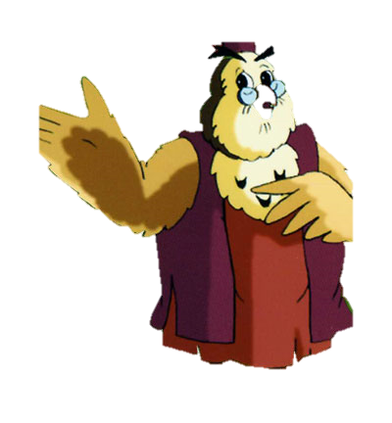
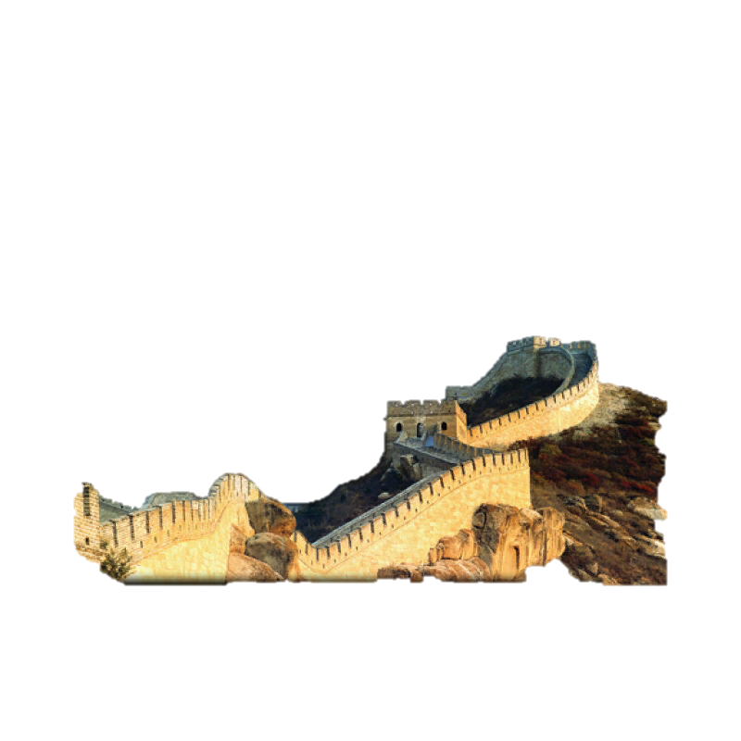

Slide 3
The world
attractions

Slide 4
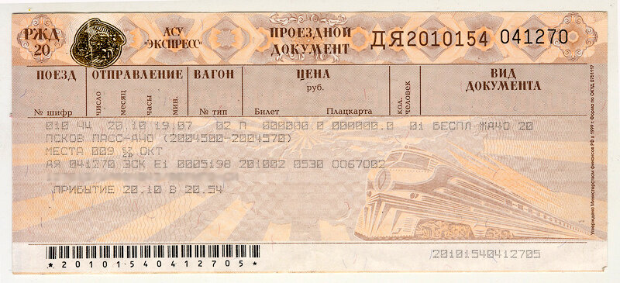
We will learn …….
We will check ……
We will create …..

Slide 5
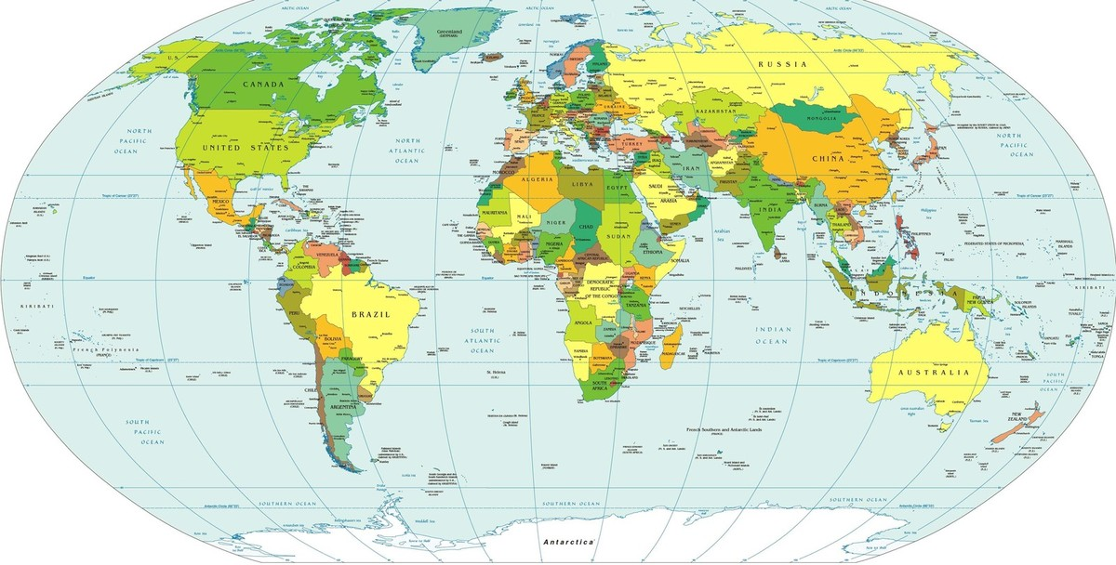
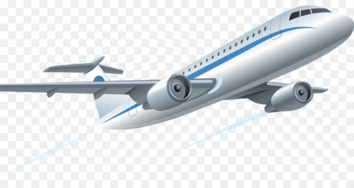
Transport
Barabinsk

Slide 6
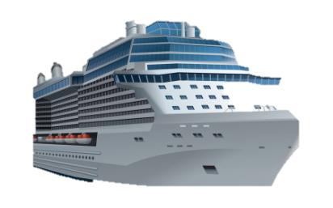
Barabinsk

Slide 7
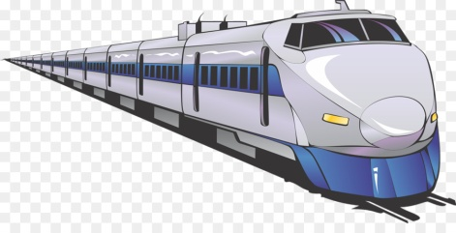
Barabinsk

Slide 8
Barabinsk

Slide 9
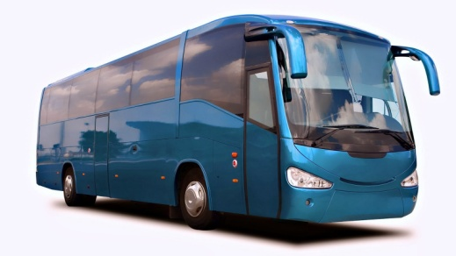
Barabinsk

Slide 10
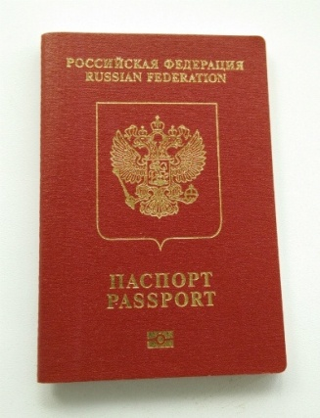
Things
Barabinsk

Slide 11
Barabinsk

Slide 12
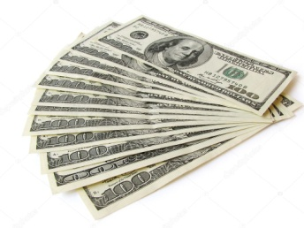
Barabinsk

Slide 13
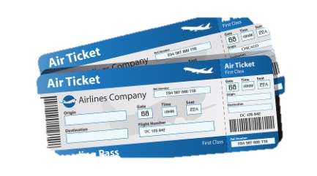
Barabinsk

Slide 14
Barabinsk

Slide 15
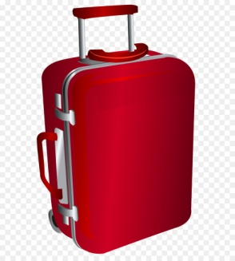
Barabinsk

Slide 16
Barabinsk

Slide 17
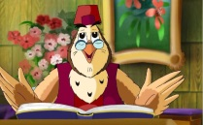
Barabinsk
Egypt

Slide 18
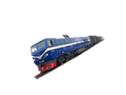
Barabinsk
Egypt

Slide 19
Barabinsk
China
Egypt

Slide 20
The 1st group Make sentences in right order.
The pyramid is the height of a 50 floor building.
The pyramids` complex are guarded by Sphinx.
The pyramid of Cheops was built in 2600 BC.

Slide 21
The 1st group Make sentences in right order.
The 2st group Give definition of each letters
E
(earth/egyptian/epoch/excellent) G
(great/good/glorius)
Y
(yellow)
P
(pyramid/pharaohs/ period)
T
(travel/trip/tourists)
The pyramid of Cheops was built in 2600 BC.
The pyramid is the height of a 50 floor building.
The pyramids` complex are guarded by Sphinx.

Slide 22
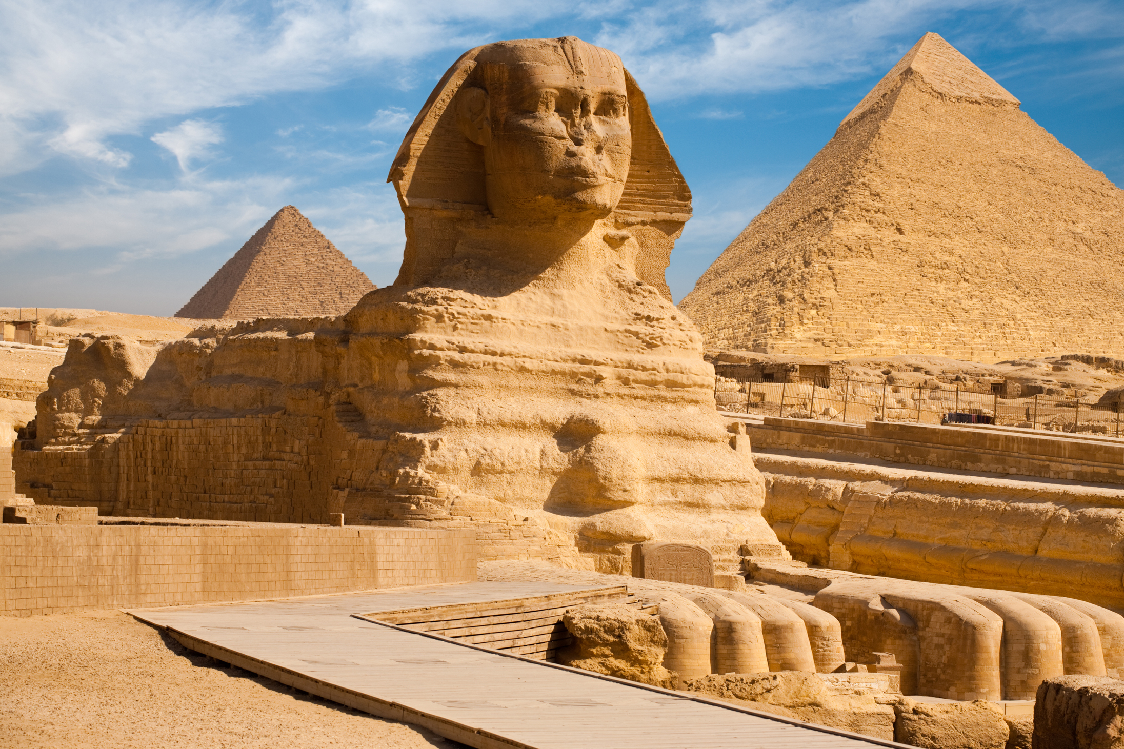
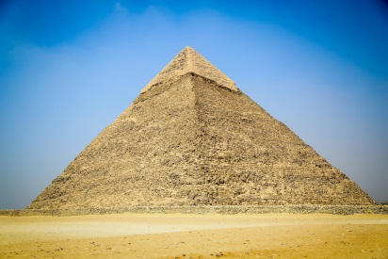
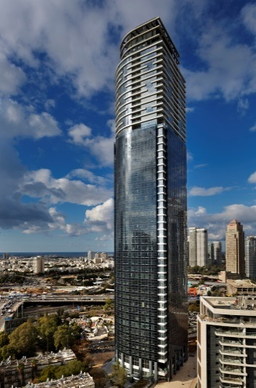
The 3rd group matches pictures with the sentences.
The pyramid is the height of a 50 floor building.
The pyramids` complex are guarded by Sphinx.
The pyramid of Cheops was built in 2600 BC.

Slide 23
физминутка

Slide 24
Barabinsk
Egypt
England

Slide 25
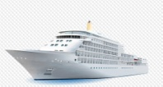
England
Barabinsk
Egypt

Slide 26
England
Barabinsk
China
Egypt

Slide 28
Stay true (T) or false (F).
London is the capital of the UK.
The President lives and works in the Buckingham Palace.
The Tower Bridge stands on the river Avon.
Many tourists come to London every year.
T
F
F
T

Slide 29
England
Barabinsk
Egypt

Slide 30
England
Barabinsk
Egypt

Slide 31
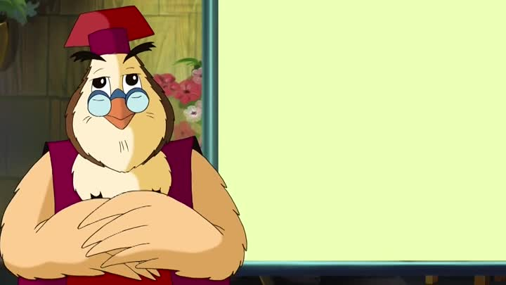
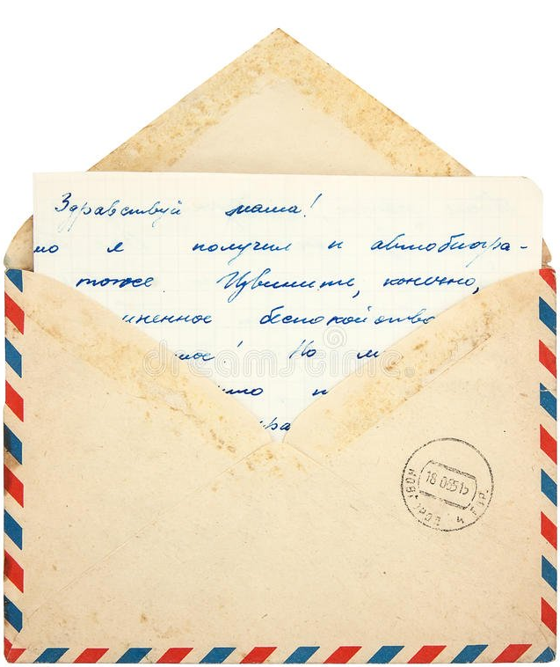
Send your story about travelling to our aunt Owl

Slide 32
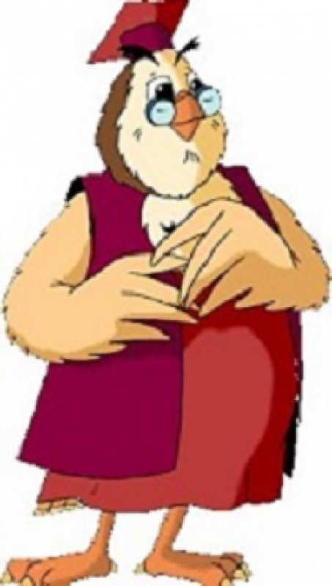
Reflection
Do you like travelling?
Do you check words of transports and things for travelling?
What do you know about our trip?
Do you like send smile?

Slide 33
Reflection
- cool, understand
– some tasks were
difficult
– don`t understand,
very difficult

Slide 34
Home task

Slide 37
Thank you for attantion!

