Slide 1
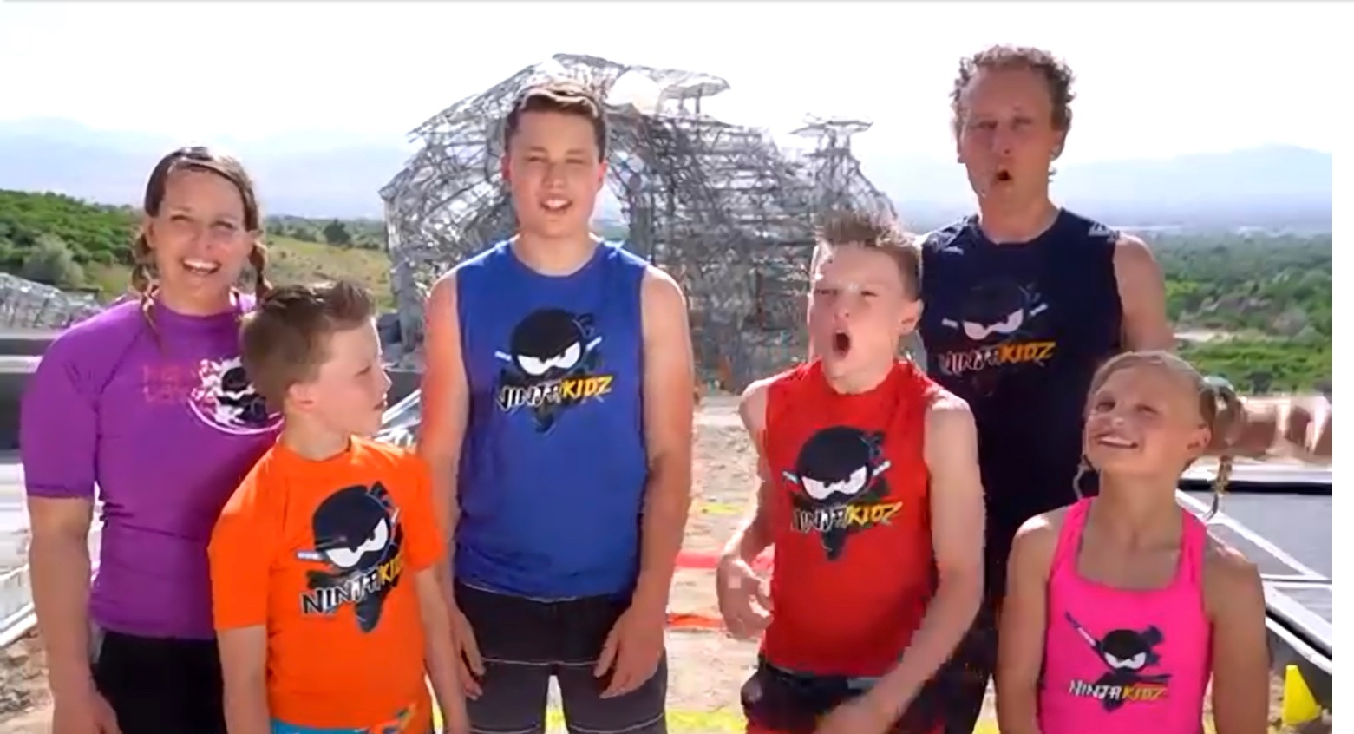
Ninja family
Выполнила: Шумелева Л.Г.
Учитель английского языка
ГАОУ РМЭ «Лицей Бауманский» г. Йошкар-Ола

Slide 2
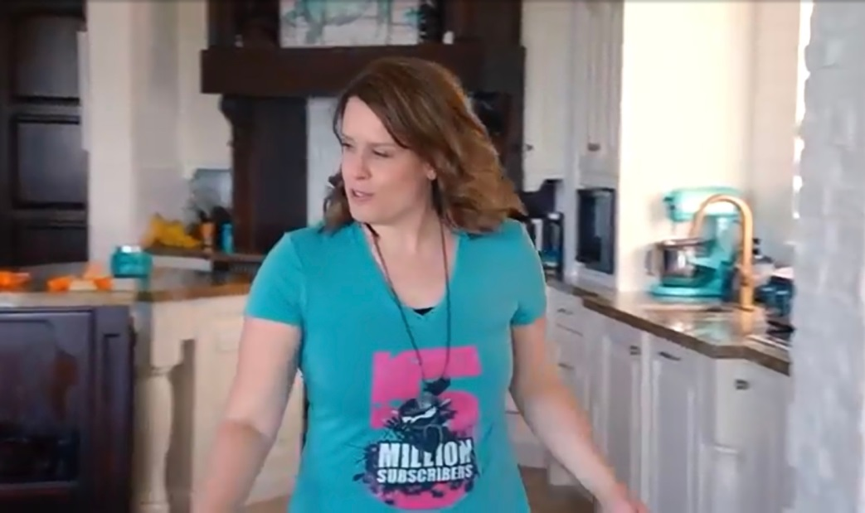
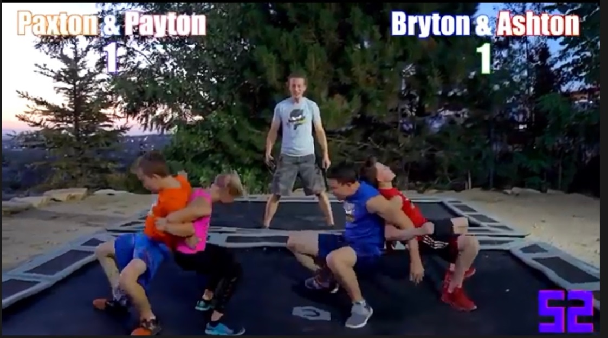
In the morning
They usually get up at 7 o’clock. Then they do morning exercises, have a shower and get dressed. Mum always cooks breakfast. At half past seven they have breakfast. The children often have some pasta and a glass of milk for breakfast. At quarter to 8 they go to school.

Slide 3
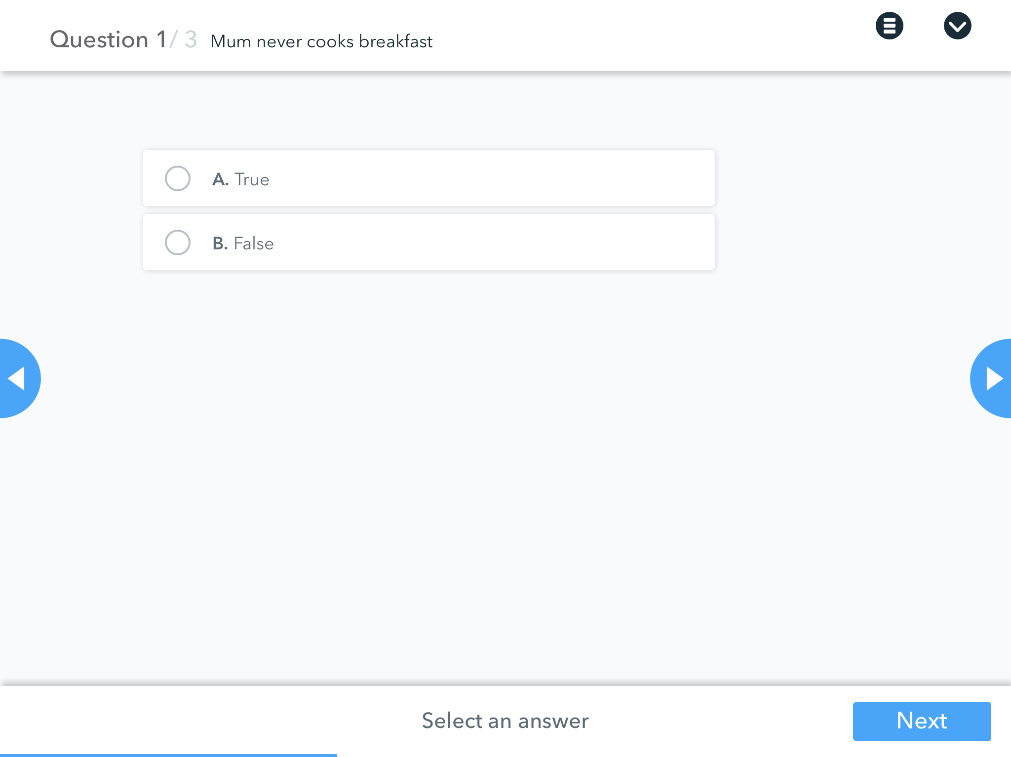

Slide 4
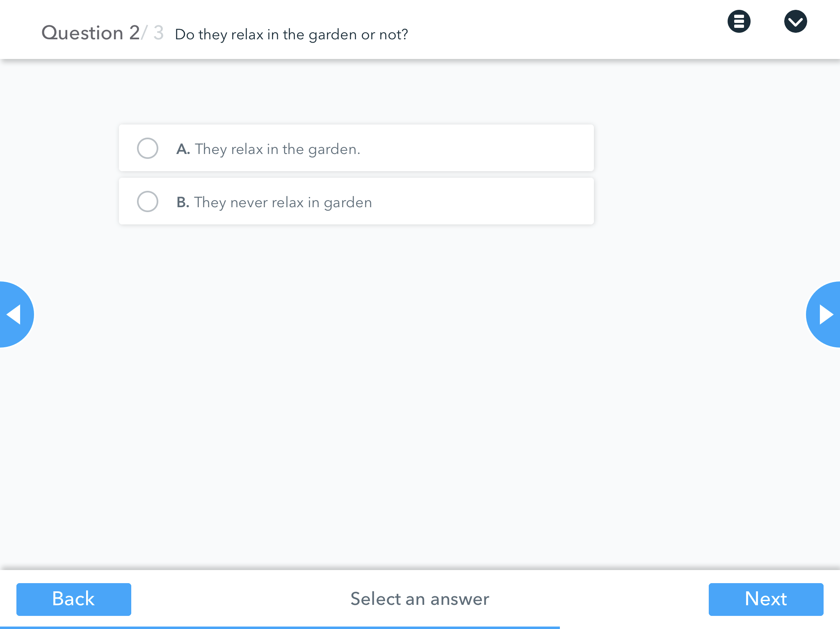

Slide 5
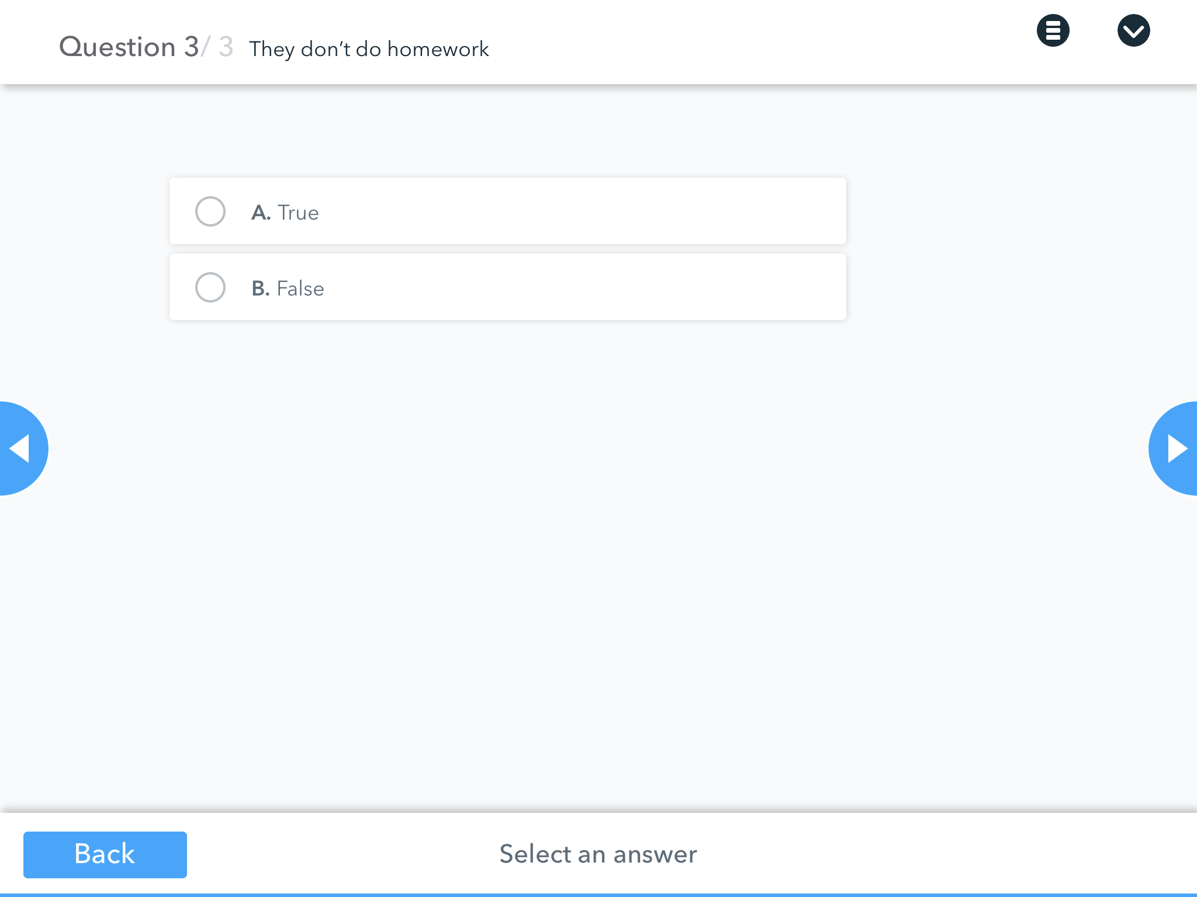

Slide 6
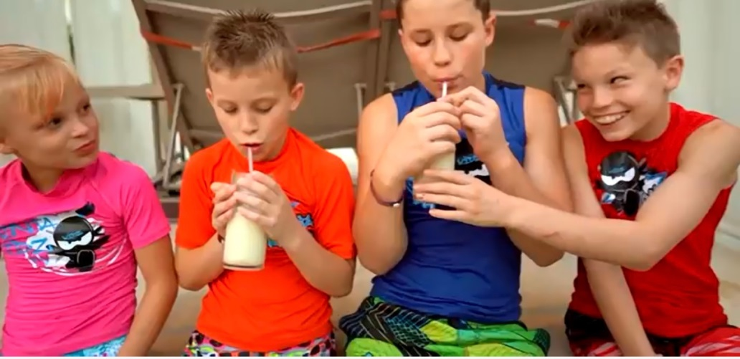
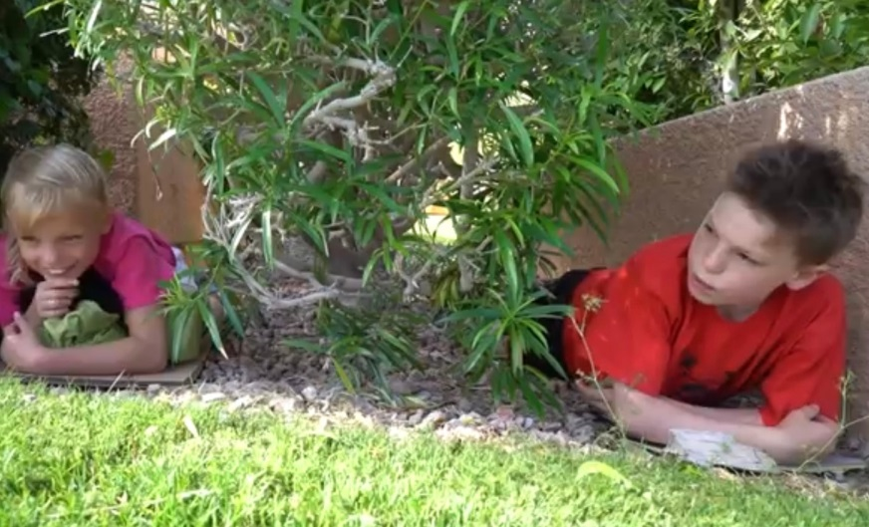
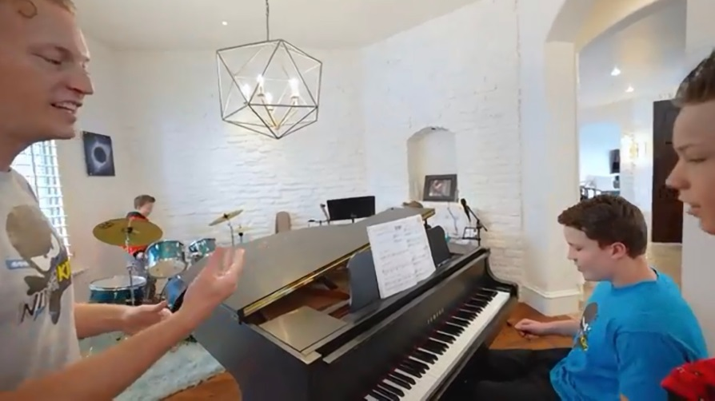
In the afternoon
The children have five lessons at school. At 12 o’clock they always have lunch. At 2 pm the school finishes and mum takes them home. After that they do their homework, relax in the garden, play the piano and drums, meet with friends.

Slide 10
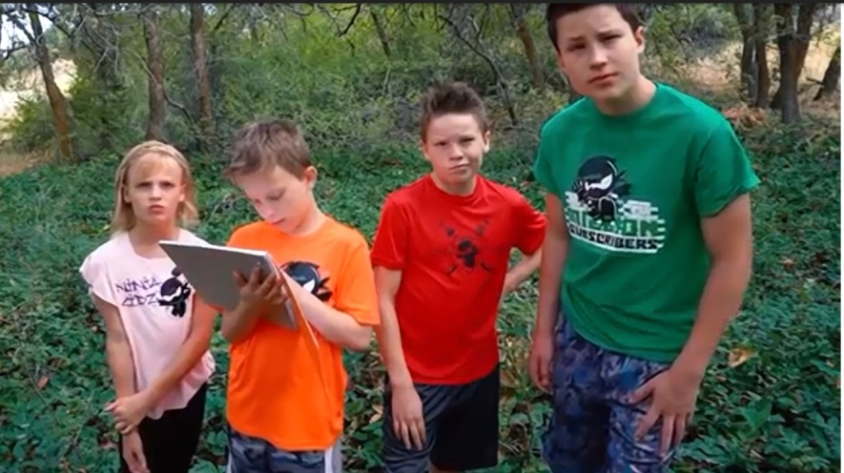
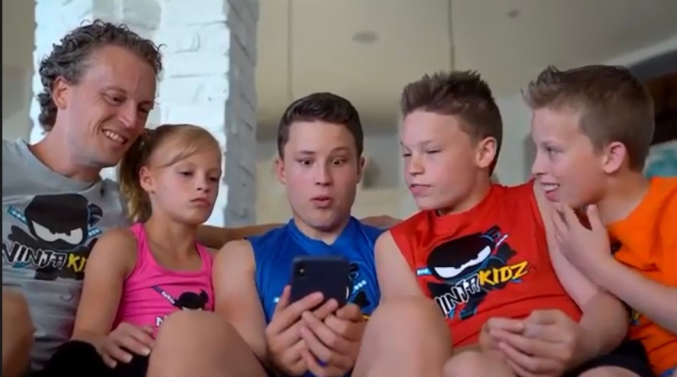
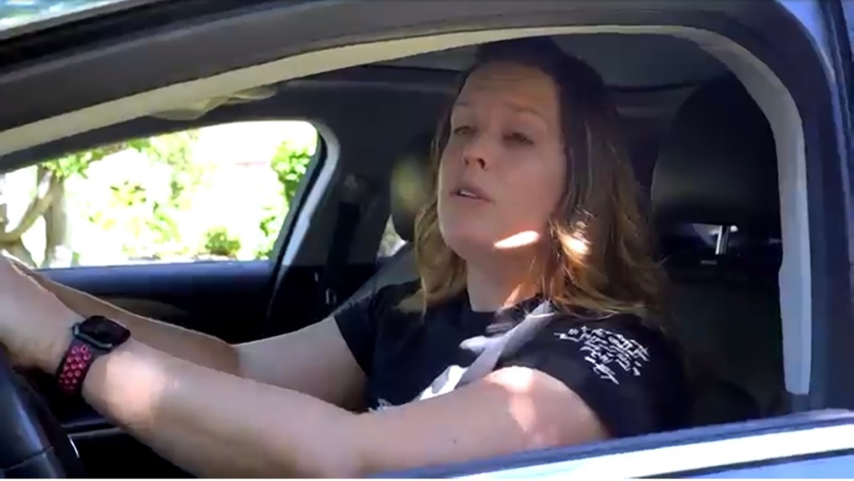
In the evening
The children read books, play video games, go shopping with mum from time to time. It is a big friendly family. They always have dinner at 6 pm and often talk about their plans at dinner. The children usually go to bed at 9 pm. They never put off till tomorrow what they can today. They want to get 1% better every day. They are real heroes.

Slide 11
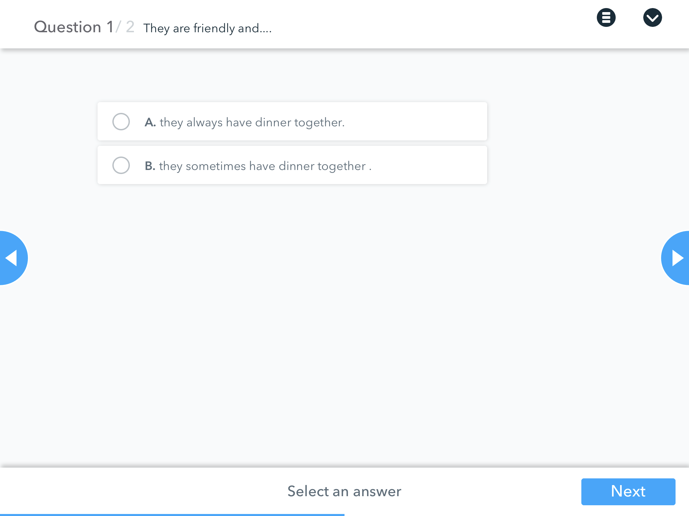

Slide 13
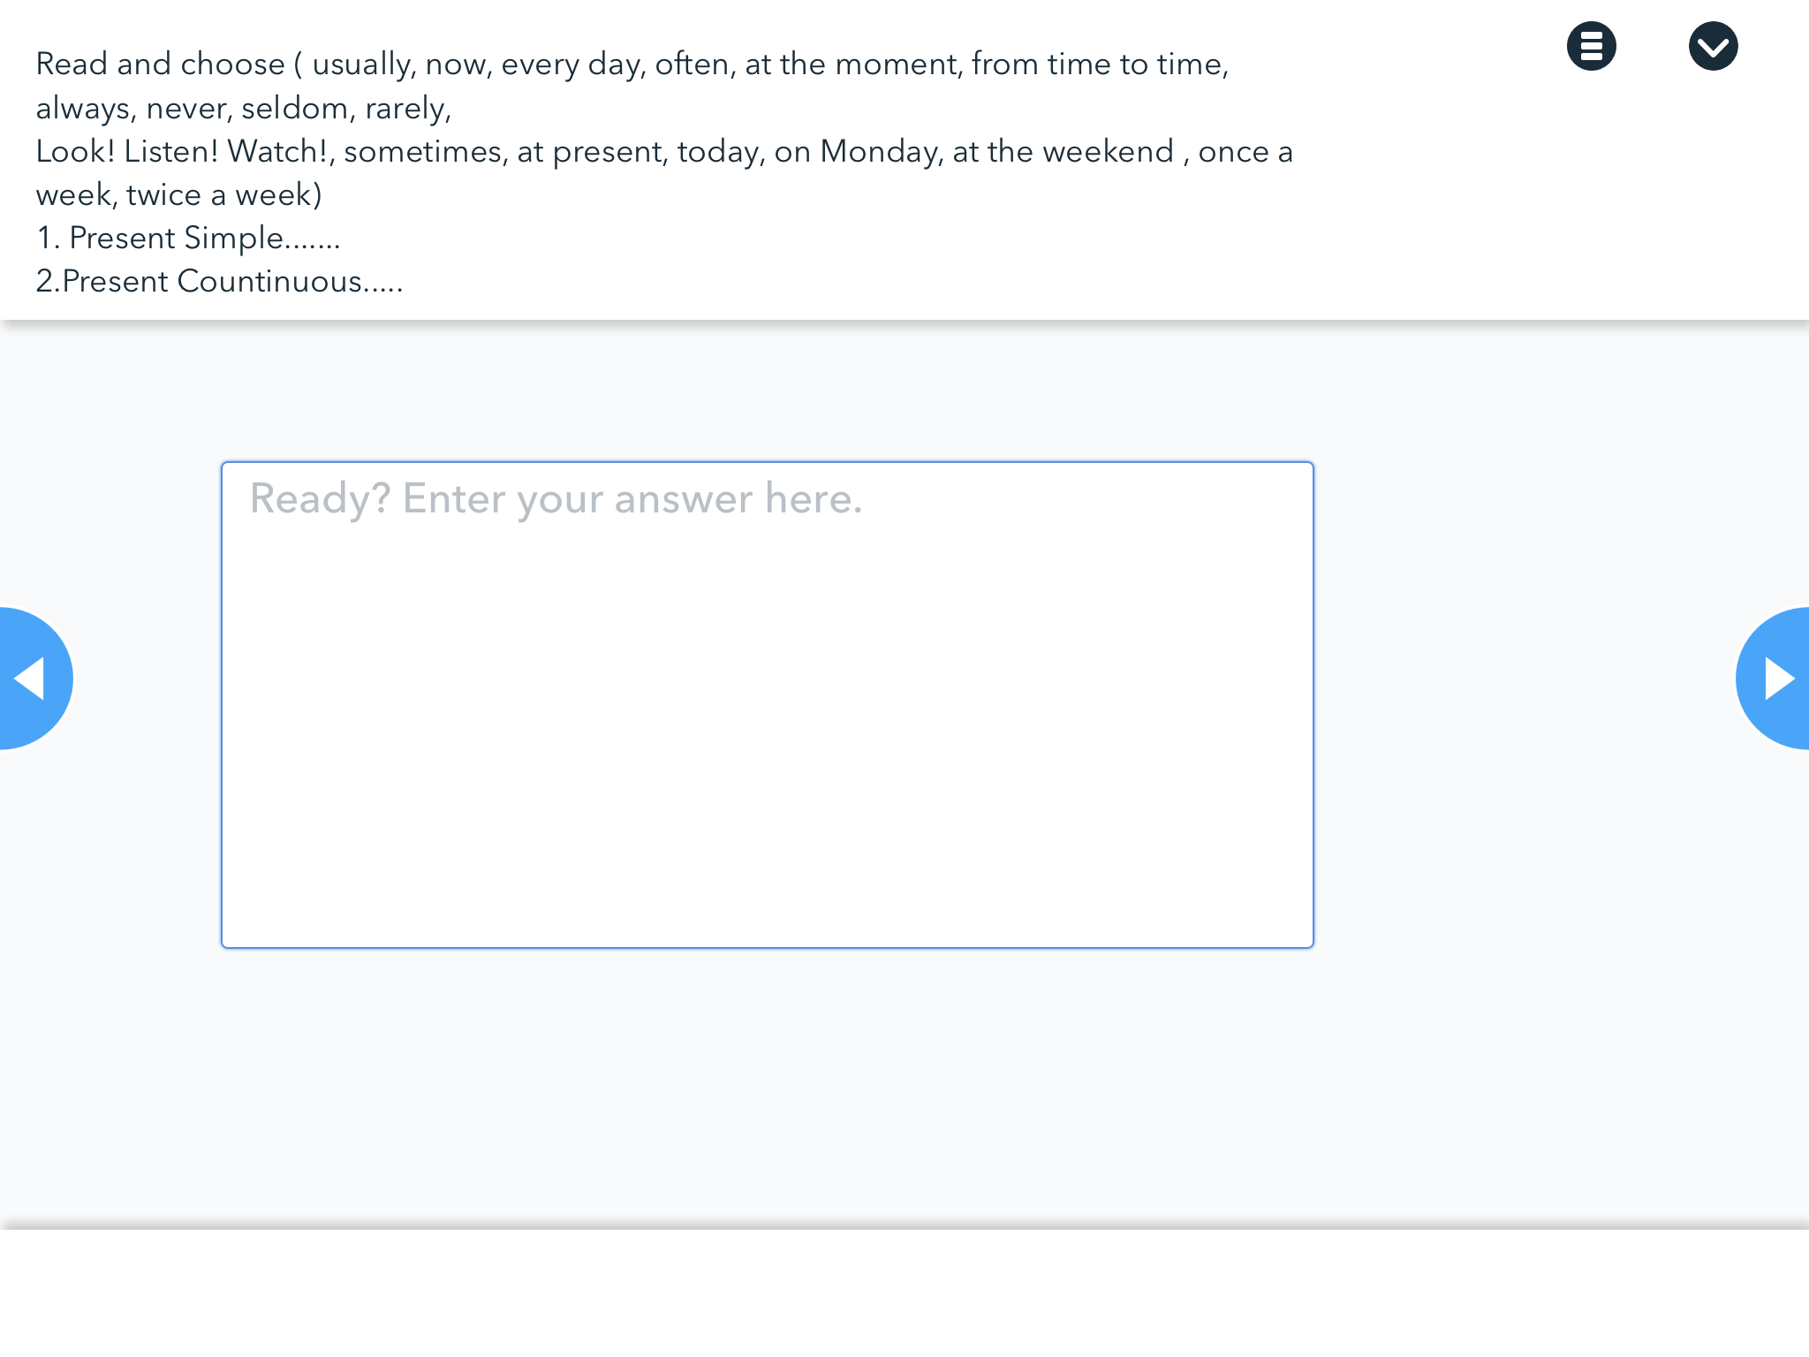

Slide 16
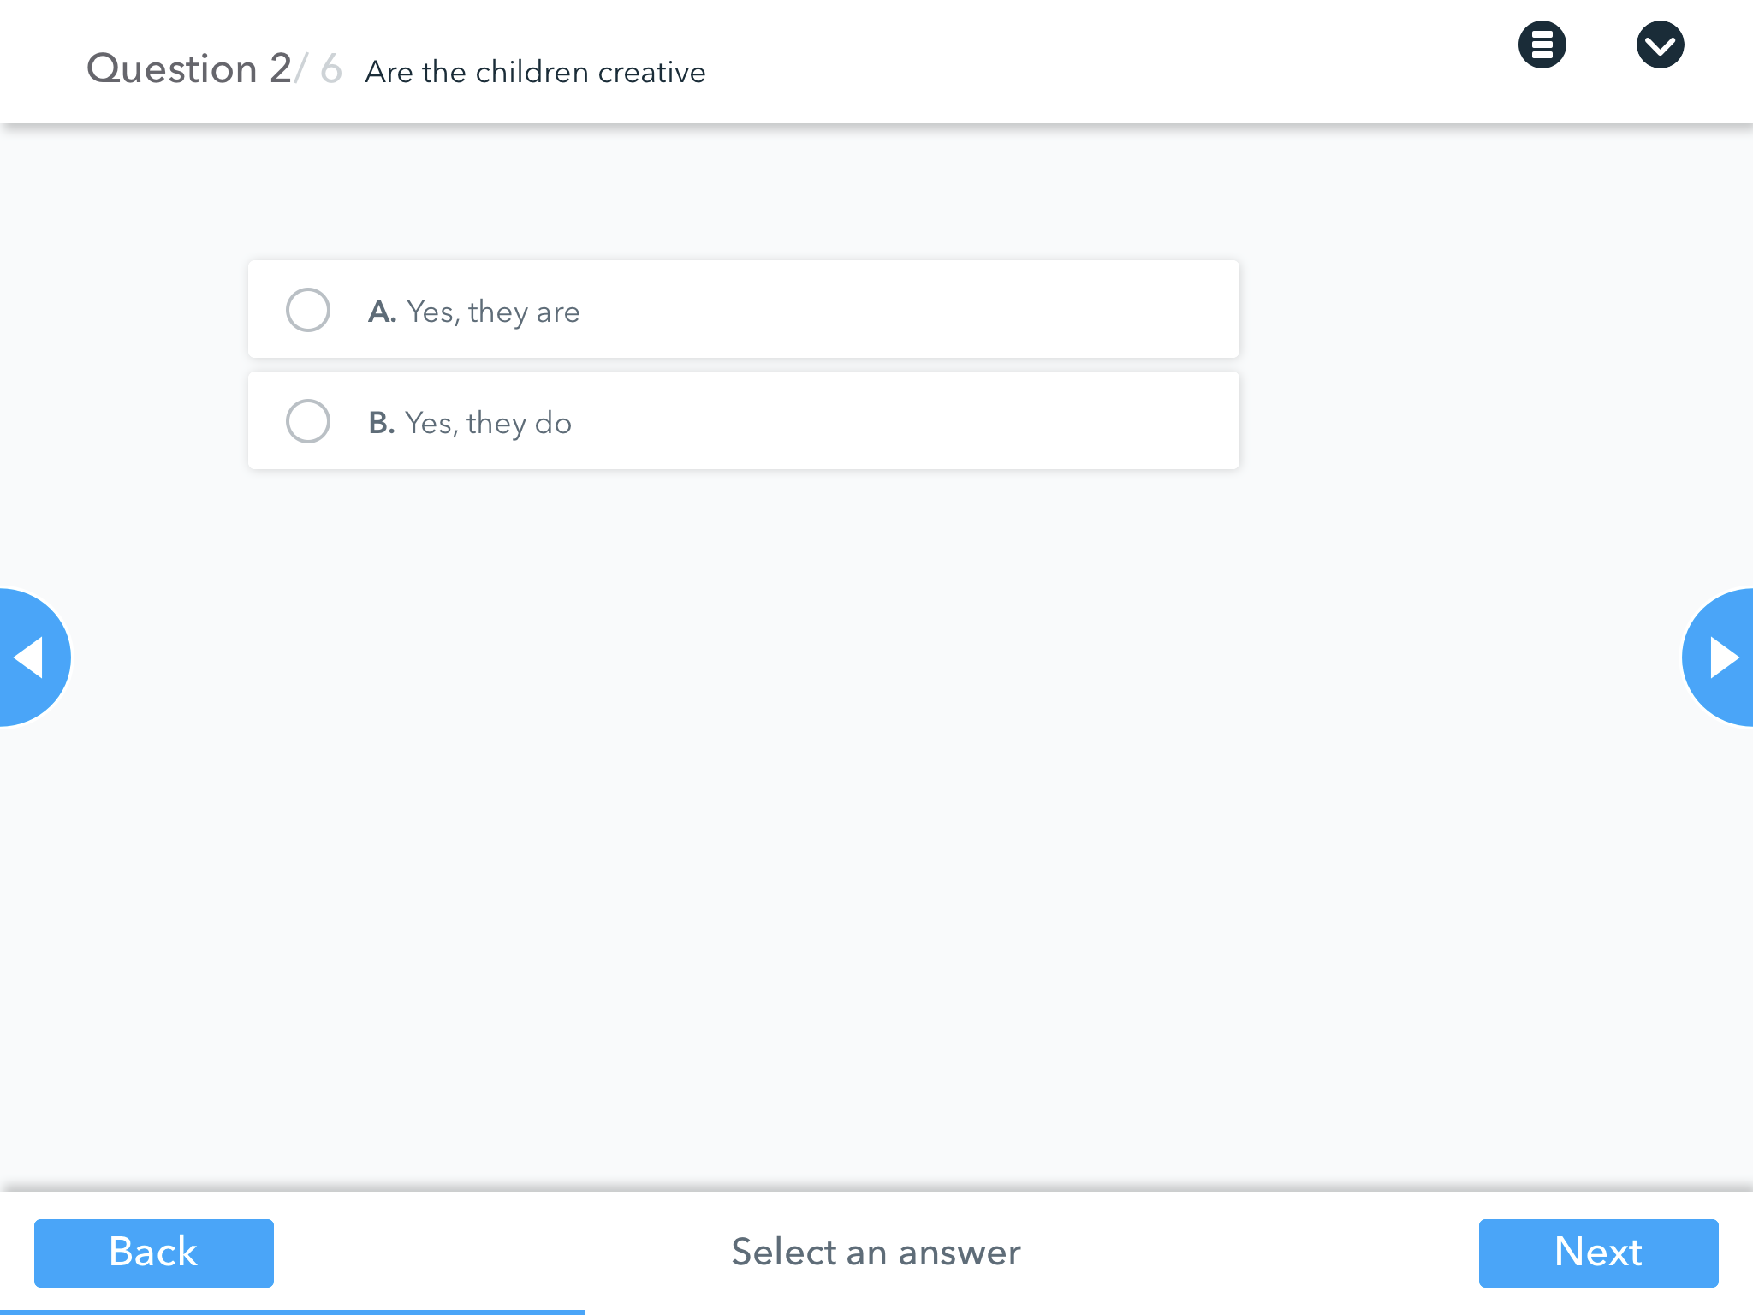

Slide 17
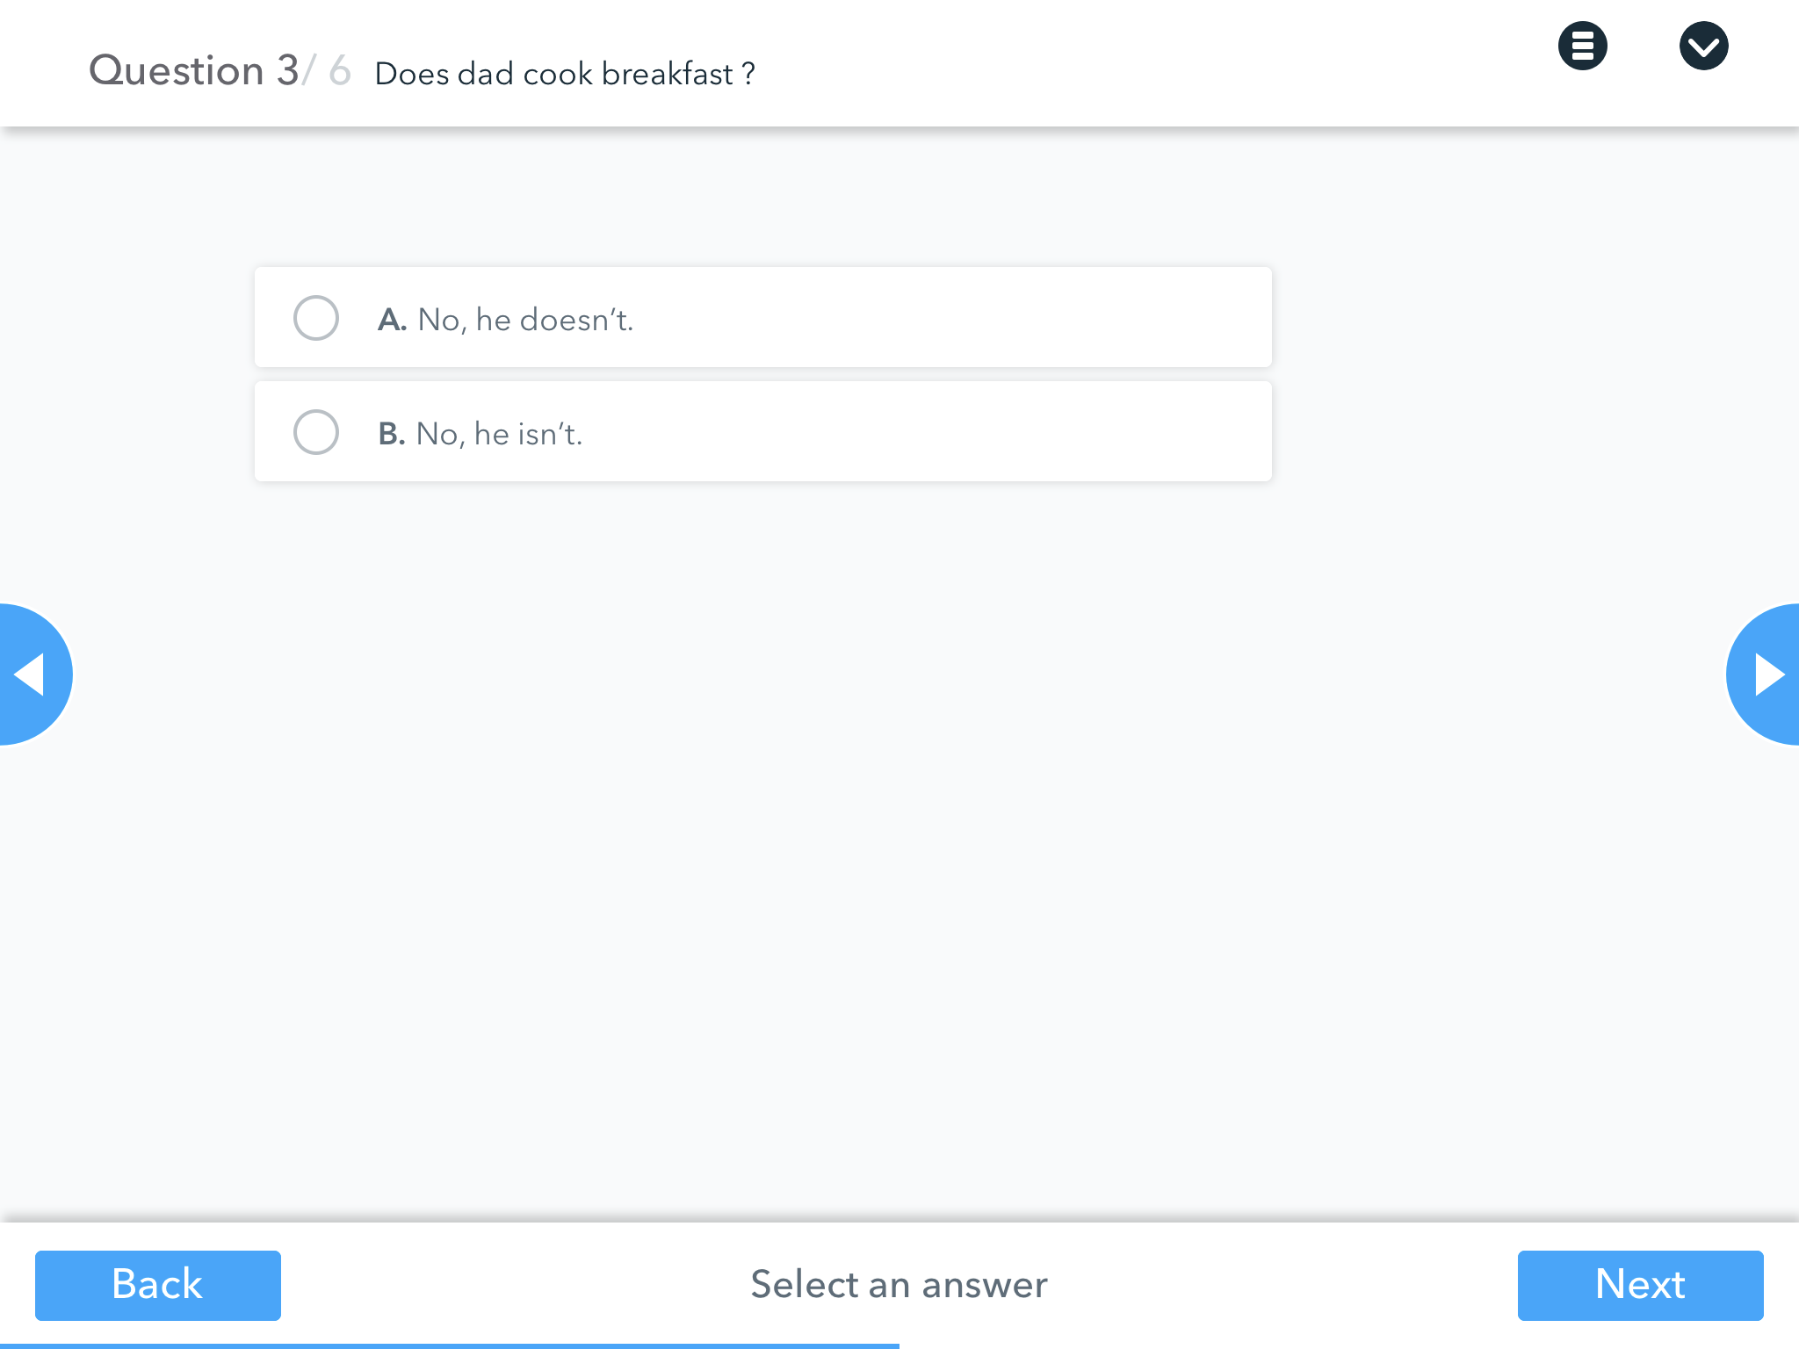

Slide 18
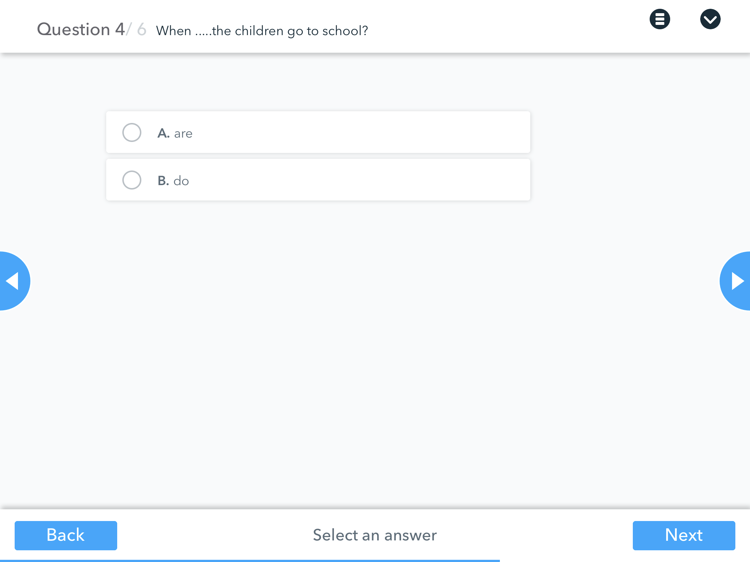

Slide 19
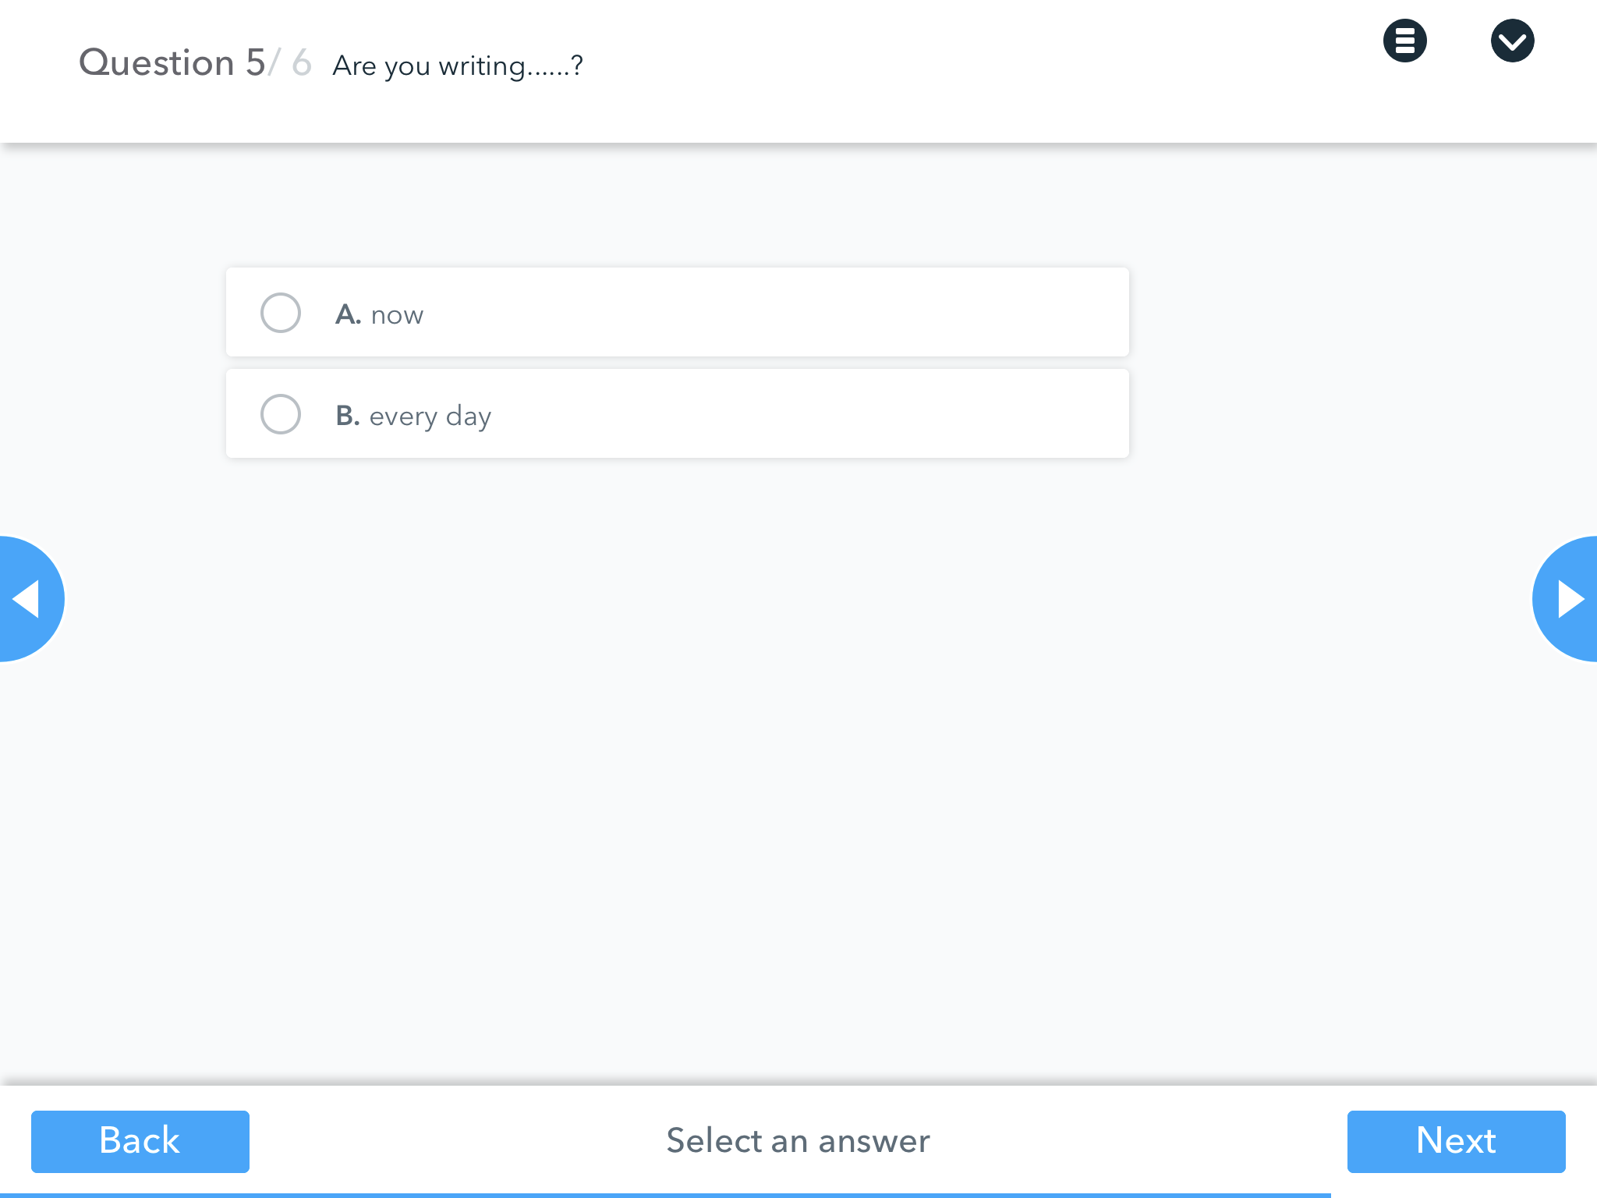

Slide 20
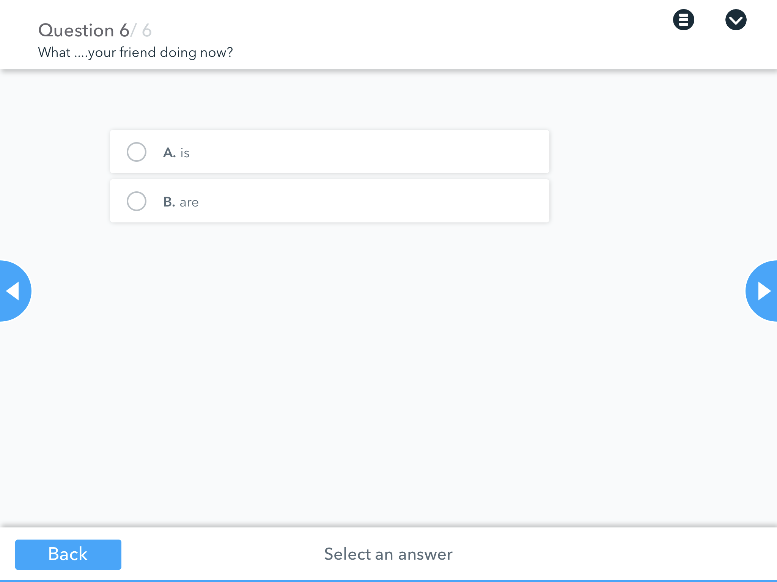

Slide 21
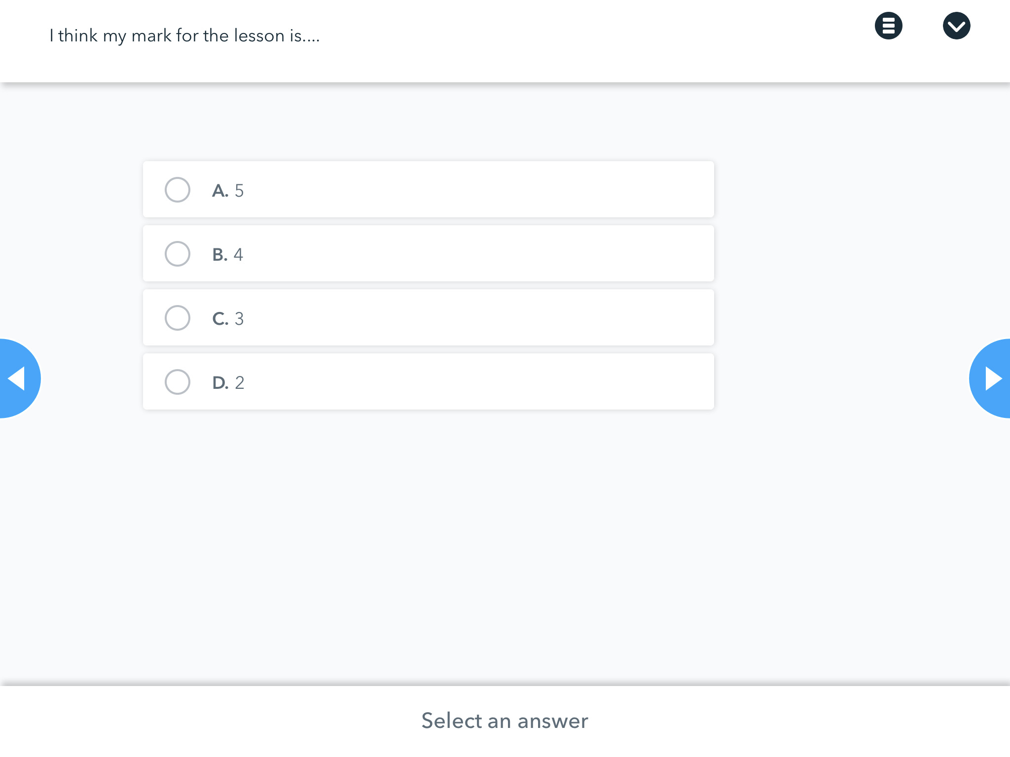

Slide 22
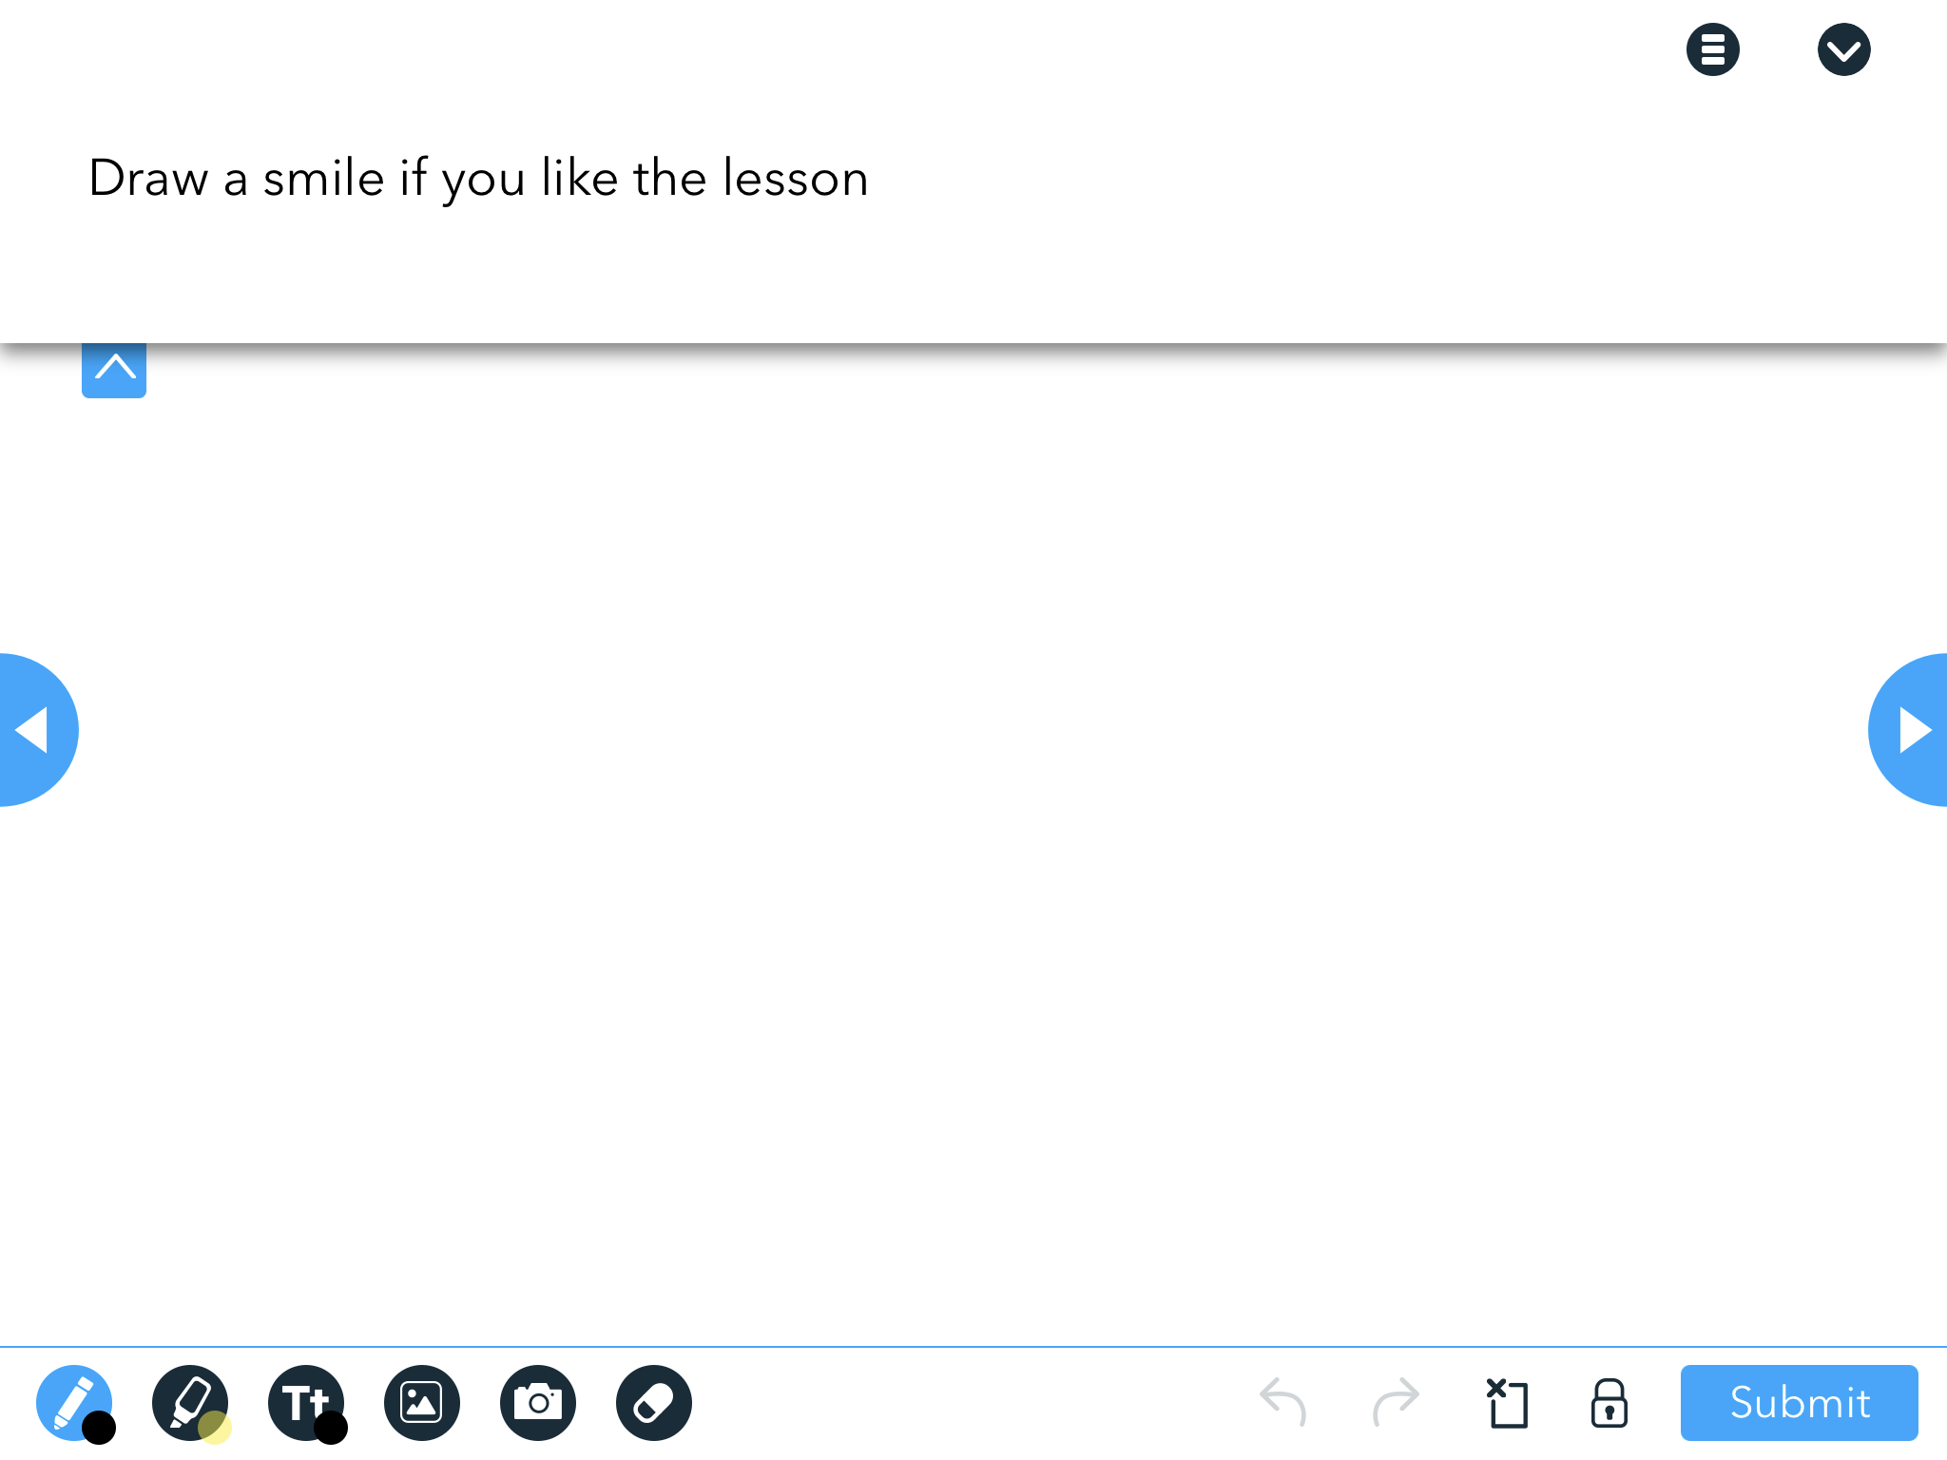

Slide 23
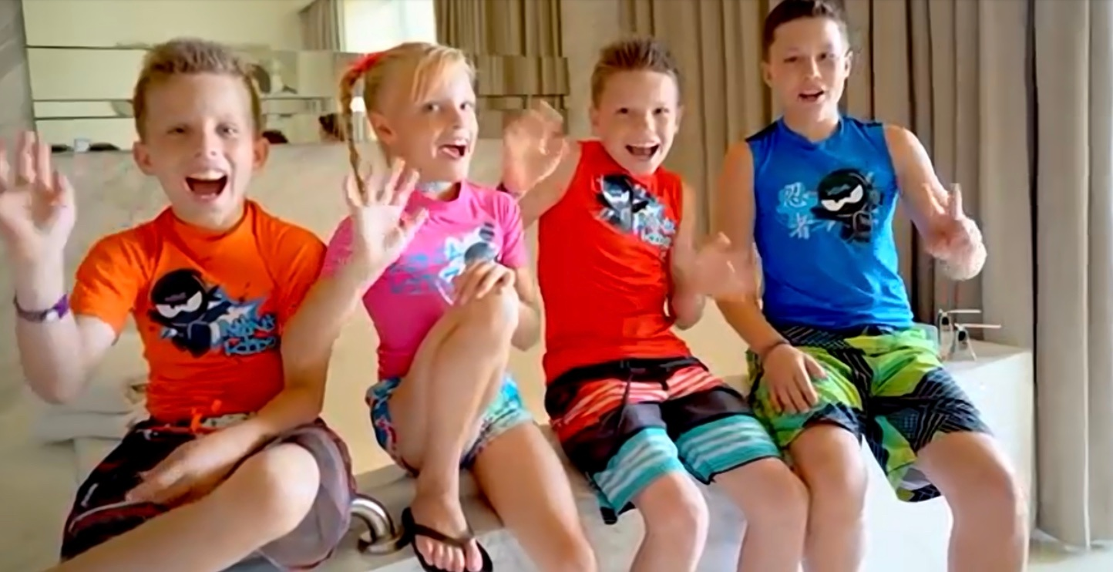
Thank you

Slide 24
Resources
https://m.youtube.com/watch?v=g6ADn177bag

