Slide 1
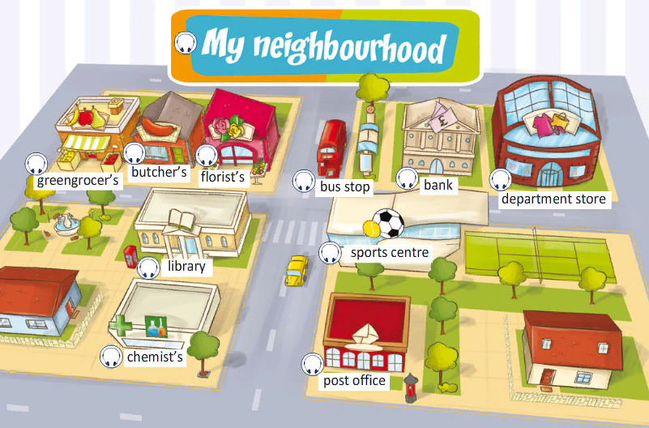
My neighbourhood
Spotlight 6. Moul 2c.

Slide 2
1.Listen and repeat. Where can you buy the things in the pictures?

Slide 3
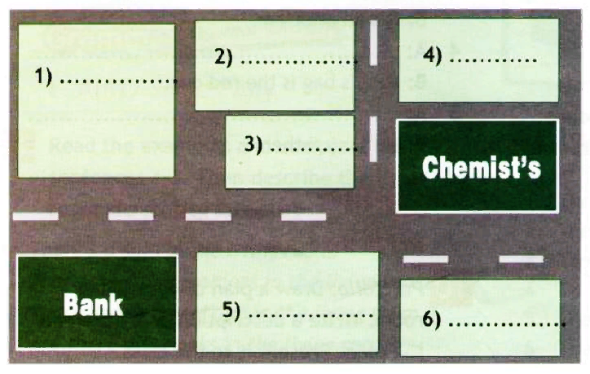
2.Listen to the conversation and labelthe places in the map below. Say where each shop is.

Slide 4
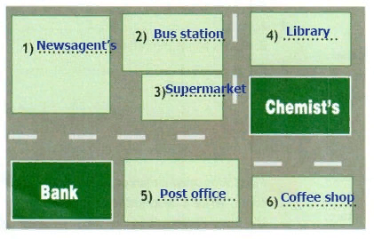

Slide 5
3. Read the title of the text. Think of six words you expect to read. Listen, read and check.
My neighbourhood
I live in a beautiful neighbourhood. There are a lot of shops and cafes around here. There's a post office right next to the bank. Opposite the bank, there's the newsagent's. There's also a supermarket opposite the post office and a bus station behind the supermarket. Next to it there's the chemist's. Behind it, there's a library. Opposite the chemist's, there's my favourite coffee shop! I like my neighbourhood a lot!
Tony Smith

Slide 6
Answer the questions.
1.Where does Tony live?
2.What does he have around there?
3.What is right next to the bank?
4.Where is the newsagent’s?
5.What is opposite the post office?
6.Where is the bus station?
7.Where is Tony’s favourite coffee shop?

Slide 7
Think of six words you expect to read.
I live in a beautiful neighbourhood. There are a lot of shops and cafes around here. There's a post office right next to the…….. Opposite the bank, there's the……….. There's also a supermarket opposite the ……….and a bus station behind the supermarket. Next to it there's the………. Behind it, there's a………... Opposite the chemist's, there's my favourite……..! I like my neighbourhood a lot!
Tony Smith

Slide 8
Interview your partner as Tony Smith about his neighbourhood.
А: Do you like your neighbourhood?
B: Oh, yes. There are a lot of shops and cafes.
A: Is there a newsagent's? Where's it?
B: It's opposite the bank.
A: Where's the supermarket?

Slide 9
Your homework. P.20,ex.4
Portfolio: Draw a street map of your neighbourhood and label the buildings. Then write a short paragraph describing it. Use Ex. 3 as a model.
Портфолио: нарисуйте карту улиц своего района и обозначьте здания. Затем напишите короткий рассказ, описывающий его. Используйте упр. 3 в качестве образца.

