Slide 1
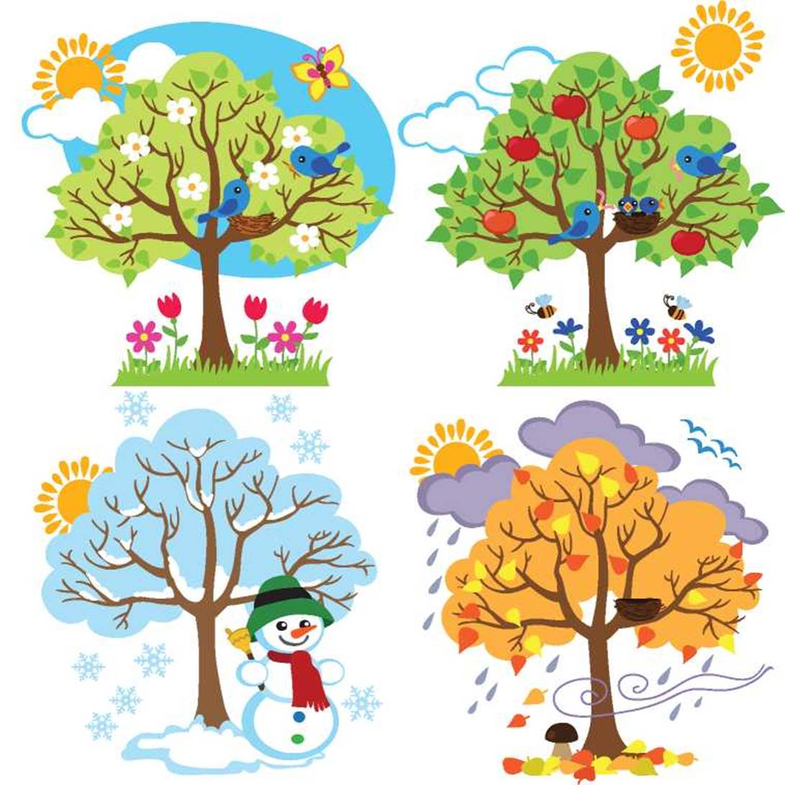
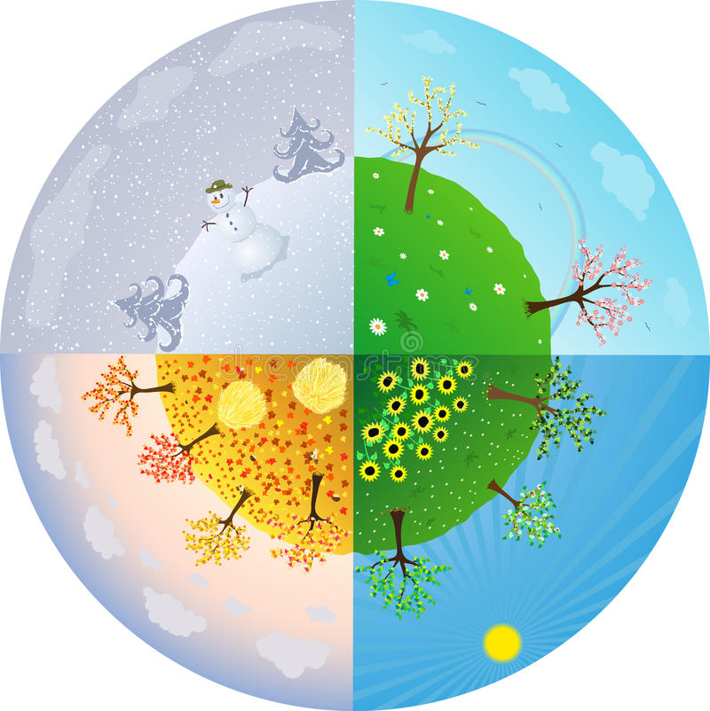
The weather and seasons

Slide 2
What`s the weather like?
It`s sunny
What`s the weather like?
It`s windy
What`s the weather like?
It`s cold
What`s the weather like?
It`s raining
What`s the weather like?
It`s hot day today
It`s funny and my favourite day today

Slide 3
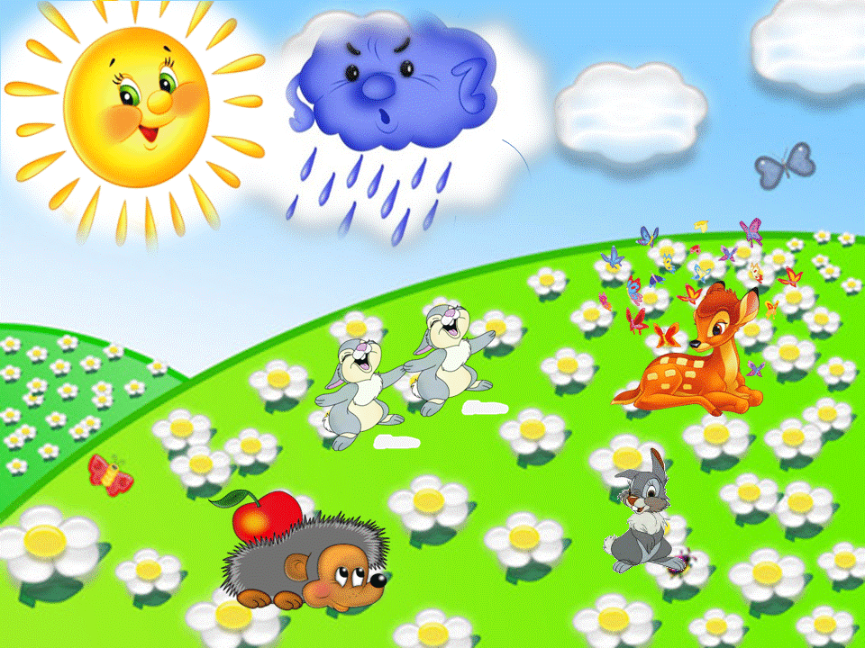
What`s the weather like today?

Slide 4
It`s sunny

Slide 5
It`s hot

Slide 6
It`s raining

Slide 7
It`s cold

Slide 8
It`s windy

Slide 9
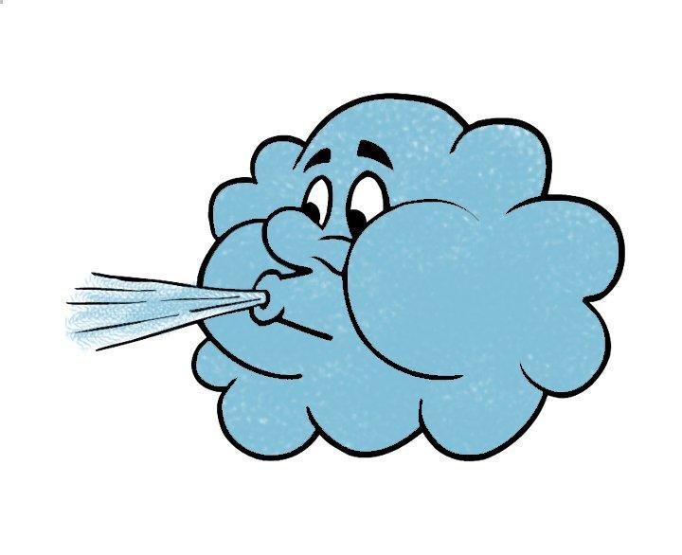
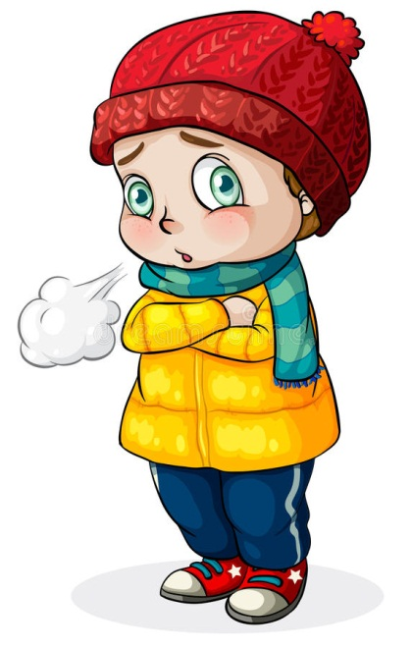
Look the pictures and fill in the gaps
It`s_____________
It`s_____________________
It`s_______________
It`s________________

Slide 10
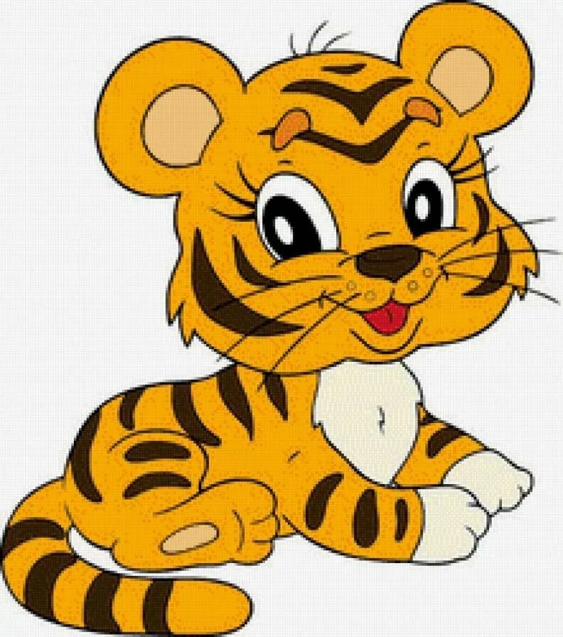
What`s the tiger`s favourite weather?

Slide 11
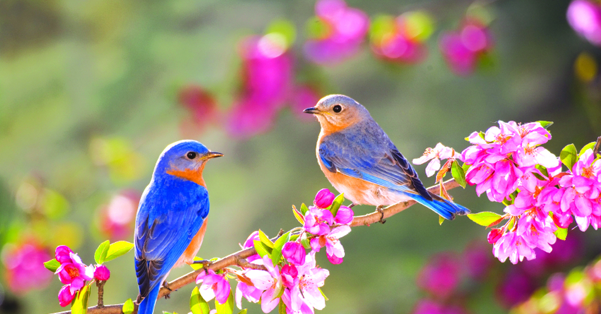
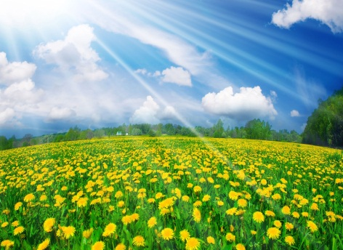
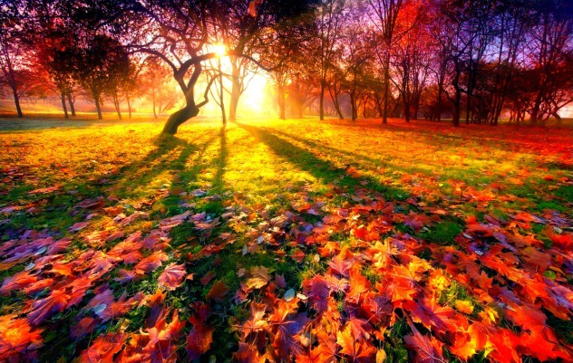
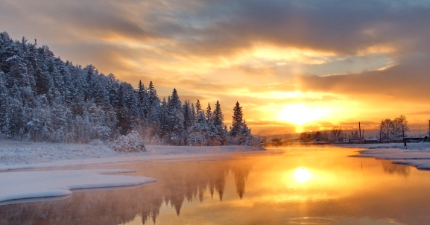
SEASONS
Spring is green,
Summer is bright,
Autumn is yellow,
Winter is white

Slide 12
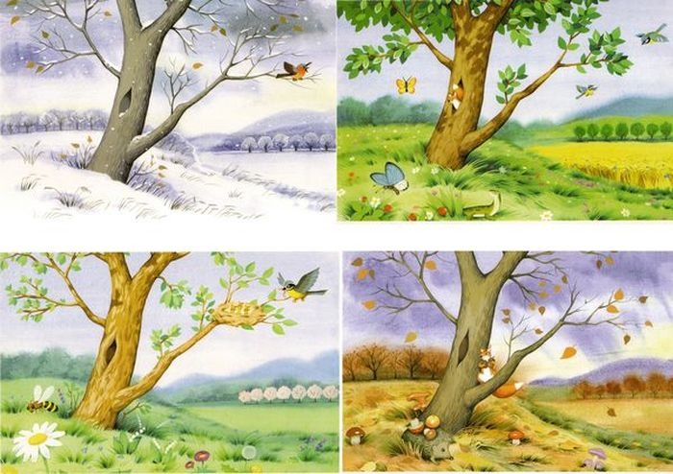
What`s your favourite season? My favourite season is_____

Slide 13
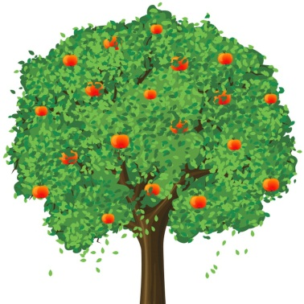
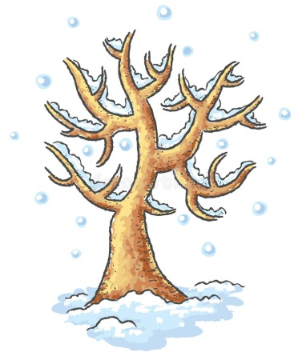
Read the words and choose right the pictures
Spring Summer Autumn Winter
1 2
3 4

Slide 14
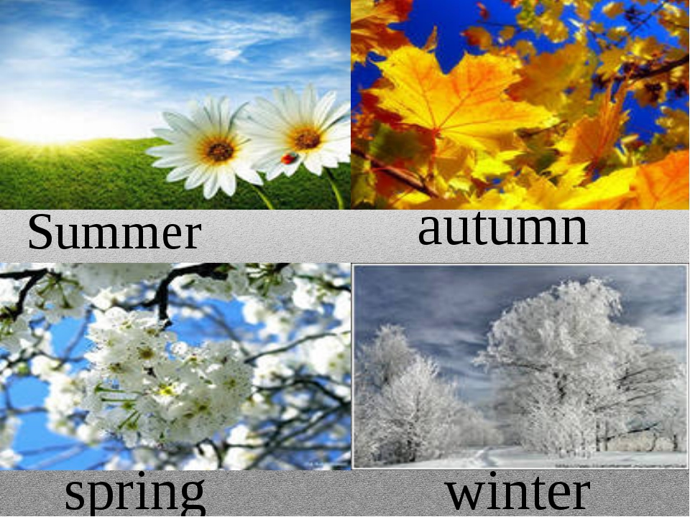
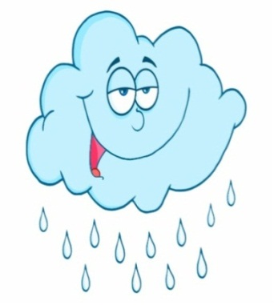
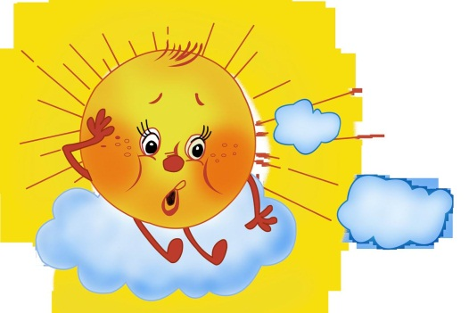
Look and match the pictures
It`s raining
It`s hot
It`s sunny
It`s cold

Slide 15
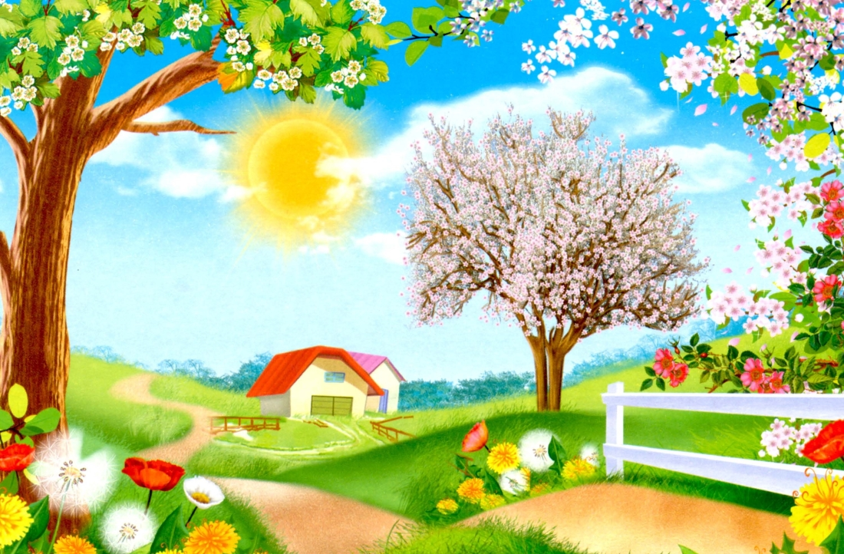
Talk about yourself
1) My favourite season is__________________
2) My birthday is in____
3) The weather on my birthday is__________

Slide 16
Thank you for your work
The lesson is over

