Slide 1
Project-based reading
Осьмухина А.В.,
учитель англ. яз. I кат.
МБОУ СОШ №6 г. Апатиты

Slide 2
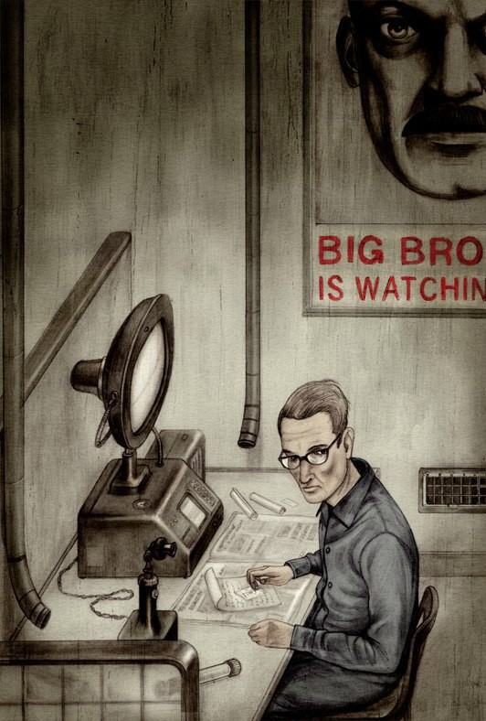
Pre-reading activities

Slide 3
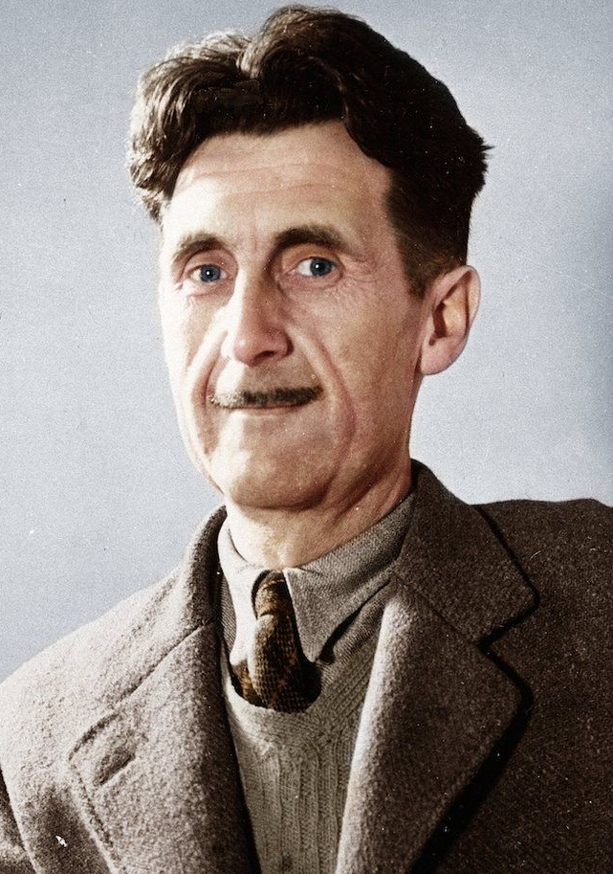
George Orwell
Do you know his real name?
What is the origin of his pen name?
What Russian writer is he compared with?

Slide 4
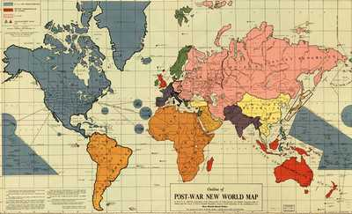
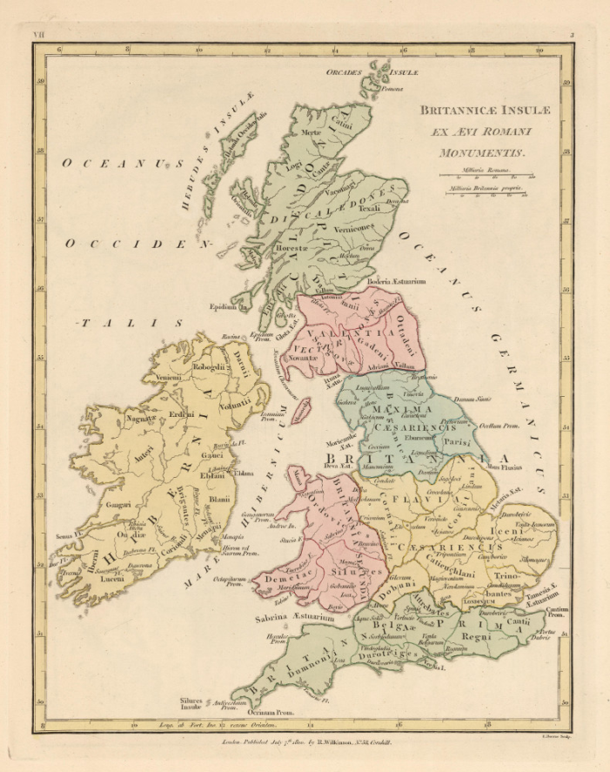
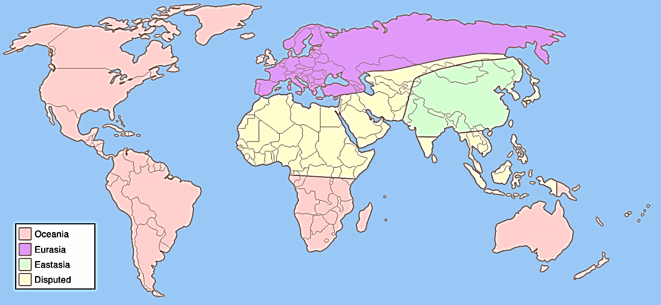
Pre-reading activities. Geographical aspects.

Slide 5
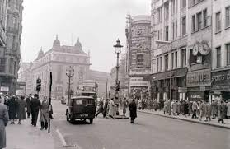
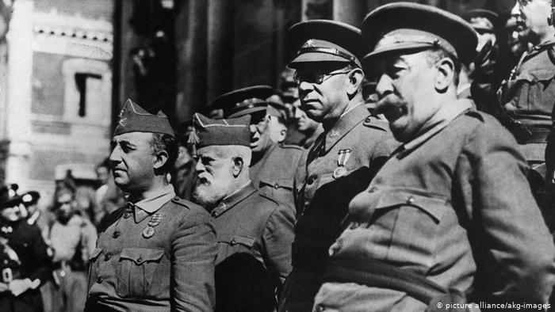
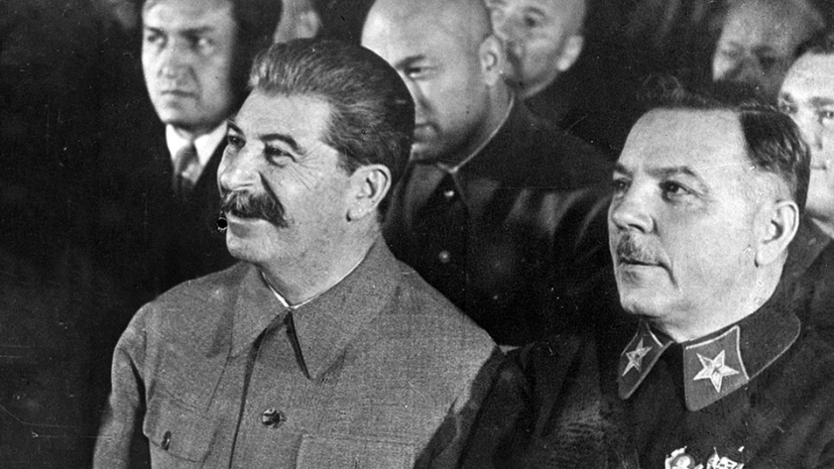
Pre-reading activities. Historical and political aspects.
What historical period is described in the story?
What are the prototypes for main aspects of the novel?
What happens with Winston, Julia and O’Brien?
What terminology is used to describe the world in novel?

Slide 6
While-reading activities.
Dramatic role reading and performance.
Roundtable.
Movie review.
CliffsNotes.
Draw!
Biography.
Adjective-itis.
Just the facts, ma’am

Slide 7
Post-reading activities.
Feedback in written or oral form.
Dear author.
Timeline.
What if?
Second chance.

