Slide 1
BRITISH HOLIDAYS - - customs and traditions

Slide 2
New Year's Day
the 31 ^{st}of December/
the 1 ^{st}of January
St. Valentine's Day
the 14 ^{th}of February
St. Patrick's Day
the 17 ^{th}of March
Easter Sunday
between 22 March and 25 April
Halloween
the 31 ^{st} of October
Guy Fawkes` Night
the 5 ^{th}of November
Christmas Day
the 25 ^{th}of December
Boxing Day
the 26 ^{th}of December

Slide 3
Now let’s read and translate some new words you’ll meet in the texts:
Wealth - благополучие
A piece of coal – кусок угля
A firework - фейерверк
New Year Resolutions – новогодние обещания
Sigh - подписать
Shamrock - трилистник
A bun - булочка
A bunny - кролик
A ghost - привидение
Jack-o-lantern – фонарь из тыквы
Commemorate – почтить память
Gunpowder - порох
A plot – заговор
A chimney - камин
A mistletoe wreath - венок омелы

Slide 4
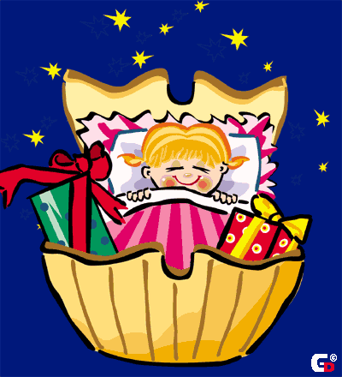
New Year
New Year’s Eve all British celebrate on the 31st of December. Most people see with friends and relatives.
At midnight they sings New Year songs and wishes a happy New Year.

Slide 5
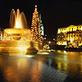
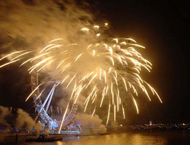
New Year
Every year the people of Norway give the city of London a present – a big Christmas tree
Some people make New Year Resolutions:
I'll get up early every morning next year.
I'll clean, my shoes every day.

Slide 6
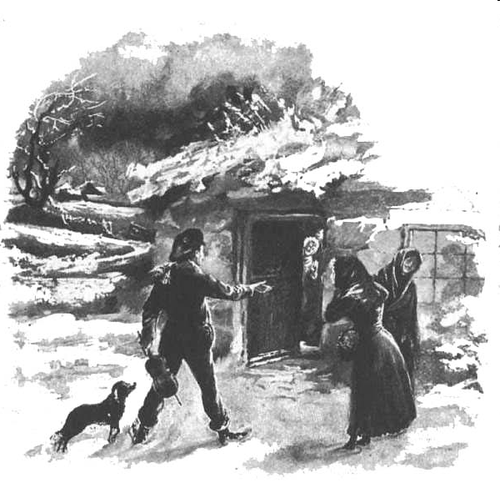
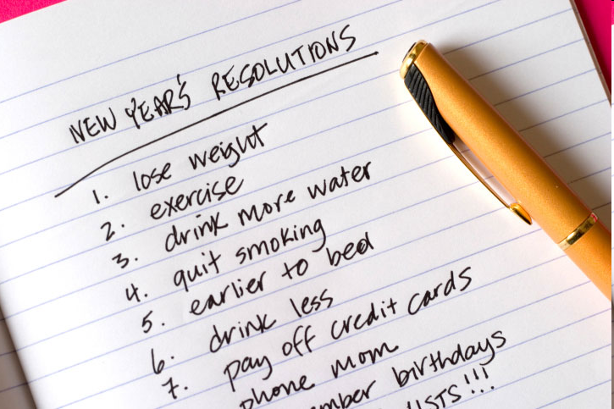
New Year´ symbols
First Footing in Scotland
fireworks
New Year's Resolutions
- the first visitor who comes into a house in the New Year morning. To bring good the First Footing must be a dark-haired man. He carries three things: a piece of coal to wish warmth, a piece of bread to wish food, and a silver coin to wish wealth.

Slide 7
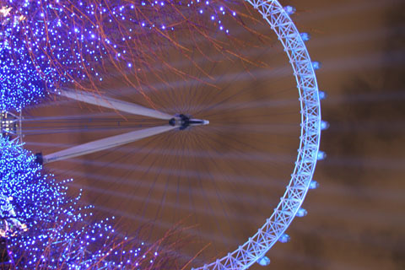
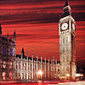
New Year
The most common type of celebration is a New Year party

Slide 8
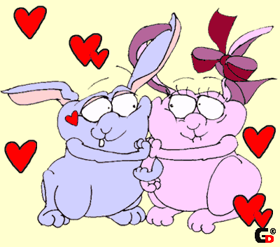
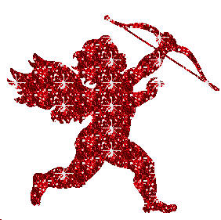
St. Valentine’s day
On the 14th of February there is St. Valentine’s Day. People send Valentine’s cards to someone they love. Usually they don’t sing them – you must guess who sent cards to you.

Slide 9
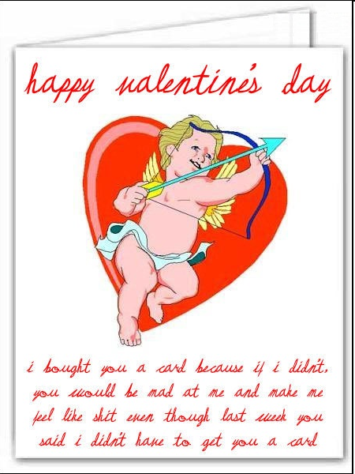
St. Valentine's
cards without a sigh (or with the sigh «Your Valentine»)
sweet hearts

Slide 10
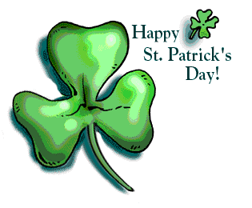
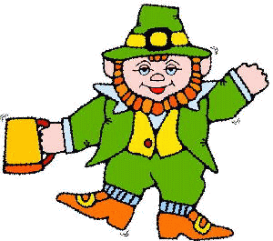
The 17th of March is a national holiday in Ireland – St. Patrick’s day. On that day people wear a shamrock. A shamrock is a plant with three leaves. It is the national symbol of Ireland.
St. Patrick was a man who had wonderful power. He cleared Ireland of snakes.

Slide 11
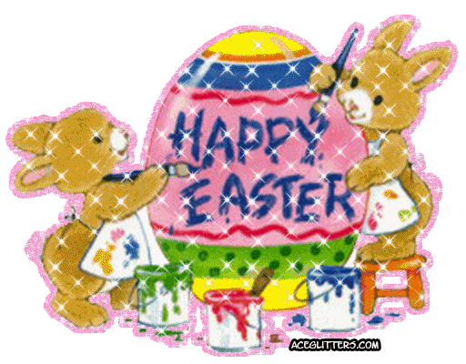
Easter
In April or at the end of March English people celebrate Easter Day. On Easter Sunday children get chocolate eggs and rabbits.

Slide 12
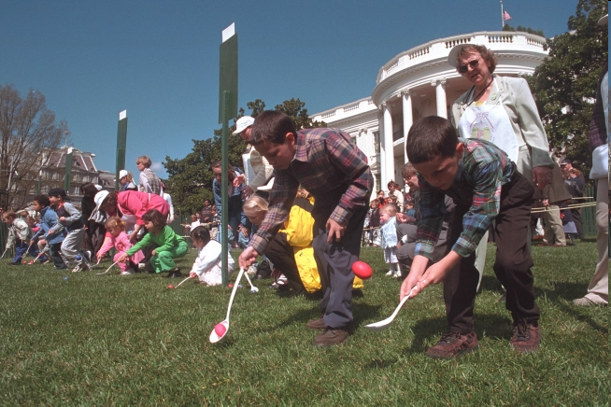
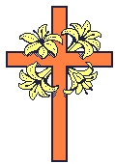
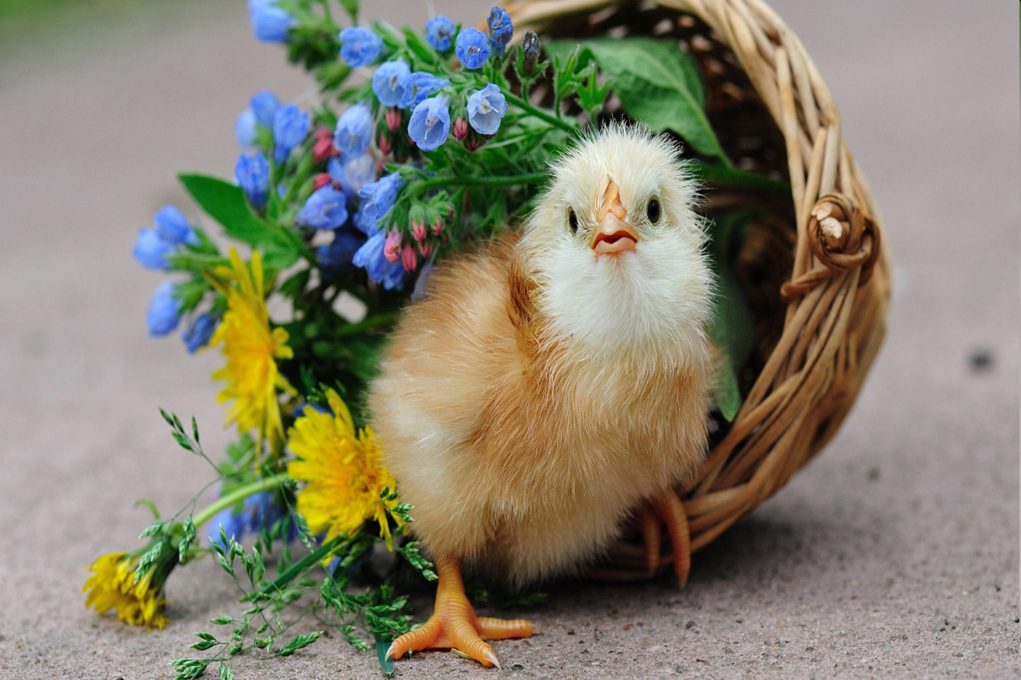
Egg rolling game
Fluffy chick

Slide 13
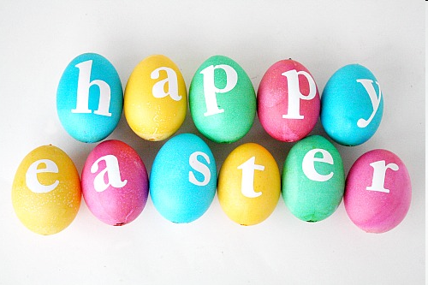
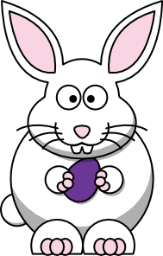
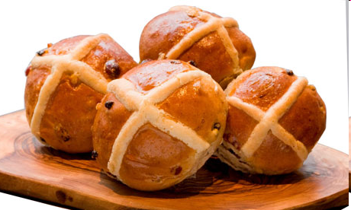
The died
eggs
Hot cross buns
Easter Bunny

Slide 14
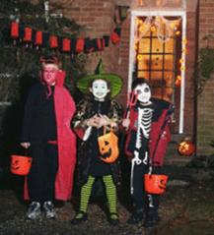
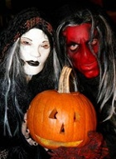
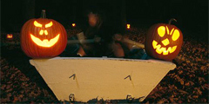
HALLOWEEN
On October 31st British people celebrate Halloween. It is the most colourful and exciting holiday of the year.
Halloween is a time for fun.

Slide 15
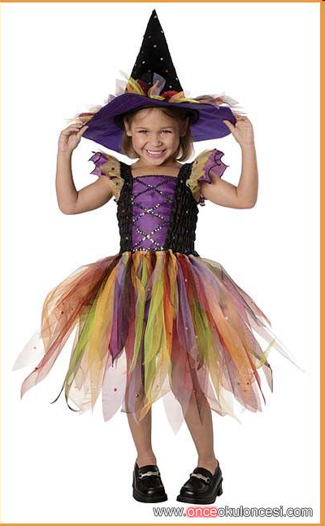
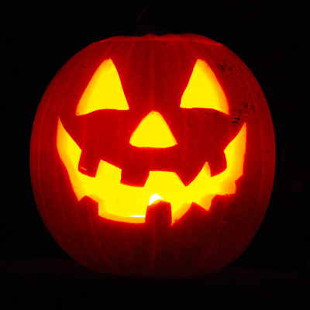
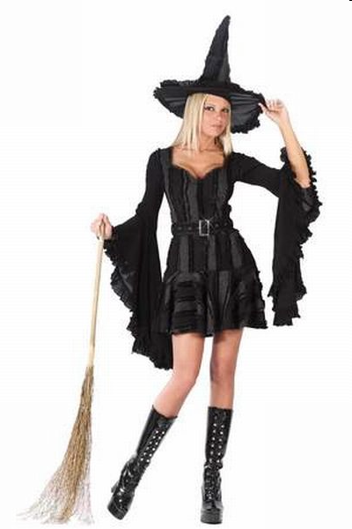
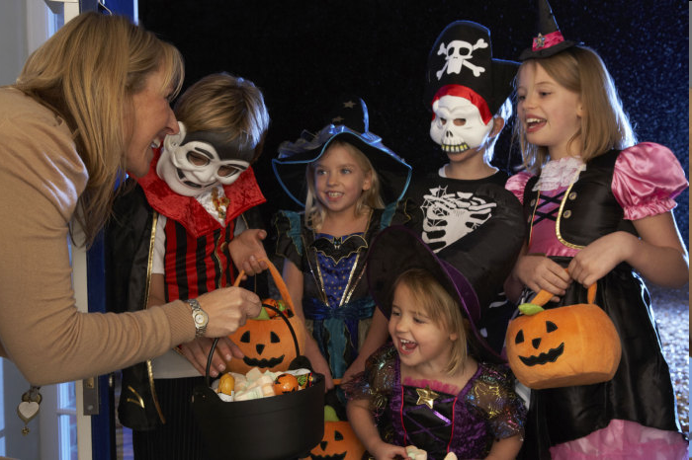
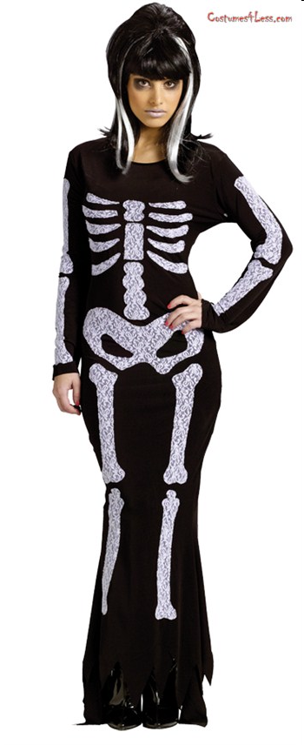
The Symbols of Halloween
Jack-o-lantern
(the lamps of pumpkins)
Funny costumes
Of witches, ghosts
Or skeletons
«Trick» or «treat»

Slide 16
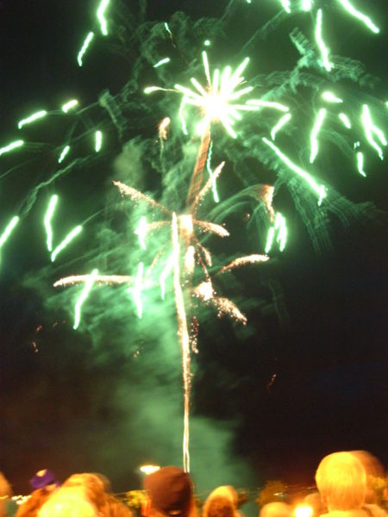
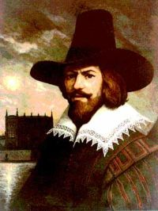
GUY FAWKES NIGHT— NOVEMBER 5
Guy Fawkes Night is one of the most popular festivals in Great Britain. It commemorates the discovery of the so-called Gunpowder Plot, and is celebrated throughout the country.

Slide 17
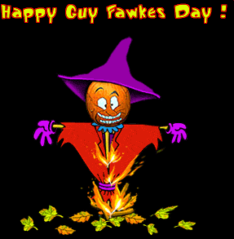
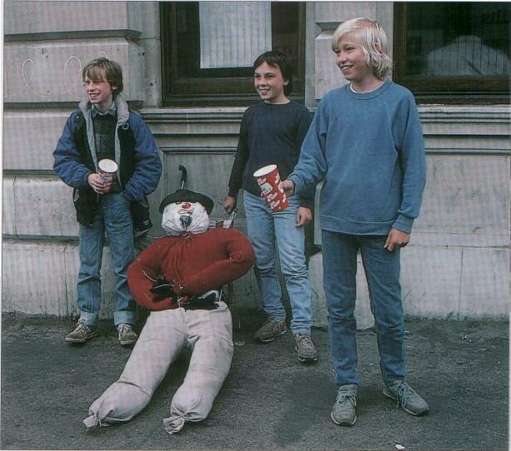
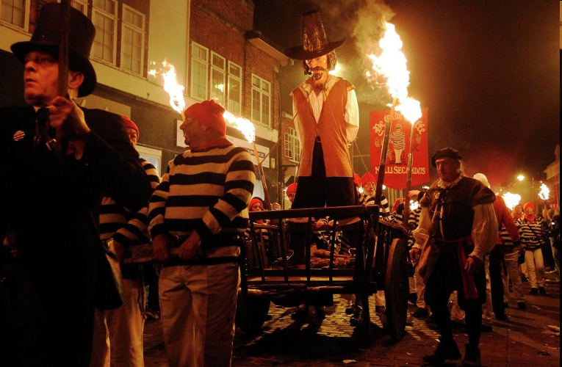
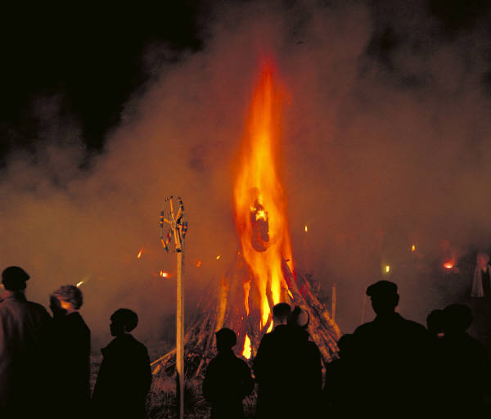
«A penny for the guy»
to collect money for
fireworks
burning a dummy called a "guy"

Slide 18
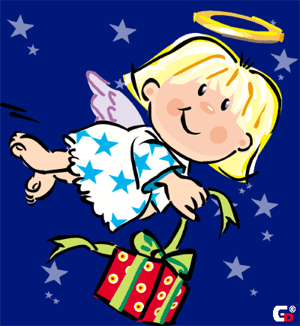
Christmas
On the 25th of December there is the greatest holiday of all in England – Christmas.People buy a Christmas tree and decorate it with toys, coloured balls.
Children wake up early to find stockings full of small presents on their bed.

Slide 19
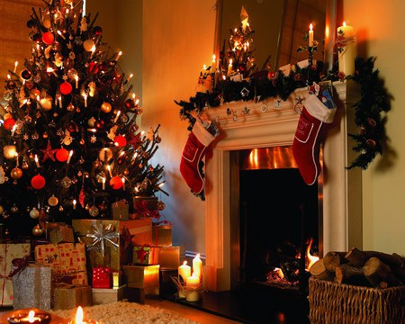
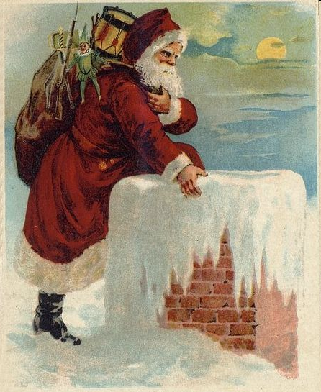
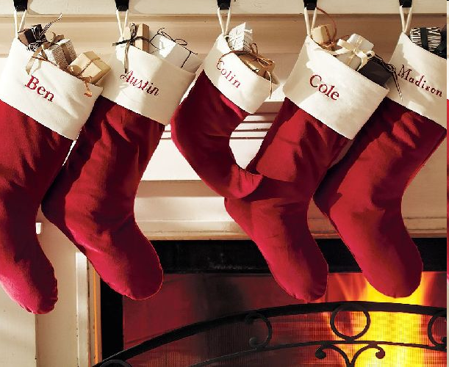
Christmas Symbols
Father Christmas
(Santa Claus).
He enters houses by
coming down
the chimney
Stockings
On Christmas Eve children put them near the beds hoping that at night Father Christmas will put the presents into the stockings

Slide 20
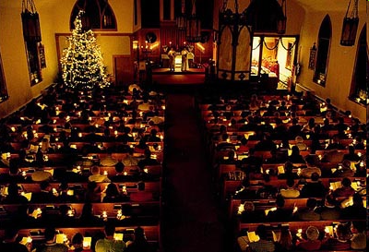
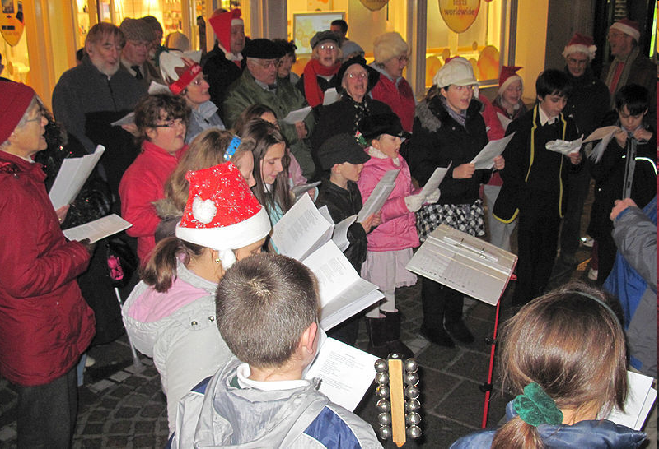
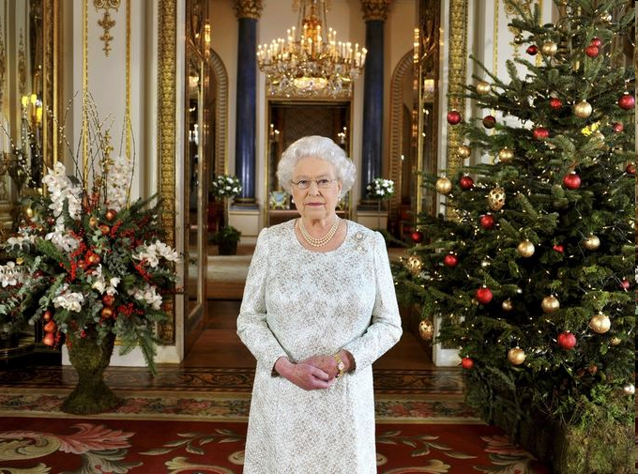
Church Service
Queen's Speech
on television – the Queen's message to the citizens of the UK.
Carols – Christmas
Hymns
(often singing to collect
money for charity)

Slide 21
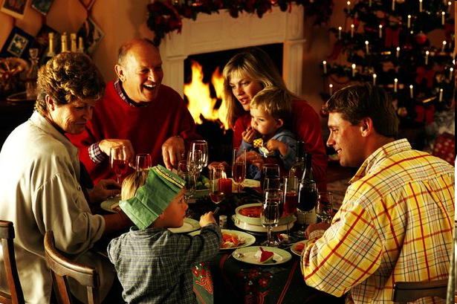
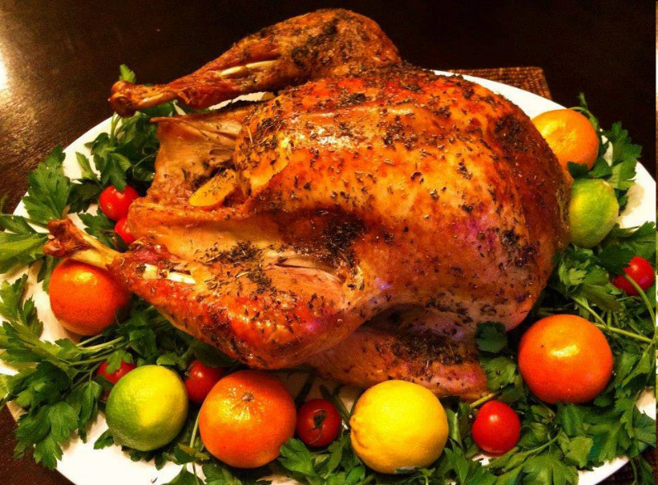
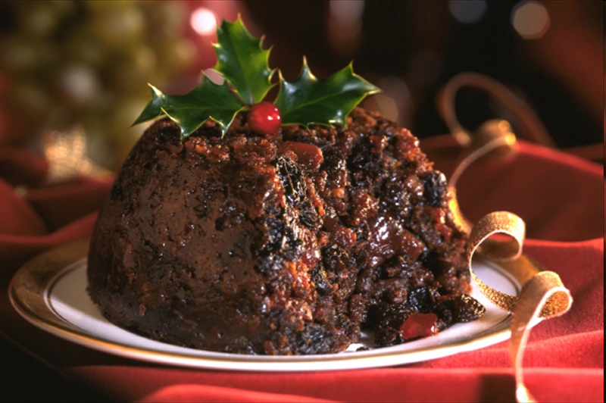
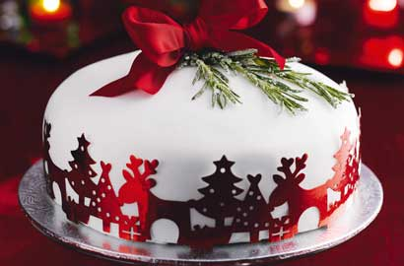
Christmas Dinner with traditional Christmas dishes…
…roast turkey
… Christmas cake
…Christmas
pudding

Slide 22
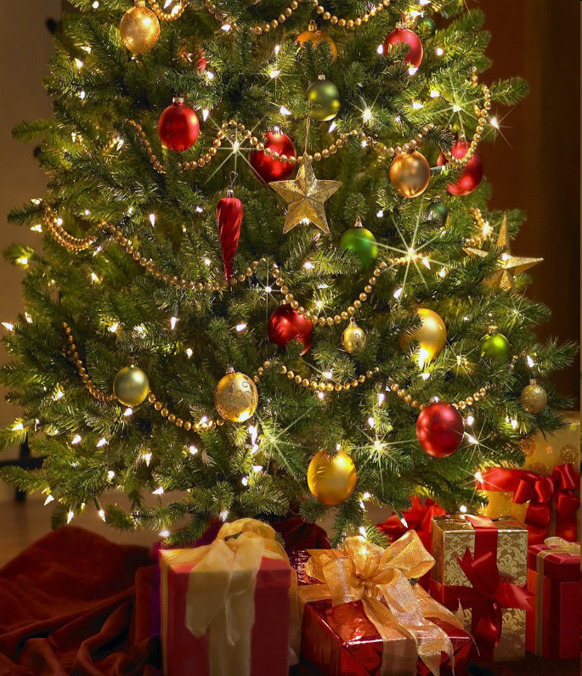
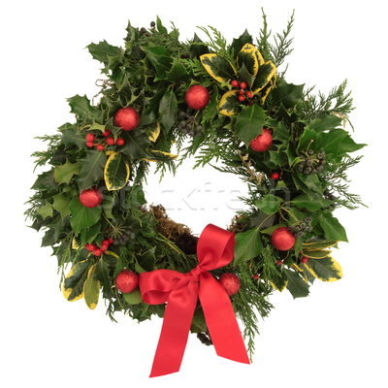
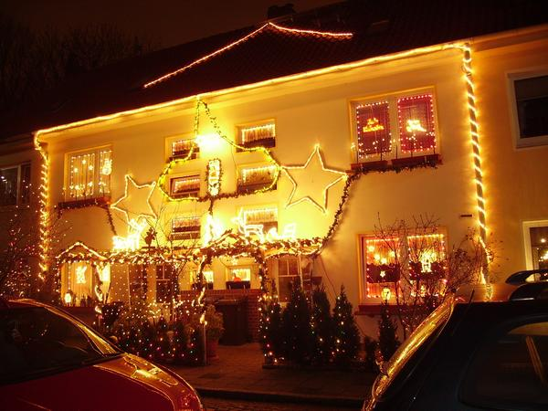
a Fir Tree (Christmas Tree)
decorated with colored balls and lights.
You can find the presents under the tree.
Christmas Holly (Mistletoe)
Wreath
Outdoor Christmas Decorations

Slide 23
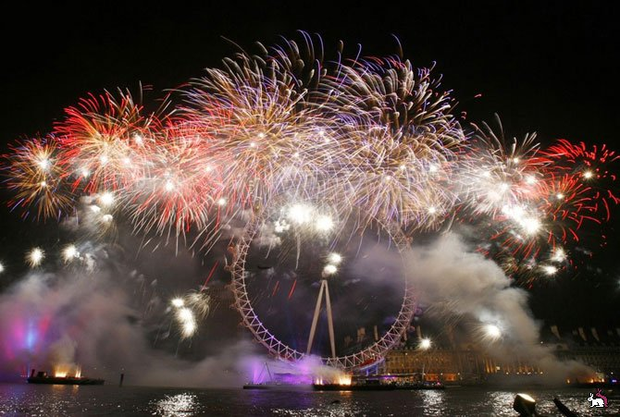
1. There is a lot of dancing, eating and fireworks. Before the holiday people write the «resolutions» (the list of the things should be made next year). On this day people usually visit their friends.
In Scotland they bring a piece of coal for good luck.
Happy New Year!

Slide 24
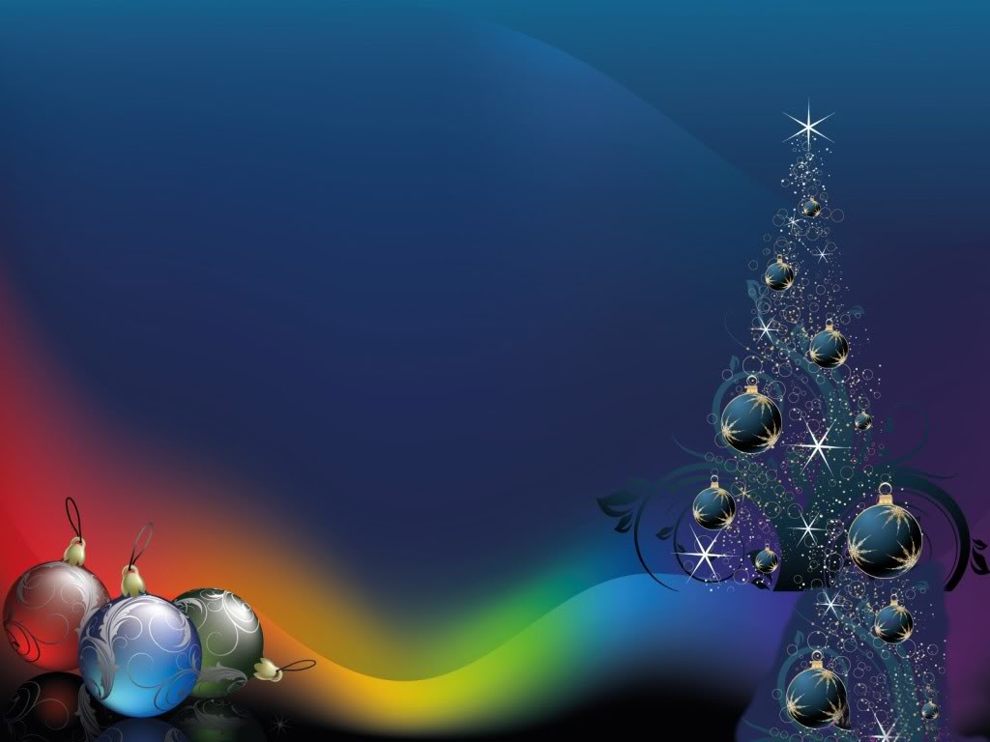
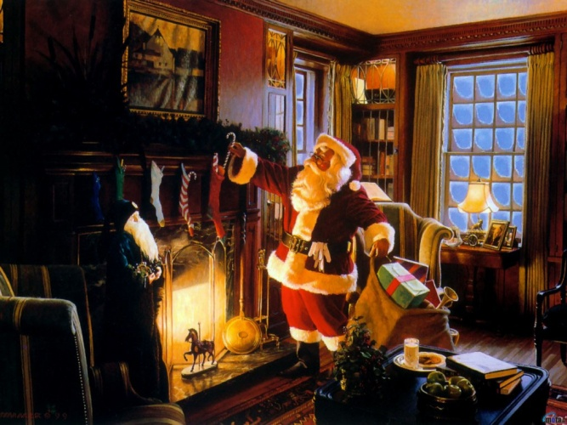
2. For more British families, this holiday is the most important festival of the year. It combines the celebration the birth of Christ and the traditional festivities of winter. On the Sunday before churches hold carol services. Carol singers can be heard on the street as they collect money for charity. People decorate their houses with a holly wreath and put a fir tree. Children find presents in their stockings.
We are glad and very gay.
We all dance and sing and say:
«Merry, merry, Christmas\New Year's Day!»

Slide 25
Five little pumpkins sitting on a gate.
3. This holiday means «holy evening». At parties people dress up in strange costumes and pretend they are witches. People make up lamps of pumpkins and other vegetables.
Some children dress in white sheets, knock on doors and ask if you would like a «trick or treat». If you give them some money or some sweets, a «treat», they go away. If not, they play a «trick» on you, such as making a lot of noise or splashing water in your face!
The first one said:
«It’s getting late! »

Slide 26
4. Christians celebrate the resurrection of Jesus Christ. This holiday is celebrated on the first Sunday after the first full moon in spring. That’s why it’s on a different date each year.
People dye eggs in various colours. Bunnies, chicks, lambs and flowers are associated with it because they are born in the spring.
Egg rolling game is very popular in Wales.

Slide 27
Thank you
for your attention.
Good Luck!

