Slide 1
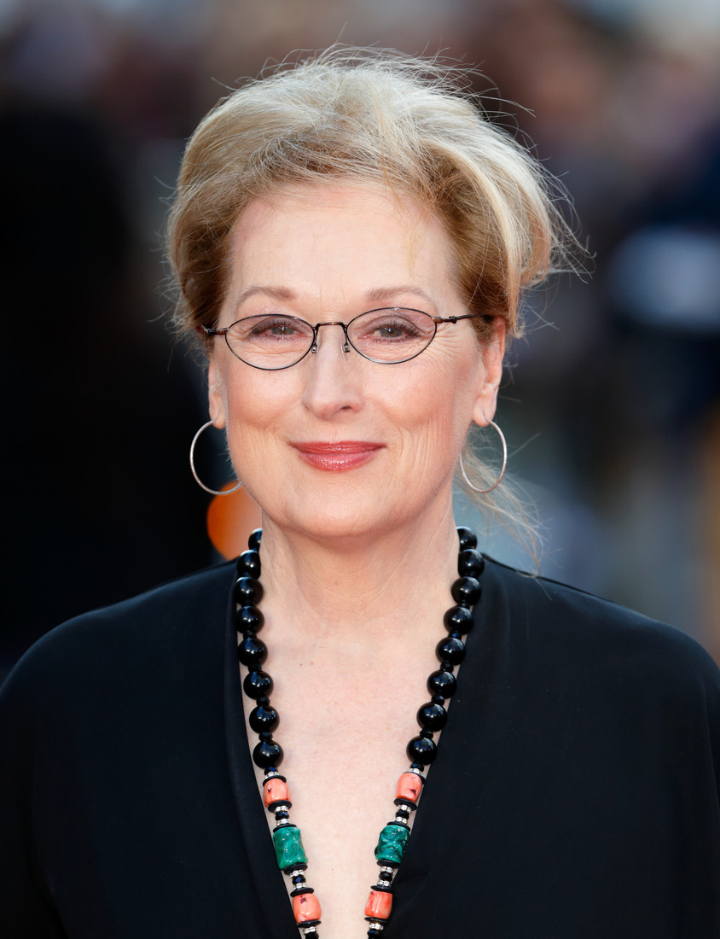

Slide 2
10 rules for success from Hollywood star Meryl Streeps
Work hard
Express yourself
Find your drive
Be empathetic
Learn from challenging times

Slide 3
10 rules for success from Hollywood star Meryl Streeps
6. Be your realself
7. Find your passion
8. Immerse yourself in your work
9. Live a zenlife
10. Have fun

Slide 4
10 rules for success from Hollywood star Jim Carrey
1. Visualize your success
2. See challenges as beneficial
3. Be a creator
4. Compromise
5. Don’t let fear hold your back

Slide 5
10 rules for success from Hollywood star Jim Carrey
6. Believe
7. Have intention
8. Take a chance on doing what you love
9. Risk being yourself
10. Follow your passion

