Slide 1

9 класс unit 4
Family Matters
УМК авт. Афанасьева О.В., Михеева И.В.

Slide 2




How are you feeling today?

Slide 3



Slide 4
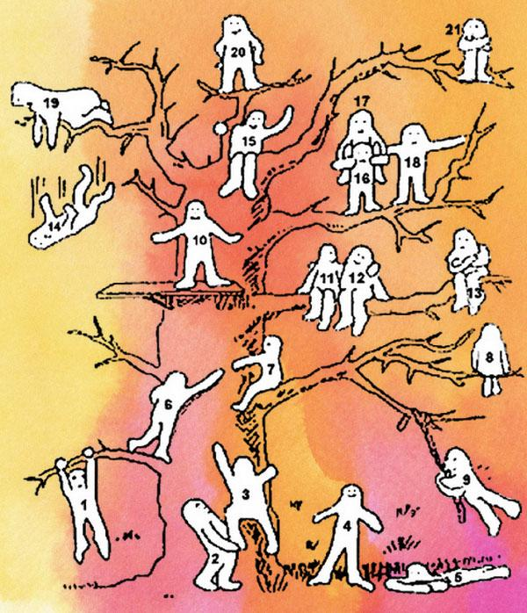

Slide 5
Task: Read the text
“One’s Difficult Son”

Slide 6
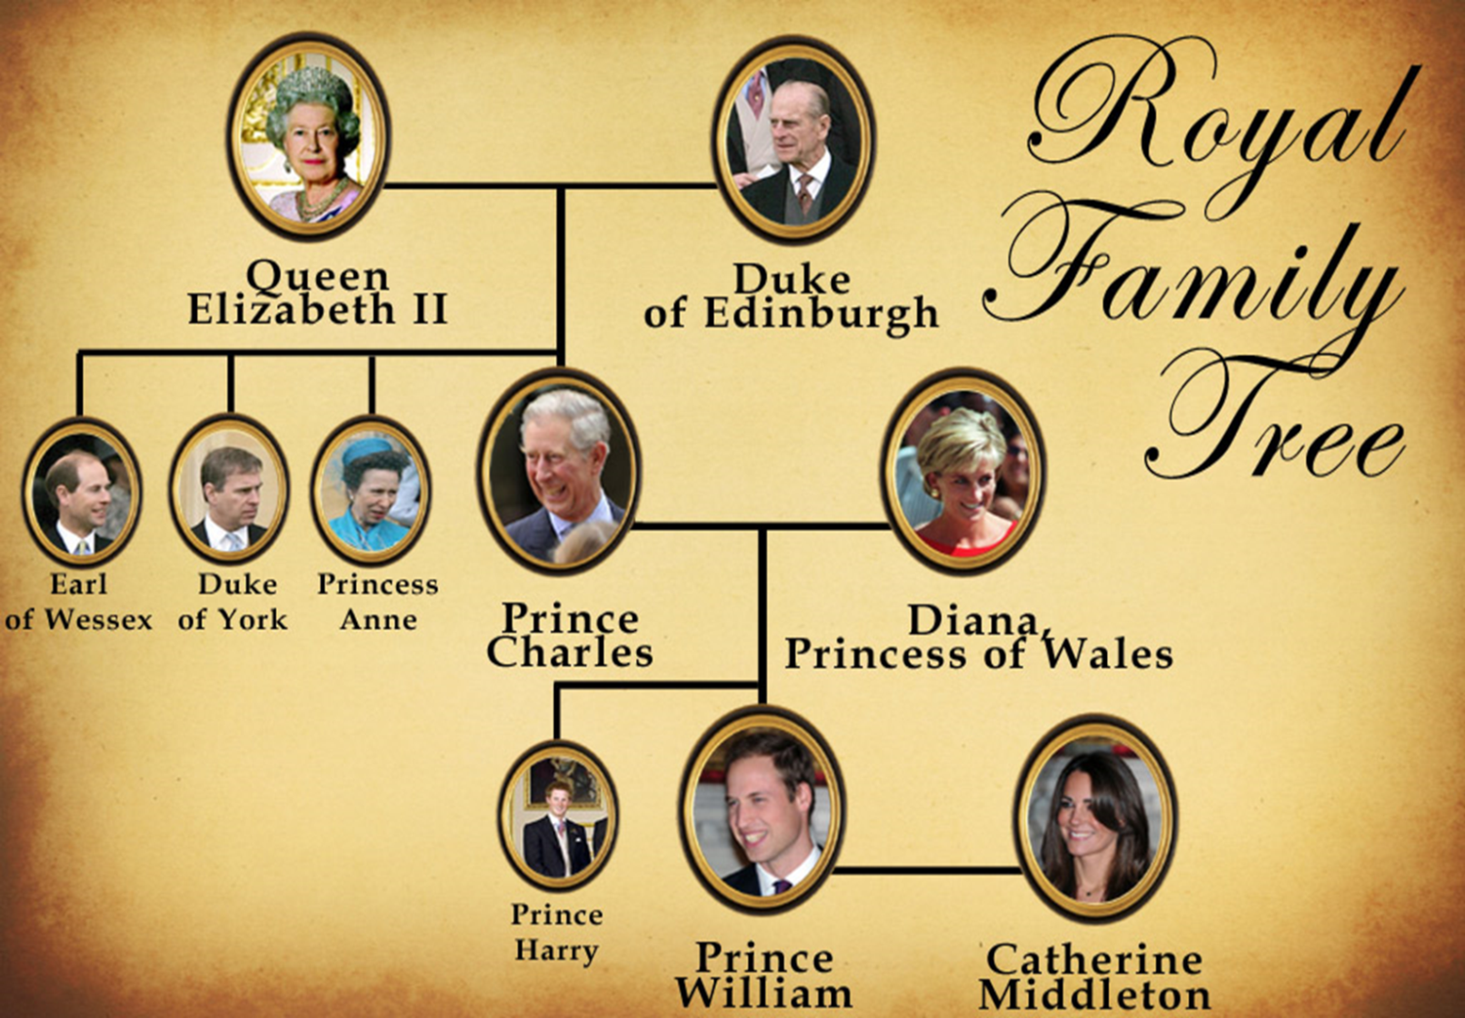

“The Queen finds Prince Charles difficult and is annoyed with his…

Slide 7
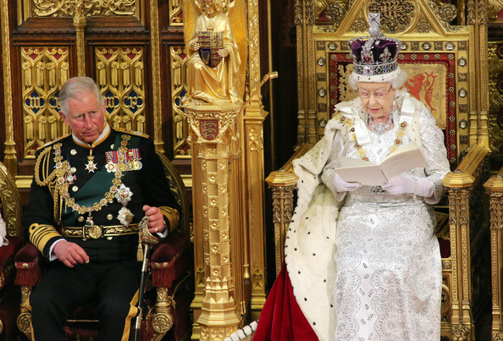
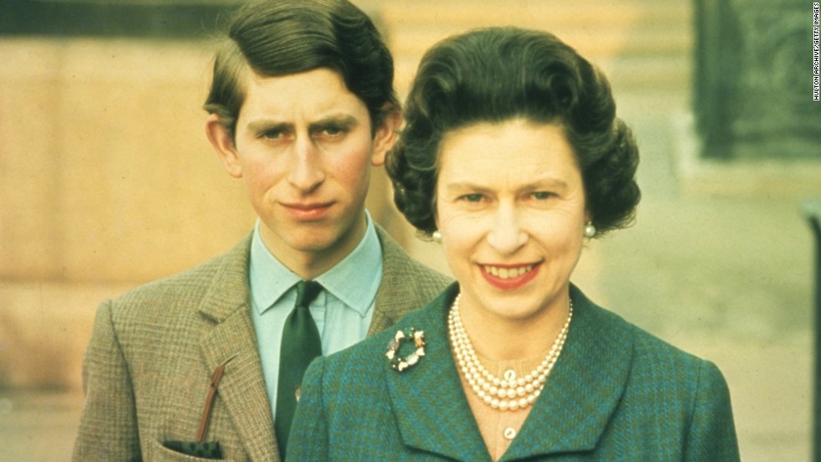
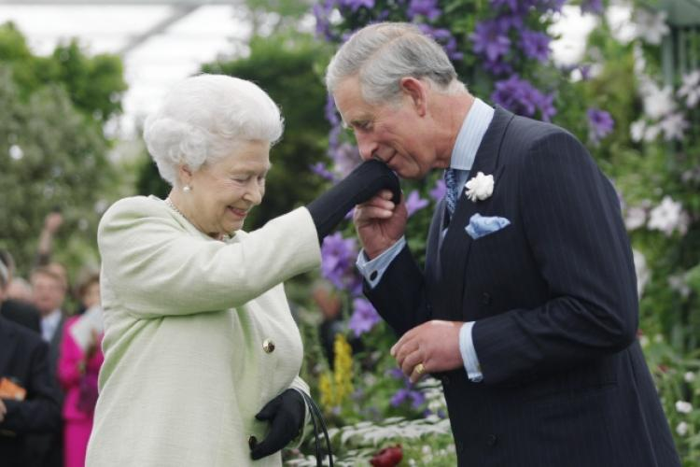
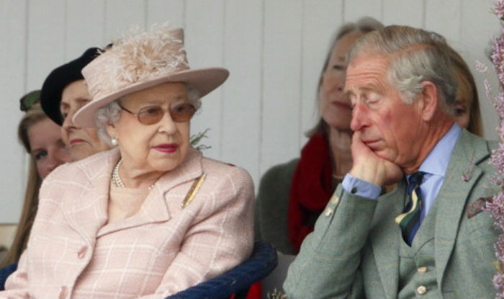
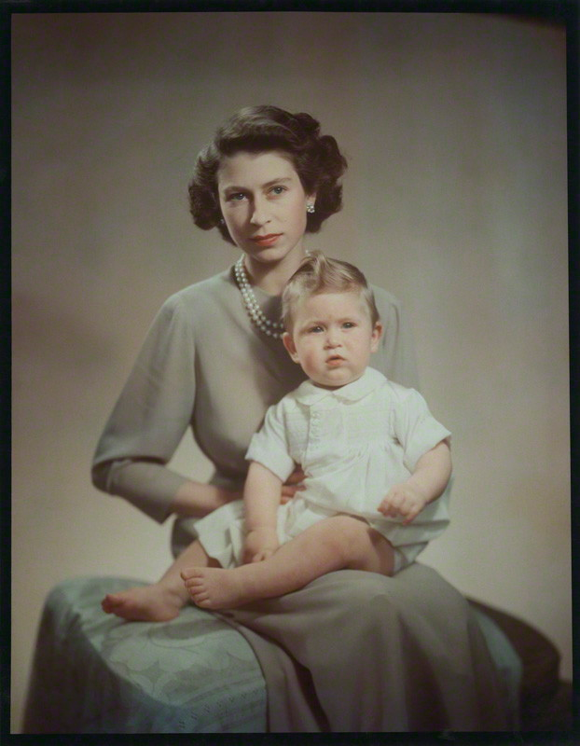
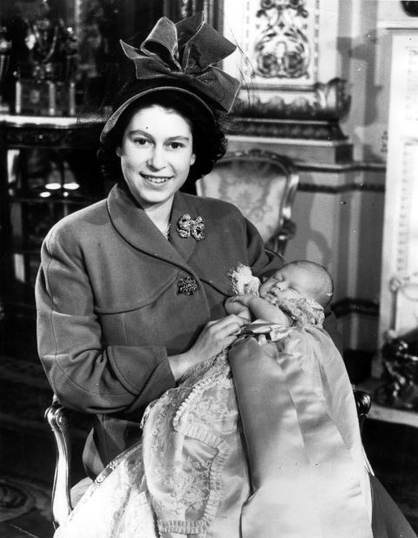
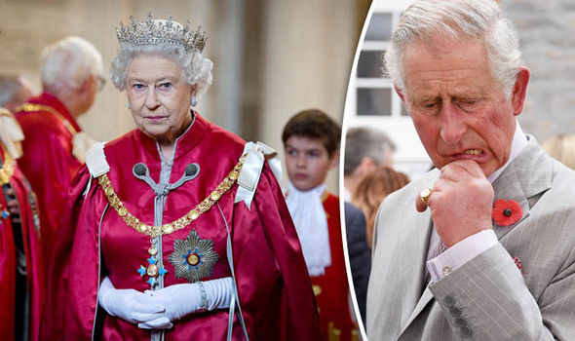
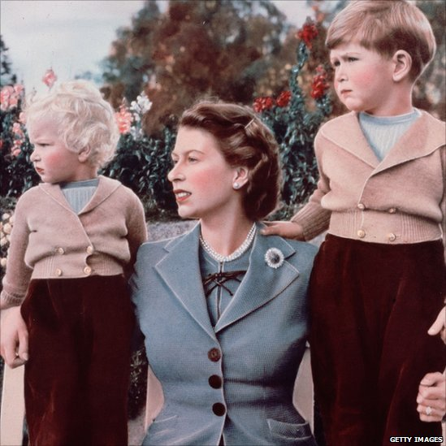

Slide 8

Queen
Queen
Prince
Charles
both
uncaring
sense of duty
employs servants
unhappy
extravagant
charity work
hard-working
aloof
generation gap
romantic
economical

Slide 9

расточительный
Extravagant
=
экстравагантный
экономный
Economical
экономический

Slide 10
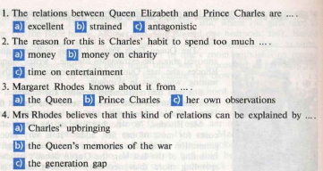


Slide 11
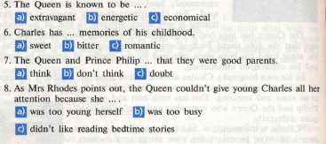

Slide 12
Red
emotions, feelings
White
facts
Black
negative information
Blue
conclusion
Hats
of thinking
Green
where and how you can use this information
Yellow
positive information

Slide 13

Emotions, feelings
What do you feel when you read about tense relationship between Prince Charles and his mother?
Do you sympathize with the people who had to live during the war?
What are your emotions when you read about the Queen’s habit to go round Buckingham Palace turning the lights off?
4. What do you feel when you read about the women who have to
juggle their job and family life?

Slide 14

Facts
What is this article about?
Who describes tense relationship between the Queen and her son?
Does she explain the reasons of their strained relationships? What are they?
Do Charles’s parents share his opinion of having unhappy childhood?

Slide 15

Negative information
Is it really bad to have strained relationship between children and parents even if it is a Royal family?
What is your attitude to wars? Do people suffer from them? Do wars influence people’s lifestyle greatly?
What do children feel when their parents are aloof and uncaring or even bullying towards them?
Who usually suffers in families where parents have a very strong sense of duty or have to work long hours?

Slide 16

Positive information
What do you think are the benefits (advantages) of belonging to the Royal Family?
Do you agree that to be economical is good for both the poor and rich?
Is it important for the country to have a monarch with a strong sense of duty who puts the country before the family?
Queen Elizabeth II is really a wonderful woman and a unique monarch, isn’t she?

Slide 17


1.What are the relations between you and your parents? Are they always good or not? What are the reasons? Whose fault is it? What should be done to improve them?
2. Can you give any examples from literature of “generation gap”?

Slide 18

Conclusion
What is the main idea of this text?
Make a conclusion.

Slide 20
H/W
Write an essay “My Relationships with my Parents”
What are the relations between you and your parents? Are they always good or not? What are the reasons? Whose fault is it? What should be done to improve them?

Slide 21
Thank you!

Slide 22
Источники
https://yandex.ru/images/search?clid=2005239&win=69&text=family%20matters&p=2&pos=60&rpt=simage&img_url=https%3A%2F%2Fimg-ipad.lisisoft.com%2Fimgmic%2F2%2F7%2F2735-1-family-matters-from-ellarum.jpg
https://yandex.ru/images/search?clid=2005239&win=69&text=%D0%B4%D0%B5%D1%80%D0%B5%D0%B2%D0%BE%20%D1%81%20%D1%87%D0%B5%D0%BB%D0%BE%D0%B2%D0%B5%D1%87%D0%BA%D0%B0%D0%BC%D0%B8%20%D0%B4%D0%BB%D1%8F%20%D1%80%D0%B5%D1%84%D0%BB%D0%B5%D0%BA%D1%81%D0%B8%D0%B8&p=2&pos=61&rpt=simage&img_url=https%3A%2F%2Favatars.mds.yandex.net%2Fget-pdb%2F966350%2F6f5b60b0-24d8-4f81-9b1c-851ae8897f65%2Fs1200%3Fwebp%3Dfalse
https://yandex.ru/images/search?text=the%20royal%20family%20tree&pos=318&p=10&img_url=https%3A%2F%2Fi.pinimg.com%2F236x%2Fe8%2Fc8%2F0f%2Fe8c80fbb72659dc2d53764c104f12200--family-trees-royal-families.jpg&rpt=simage

