Slide 1
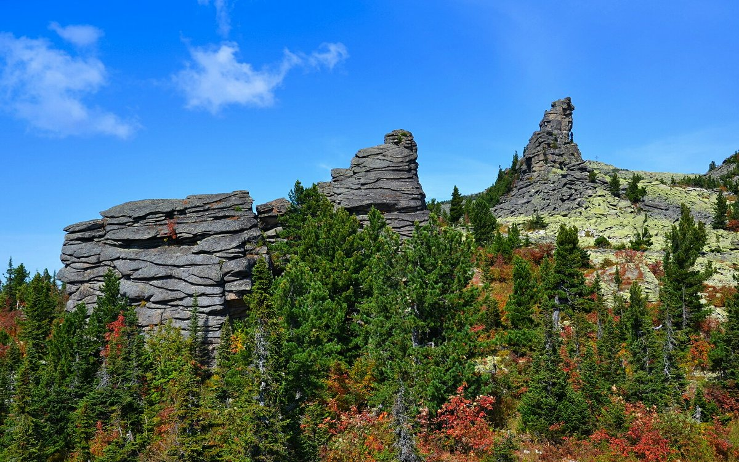
Путешествие по Кузбассу

Slide 2
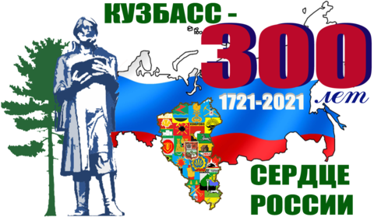

Slide 3
Кузнецкая наша земля
Богата родная Россия,
Но прямо скажу без прикрас,
Что края любого красивей
Наш юный, могучий Кузбасс.
И сталью, и углем богата
Родная сторонка моя.
Любимая, как хороша ты,
Кузнецкая наша земля!!!

Slide 4

Kuzbass is a subject of the Russian Federation, part of the Siberian Federal district.
The area of the region is 95 725 km2; according to this indicator, the region ranks 34th in the country.

Slide 5
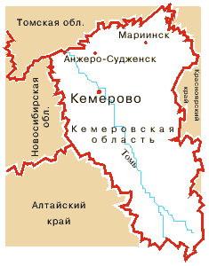
The territory of modern Kuzbass was inhabited several thousand years ago. In 1618, in the South of the future region was founded Kuznetsky Ostrog to protect Russian lands from the Mongol and Dzungarian invaders, in 1698 — Mariinsk — is the oldest settlements of the Kemerovo region. In 1721 Mikhailo Volkov found on the shore Tom "burnt mountain" (burning coal seam), thereby becoming a pioneer of Kuznetsk coal.

Slide 6
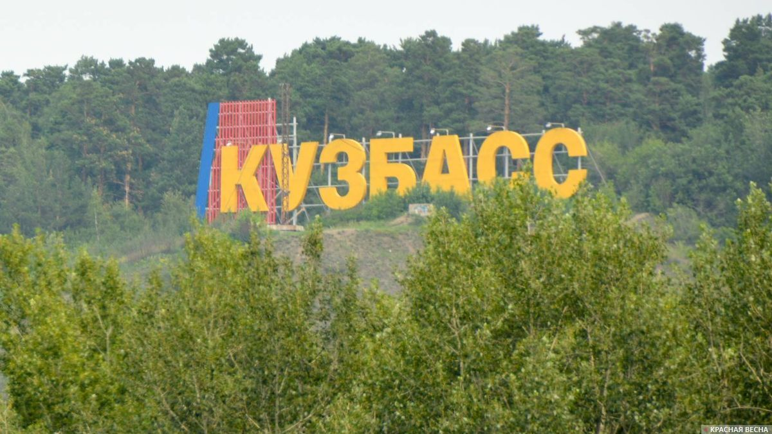
A notable development in the region is at the end of the XVIII century were constructed the Kolyvan—Voskresensk plants A. N. Demidov, who later became the property of the Imperial house of the Romanovs — this time a large part of the Kuzbass included in the Altai mountain district, was in charge of the Cabinet of His Imperial Majesty.

Slide 7
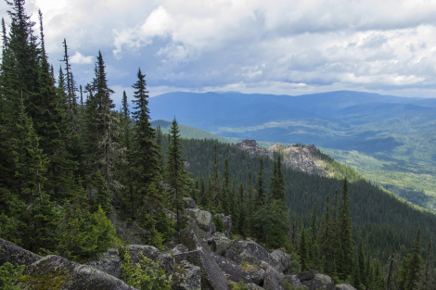
During the XIX century the territory of the modern region was part of the Tomsk province — Kuznetsk and Mariinsky counties. In this period appeared the first industrial enterprise: iron-making Tomsk, Gavrilovsky and silver-Gur factories, Sharansky and the Salair mountain mines. In connection with the construction of the TRANS-Siberian railway Kuzbass industry has received rapid development.

Slide 8
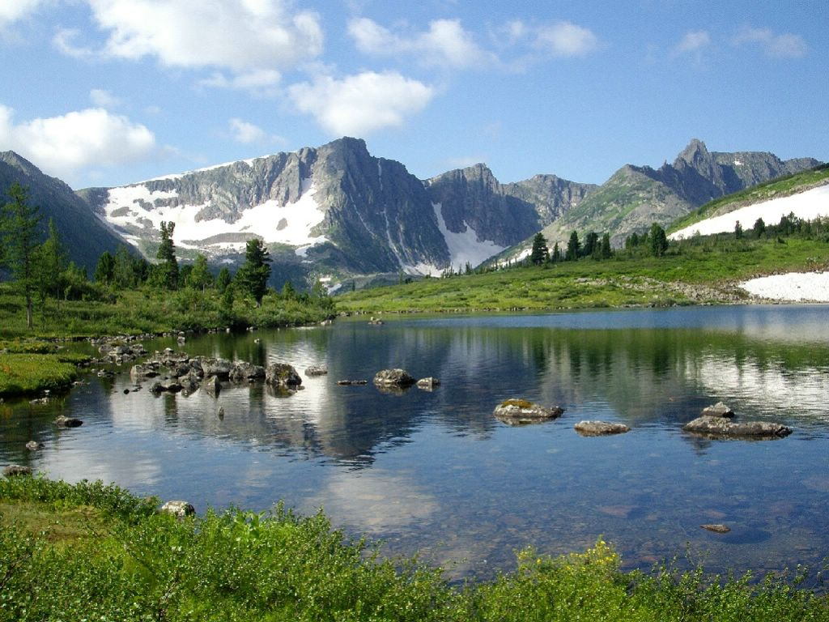
In 1943, the Presidium of the Supreme Soviet of the USSR decree of 26 January adopted a decision on allocation from the Novosibirsk region of Kuzbass and the establishment on its territory of the Kemerovo region with the administrative center in the city of Kemerovo. The population of Kemerovo region was 42 % of the total population of Novosibirsk region.

Slide 9
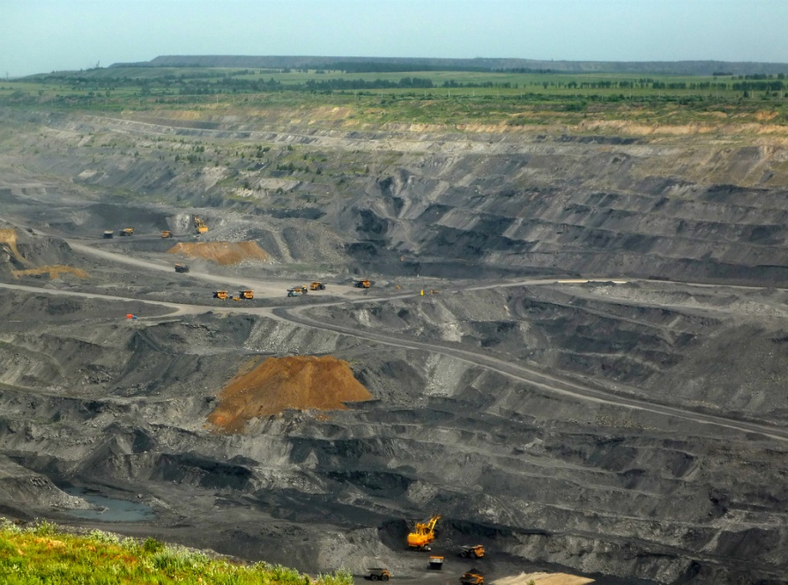
The coal industry is developed in the region, its most important centers are Prokopyevsk, Mezhdurechensk, Belovo, Berezovsky, Kemerovo, Novokuznetsk, Osinniki, Leninsk-Kuznetsky, Novokuznetsk and Prokopevsky districts. Mines and sections are located mainly in the Central part of the region. Metallurgy and mining are also developed in the South of the region. Also in the region there are mechanical engineering and chemical industry. Well-developed rail transport and combined heat and power .

Slide 10
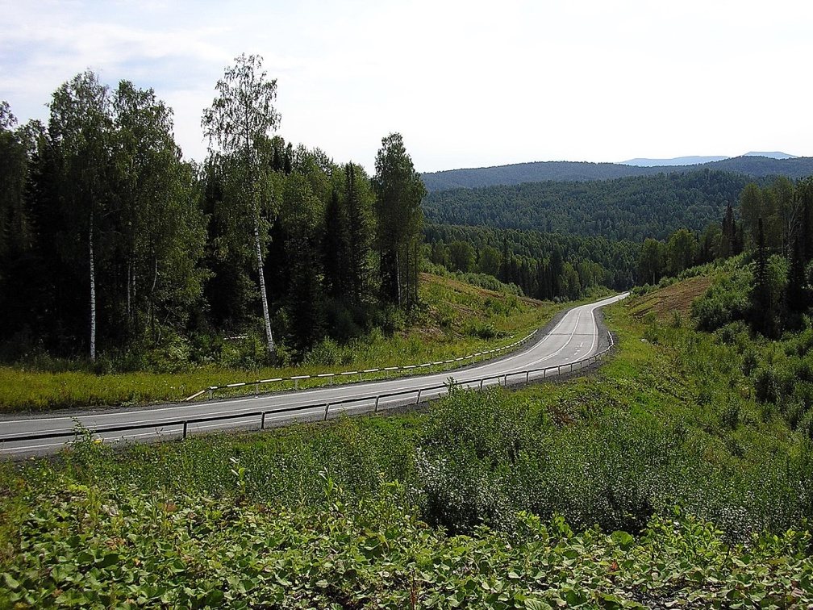
Kemerovo region is located in the South-East of Western Siberia, occupying the spurs of Altai and Sayan. A large difference in surface heights determines the diversity of natural conditions. The highest point — Golets Upper Tooth on the border with the Republic of Khakassia — rises to 2178 m, the lowest — 78 meters above sea level — lies in the valley of the Tom River on the border with the Tomsk region.

Slide 11
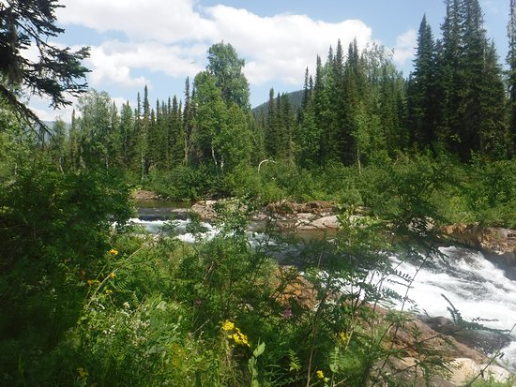
The vegetation is very diverse. Forests cover 63.9 thousand km2, which is 67 % of the total territory. Of the large animals live elk and maral. The most typical prey of brown bear, lynx, Wolverine. Of commercial importance are the squirrel, muskrat, birds — capercaillie, hazel grouse, black grouse.

Slide 12
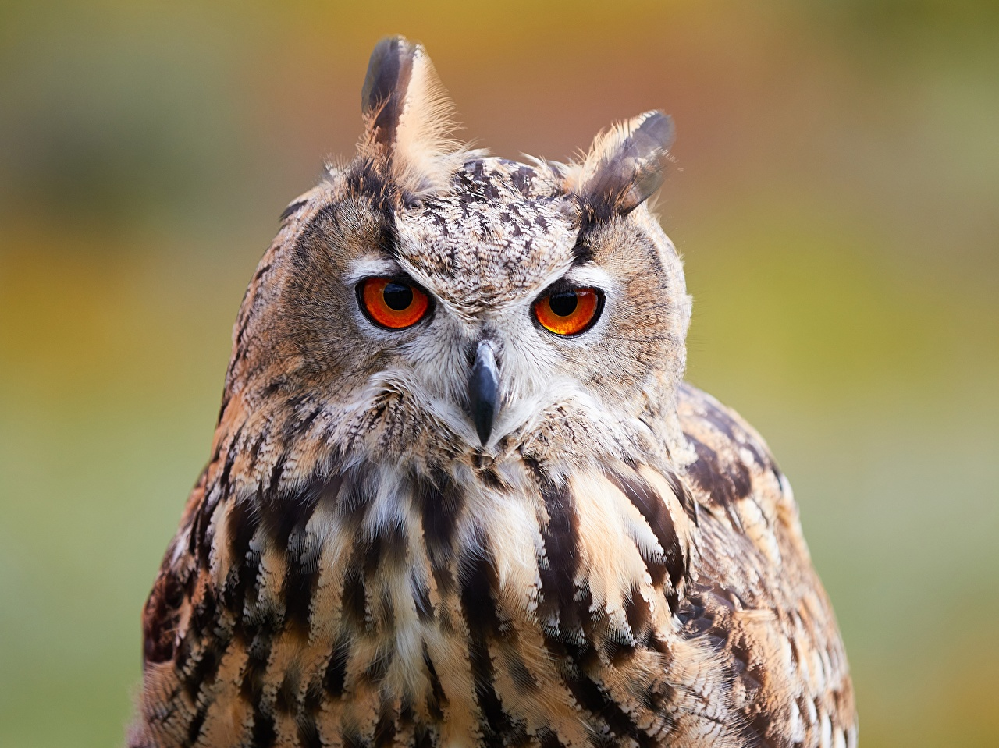
Tomskaya Pisanitsa

Slide 13
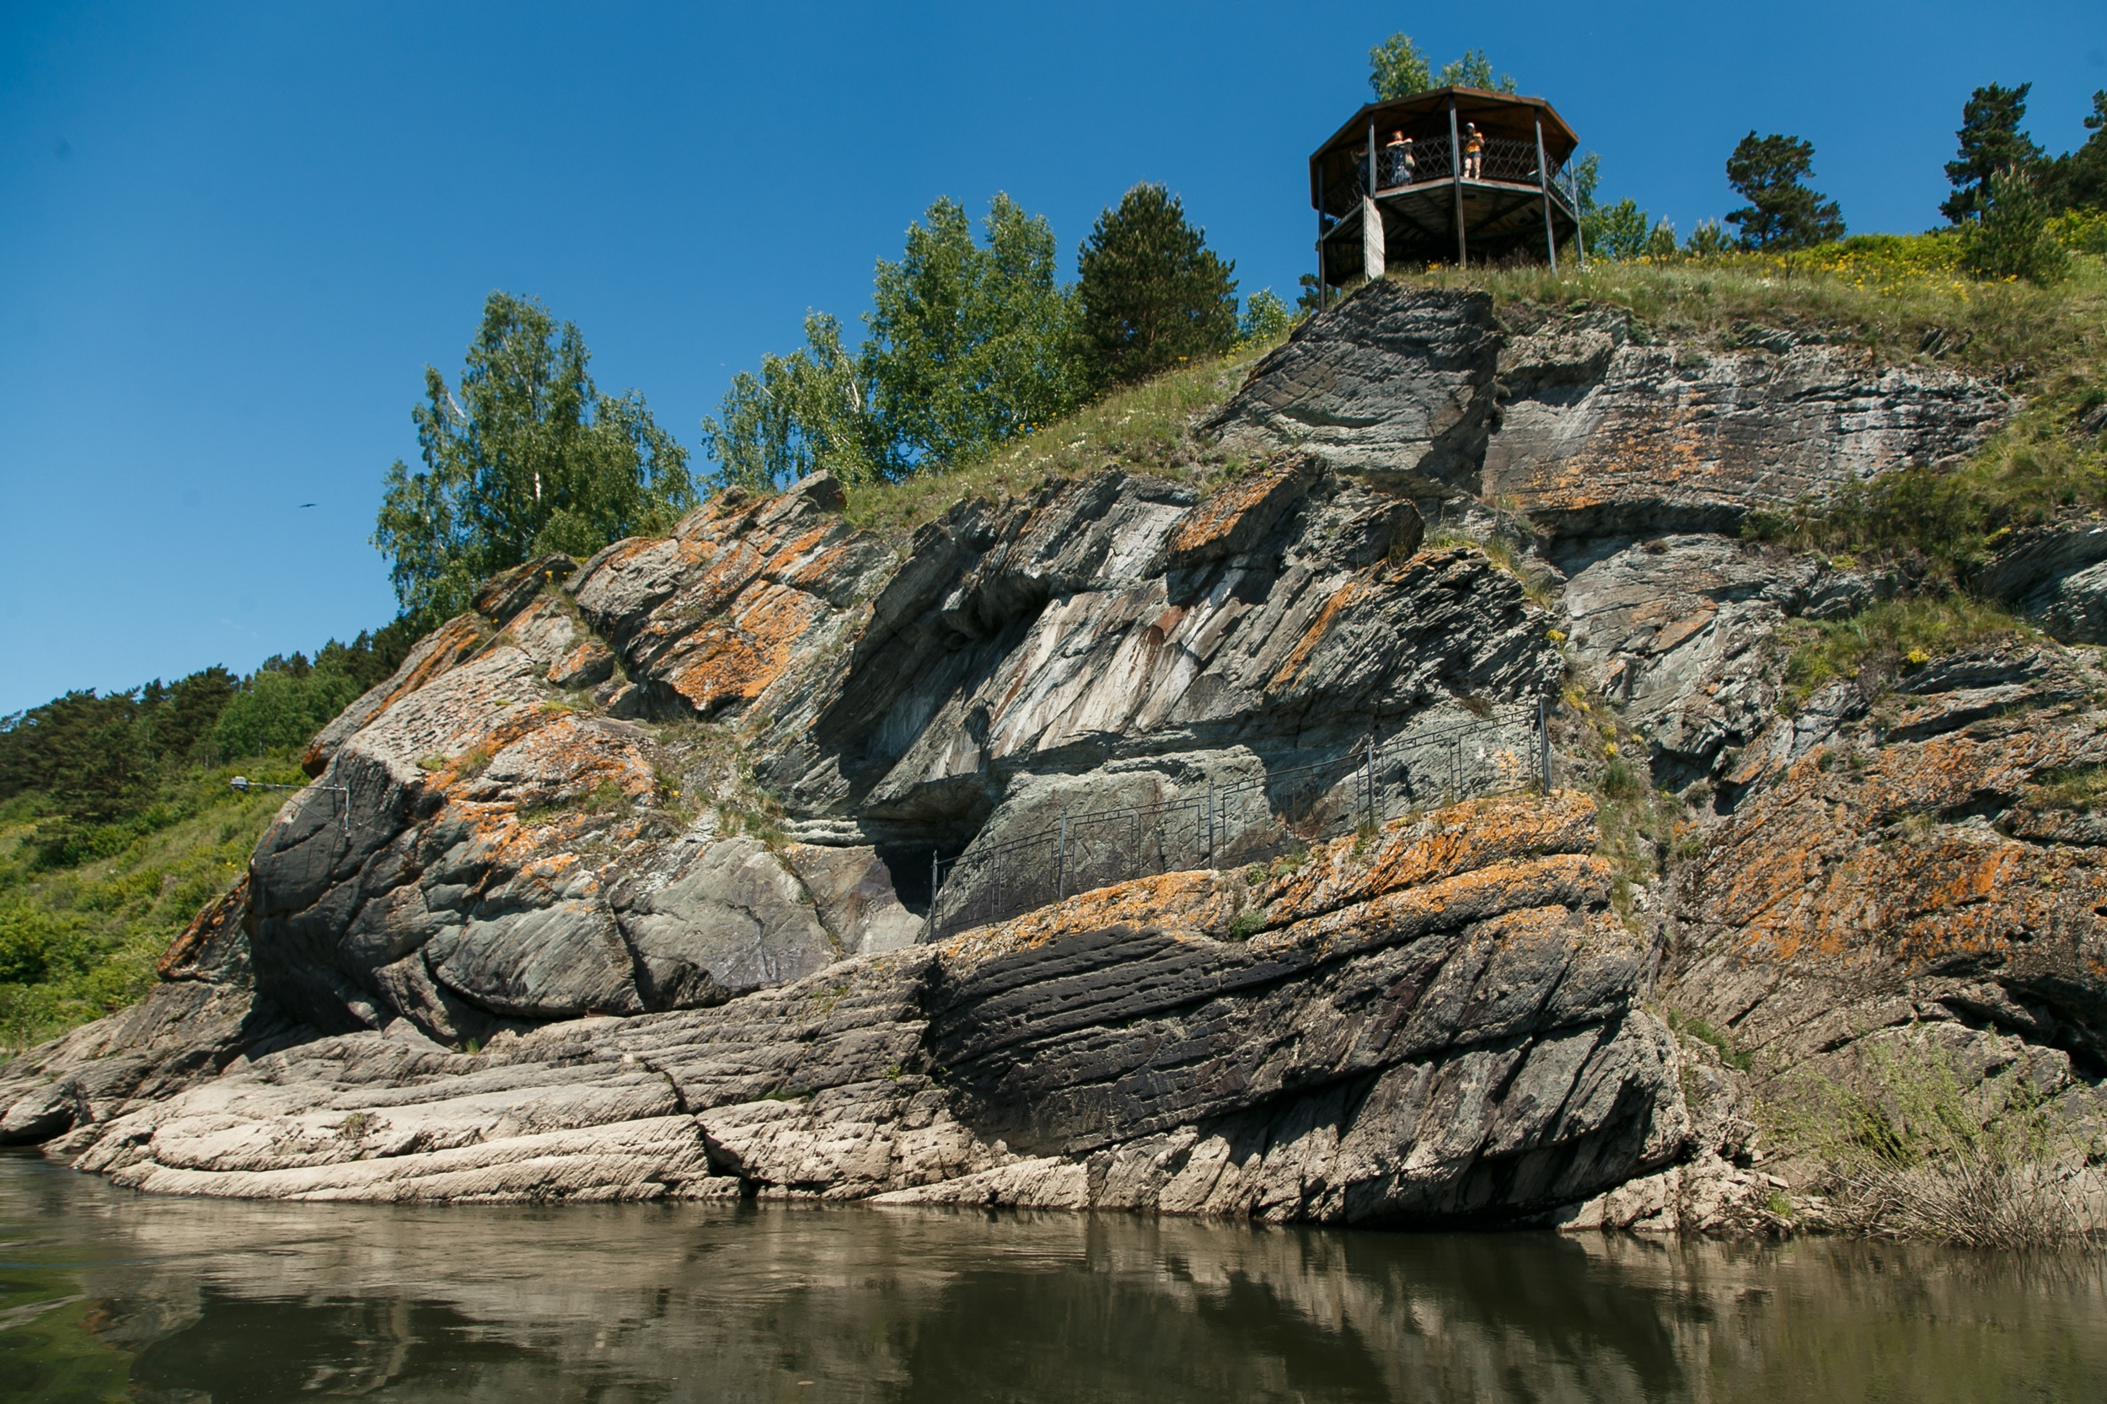
A bit of history…
Information about the existence of rocks with unique drawings of ancient people are found in the notes of famous travelers from about the middle of the XVI century.
In Soviet times, the study of rock art was given great attention, but with fame came the threat of destruction of rocks at the hands of vandals, so there was a need to protect the unique archaeological sites.

Slide 14
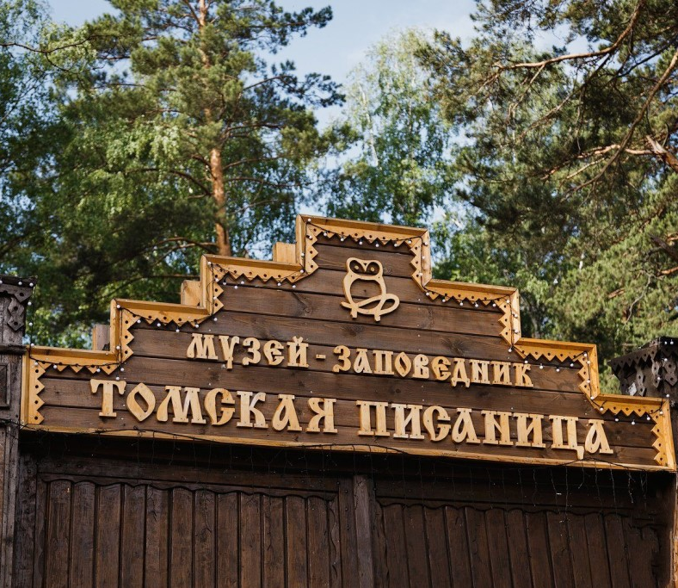
A bit of history…
Since 1968, the vicinity of Tomsk Pisanitsa became a protected area. In the 80-ies there was no doubt that the monument of primitive art will be an open-air Museum. By the end of the XX century Tomsk Pisanitsa became known not only in Russia but also abroad.
.

Slide 15
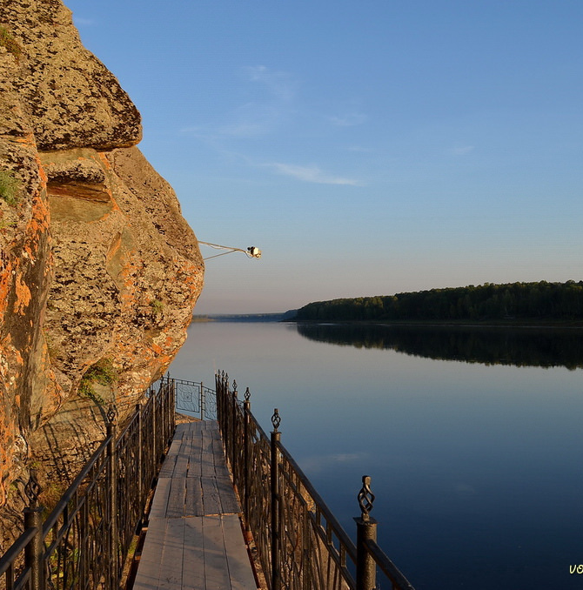
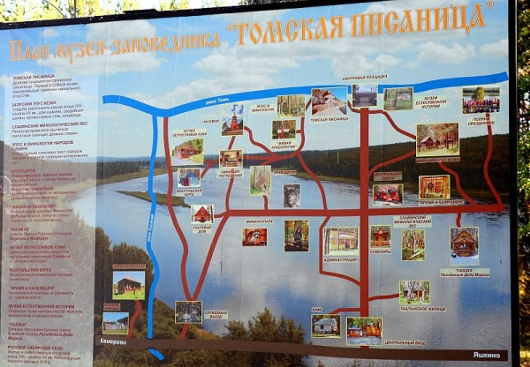
The exposition of the Museum
The main exposition complexes of the Tomsk Pisanitsa are conditionally divided into three thematic areas - ethnographic, archaeological and natural history.
In addition, the Residence of the Kuzbass Father frost begins its work in winter

Slide 16
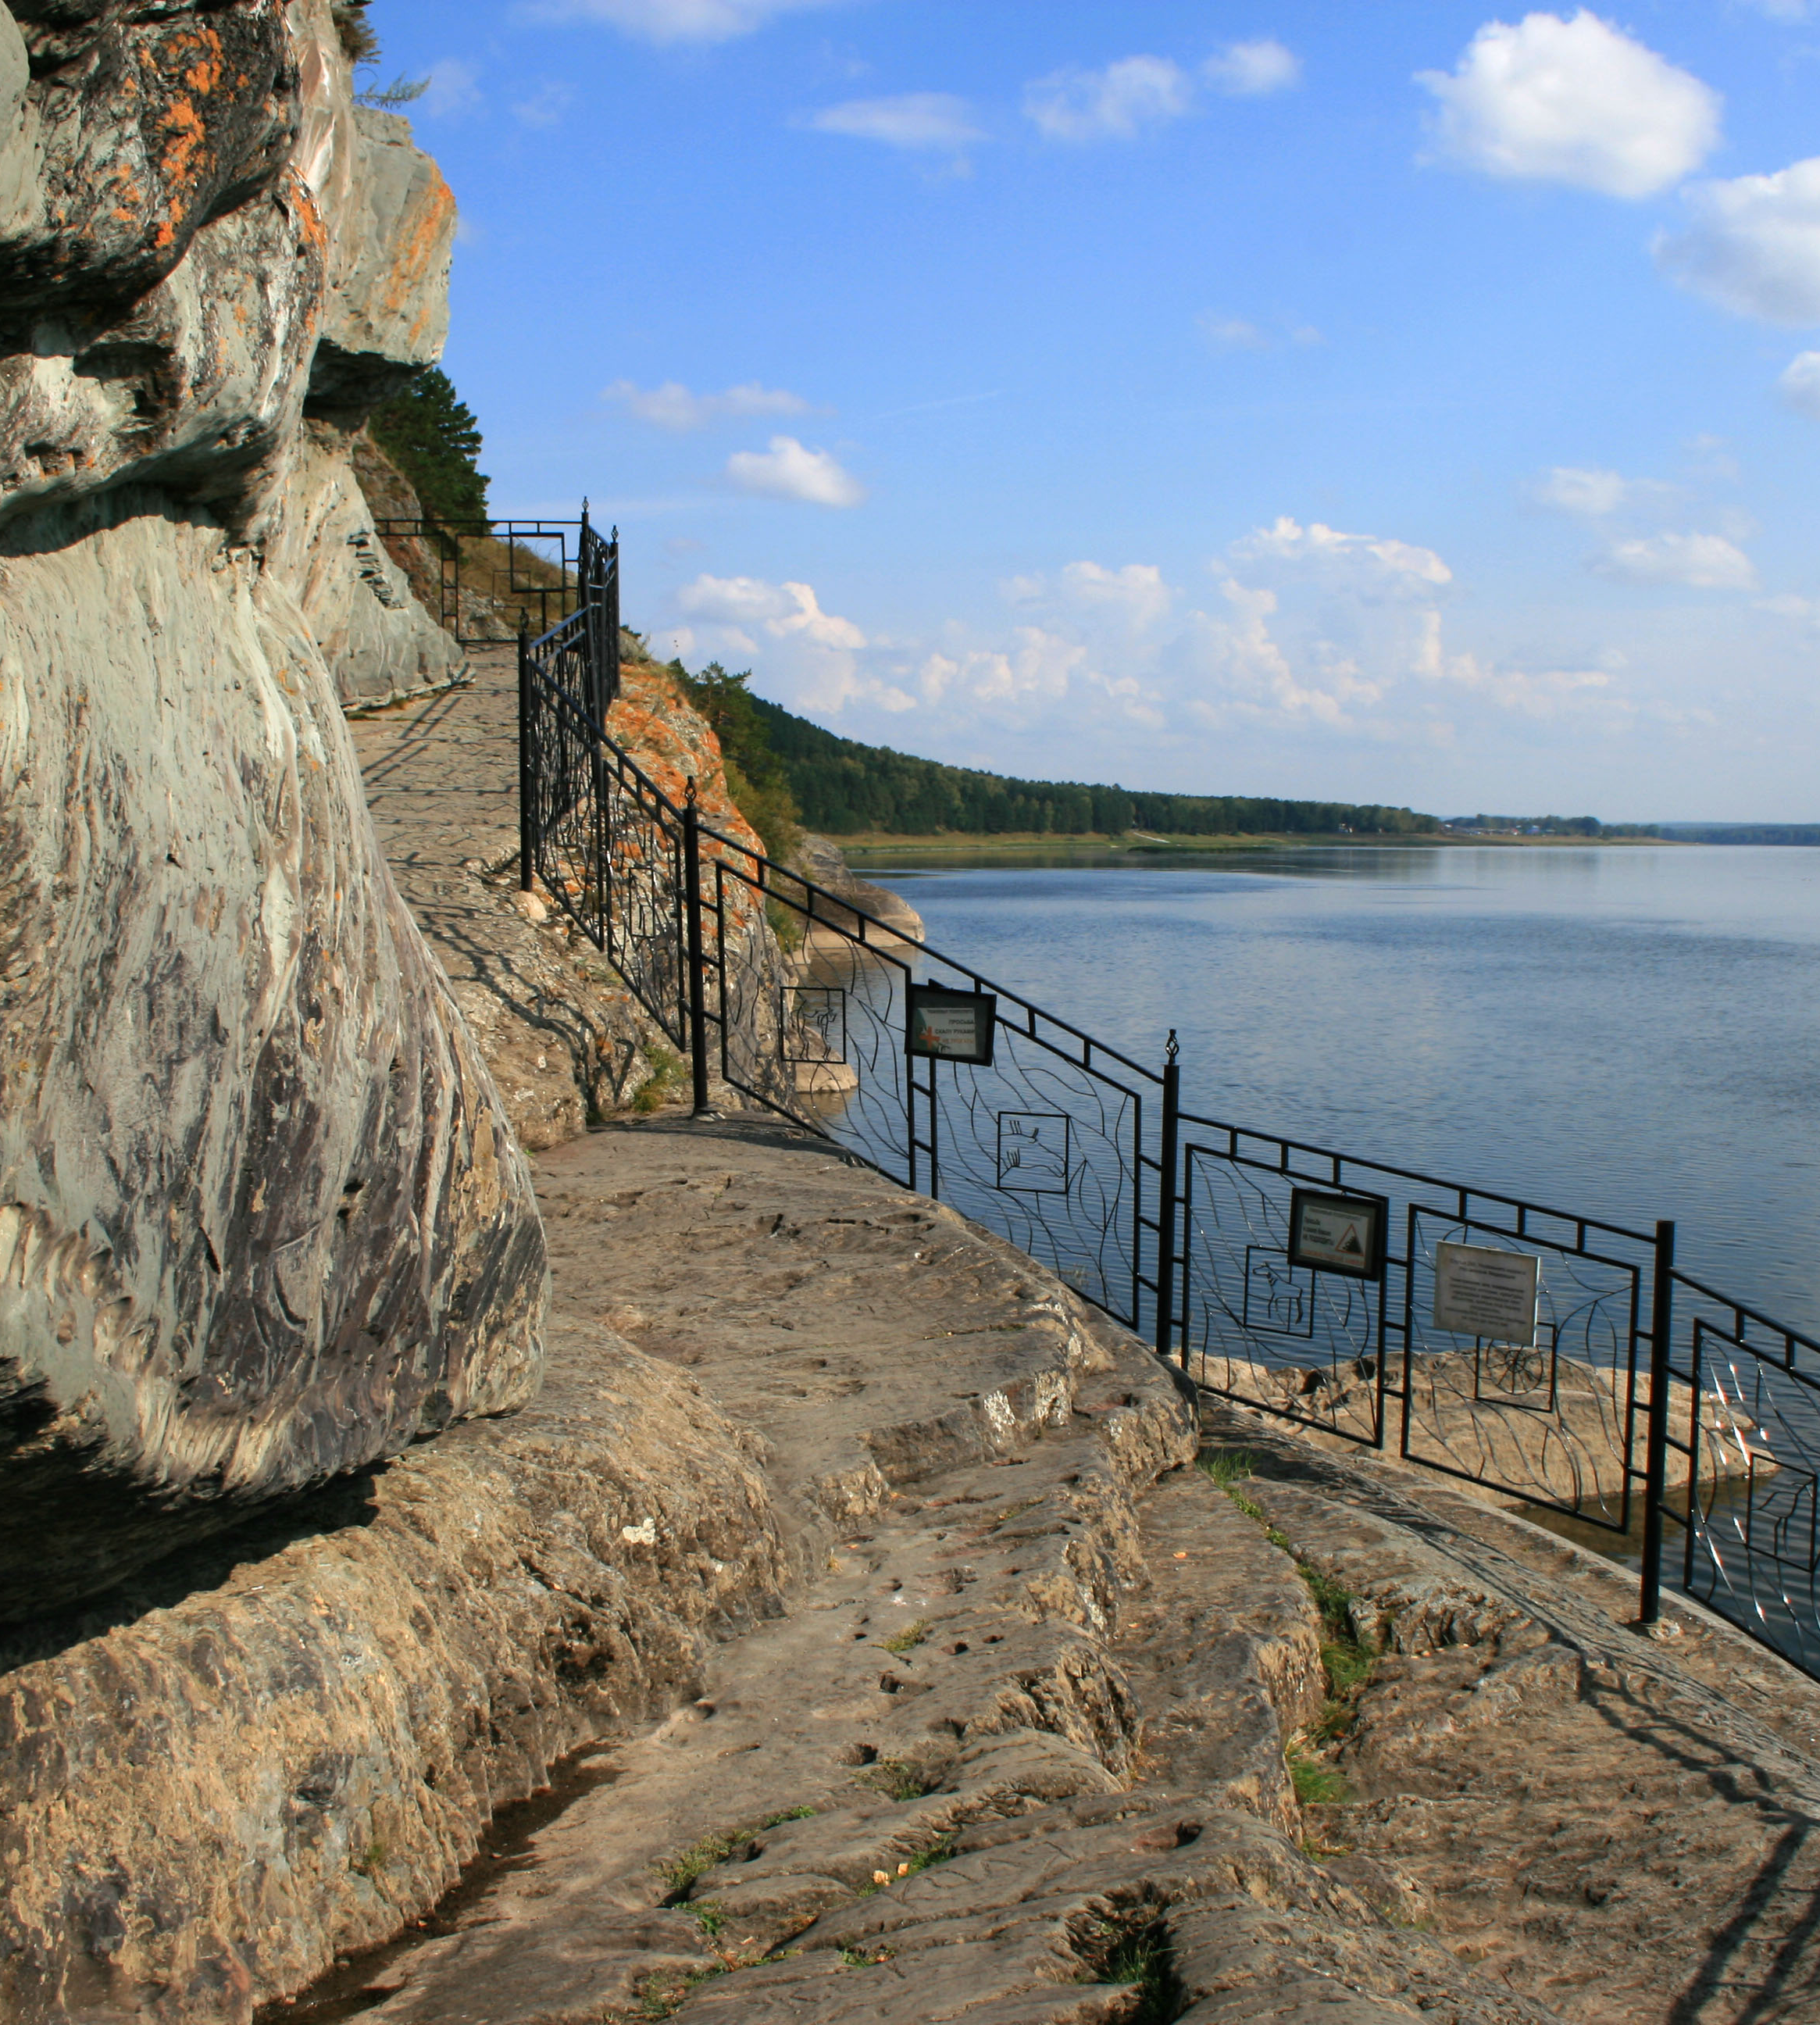
Permanent exhibitions of the Museum
To date, the Tomsk Pisanitsa operates 11 permanent exhibitions, which we will consider below.

Slide 17
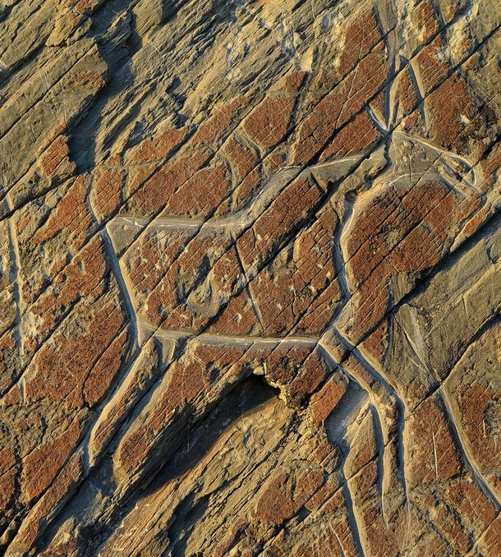
Ancient sanctuary
This is a large rock on which, as if on a stone canvas, drawings of the Neolithic and bronze age. Most often depicted moose, which hunted the first inhabitants of Siberia and worshipped them as deities. Many pictures of wolves, bears, foxes, birds - cranes, geese, owls.

Slide 18
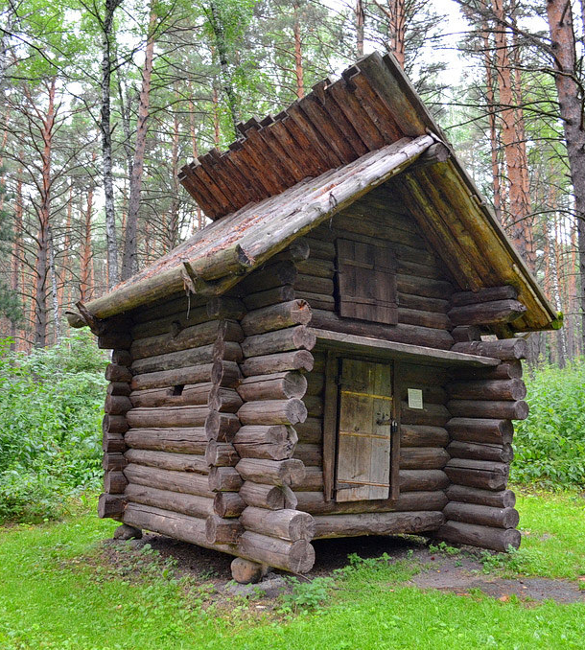
"Shor Ulus Kezek"
It is an architectural and ethnographic complex, which introduces the life of the shorians, the indigenous people of the Kemerovo region. Between the pines recreated a wide estate with buildings for housing, livestock, blacksmithing, as well as the structure of the bath and a hut for marriage ceremonies

Slide 19
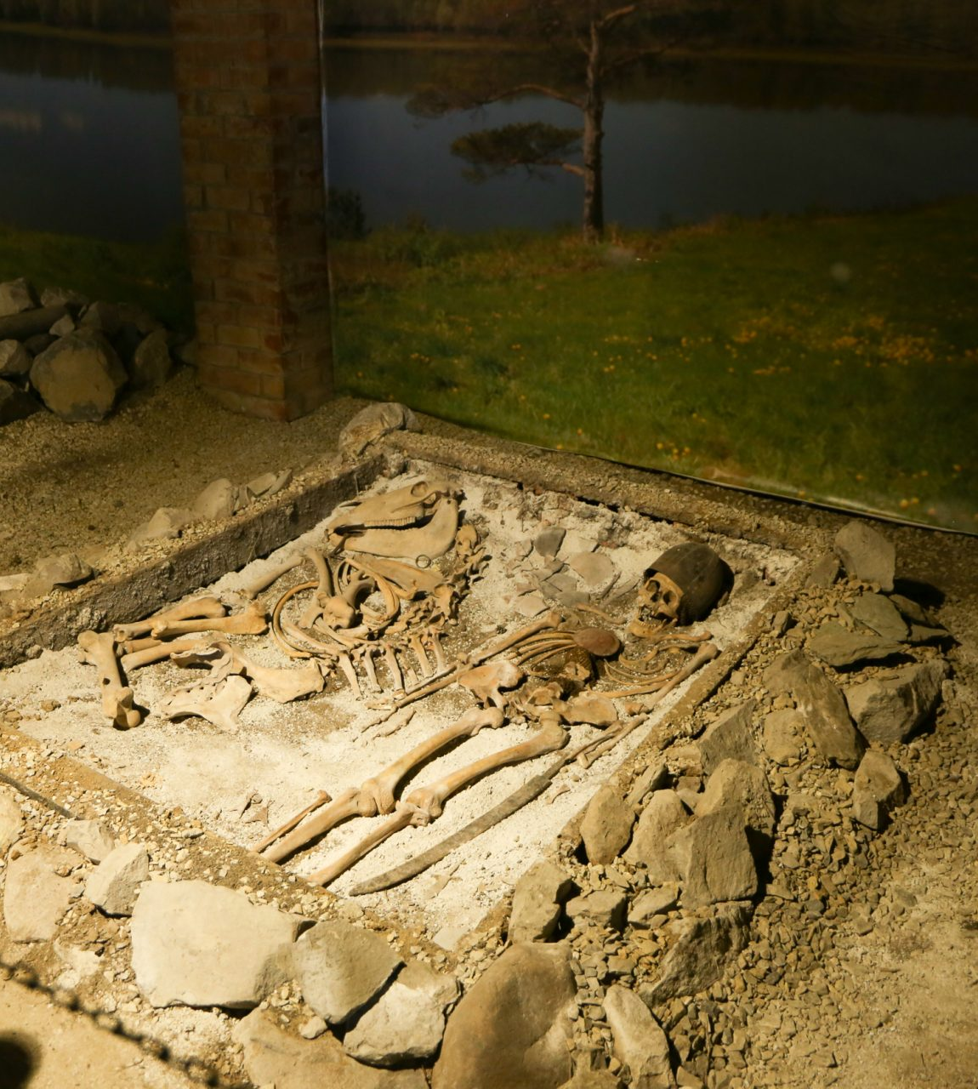
"Archeodrome"
Includes "ancient burial models Pavilion" and full-scale models of ancient dwellings. In the "Pavilion of models of ancient burials" you can learn about the funeral rites and spiritual representations of the peoples who lived on the territory of our region.

Slide 20
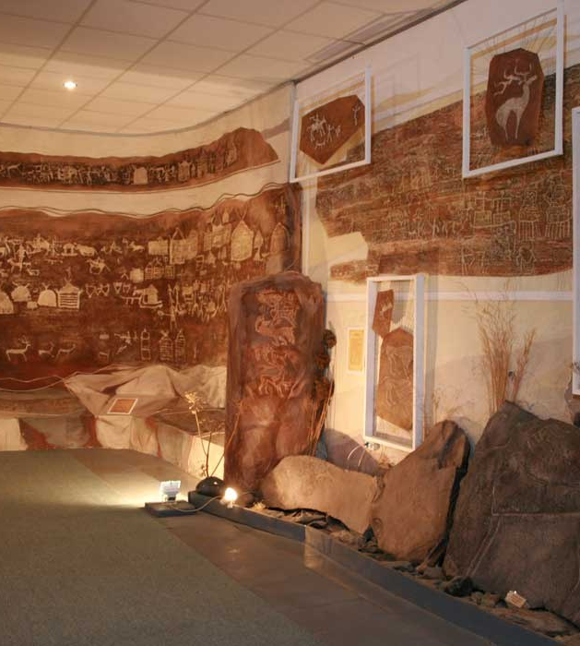
Museum of Asian rock art
The Museum houses a collection of petroglyphs collected in different parts of Eurasia. Visiting the Museum is interesting for those who are interested in the history of primitive society.

Slide 21
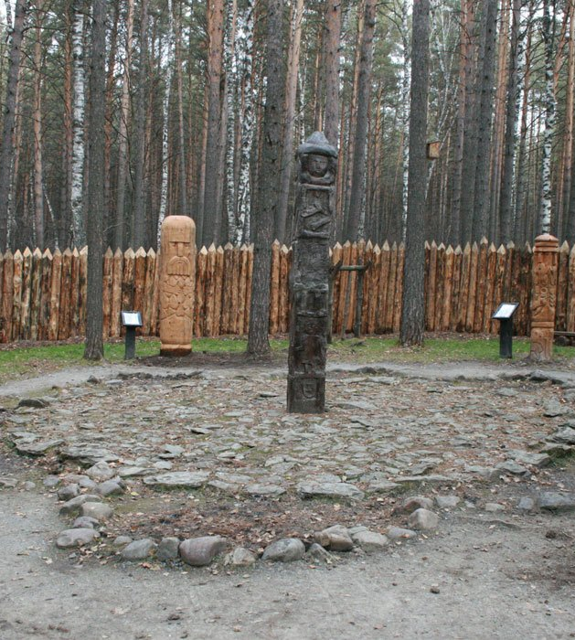
Slavic mythological forest
This forest tells about the early Slavs-the Gentiles, migrated to Siberia in the early XVII century, and their verlans and rituals. In the center of the yard fenced with a high palisade stands a sculptural copy of the Zbruch idol. All place of worship repeats in miniature investor pagan temple of Perun.

Slide 22
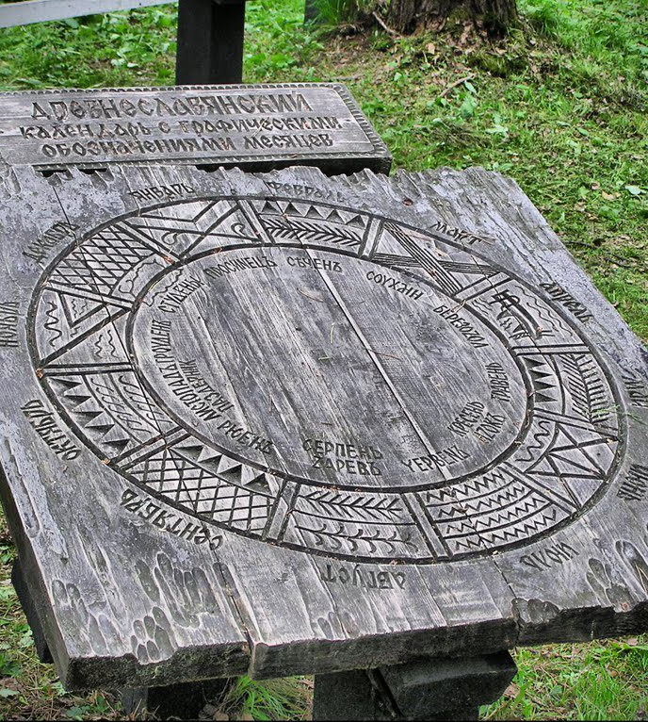
"Time and calendars"
The exhibition is placed on the wall of time and tells about the different types of calendars peculiar to certain eras and peoples.

Slide 23
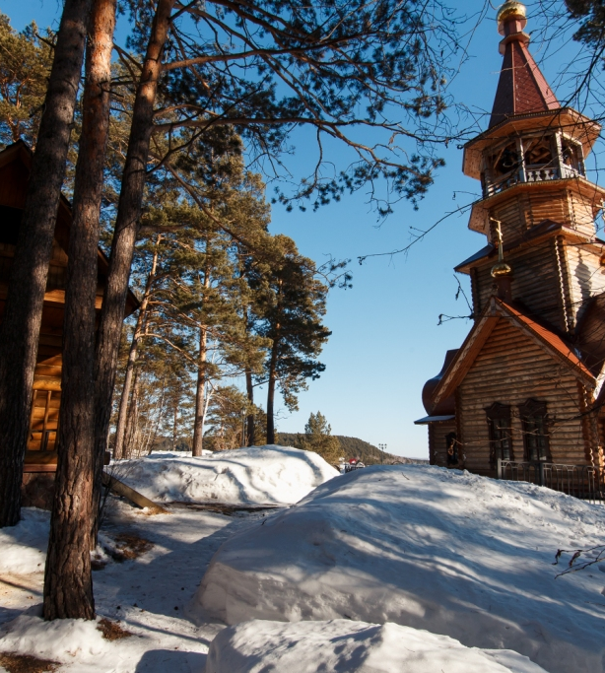
"Russian Siberian village"
This complex, which is a Russian homestead Pretoma with the reconstructed residential and farm buildings. There are even small details of the village architecture, typical of most villages of Russian immigrants.

Slide 24
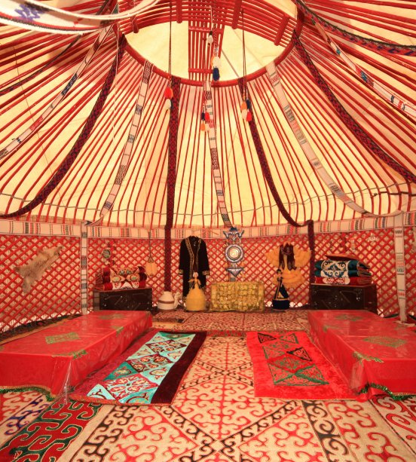
Mongolian Yurt
In the Yurt, covered with felt, recreated the life of pastoralists, nomads. The interior of the room is striking with bright colors of carpets, felt flooring. All furniture and wooden frame of the Yurt is painted in red, everywhere carving with the wishes of all the best.

Slide 25
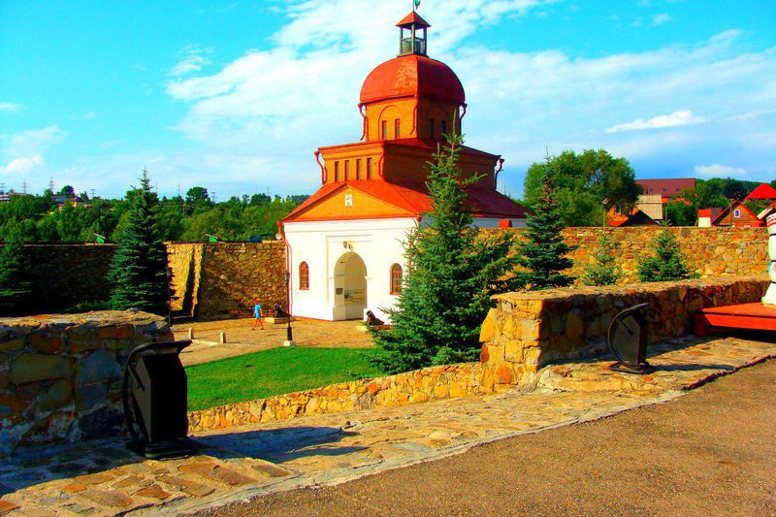
Kuznetsk fortress

Slide 26
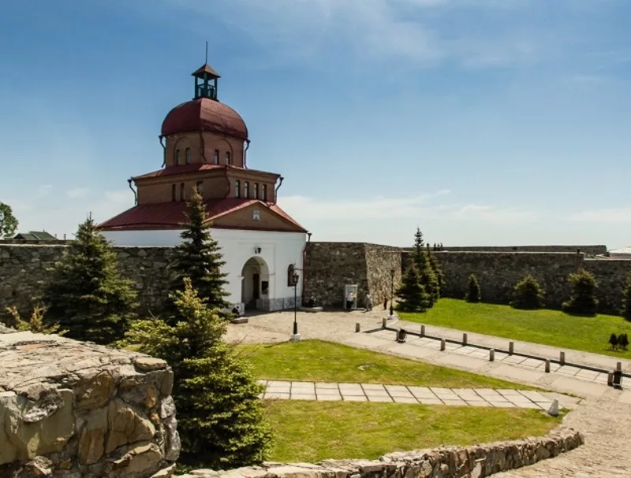
Kuznetsk fortress — a monument of history and architecture of Federal importance, located in the Kuznetsk district of Novokuznetsk, Kemerovo region. The stone fortress on the ascension hill was built in the city of Kuznetsk in 1800-1820 by order of Emperor Paul I, as part of the Siberian line to protect southern Siberia from the Chinese threat. Never since the construction has not participated in hostilities. It was abolished as a military fortress in 1846. Now in the castle Museum. The image of the fortress is used as an emblem by some organizations of Novokuznetsk, in particular, the newspaper "Kuznetsk worker".

Slide 27
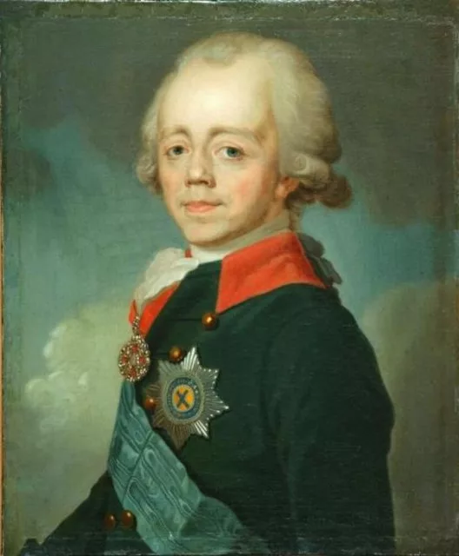
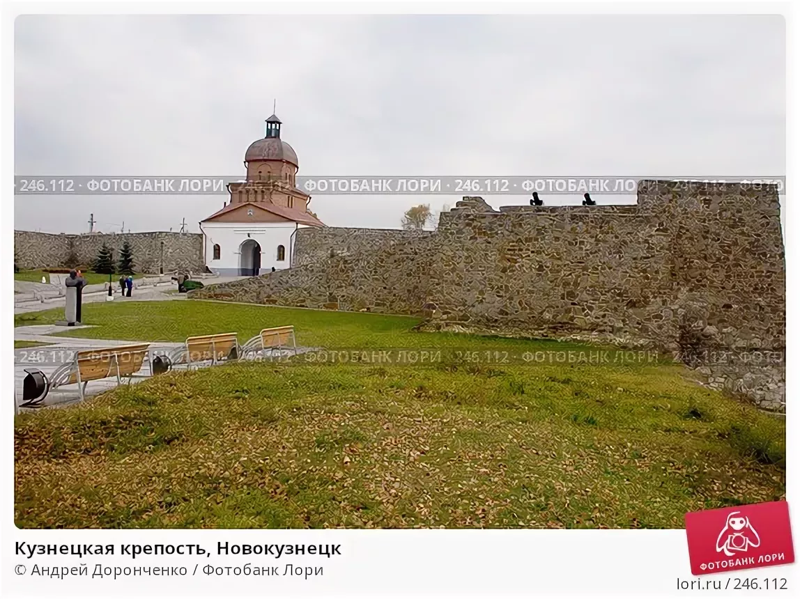
In the 17th and 18th century, the town of Kuznetsk was repeatedly attacked by neighboring tribes. According to one legend, when attacking the city in 1764, a 12-year-old boy pointed guns at the enemy[1]. At the end of the XVIII century the city of Kuznetsk remained an important stronghold on the Eastern flank of the border linear system from the Caspian to the Altai. To modernize the Kuznetsk fortifications, the commander of the Siberian corps, Lieutenant General Gustav Strandman developed a project, which consisted in the construction of two earthen fortresses of Bastion type. In April 1798, Emperor Paul I approved this project. In 1799, the year one of consolidation (so-called "Swamp citadel") at the foot of the ascension of the mountain is already built. On the mountain itself, the construction of a unique engineering fortification began only in 1800.

Slide 28
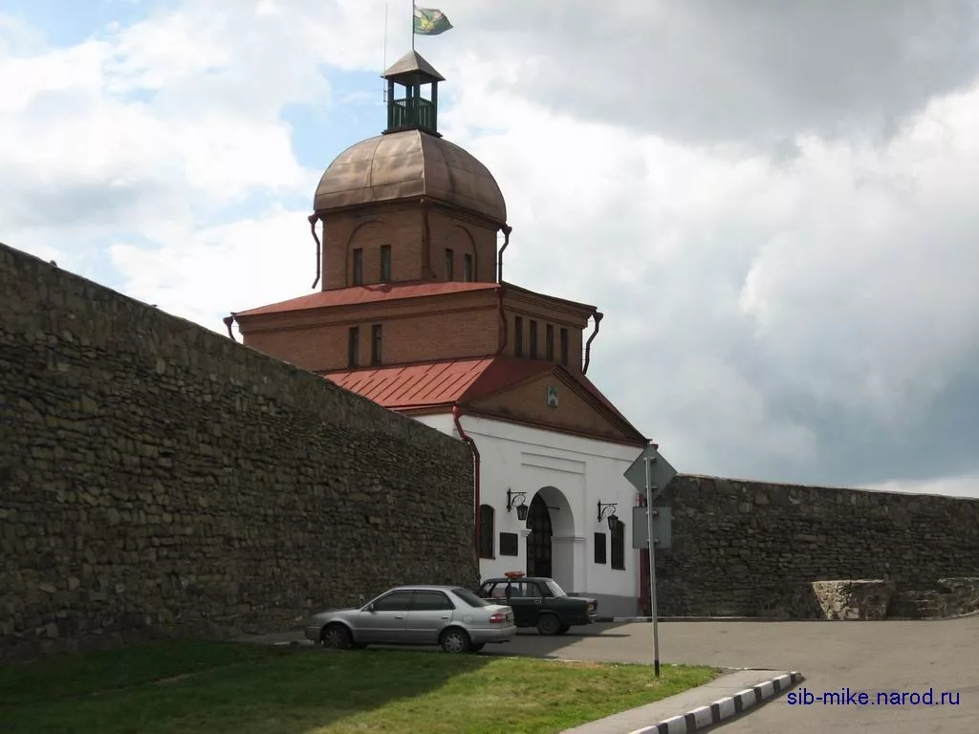
By the end of the 1830s the fortress was not needed, began a gradual withdrawal of military units from its territory. In 1846, the fortress was removed from the balance of the Ministry of War and transferred to the Altai mining Department. The fortress was rebuilt several times, some of them were sold for scrapping. In the 1860s, in one of the converted buildings of the fortress lived unmarried lower ranks of the Kuznetsk wheelchair team.
In 1870, the fortress was organized Kuznetsk prison Tomsk province for criminals. It was called "Kuznetsk prison castle".

Slide 29
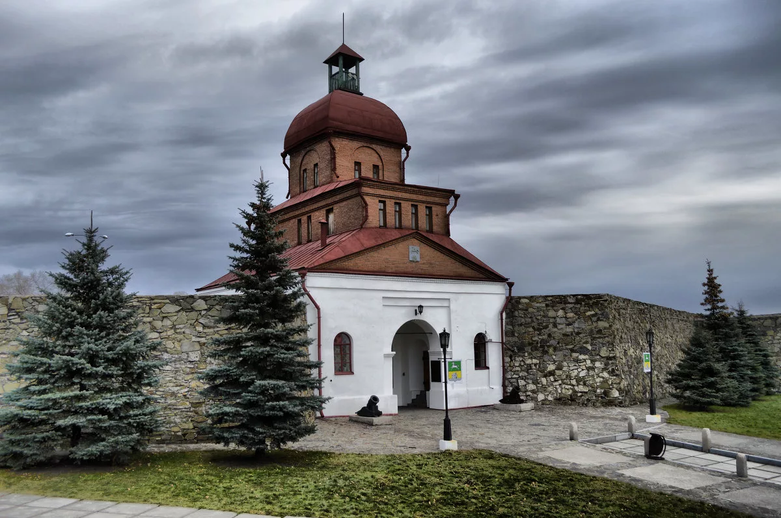
The Museum occupies an area of about 21 hectare. Here you'll find not only the fortress itself, but many other historical and natural monuments, including a waterfall in a narrow canyon near the site of the redoubt Verkhotomskoye Kuznetsk fortress. The Museum includes more than a dozen military fortifications and architectural objects of varying degrees of preservation. The Museum has several archaeological sites of different types. Museum staff continue to study the Kuznetsk fortress (archaeological and archival research), working on updating the exhibition. The exhibition presents the military history of the region, the materials of excavations of Kuznetsk fortress, the history of fortified "lines", the history of the Kuznetsk prison castle, located on the territory of the fortress.

Slide 30
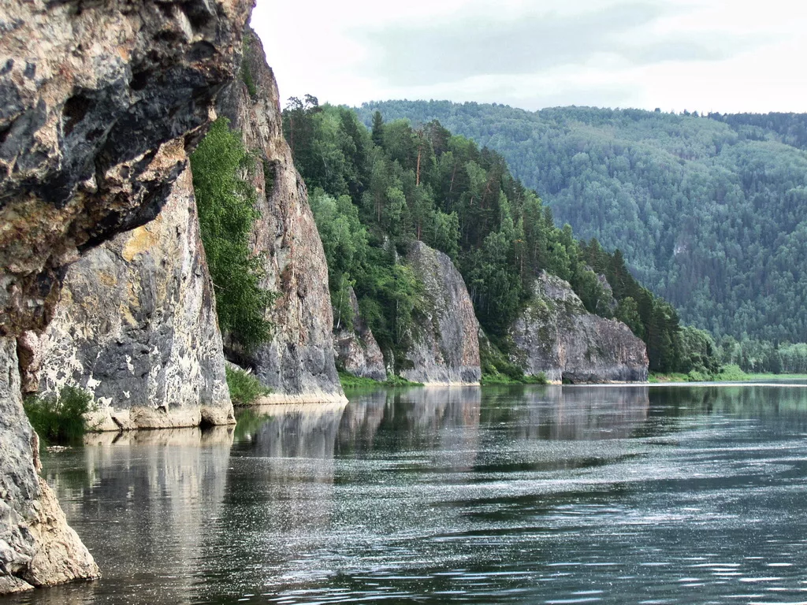
Gornaya Shoria

Slide 31
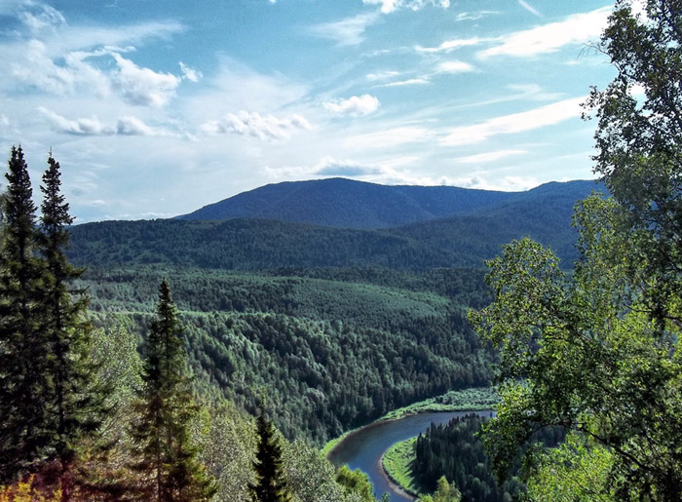
Mountain Shoria
Mountain Shoria (shorsk. Tala shore) is a mountain-taiga region, situated in the southern part of the Kemerovo region on a joint of Altay, Sayan and Kuznetsk Alatau. The region can be conditionally attributed to the Altai mountain system.
The name of Gornaya Shoriya received from a small number of original people Shors, the ancestors of which all Siberia was famous for their ability to smelt iron. It was their first Russian explorers called "Kuznetsk Tatars".

Slide 32
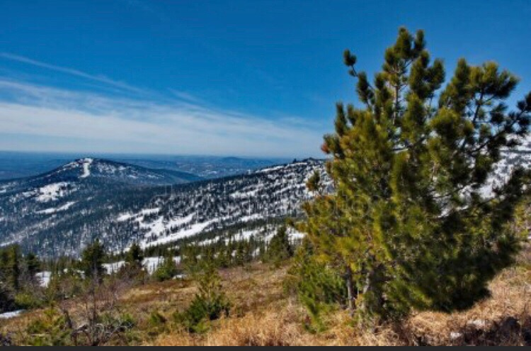
The modern relief of the Mountain Shoria was formed as a result of the long destruction of rocks and the gradual uplift of the entire territory. These are mountains of average height, mainly 500-800 meters. The formation of the relief was mainly influenced by flowing water, fluctuations in winter and summer temperatures, chemical and physical processes of weathering. As a result, picturesque narrow river valleys with rocky shores, soft outlines of peaks, numerous caves and grottoes were formed.

Slide 33
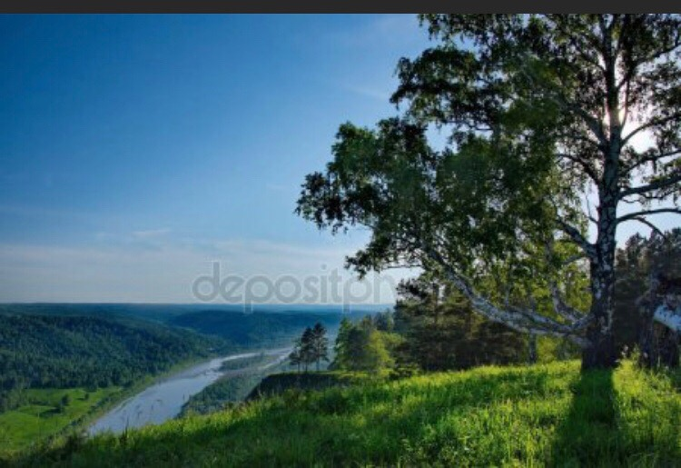
Heights
The height of the region is from 500 to 1630 meters. The highest point Of the mountain Shoria — mount Mustag (Ice mountain) — a large granite massif stretching from South-West to North-East for more than 25 km. Under the influence of weathering here formed rocks similar to the humps of camels, the peaks of medieval palaces, rooster crest. In addition to the Mustag over coniferous taiga climb the snow-capped peaks Patina, Outage, Kubesa, Temirtau (Iron mountain), Green, Kul-Taiga. Almost all of them are skiing in winter, and in summer they are conquered by climbers.

Slide 34
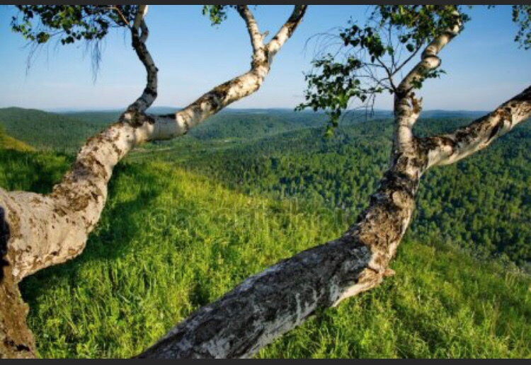
The most famous mountains:
Of patyn ("the Place of residence of the Kuzbass Yeti") — 1630 meters — the highest mountain of Mountain Shoria. In the area of large system of caves.
Mustag — located in the resort of Sheregesh
Kurgan
Caritel (better known as G. Green, on the mountain there are most ski resort Sheregesh)
Ducking
Rivers
Mountain, clean and transparent to the bottom of the river cut through the deep riverbeds mountain ranges. The main of them — Kondoma, Mundybash, Mrassu (according to the toponymic dictionary — "cedar river"; in Shor pyras or Pras), Pyzas.

Slide 35
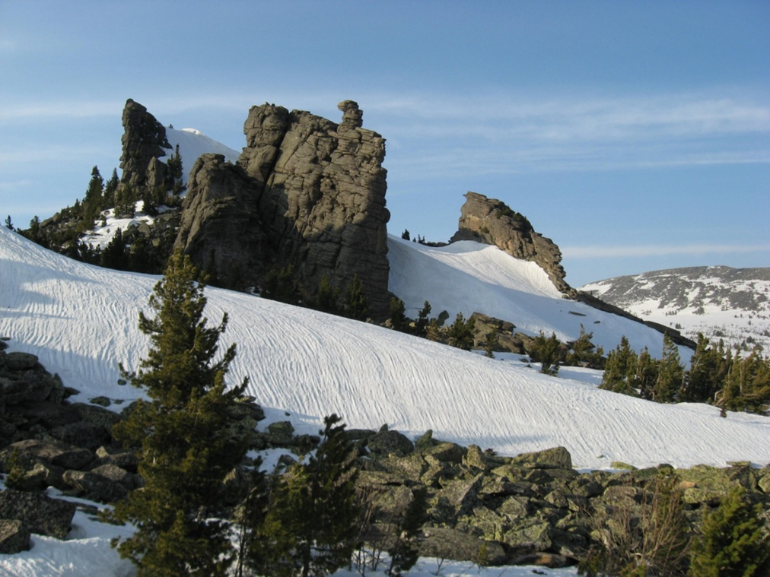
In winter, Mountain Shoria is a ski resort, popular not only in the Kemerovo region, but also throughout the Siberian region. Especially popular Green mountain (Karitsa), 1270 m, located near the settlement of Sheregesh. There are constantly held professional and Amateur Championships of Russia. In winter there is a regular Tourist train "Winter fairy tale"from Novosibirsk.
Features of the ski resort:
the steepness of the slopes of 15-45°;
duration of snow cover — 7 months;
light "cold" snow;
the high level of trails on mount Green is recognized by experts of the international Federation of skiing and snowboarding.

Slide 36
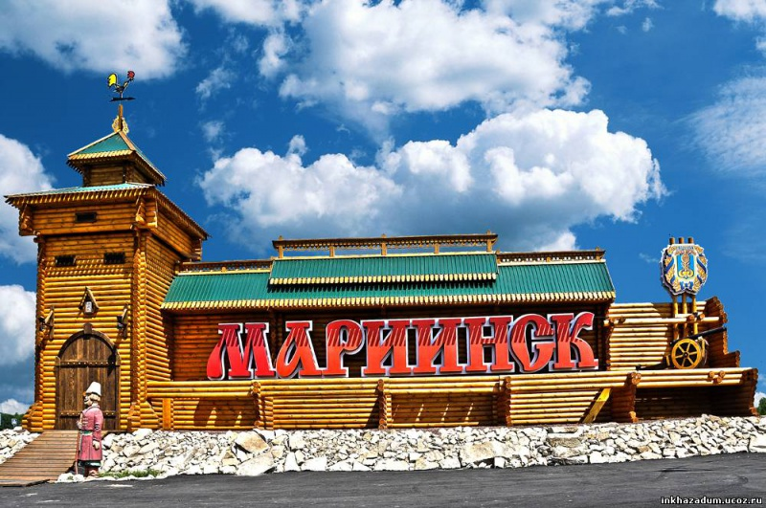
Mariinsk

Slide 37
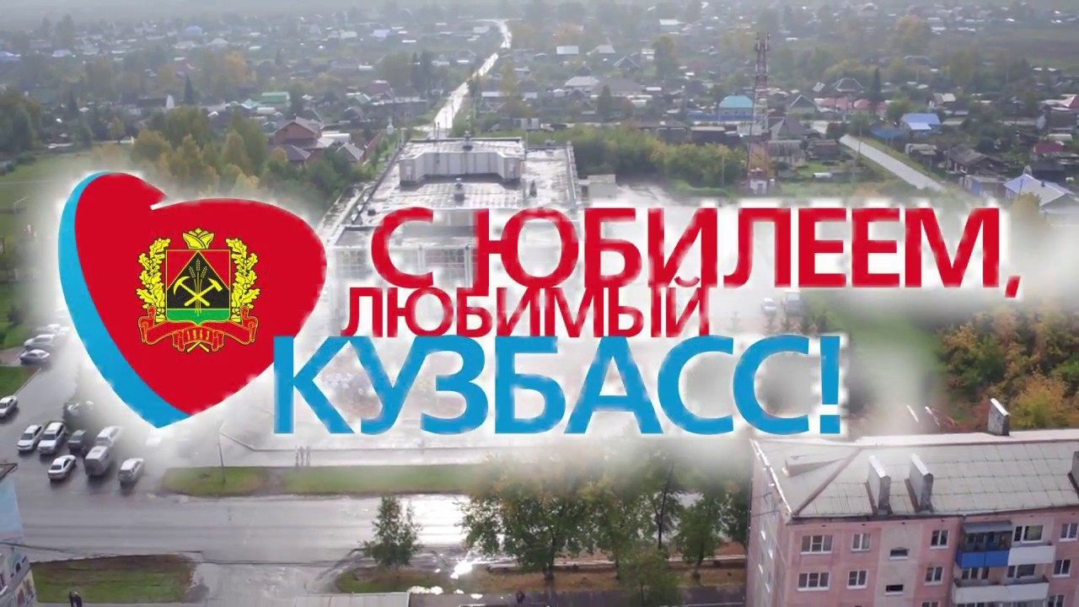
Кузбасс, Кузбасс – моя держава,
Мой отчий дом, мой край родной,
Кузбасс былинный, величавый,
Одной мы связаны судьбой…
(Н. Чимбарова)

Slide 38
Спасибо за внимание!

