Slide 1
Fyodor Mikhailovich Dostoevsky
The famous Russian Novelist

Slide 2
ROUND 1

Slide 3
Match the writers and the literary works. Write down your answers. You have 5 minutes! Then hand in your answers.

Slide 4
Match the writers and the literary works.
Writers | Literary works
Ivan Turgenev Anton Chekhov Nicolai Gogol Fyodor Dostoyevsky Leo Tolstoy Alexander Pushkin | “War and Peace” “The Seagull” “Dead Souls” “Crime and Punishment” “Father and Sons” “Eugen Onegin” “Anna Karenina” “The Nose” “Uncle Vanya” “The Captain’s Daughter” “A Nest of Nobles” “The Idiot”

Slide 5
The correct answers
Ivan Turgenev | “Father and Sons”
 | “A Nest of Nobles”
Anton Chekhov | “The Seagull”
 | “Uncle Vanya”
Nicolai Gogol | “Dead Souls”
 | “The Nose”
Fyador Dostoyevsky | “The Idiot”
 | “Crime and Punishment”
Leo Tolstoy | “Anna Karenina”
 | “War and Peace”
Alexander Pushkin | “The Captain’s Daughter”
 | “Eugen Onegin”

Slide 6
ROUND 2

Slide 7
Read the text about Dostoevsky’s biography and find out if the given statements are True or False. You have a sheet of paper and a glue. Be ready to glue the answers in the wright column. You have 15 minutes! Then hand in your answers.
TRUE
FALSE
Was born in 1821

Slide 8
Which statements are True or False?
TRUE
FALSE
Was the youngest of six children
Studied at the Military Engineering Academy
Suffered from epilepsy
Was sentenced to death
Was sentenced to 4 years of exile (ссылка)
Was the editor of the successful journal ‘Epoch’
Suffered from gambling disorder (влечение к азартным играм)
Was married three times
Had only one child

Slide 9
The correct answers
TRUE
FALSE
Studied at the Military Engineering Academy
Was the youngest second of six children
Suffered from epilepsy
Was the editor of the unsuccessful journal ‘Epoch’
Was sentenced to death
Was married three two times
Was sentenced to 4 years of exile (ссылка)
Had only one child four children
Suffered from gambling disorder (влечение к азартным играм)

Slide 10
ROUND 3

Slide 11
Read the text about Dostoevsky’s biography and match the paragraphs of the texts with the pictures. Write down your answers. You have 10 minutes. Then hand in your answers.

Slide 12
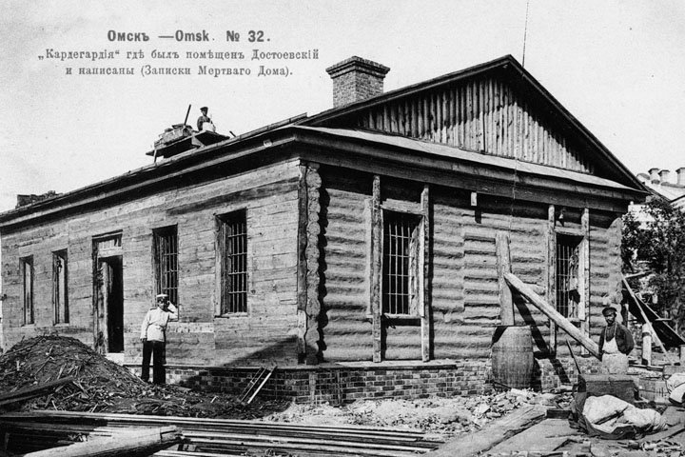
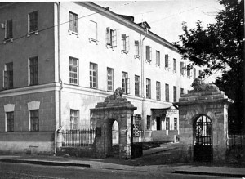
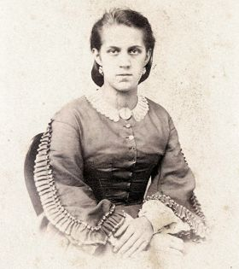
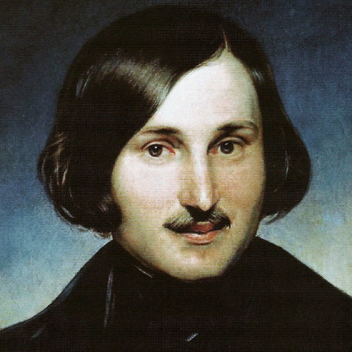
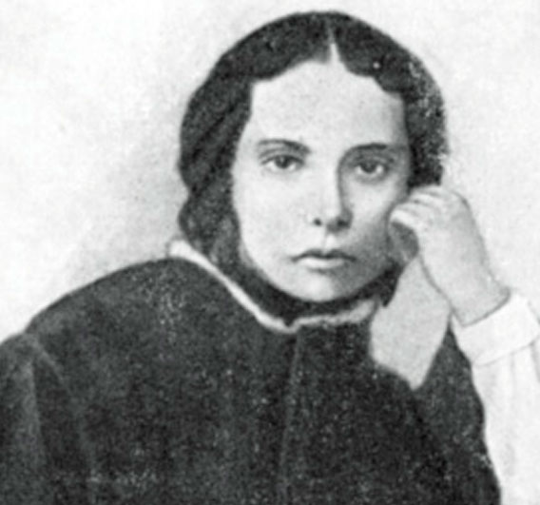
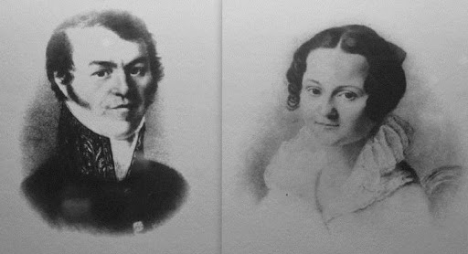
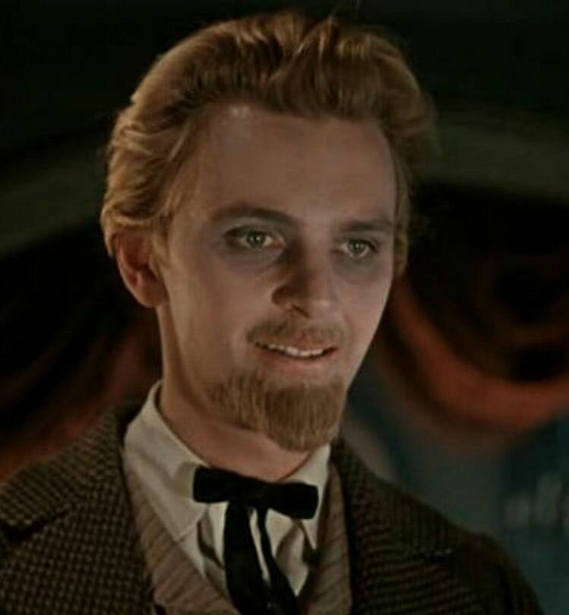
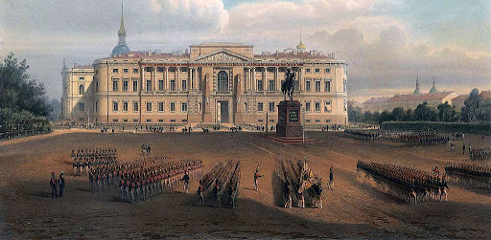
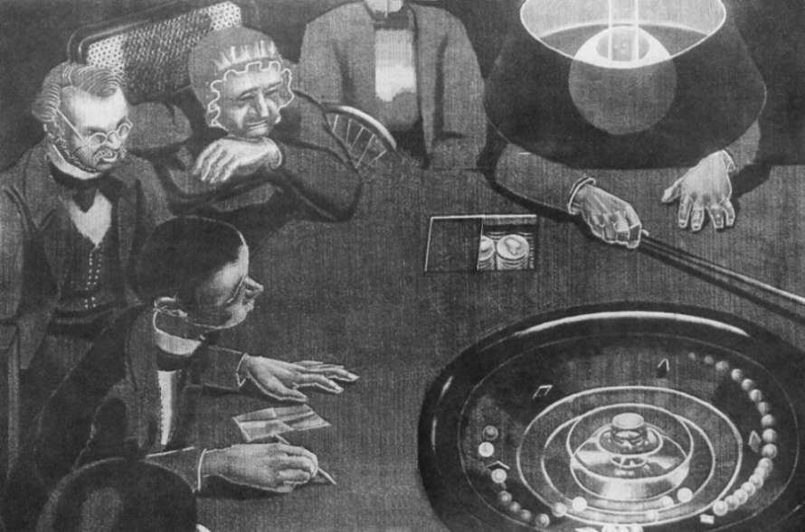
Match the paragraphs of the texts with the pictures.
C -Gogol
D - katorga prison camp in Omsk
A - Hospital for the Poor
B - Anna Snitkina
G - Maria Isayeva
H-Dostoevsky’s parents
I-Gambling
E-Prince Myshkin
F - the Military Engineering Academy at Saint Petersburg

Slide 13
The correct answers
H
F
A
E
C
D
G
I
B

Slide 14
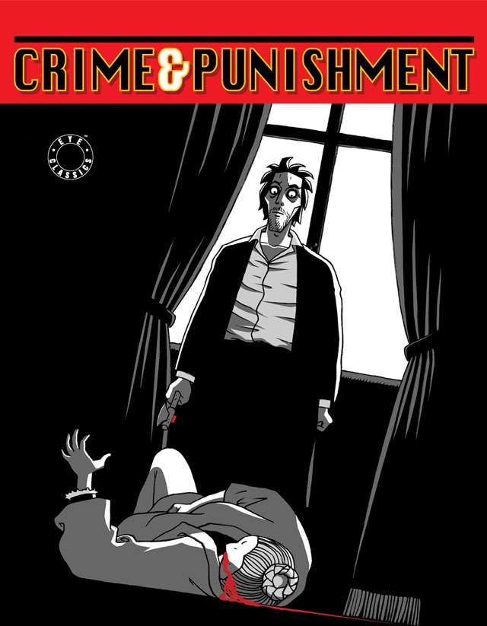
ROUND 4

Slide 15
Study some key characters of the novel.
Rodion Romanovich Raskolnikov – a former student, who commits a murder.
Sonya Marmeladova - a self-sacrificial, innocent young woman, being forced into prostitution to help her family. She is an important source of moral strength and support.
Dunya Raskolnikova - Rodion's beautiful and strong-willed sister who works as a governess. She is one of factors in her brother’s decision to commit the murder.
Arkady Ivanovich Svidrigaïlov - a wealthy former employer of Dunya Raskolnikova.
Semyon Zakharovich Marmeladov – a drunk who Raskolnikov meets while considering the murder. Marmeladov understands that he ruined his life and the life of his daughter Sonya being forced into prostitution.
Alyona Ivanovna - an old pawnbroker. She is killed at the beginning of the novel.

Slide 16
Read the plot of the novel “Crime and Punishment” and choose the correct words to describe the plot. You have 15 minutes! Then hand in your answers.

Slide 17
The correct answers
1) poor
2) St. Petersburg
3) murders and robs
4) pawnbroker
5) half sister comes
6) murders
7) ill
8) newspapers
9) carriage
10) falls in love with her
11) Sonya
12) eight
13) follows

Slide 18
ROUND 5

Slide 19
Read the passages from the novel and present them in the order in which the events occurred. You have 15 minutes. Then hand in your answers.

Slide 20
1-A 2-C 3-F 4-H 5-D 6-G 7-B 8-E
The correct answers

Slide 21
Answer the questions:
Which task did you find the most interesting?
What have you learnt about Dostoevsky F.M. today?
Did you like the game?

Slide 22
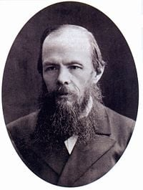
Who is the winner of the game? The team that has got the maximum number of points is the winner.

