Slide 1
Education in the UK: Public Schools
подготовила:
преподаватель английского языка БПОУ УР «РМТ им. В.А.Шутова»
Кулахметова Наталья Николаевна

Slide 2
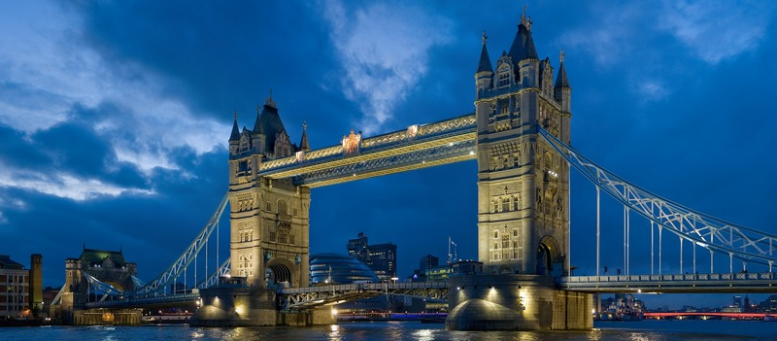
To get education is a duty to all children of the UK from 5 to 16 years old. About 90% children go to the state schools. There are 35,000 state schools in Britain.
Other part of British schools are public schools. It is very prestigious to learn there, but fee is very high.

Slide 3
The education system of the UK consists of:
Pre-school – for children from 2 to 4(5).
Primary school – for children from 5 to 11.
Secondary school (of different types) – for children from 11 to 16. Exam- GCSE
! But if a person want to enter a university he/ she should stay at the Sixth form of secondary school till 18. Exam - A-level

Slide 4
Types of secondary schools in the UK:
Comprehensive school – единая средняя школа (самая массовая государственная средняя школа в Британии)
Grammar school – классическая «грамматическая» школа, где занятия ведутся по углубленной программе
Public school – частная школа. Большинство таких школ – интернаты – Boarding schools.

Slide 5
Most public schools are divided into two types:
Only for boys
Only for girls

Slide 6
There are several reasons for separating schools by gender type:
For boys only. Why?
For girls only. Why?
Boys need to move much, more sports and games.
They have different rates of success (leadership, hardiness etc).
The competitive environment is necessary to express themselves.
The boys from childhood accustomed to easily cope with the " work not for men" and become self-sufficient and self-reliant.
Girls develop physically and emotionally faster than boys.
Girls tend to have better disciplined.
Girls' teams are better organized and focused on learning.
Girls are more appreciate the support and teamwork.

Slide 7
School subjects at public school of the UK:
Compulsory:
Optional:
Math
English and English Literature
Science
Geography
History
Music
P.E. and Games
Art and Design
Modern foreign languages
Information and Communication Technologies
Religion
Design and Technology
Latin
Greek
History of Art
Theatre
Photography
Statistics
Management
etc

Slide 8
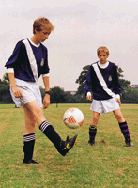
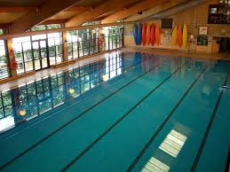
There are many extracurricular activities in public schools:
Horse riding
Ballet
Street dances, Hip-hop
Sport games: netball, la-cross, squash, cricket etc.
Exchange trades
Cookery
Swimming

Slide 9
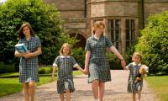
Typical distribution of training time in public schools of the UK:
School year:
September-December (autumn)- Michaelmas Term
vacations
January – March (spring) –Lent Term
vacations
April – beginning of July – Summer Term
vacations
School week :
From Monday to Friday ( at classes, labs, IT classes, gyms and workshops
Saturday is a day for sport matches and outdoor activities
School day:
The typical school day lasts from 9 am to 3 pm.
There two breaks: for lunch, for dinner.
All sport games, workshops and outdoor activities are usually held after 3pm.

Slide 10
School uniform is one of compulsory elements in many school of the UK. As a rule, students are proud of their uniform and even participate in its design. Here you can see a sample of school uniform in one of comprehensive school in London:

Slide 11
In public schools of the UK, school uniform is compulsory. It is one of elements in student’s image. Sometimes it is cute but in some cases, school uniform is rather unusual. Here you can see a sample of Harrow School uniform:

Slide 12
School uniform in many school is based on traditions (religious or genteel):
School uniform in Christ Hospital School:
School uniform in Eton School:

Slide 13
Harrow School is one of the oldest public schools for boys in the UK. It was founded in 1572.
Coat of arms
Appearance

Slide 14
Location and general information
General information:
Place to live and learn:
Address:1 High St, Harrow on the Hill, Middlesex HA1 3HT
Principal: Mr B J Lenon
Year of foundation : 1572
School Status: For boys 13-18. Accommodation is possible with the school for 13 years.
Number of students: 800 (only full board).
Site: harrowschool.org.uk

Slide 15
In addition to scions of royal families many famous people were graduates of Harrow School:
Sir Winston Churchill- the Prime Minister of the UK
Javāharlāl Nehrū – the Prime Minister of India
Hussein ibn Talal – the King of Jordan
George G. Byron –great English poet
Benedict Cumberbatch – famous British actor

Slide 16
All students of Harrow School are divided into 5 groups (these groups are based on the years of training):
1.Shell – first year of training
2. Remove – preparing to GCSE exam
3. Lower Fifth - preparing to GCSE exam
4. Lower Sixth - preparing to A-level exam
5. Upper Sixth - - preparing to A-level exam exam

Slide 17
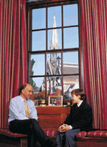
Special traits of the educational process at Harrow School:
Tutors and their students:
There are 14 parameters to assess the success of students: e.g. theoretical and practical perception of the material, progress in the written and lab works etc;
Every student has his own tutor (from school teachers). The main aim of tutor is caring about academic progress and the spiritual development;
Tutor is a main contact person between student’s parents and School.

Slide 18
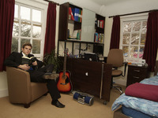
The conditions to live and learn at Harrow School:
Accomodation:
The typical students’ rooms:
1. There are 11 dormitories – Houses at School. They compete with each other.
2. During first three or six terms a student of Harrow usually shares his room with his contemporary.
3. 70% of older students live in separate rooms.

Slide 19
Admission to British public school is a very prestigious thing! Why?
Reasons for:
The best universities of the UK: Oxford and Cambridge
The level of education is extremely high;
Each student is provided a list of the best subjects for entry into most prestigious universities;
95% of students enter to the best universities.
During training, students acquire the brilliant links that will help them later in life.

Slide 20
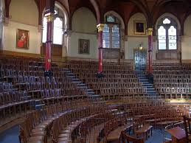
Источники создания презентации:
https://ru.wikipedia.org/wiki/Система_образования_Великобритании
www.edemvlondon.ru/school-system-in-england.html
freewayrussia.ru/ob_obrazovanii/school_obraz_Engl
www.estudy.ru › Страны › Англия
global-edu.ru/foreign-education/school-education-united-kingdom/
https://ru.wikipedia.org/wiki/Хэрроу_(школа)

