Slide 1
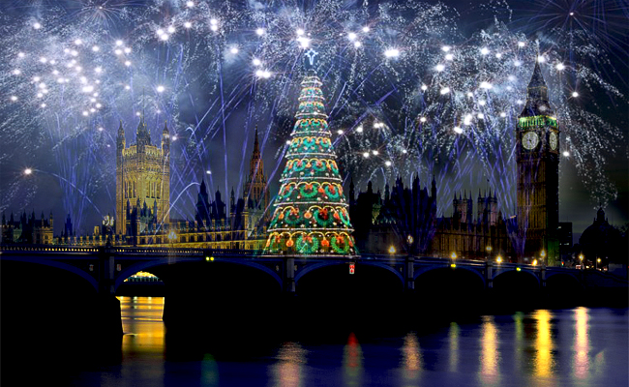
Holidays in English-speaking countries

Slide 2
The aims of the lesson are:
- to learn and train new words
- to read the text and try to speak
- to revise some grammar material

Slide 3
There are names of holidays
Christmas
New Year's Day
St. Patrick's Day
April Fool's Day
Mother's Day
St. Valentine's Day

Slide 4
The Dates
July, 4
February, 14
October, 31
3rd Thursday , November
March, 17
December, 25

Slide 5
There are names of holidays
Mother’s Day
St. Valentine's Day
St. Patrick's Day
Halloween
Thanksgiving
Independence Day
Christmas
Easter

Slide 6
Match the words from the columns:
Christmas Easter New Day Mother’s Day Halloween April Fools’ Day | is | in May on the 31st of October on the 25th of December late March or early April on the 31st of December on the 1st of January

Slide 7
Fill in was or were
I My mother My friend My parents My granny | was/wasn`t were/weren`t | at home in the country at the stadium at the sports ground at school | last month last December last Christmas

Slide 8
Answer the questions
Which holidays are not widely celebrated in Russia?
Which is a holiday for playing tricks and jokes?
On which holiday is everything green?
In Russia these holidays have different dates of observance?
Which holiday is very similar to the 8th of March in Russia?

Slide 9
Complete the dialogue and act it out
Terry: … How are you?
Sylvia: … And how are you?
Terry: … Where were you at the end of December? What did you do?
Sylvia: … And what about you? Did you celebrate only Christmas or did you celebrate the New Year too? Did you decorate the Christmas thee ?

Slide 10
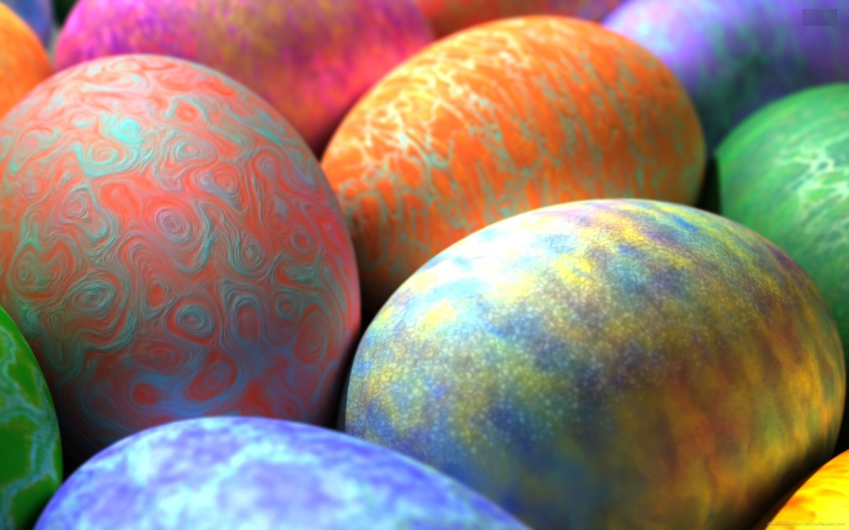
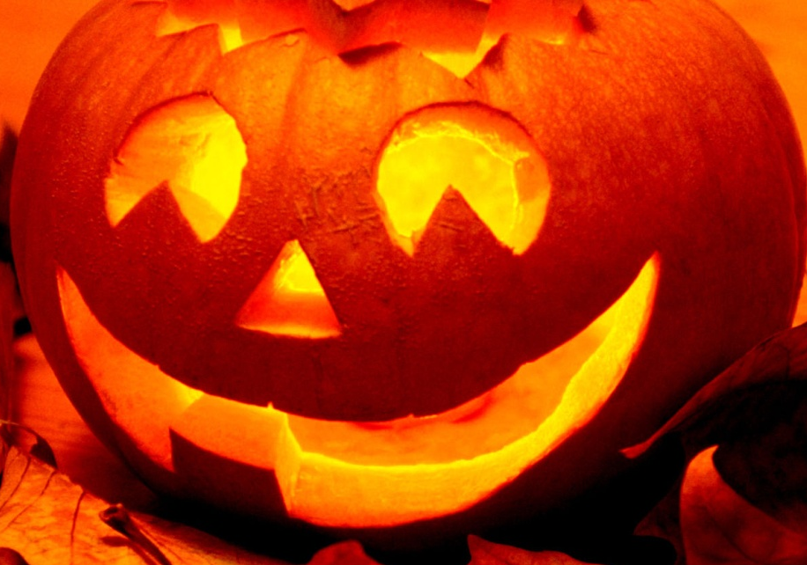
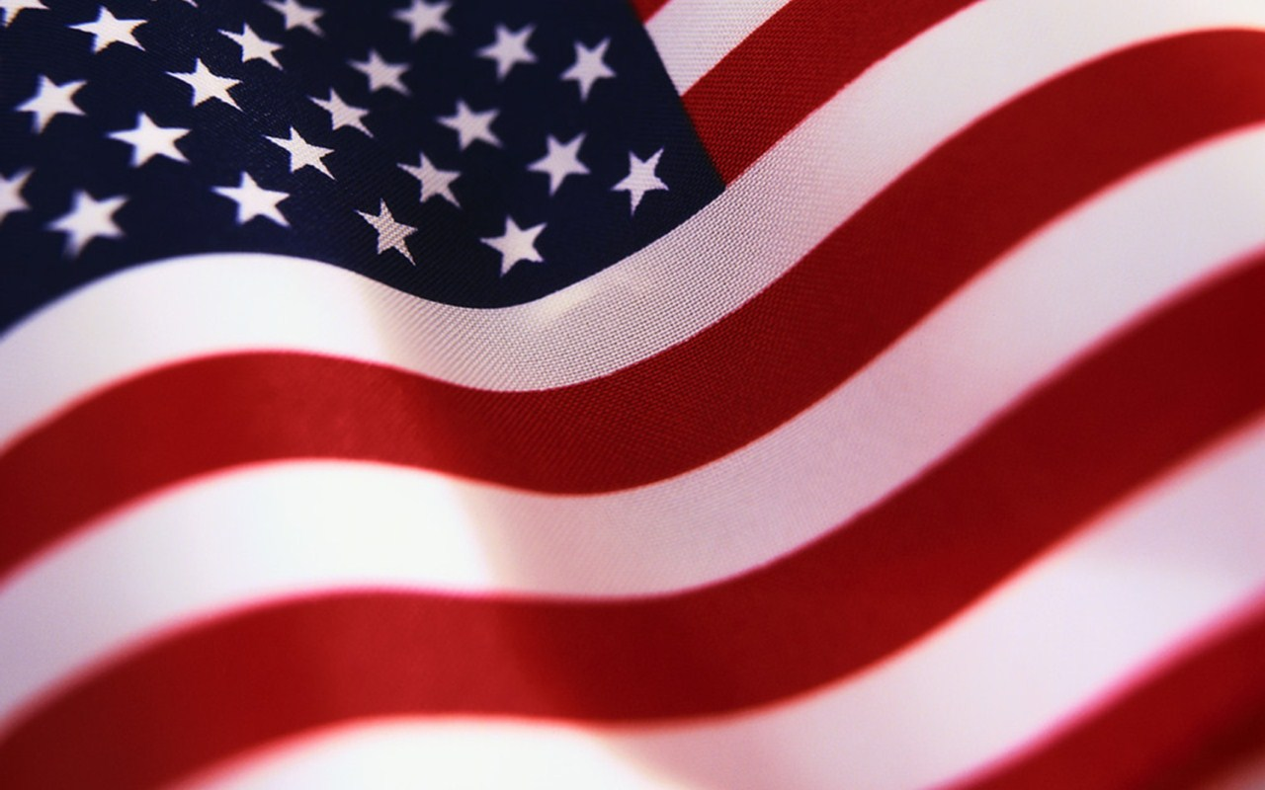
There are symbols of holidays:
Colored eggs
Pumpkin
American flag

Slide 11
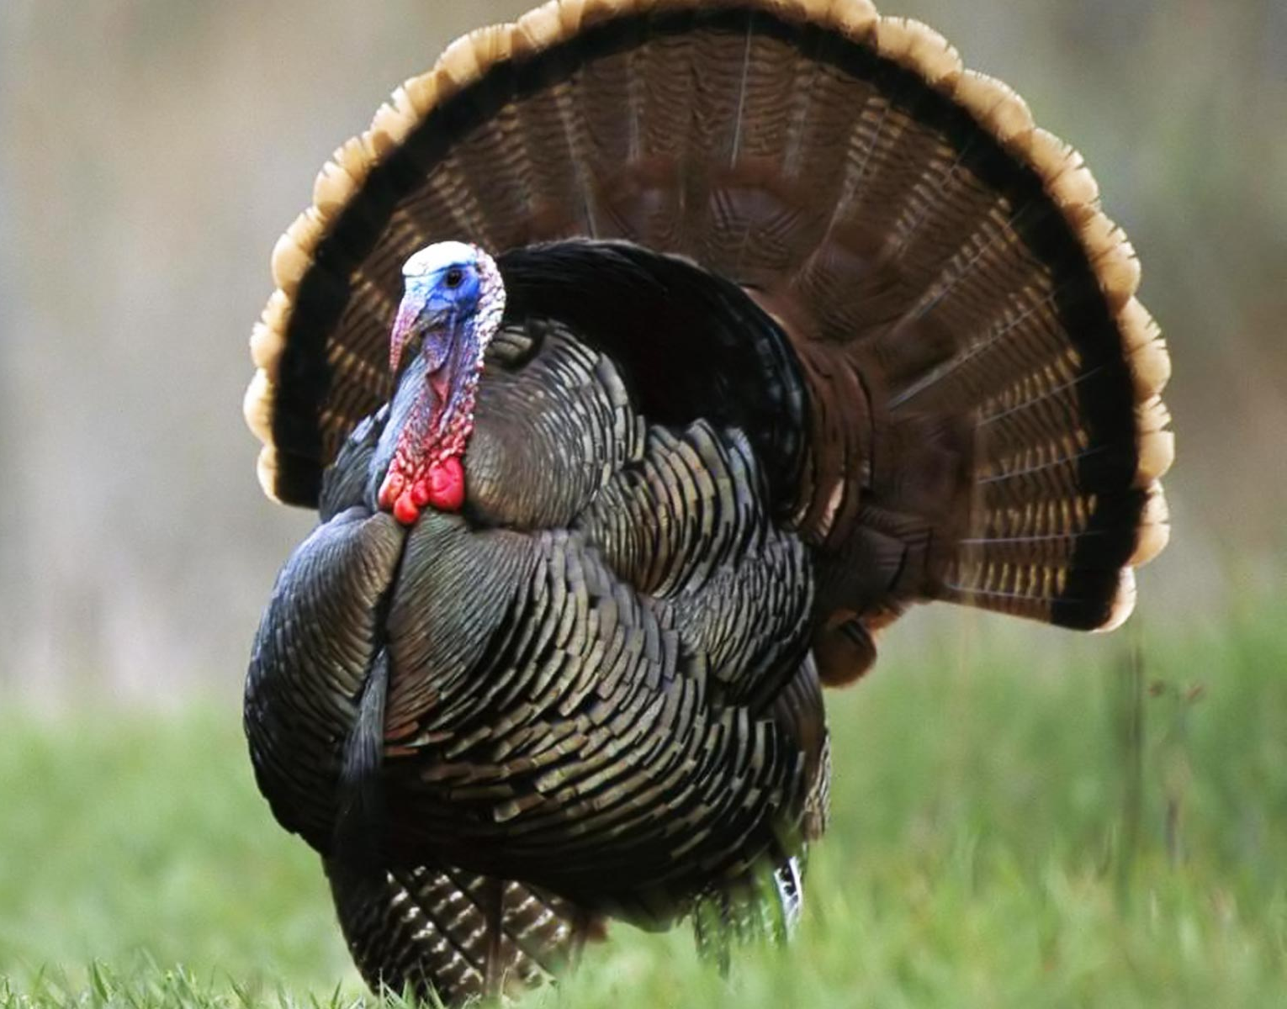
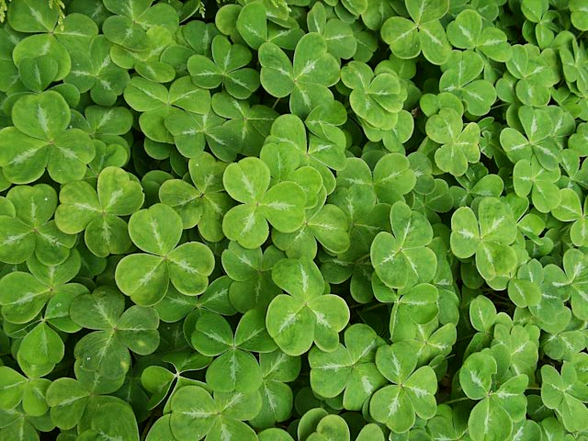
There are symbols of holidays:
Red heart
Turkey
Shamrock

Slide 12
Answer these questions:
Which symbol belongs to Russian holidays?
Which symbol is for St. Patrick s Day?
Which symbol is for U.S. Independence Day?
Which symbol is for St. Valentine s Day?
Which symbol is for Thanksgiving Day?
Which ones symbolizes Easter?

Slide 13
There are dates of some holidays
July 4- U.S. Independence Day?
February 14- The most frightening Day
October 31- St. Valentine s Day
December 25 -People gather with family and have dinner on this date
March 25 - The Western Christian date of birth of Jesus Christ

Slide 14
Fill was or were
My parents … in New York on Christmas Eve.
I … at home on the 14 of February, we … busy reading our Valentine s Day cards.
My brother … fourteen on the first of January.
Where … you at the end of the week?

Slide 15
Complete the text using the past tense forms of the verbs given below
Nobody knows very much about St. Valentine. He …a Christian. He … a poor girl some money before he … So people … him the saint of love and … to celebrate St. Valentine s Day on the 14 of February. Last year I … a lot of Valentine s cards. There … hearts on them. My friends … them to me. Some of them … their names down.
( was, died, were, gave, called, did not , put, sent, began, got).

Slide 16
Put the verbs in brackets into the Passive. Use the Present Simple or Past Simple tense
Thanksgiving (celebrate) fourthThursday in November.
First colonists (give food) by native American Indians in 1620.
They (show) how to grow food by native American Indians.
In 1621 first Thanksgiving festival (celebrate) by the colonist.
It ( make) a holiday by the President Linkoln in 1864.
Now turkey and pumpkin pie (eat) in family dinners.

Slide 17
Is it true or false sentences?
Thanksgiving is celebrated on the fourth Thursday in November.
First colonists were given food by native American Indians in 1620.
They were shown how to grow food by native American Indians.
In 1621 first Thanksgiving festival was celebrated by the colonist.
It was made a holiday by the President Linkoln in 1864.
Now turkey and pumpkin pie are eaten in family dinners.

Slide 18
Use the words below to write questions in the Passive Voice.
Where (4 July) celebrate?
Where (goulash) eat?
When ( Boxing Day) celebrate?
Who (telephone) invent by?
Who (Romeo and Juliet) write by?
Where (BMW cars) make?

Slide 19
Use the words below to write questions in the Passive Voice.
Where is the 4 July celebrated?
Where is goulash eaten?
When is Boxing Day celebrate?
Who was telephone invented by?
Who was Romeo and Juliet written by?
Where are BMW cars made?

Slide 20
Say if these sentences are true or false
Thanksgiving Day is British holiday.
Thanksgiving Day is the most important day in American year.
People celebrate this holiday in offices.
They eat bacon and eggs to celebrate Thanksgiving Day.
Thanksgiving Day is rather like Christmas.
Since 1621 turkey has become a symbol of Thanksgiving Day .

Slide 21
Could you answer the following questions about Thanksgiving Day ?
When did people celebrate this holiday for the first time?
Why did they do it?
What is the traditional food of this holiday?
Why do people call this holiday Thanksgiving Day ?

Slide 22
Подведение итогов . Рефлексия.
Do you like lesson?
What do you like the most?
Thank you very much for your participation.
I’ll put you marks, and wish you good health.

Slide 23
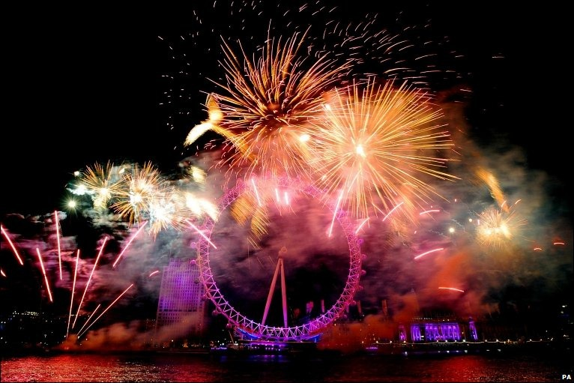
Информационные ресурсы:
http://www.christmasintheusa.com/
http://www.Learningchocolate.com/
http://www.native-english.ru/exercises

