Slide 1
Moscow Comprehensive
Secondary School № 717
2014

Slide 2
Presentation for the lesson
«How much
do we know about each other?»
made with using google Presentation

Slide 3
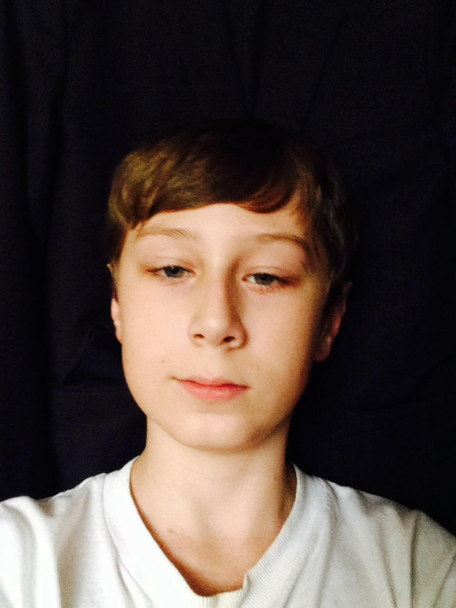
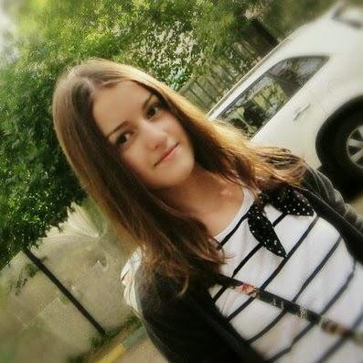
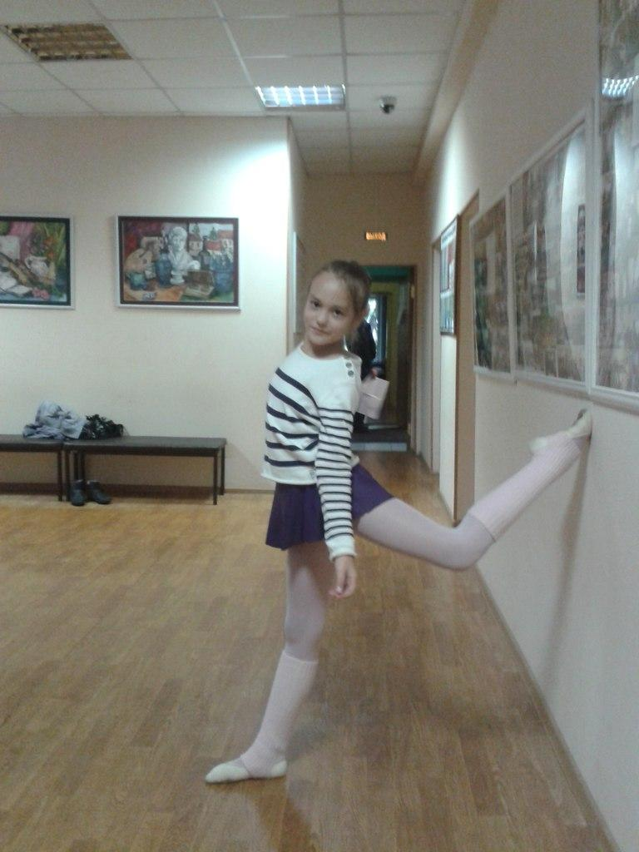
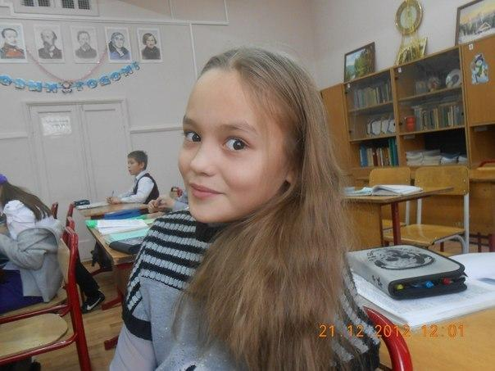
“How much do we know about each other?”
Ignatova Kate
Kulikova Anna
Buchenkov Vladimir
Charkov Igor
Tsalkin Boris
Tchitlova Tanya
Petrova Kate
Slovick Blad
Suhnev Oleg
Kalinin Maksim
Lutov Yaroslav

Slide 4
- Can we ask each other questions?
- Can we answer our friends’ questions?
- Can we anаlyse information and write short essays?
- Yes, we can. To do this project we asked each other some questions and then wrote short notes about each other.

Slide 5
Lutov Yaroslav about Suhnev Oleg
My friend's name is Oleg. He is my best friend. He likes technics. He likes trains, cars and most of all tanks and planes.
He likes to spend his summer holidays in the country. He likes to go to the forest and pick up mushrooms there. He likes when his mum cooks a very tasty soup.
But one year ago he spent his summer holidays in Mexico. He enjoyed there very much. He spent in Mexico two weeks. It was the best holidays in his life.

Slide 6
Kalinin Maksim about Slovick Vladislav
My best friend is Vlad. He's 12 years old.Vlad is in Year 6 at school. He is very cheerful and curious. Last summer Vlad was in the country.
He loves board games especially "Monopoly." His favourite pet is his guinea pig. His favourite food is pizza. He loves adventure books. He's a good football player. In the future Vlad wants to become a lawyer. His favorite subject is Math and the Russian language. His favourite city is Moscow. Sometimes at the weekends we go for a walk with Vlad. I am very lucky that I have such a loyal and reliable friend as Vlad.

Slide 7
Tania Chitlova about Petrova Kate and Ermakova Kate
My girlfriend’s name is Kate Ermakova. She is 12 years old. She has been attending art school for three years. She draws very well. Last summer she travelled to Thailand and Sochi and she brought me a lot of souvenirs. She has got a lot of pets. She has got a rabbit, two parrots, three cats, a dog and a wonderful aquarium with fish. In the summer we often walked with her and had a lot of fun. It was very cool. I'm glad that I have such a good friend as Kate.
Katya Petrova is my friend too. She enjoes dancing. I think she is a talented dancer. She draws very well. We like to walk together. I like my friends.

Slide 8
Laevskay Natalya about Kulikova Anna
My best friend is Anna Kulikova. She's a good friend. I think that she is a talented singer. Her voice is strong and beautiful. Anya is engaged in singing. She sings in a famous Moscow choir. Every year they travel to different countries and take part in different contests. Last summer they were in Bulgaria. She is fond of dancing. I love my friend.

Slide 9
Kukikova Anna

Slide 10
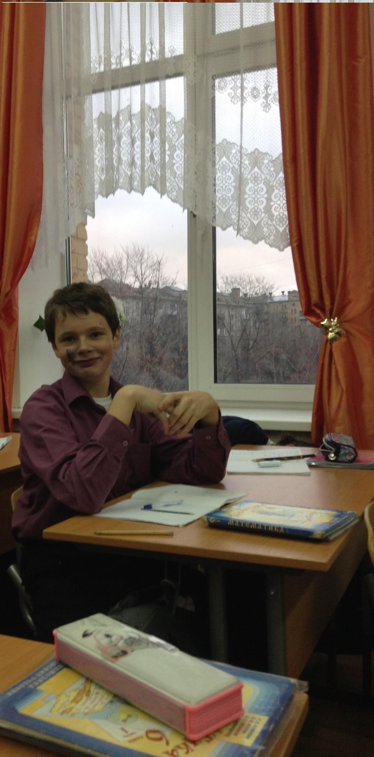
Buchenkov Bladimir about Tsalkin Boris
I have a good friend. His name is Boris. He is 12 years old. He likes to go to school. He is a good football player. In his free time he always plays computer games. His favourite music is rock. Also he likes eating and watching movies. His favourite food is Italian food. His favourite film is Spartak. He is a good friend.

Slide 11
Petrova Kate obout Tchitlova Tanya
I would like to tell some words about my friend Tany Chitlova. She is very kind and friendly. She is interested in playing the piano. She likes different styles of music, but most of all she likes rock. She often goes for a walk with her friends or they go to the cinema. She doesn’t like shopping. Tany prefers sport style in clothes. She likes clothes from Addidas. She likes dancing and she likes modern dance. She has never been to other countries. She likes animals, but she hasn’t got any pets at home.

Slide 12
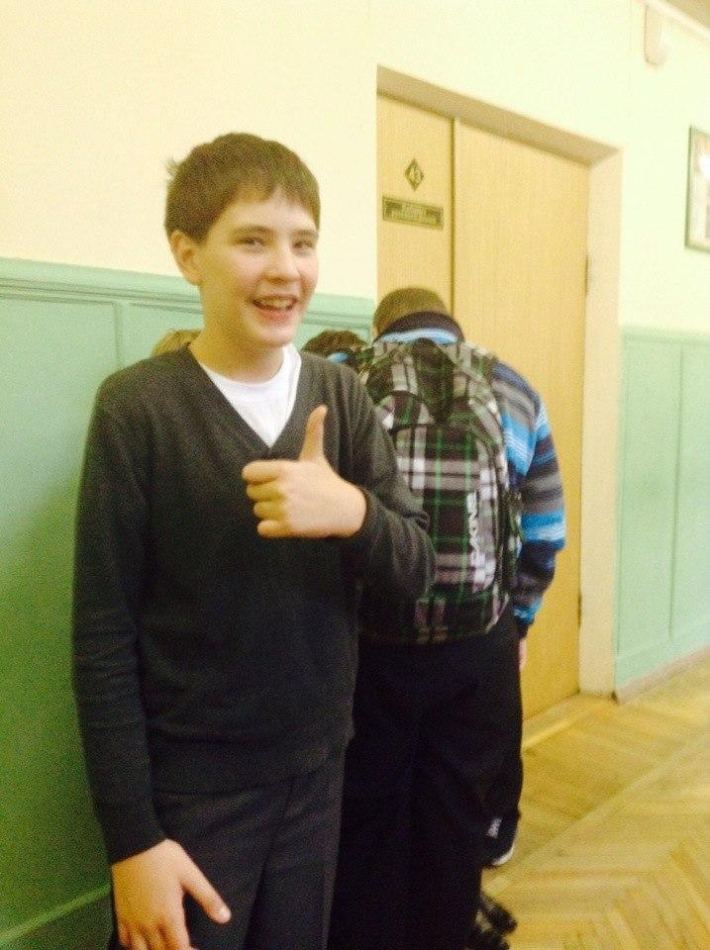
Tsalkin Boris obout Charkov Igor
I have got a friend! His name is Igor. He is 12 years old. He likes football. His favourite movie is “A green elephant”. He often plays computer games and rarely watches TV. He is a patriot but his favorite country is England. His favourite subject is History. His favorite book is “Lord of the ring”. His favourite computer game is “Total War”. He likes to spend his summer holiday in Egypt.

Slide 13
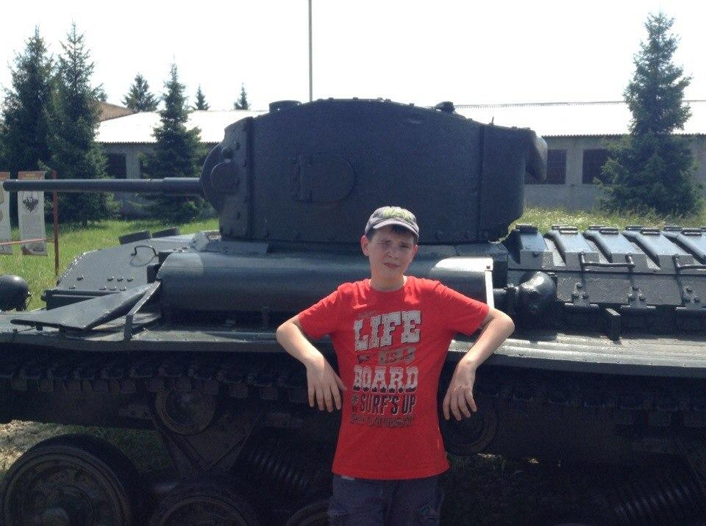

Slide 14
Charkov Igor about Buchenkov Bladimir
I have a good friend Vladimir.
His favorite movie is "Avatar” and his favourite music is rock. His favorite book is "Journey to the Center of the Earth" by Jules Verne. After school we communicate with each other using Skype. At the weekends we often go to the cinema, supermarkets and museums.
We have been friends for a long time, and I'm proud that we are friends.

Slide 15
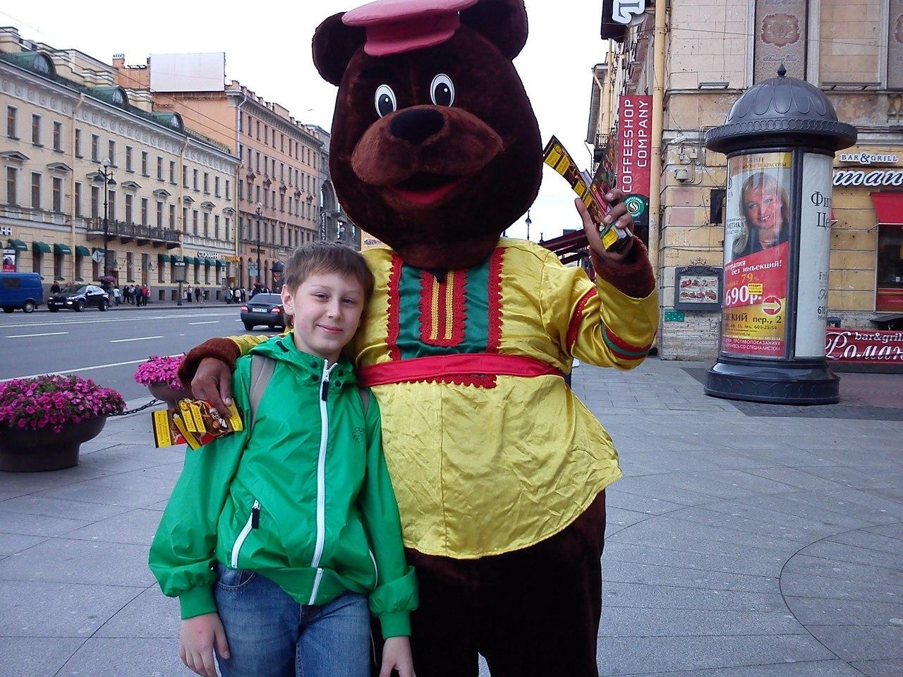
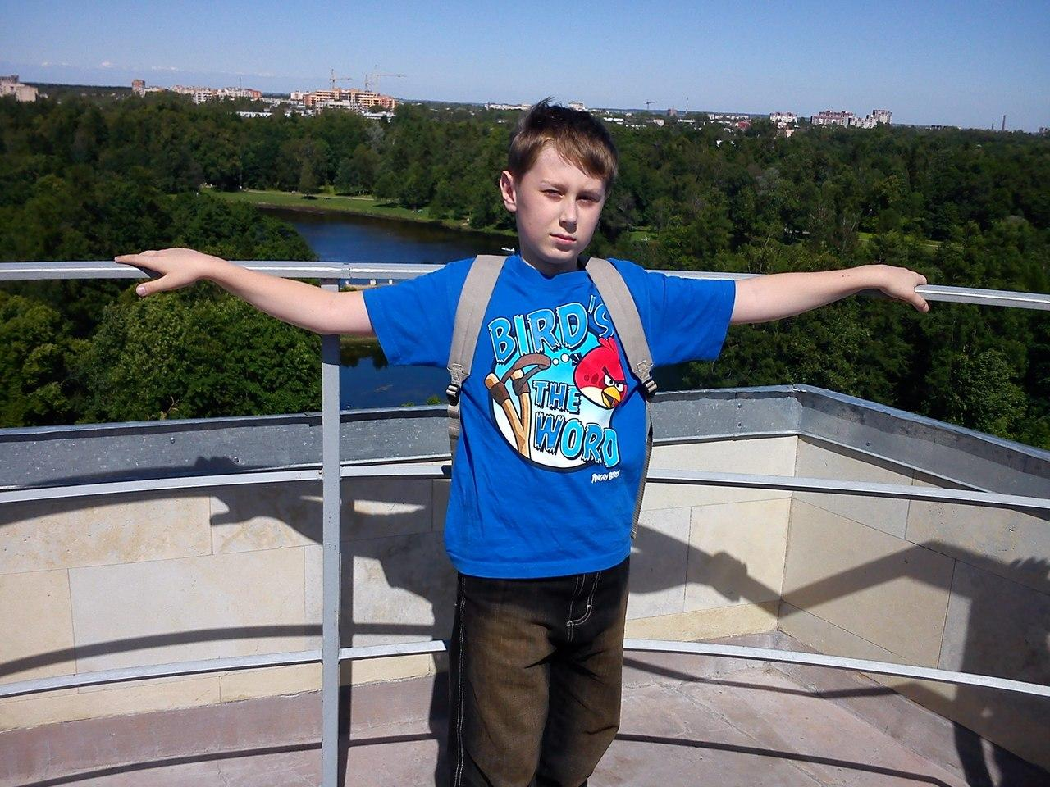

Slide 16
Ignatova Kate about Kulikova Anna
My best friend is Kukikova Anya. Ann enjoys dancing and singing. In her free time Ann walks with her friends. Last summer we were in Bulgaria. There we sang in the choir, swam in the Black sea and had a rest.
Ann likes shopping. She goes to the shopping center every week. Anya listens to different music and watches comedy films. Her favourite food is soup. Also her favourite color is peach.

Slide 17
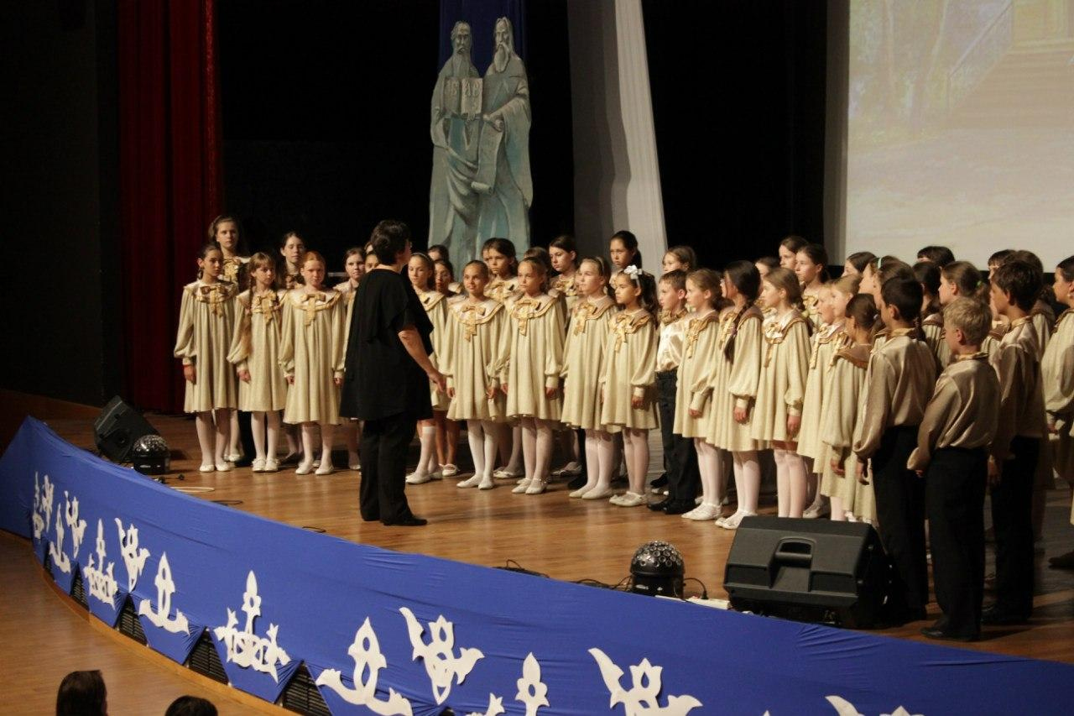

Slide 18
Kulikova Anna about Ignatova Kate
My best friend is Kate Ignatova. She is fond of singing. We sing in the choir “Raduga” together. Katya likes to walk with friends. In our free time she listen to music and watche films. Her favourite color is yellow. Her favourite food is spaghetti.

Slide 19
