Slide 1

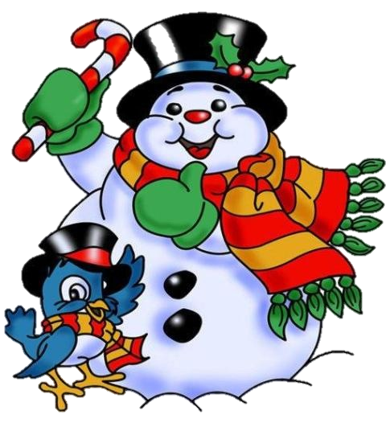
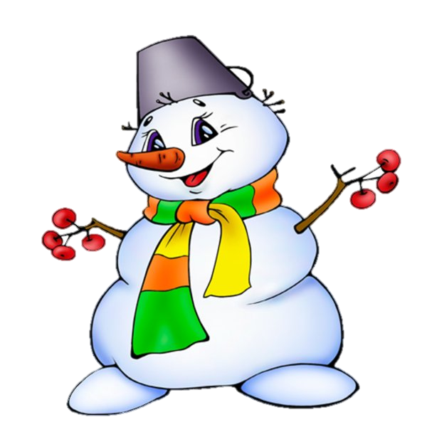
What are you doing for the winter holidays?

Slide 2
Unscramble the words and learn what we are going to speak about.
MASCHIRTS
NI REAGT BRTIAIN

Slide 3


Slide 4
The aim of the lesson is:
- to learn about celebrating Christmas in Great Britain
- to say what people are doing on Christmas

Slide 5

Listen, read and repeat
[k] – Christmas, decorate, decoration, capital, carols, consist
[s] – city, centre, central, December, celebrate
[θ]- the 25th of December, the 24th of December
[ə] – decorate, collect, consist, potato
[o:] – for, before, Norway, thought, law
[Λ] – London, Londoners, colour, coloured, money

Slide 6

Listen and say what season Simon and Susan like and why.
spring summer
autumn winter

Slide 7
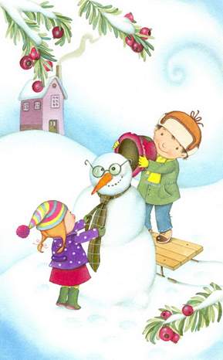
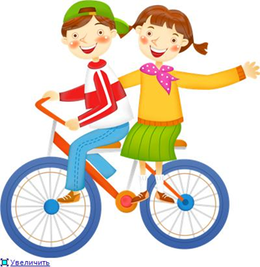
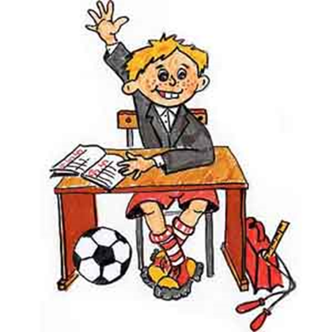
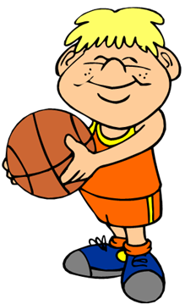

Say what season is the most favourite of your classmates. Why do they like it? Is it your favourite too?
… is the most favourite season, because we …
I like … too.

Slide 8
Read the text and find out:
Text A Text B
What present do 1. What have central
Londoners get every London’s got at
year from the people Christmas?
of Norway?
2. What is there in 2. When is Christmas
the centre of London Eve?
in winter?
3. What does British 3. What do Christmas
Christmas dinner groups of singers perform
consist of? in the streets and squares?

Slide 9
Fill in the missing information
Text A Text B
1. a big Christmas tree 1. beautiful decorations
2. A nice skating rink 2. traditional Christmas
songs and carols
3. Christmas pudding 3. the 24th of December

Slide 10
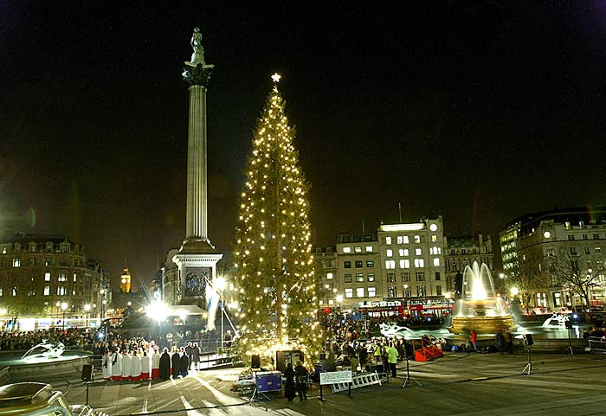
True or False?
F
T
T
F
T
F

Slide 11
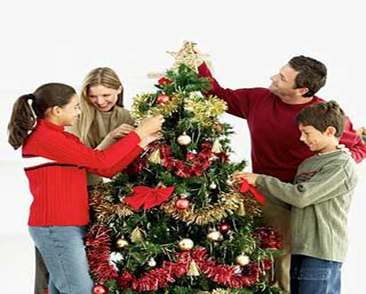
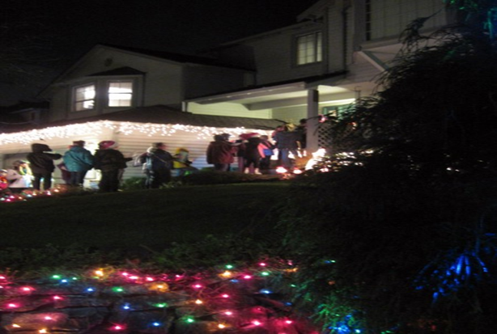
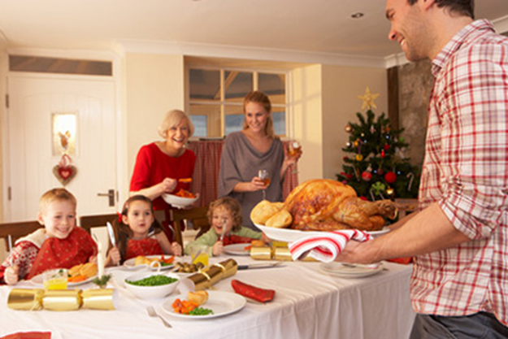
Say what people are doing on Christmas.
They are … ing.
For ideas: take a photo, skate, listen to music, speak on the phone, sing Christmas songs and carols, collect money for charity, decorate the Christmas tree, have Christmas dinner, enjoy Christmas

Slide 12

Homework
Ex. 11, 12, p.80

Slide 13
Let’s make a conclusion
Do you learn about celebrating Christmas in Great Britain?
Have you got a lot of practice?
What was easy to learn?
What was difficult?
What do you like?
What don’t you like?

Slide 14
Ресурсы
Биболетова М.З., Денисенко О.А., Трубанева Н.Н. Английский язык: Английский с удовольствием/ Enjoy English: учебник для 5 класса , Обнинск: Титул, 2012
“Enjoy English: 5 класс: Учебник ФГОС (CDmp3)” Биболетова М.З., Денисенко О.А., Трубанева Н.Н. - Обнинск: Титул, 2012.
www.images.yandex.ru

