Slide 1
Teenagers’ Leisure Activities in Great Britain

Slide 2
When we have free time
British teens have a lot of activities which include a wide variety, everything from gardening to travelling…

Slide 3
Playing computer games and watching TV

Slide 4
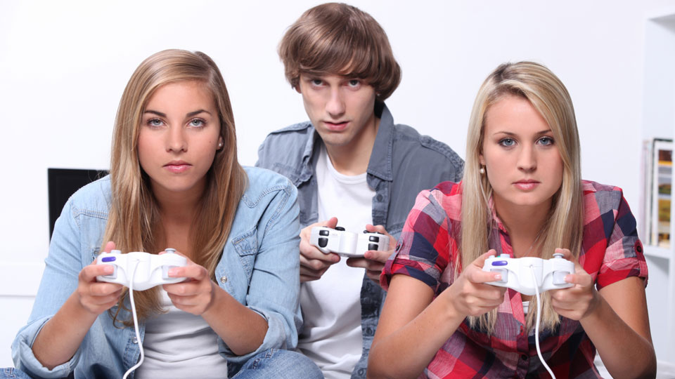
Watching videos and playing computer games with friends

Slide 5
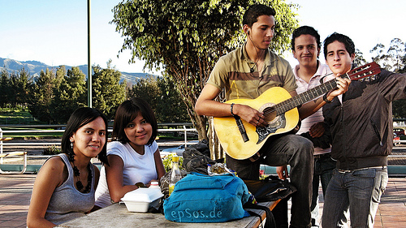
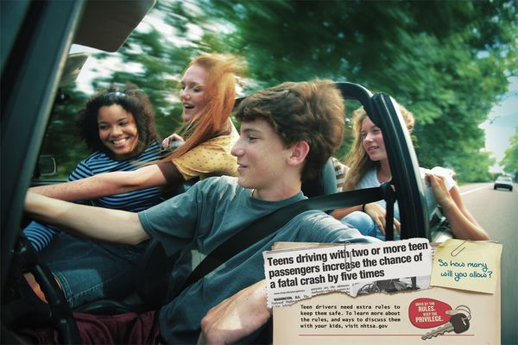
Hanging out with friends

Slide 6
Dancing

Slide 7
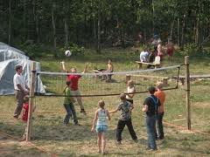
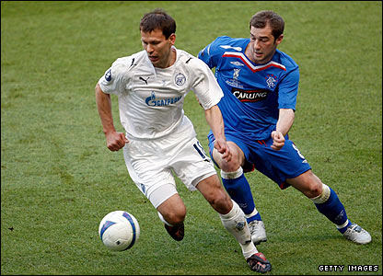
Playing and watching sports games

Slide 8
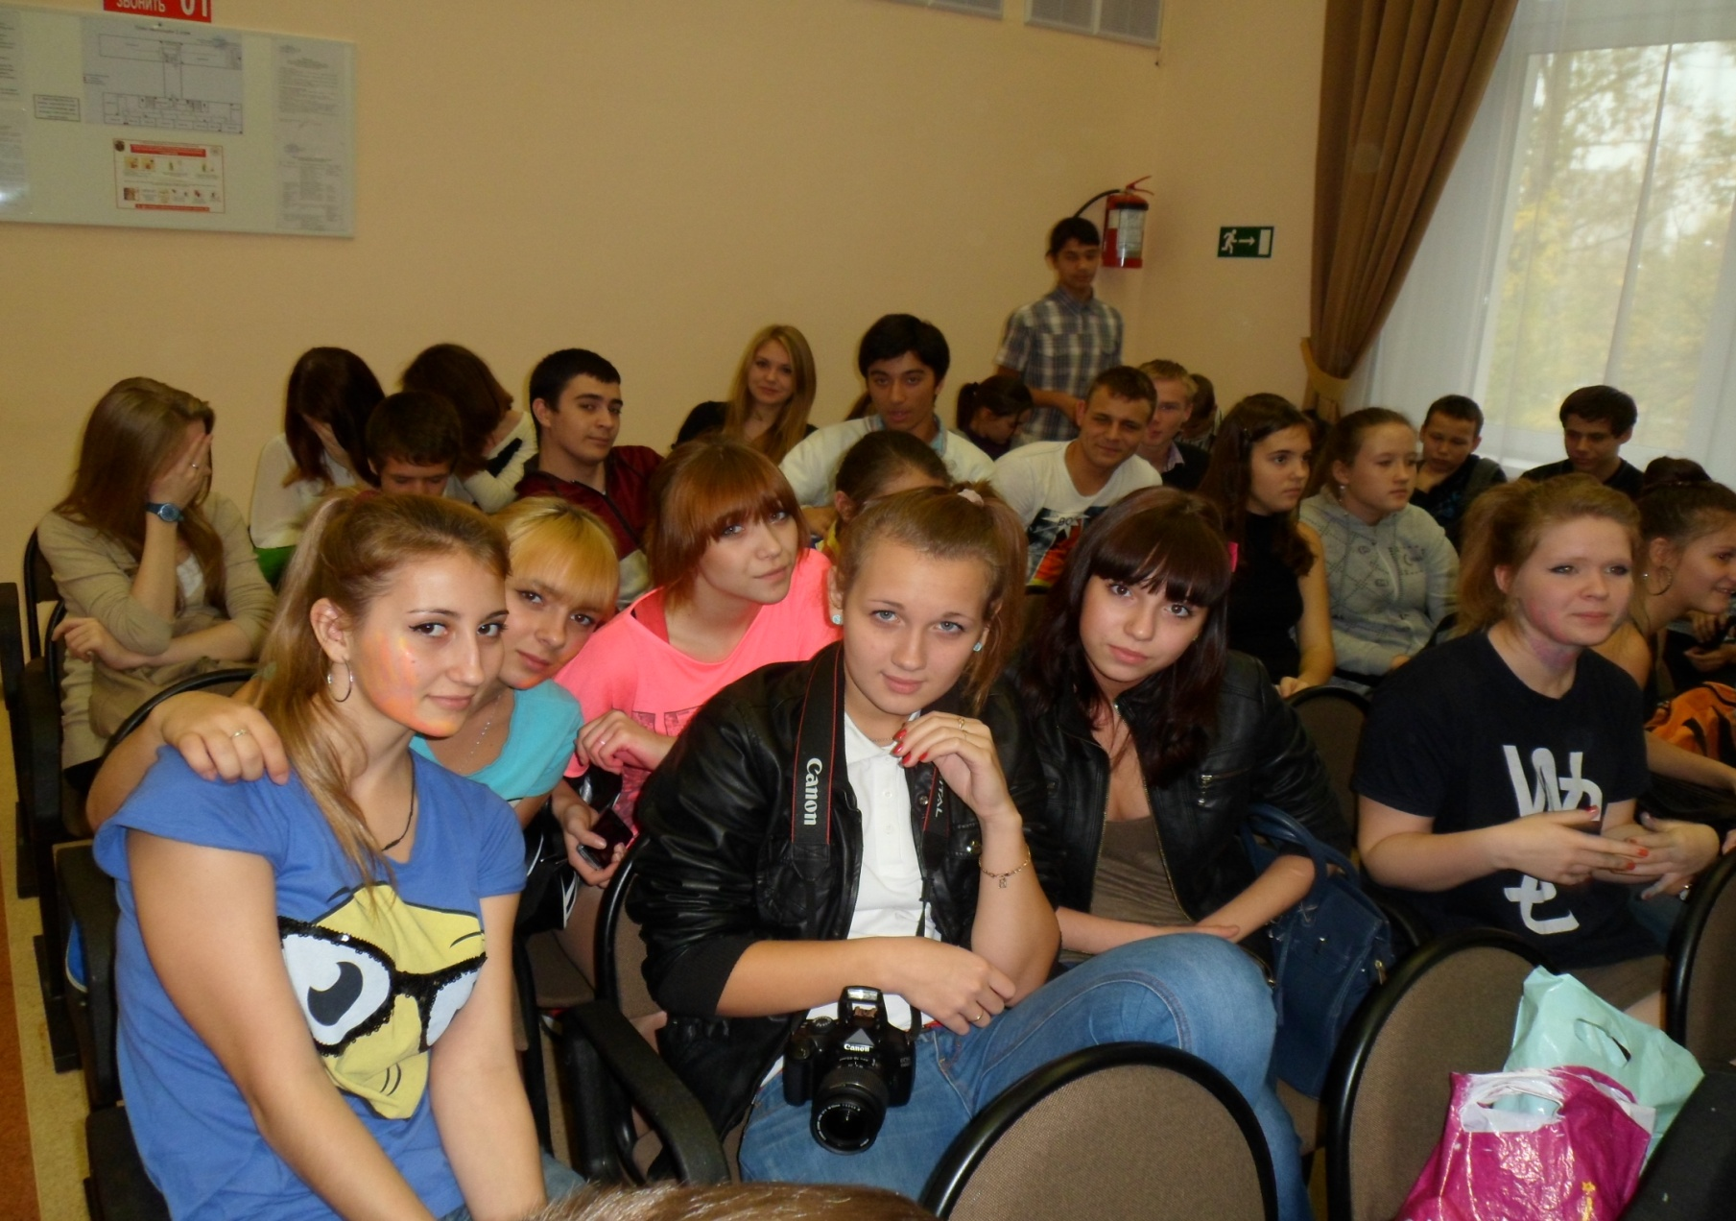
Going to the cinema or theatre

Slide 9
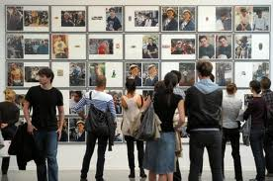
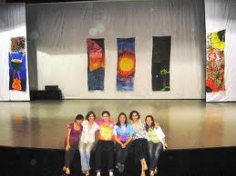
Visiting exhibitions

Slide 10
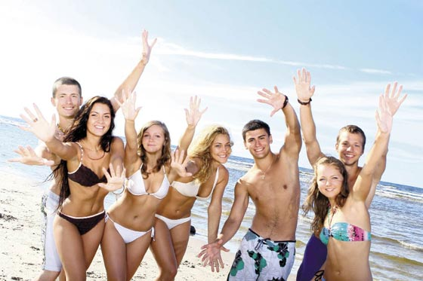
We enjoy holidays

Slide 11
School trips to museums

Slide 12
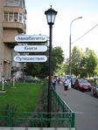
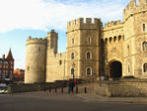
Travelling

Slide 13
Reading books or magazines

Slide 14
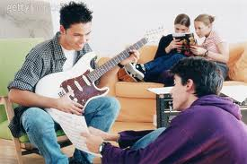
Listening to music and playing music

Slide 15
Taking part in festivals

Slide 16
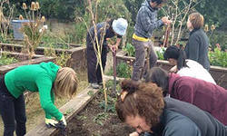
Gardening

Slide 17
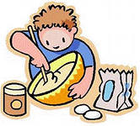
Cooking

Slide 18
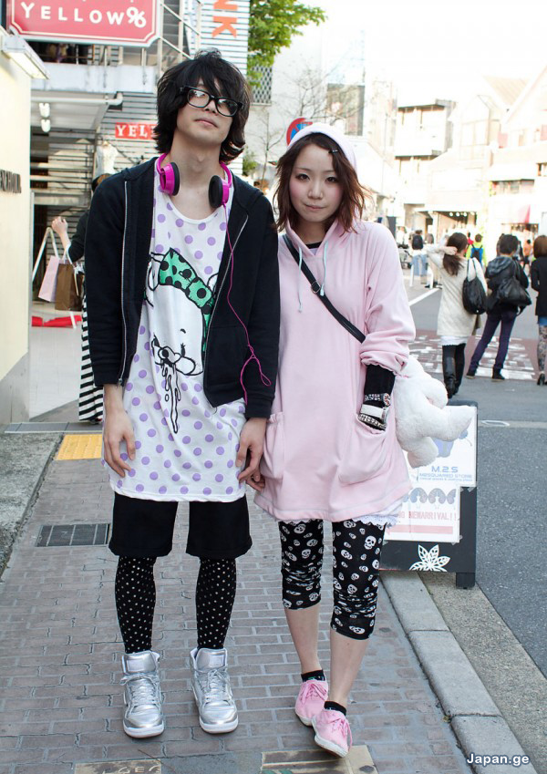
Going to malls and shopping

Slide 19
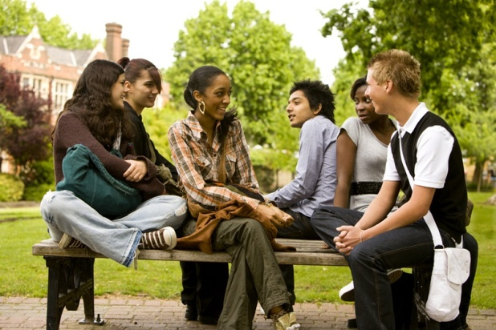
Every teenager wants to have a good future, to get a good education and a good job afterwards. Everybody wants to lead a good life and have a lot of money. ...
Nowadays there are a lot of youth problems , but we need to do everything possible and impossible to solve them.
We are all teens and we should start thinking about our future.

Slide 20
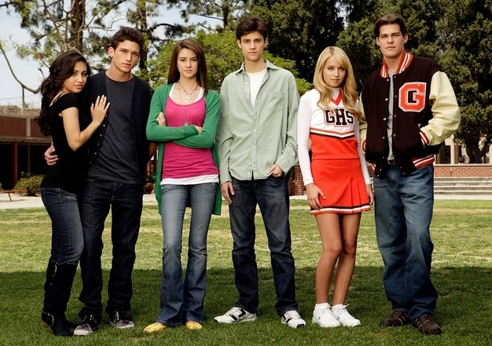
Thank you for your attention!
He is rich who is satisfied
Made by O. G. Sergeeva
School №842

