Slide 1
What do you collect?
What do you collect?
What do you collect?
What do you collect?

Slide 2
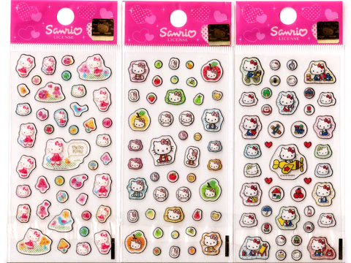
stickers

Slide 3
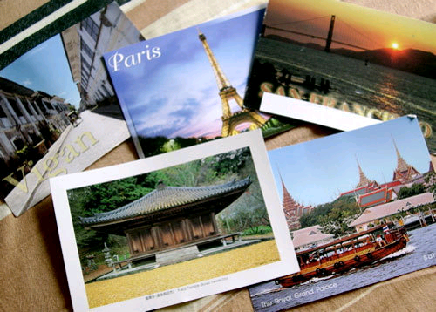
postcards

Slide 4
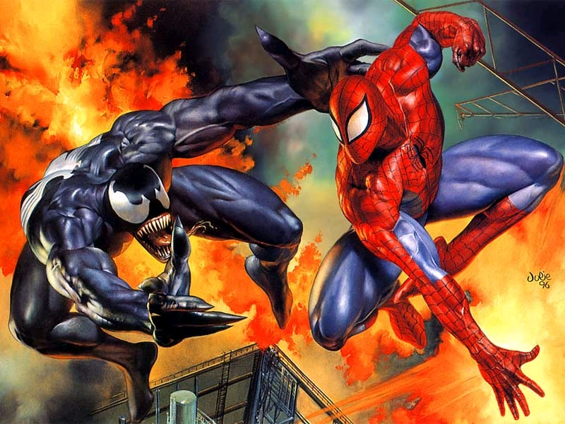
comics

Slide 5
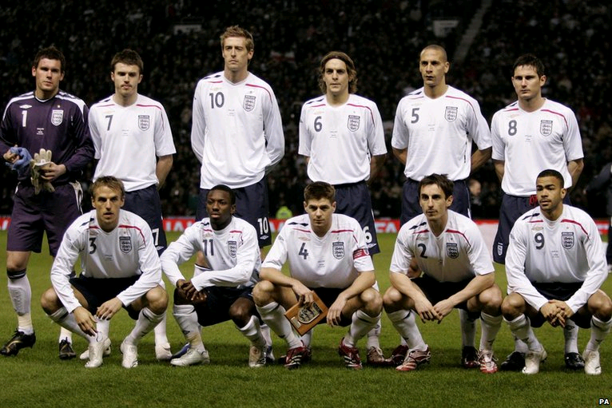
football pictures

Slide 6
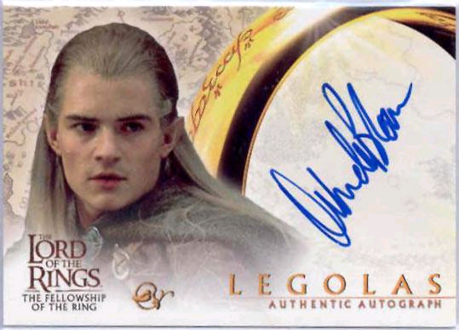
autographs

Slide 7
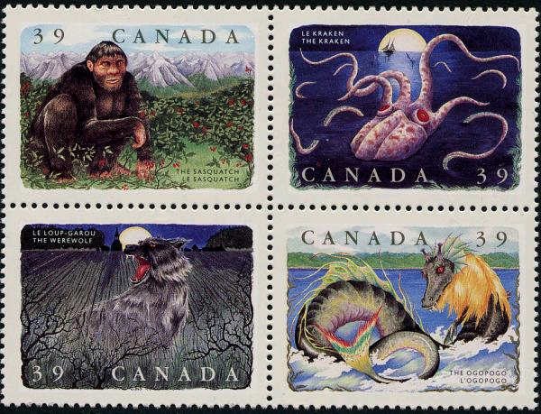
stamps

Slide 8
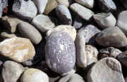
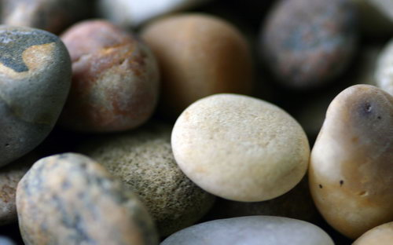
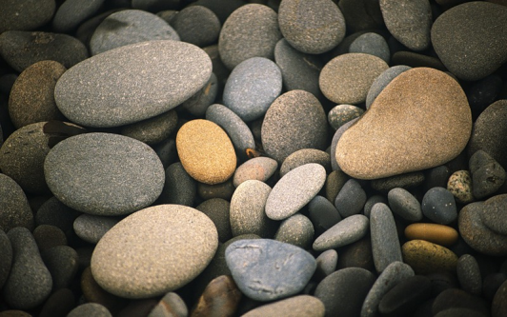
stones

Slide 9
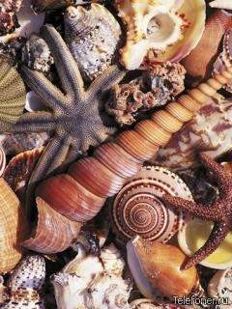
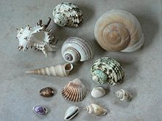
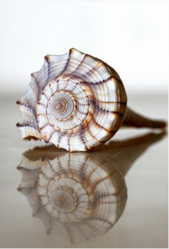
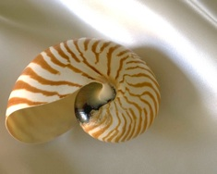
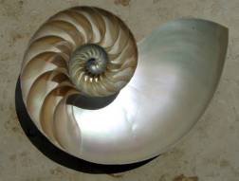
shells

Slide 10
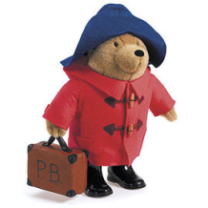
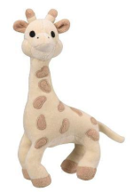
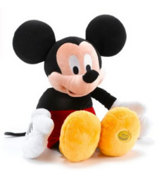
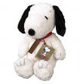
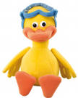
soft toys

Slide 11
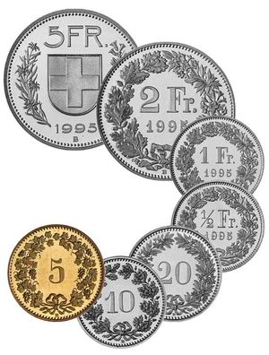
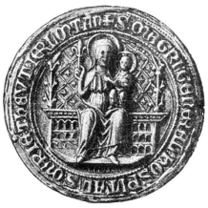
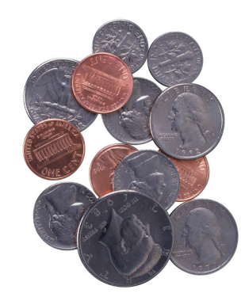
coins

Slide 12
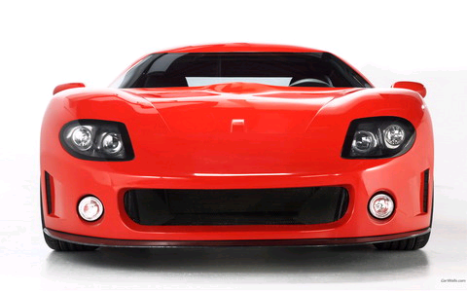
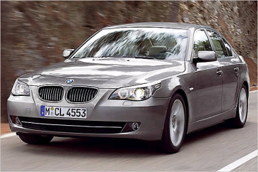
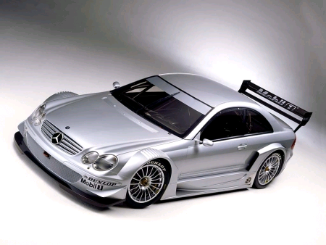
Photos of cars

Slide 13
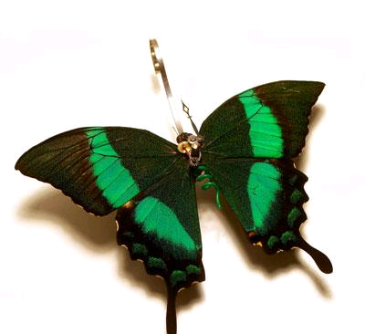
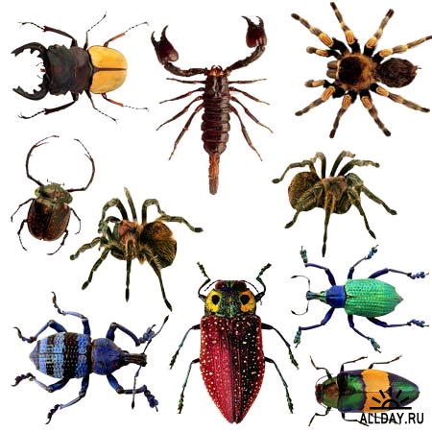
insects

Slide 14
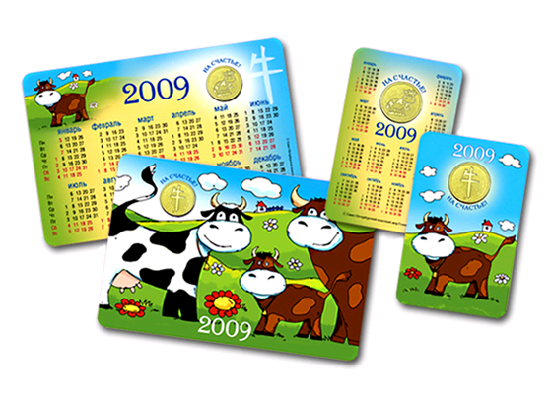
calendars

Slide 15
What do you collect?
stickers
cars
soft toys
insects
dolls
football pictures
stones
shells
animals
coins
dog collection
stamps
computer games
calendars
postcards
autographs
I collect

Slide 16
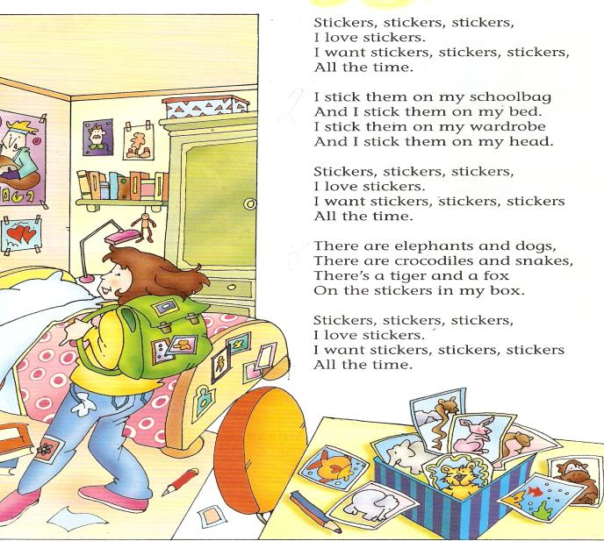
Let`s sing a song “Stickers”

Slide 17
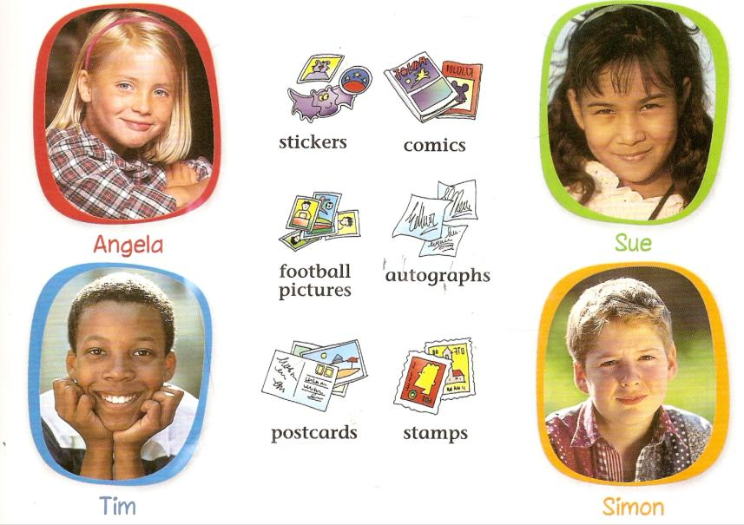

Slide 19
10 | ten
11 | eleven |  |  | 1 | one
12 | twelve | 20 | twenty | 2 | two
13 | thirteen | 30 | thirty | 3 | three
14 | fourteen | 40 | forty | 4 | four
15 | fifteen | 50 | fifty | 5 | five
16 | sixteen | 60 | sixty | 6 | Six
17 | seventeen | 70 | seventy | 7 | seven
18 | eighteen | 80 | eighty | 8 | eight
19 | nineteen | 90 | ninety | 9 | nine
a hundred

Slide 20
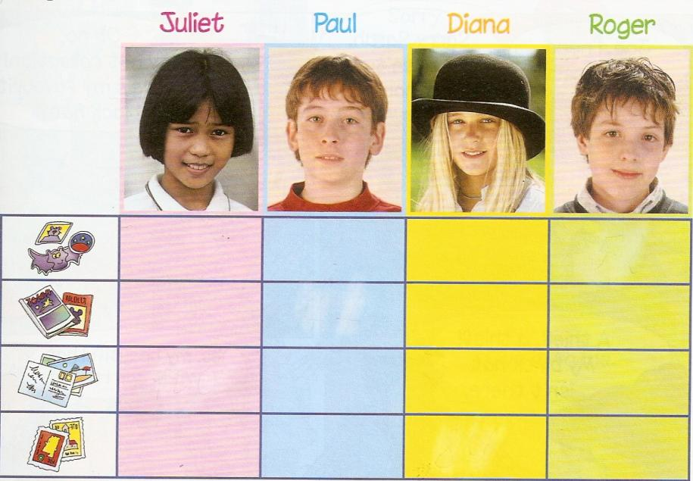

Slide 21
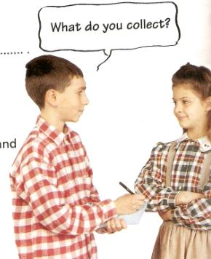
Listen and complete the dialogue:
What do you collect?
I collect autographs and ________________.
How many have you got?
I`ve go ________ autographs and about
_________________ _______________
Wow! That`s a lot!
books
seven
a hundred
books

Slide 22
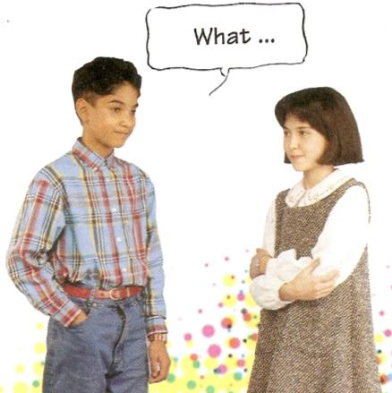
Put the dialogues in the correct order:
Football pictures? Ninety-five.
Eighty, I think.
Football pictures and comics.
And how many comics?
What do you collect, Susan?
How many have you got?

Slide 23
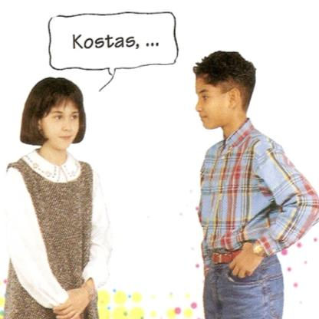
How many have you got?
I`ve got twenty-six.
Kostas, what do you collect?
Twelve? That`s not a lot.
Twelve.
Postcards.

Slide 24
need нуждаться thief вор
poster плакат reward награда
find находить later позже
гanch ранчо

Slide 25
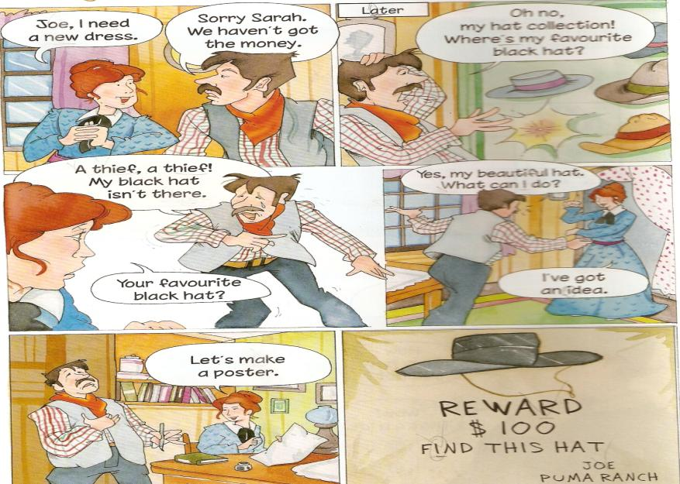
Joe`s favourite hat

Slide 26
