Slide 1
The Modal verb Can
Учитель: Антонова Наталья Ивановна
МБОУ – Сыланская средняя общеобразовательная школа имени Г.П.Башарина

Slide 2
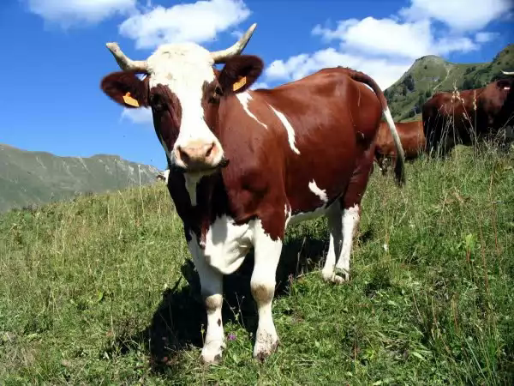
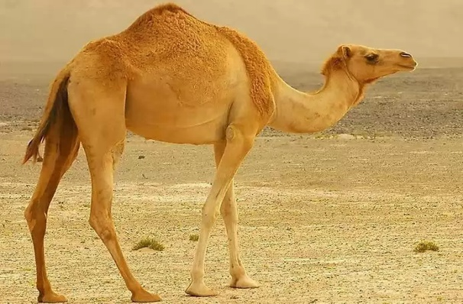
There are some riddles. Try to guess animals.
Answers:
1. I eat grass and hay
I am big. I live in the country.
You drink my milk.
I am a ---
2. I live in the hot country. I am big. I have a hump on my back. What am I?

Slide 3
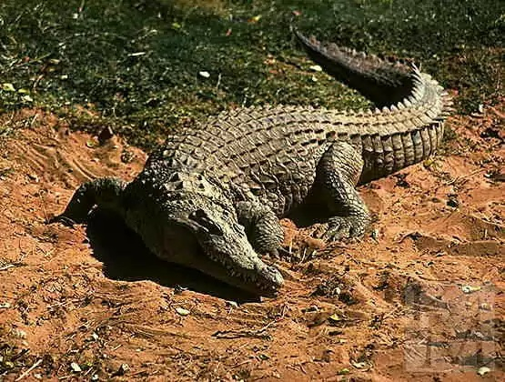
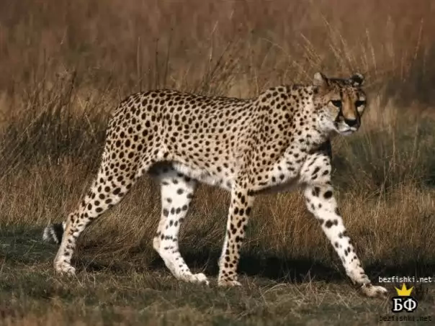
3. I live in the river.
I am green.
I am big. I hunt in small animals.
4. I am a wild animal.
I live in the forest.
I hunt in small animals.
I have spots.

Slide 4
Tell the names of animals.
For example: A kangaroo - кенгуру
What is a dolphin?
Дельфин
What is a pelican?
Пеликан
What is a giraffe?
Жираф
What is a hippo?
Бегемот

Slide 5
the rule of reading the letter “e” at the end of the word.
E [─] | little jungle name crocodile type love giraffe face favourite have tense

Slide 6
Read the tale and answer the questions. You must read this story one by one. Divide in two groups.
The first group will find animals.
The second group will find verbs.

Slide 7
WHAT ANIMALS DO WE HAVE IN THIS STORY?
WHAT THEY DO?
- A DOG
-KITTENS
- CHICKS
-A HEN
RUN
LIVE
SAY
MEET

