Slide 1
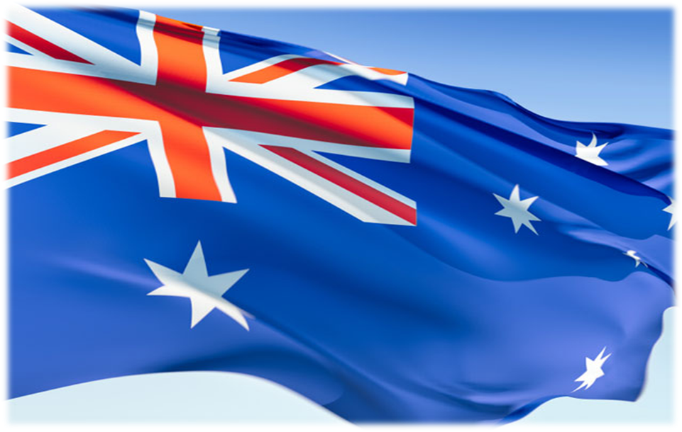
Life in Australia

Slide 2
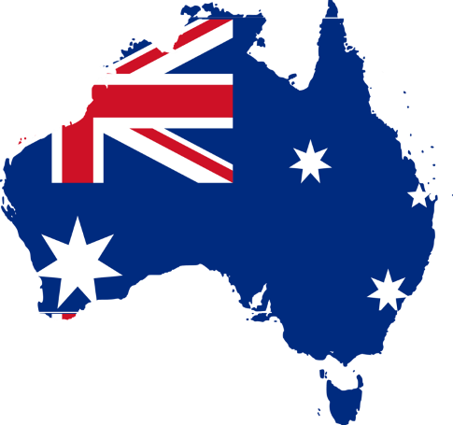
Facts and figures
National capital | Canberra
Largest city | Sydney
Mainland coastline | 35 877 km.
Language | English
Population | 21 million
Proportion born overseas | Almost 22%
Surface area | 7.74 million square km.
Currency | Australian dollars ($A)
Workforce | 10.28 million

Slide 3
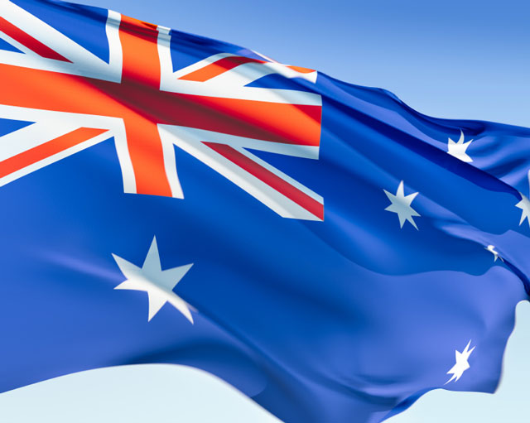
The flag of Australia is a defaced Blue Ensign: a blue field with the Union Flag in the canton (upper hoist quarter), and a large white seven-pointed star known as the Commonwealth Star in the lower hoist quarter. The fly contains a representation of the Southern Cross constellation, made up of five white stars – one small five-pointed star and four, larger, seven-pointed stars. The flag's original design (with a six-pointed Commonwealth Star) was chosen in 1901 from entries in a worldwide competition held following Federation, and was first flown in Melbourne on 3 September 1901. A slightly different design was approved by King Edward VII in 1902. Over the next few years, the exact specifications of the flag were changed several times both intentionally and as a result of confusion.

Slide 4
Coat of arms of Australia
The coat of arms of Australia (formally known as Commonwealth Coat of Arms) is the official symbol of Australia. The initial coat of arms was granted by King Edward VII on 7 May 1908, and the current version was granted by King George V on 19 September 1912, although the 1908 version continued to be used in some contexts, notably appearing on the sixpenny coin until 1966.

Slide 5
Advance Australia Fair
Australians all let us rejoice, For we are young and free; We've golden soil and wealth for toil; Our home is girt by sea; Our land abounds in nature's gifts Of beauty rich and rare; In history's page, let every stage Advance Australia Fair. In joyful strains then let us sing, Advance Australia Fair.
"Advance Australia Fair" is the official national anthem of Australia. Created by the Scottish-born composer, Peter Dodds McCormick, the song was first performed in 1878, but did not gain its status as the official anthem until 1984.

Slide 6
Geography
Australia's landmass of 7,617,930 square kilometers is on the Indo-Australian plate. The continent of Australia, including the island of Tasmania, was separated from the other continents of the world many millions of years ago. Because of this, many animals and plants live in Australia that are not found anywhere else. These include animals like the kangaroo, the koala, the emu, the kookaburra, and the platypus.
People first arrived in Australia more than 50,000 years ago. These native Australians are called the Australian Aborigines.

Slide 8
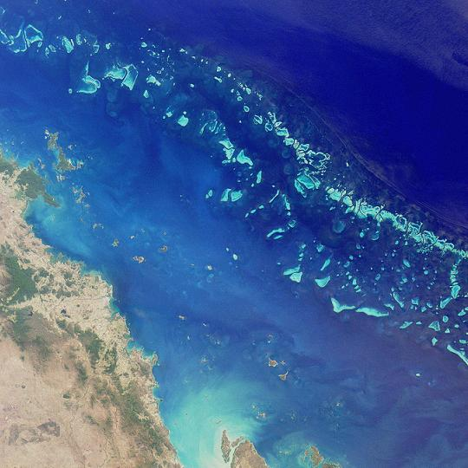
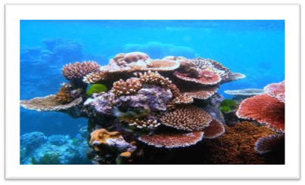
Great Barrier Reef
The Great Barrier Reef is the world's largest reef system composed of over 2,900 individual reefs and 900 islands stretching for over 2,600 kilometers (1,600 mi) over an area of approximately 344,400 square kilometers (133,000 sq mi). The reef is located in the Coral Sea, off the coast of Queensland in north-east Australia.
The Great Barrier Reef has long been known to and used by the Aboriginal Australian and Torres Strait Islander peoples, and is an important part of local groups' cultures and spirituality. The reef is a very popular destination for tourists, especially in the Whitsunday Islands and Cairns regions. Tourism is an important economic activity for the region, generating $1 billion per year.

Slide 9
Uluru-Kata Tjuta National Park
Uluṟu-Kata Tjuṯa National Park is UNESCO World Heritage-listed in the Northern Territory of Australia. It is located 1431 kilometers south of Darwin by road and 440 kilometers south-west of Alice Springs along the Stuart and Lasseter Highways. The park covers 2010 square kilometers and includes the features it is named after - Uluru / Ayers Rock and, 40 kilometers to its west, Kata Tjuta. Mount Olga and is serviced by flights from most Australian capital cities.

Slide 10
Uluru-Kata Tjuta National Park
Europeans came to the western desert area of Australia in the 1870s.
Uluru and Kata Tjuta were first mapped by Europeans during the expeditionary period made possible by the construction of the Overland Telegraph Line in 1872.
In separate expeditions, William Ernest Powell Giles and William Christie Gosse were the first European explorers to this area. In 1872 while exploring the area, Ernest Giles sighted Kata Tjuta from near Kings Canyon and called it Mount Olga, while the following year Gosse saw Uluru and named it Ayers Rock after Sir Henry Ayers, the Chief Secretary of South Australia. Further explorations followed with the aim of establishing the possibilities of the area for pastoralism.

Slide 11
The Sydney Opera House is a multi-venue performing arts center in the Australian city of Sydney. It was conceived and largely built by Danish architect Jørn Utzon, finally opening in 1973 after a long gestation starting with his competition-winning design in 1957. Utzon received the Pritzker Prize, architecture's highest honour, in 2003. The Sydney Opera House was made a UNESCO World Heritage Site on 28 June 2007. It is one of the 20th century's most distinctive buildings and one of the most famous performing arts centres in the world.

Slide 12
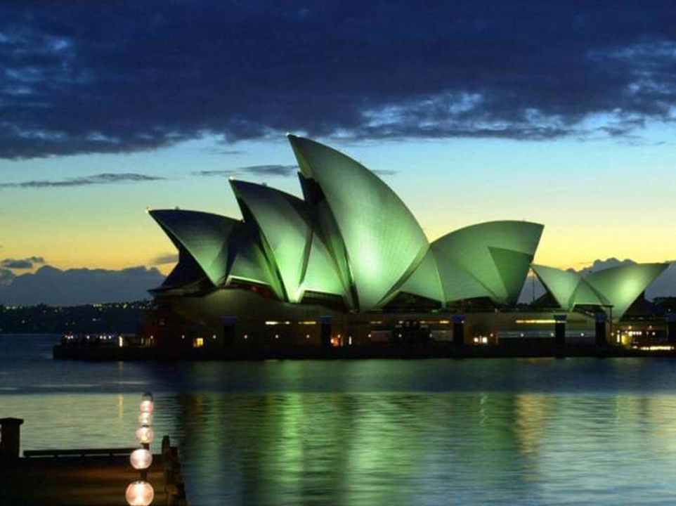
It sits at the northeastern tip of the Sydney central business district (the CBD), surrounded on three sides by the harbour (Sydney Cove and Farm Cove) and neighbored by the Royal Botanic Gardens.
Contrary to its name, the building houses multiple performance venues. As one of the busiest performing arts centres in the world, hosting over 1,500 performances each year attended by some 1.2 million people, the Sydney Opera House provides a venue for many performing arts companies including the four key resident companies Opera Australia, The Australian Ballet, the Sydney Theatre Company and the Sydney Symphony Orchestra, and presents a wide range of productions on its own account. It is also one of the most popular visitor attractions in Australia, with more than seven million people visiting the site each year, 300,000 of whom take a guided tour.

Slide 14
2000 Summer Olympics
The Sydney 2000 Summer Olympic Games or the Millennium Games/Games of the New Millennium, officially known as the Games of the XXVII Olympiad, were an international multi-sport event which was celebrated between 15 September and 1 October 2000 in Sydney, New South Wales, Australia. It was the second time that the Summer Olympics were held in the Southern Hemisphere, the first one being in Melbourne in 1956, and as a result of this location and the dates, took place in early spring.

Slide 15
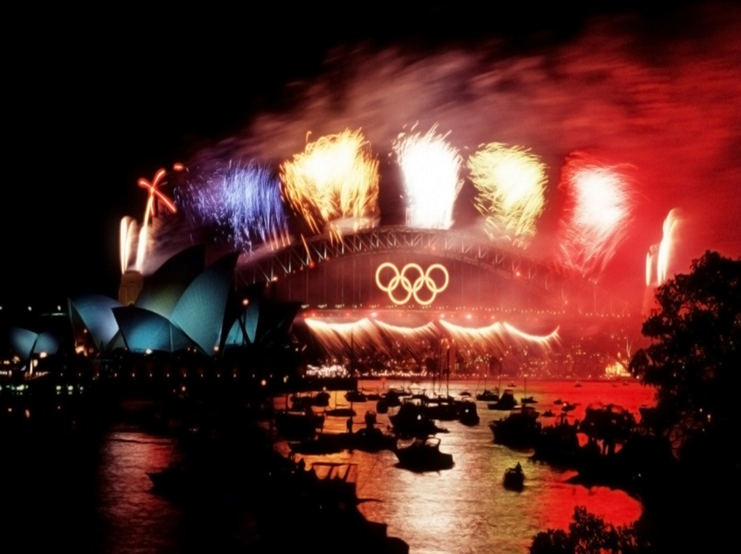
Sydney won the right to host the Games on 24 September 1993, after being selected over Beijing, Berlin, Istanbul and Manchester in four rounds of voting, at the 101st IOC Session in Monte Carlo, Monaco
2000 Summer Olympics bidding results
City NOC Name Round 1 Round 2 Round 3 Round 4
Sydney Australia 30 30 37 45
Beijing China 32 37 40 43
Manchester Great Britain 11 13 11 —
Berlin Germany 9 9 — —
Istanbul Turkey 7 — — —
The main venue (Stadium Australia) host concerts and sporting events every year including the annual NRL Grand Final (Rugby League), being the home ground of two NRL teams (Bulldogs and Rabbitohs) it is used constantly in winter. The Aquatic center became a public swimming center. The Olympic site itself has been used for the final race of the V8 Supercars Championship (Sydney 500) since 2009.
Unlike Beijing, Sydney sold out its events and unlike Athens (2004), the venues had fully completed construction.

