Slide 1
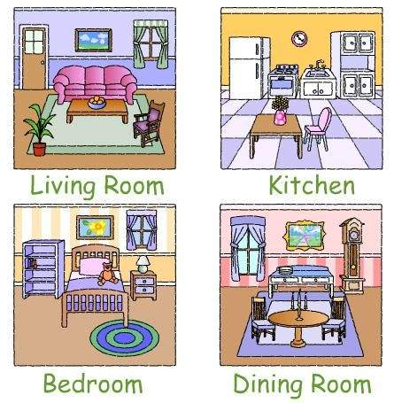

Slide 2
a house
a block of flats
a floor
a living room
a kitchen
a bathroom
a bedroom
a hall
a dining room
a garden
a garage

Slide 3
a wardrobe
a bed
a lamp
a desk
a bookcase
a book-books
a carpet
a mirror
a washbasin
a toilet
a bath

Slide 4
a sink
a cooker
a fridge
a chair-chairs
a table
a painting-paintings
an armchair
a window
a sofa
a coffee table

Slide 5
in
on
near
by
next to
under
behind
in front of
opposite
between

Slide 6
There is…
There isn’t…
Is there…?
There are…
There aren’t…
Are there…?

Slide 7
“I’m a room designer”

