Slide 1
American auto industry 19-21 century
Выполнила
учитель английского языка
Иванова Наталия Евгеньевна
2019

Slide 2
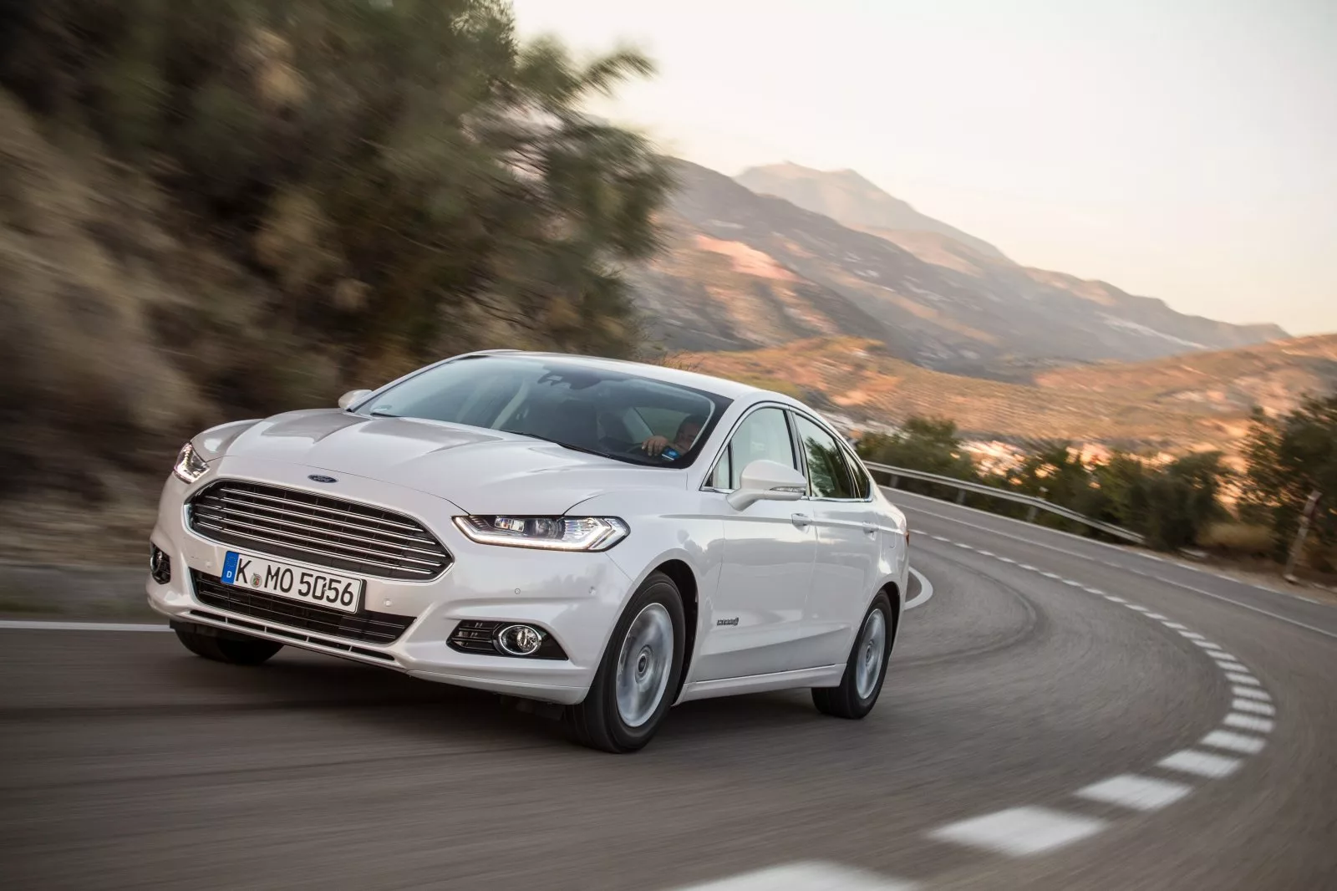
Relevance
Now there is a wide variety of makes and models of cars. I want to tell people how the production of cars in America began, so that people have an idea of ​​how everything developed over time.

Slide 3
Target
Expand knowledge of the automobile industry of the 19-20th century to form a clear idea of ​​modern cars.

Slide 4
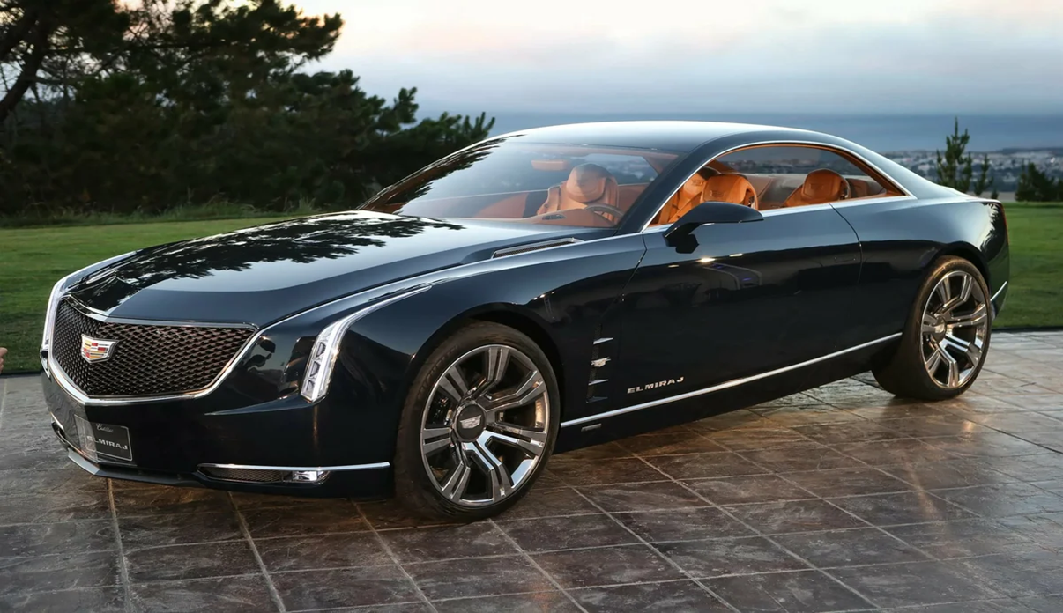
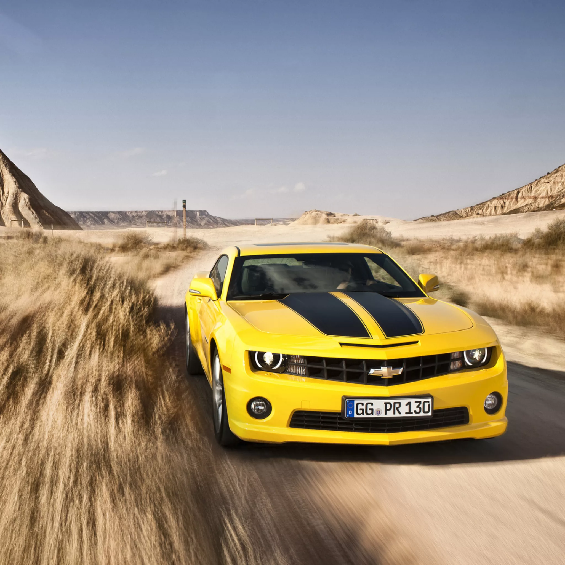
Hypothesis
I want to prove that the auto industry has changed a lot since the 18th century and achieved a great success so that now everyone can afford to have a good car.

Slide 5
Tasks
1. Remind people the history of the 19-20th century
2. Create a more confident view of the American auto industry
3. Tell about popular museums of the automobile industry
4. How production developed
5. Explain how cars reflected cultural development

Slide 6
Plan
1. How did the ideas for creating cars come
2. Development of production
1)when the automotive industry was born
2) how it developed
3) what came to
3. How cars reflected cultural development
4. List of automobile industry museums and what is represented there

Slide 7
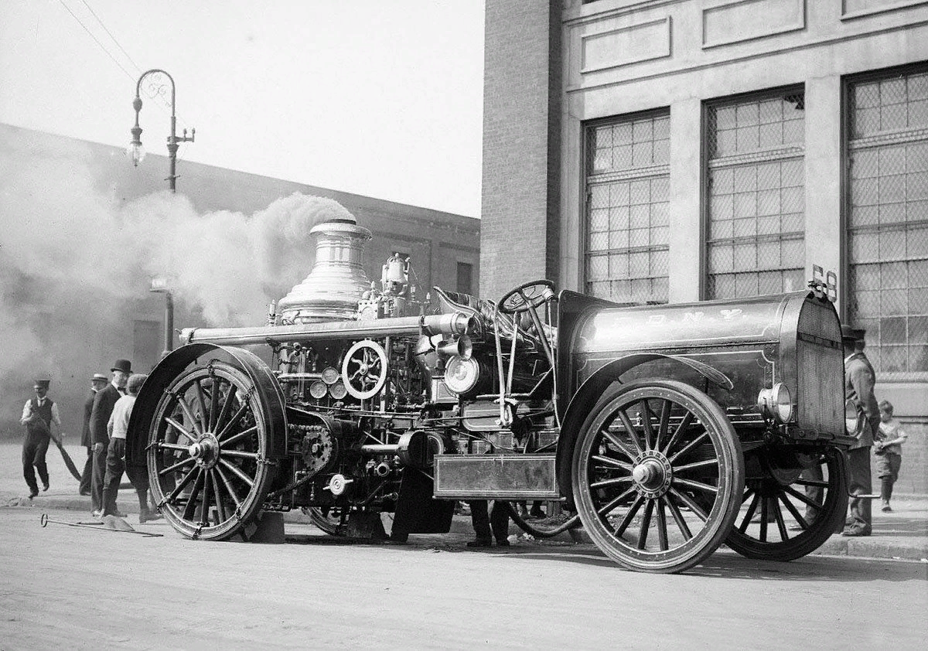
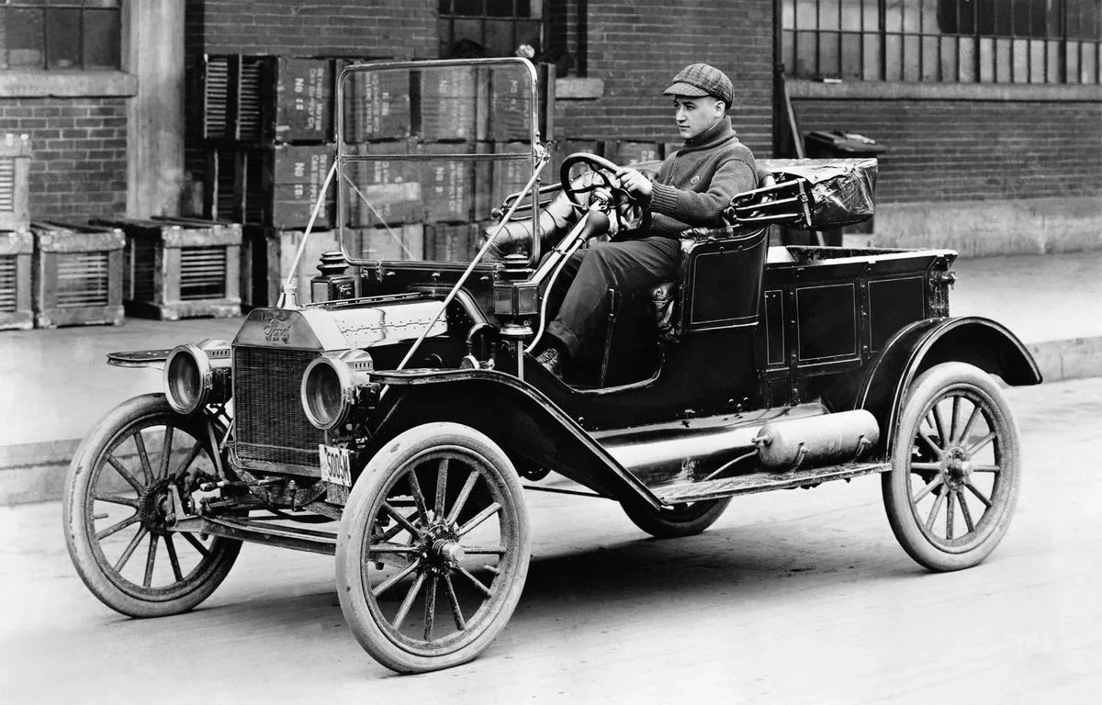
1. Firstly, steam engineering developed. In 1890, the first working internal combustion engine appeared in America.

Slide 8
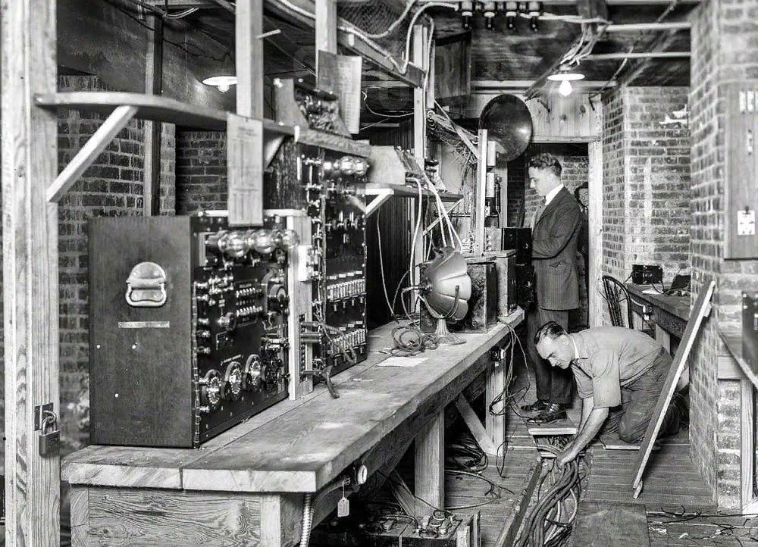
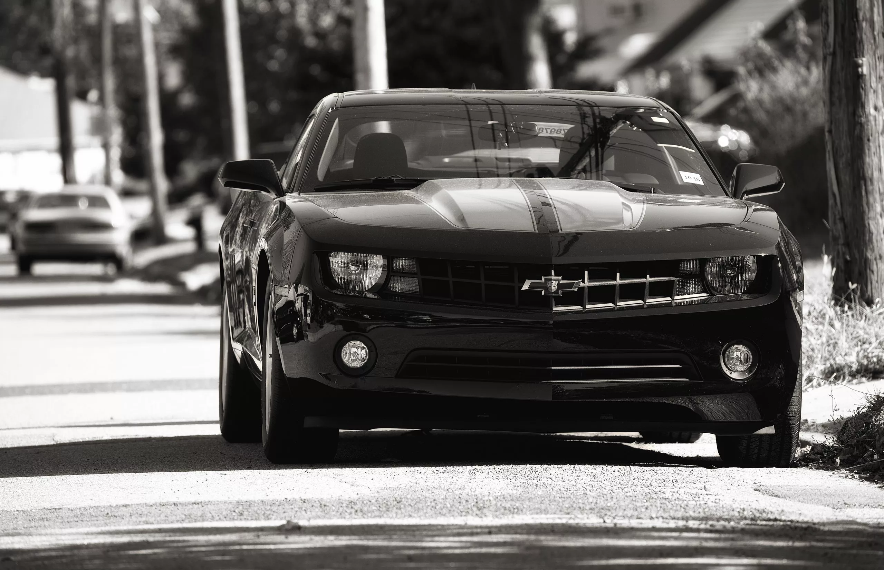
2. 1) The automotive industry grew rapidly. Henry Ford believed in the idea of ​​creating a "people's car." “I will produce cars for hundreds of thousands of Americans,” he said.
2) Ford's wide soul has allowed many Americans to start their own business in the automobile industry. Hundreds of ambitious Americans decided to arrange production based on Ford's technical developments.
3) Years passed, and the American automobile industry turned into the strongest in the world.

Slide 9
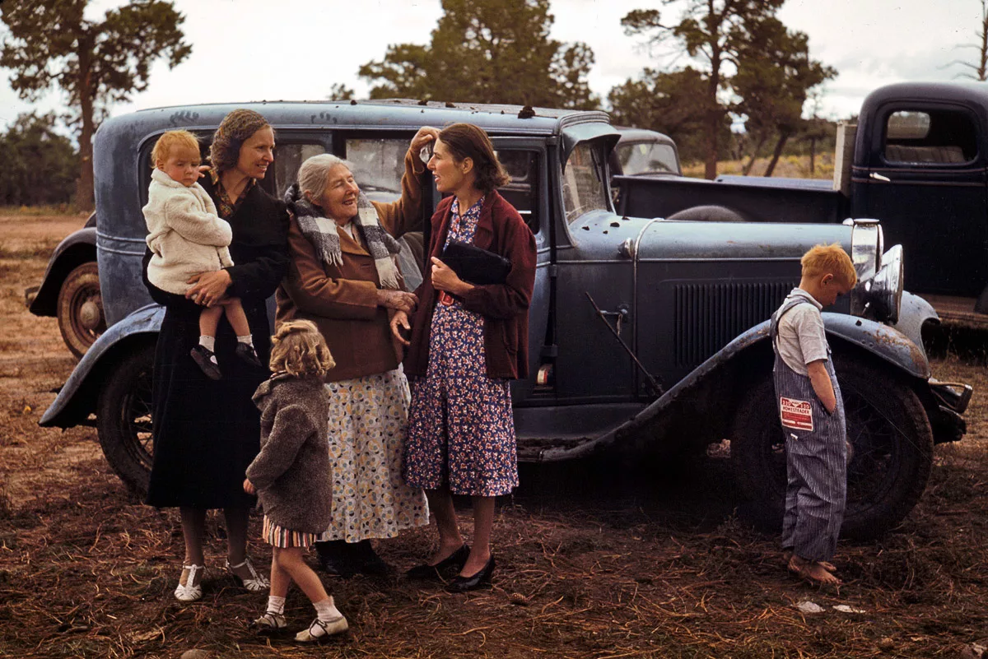
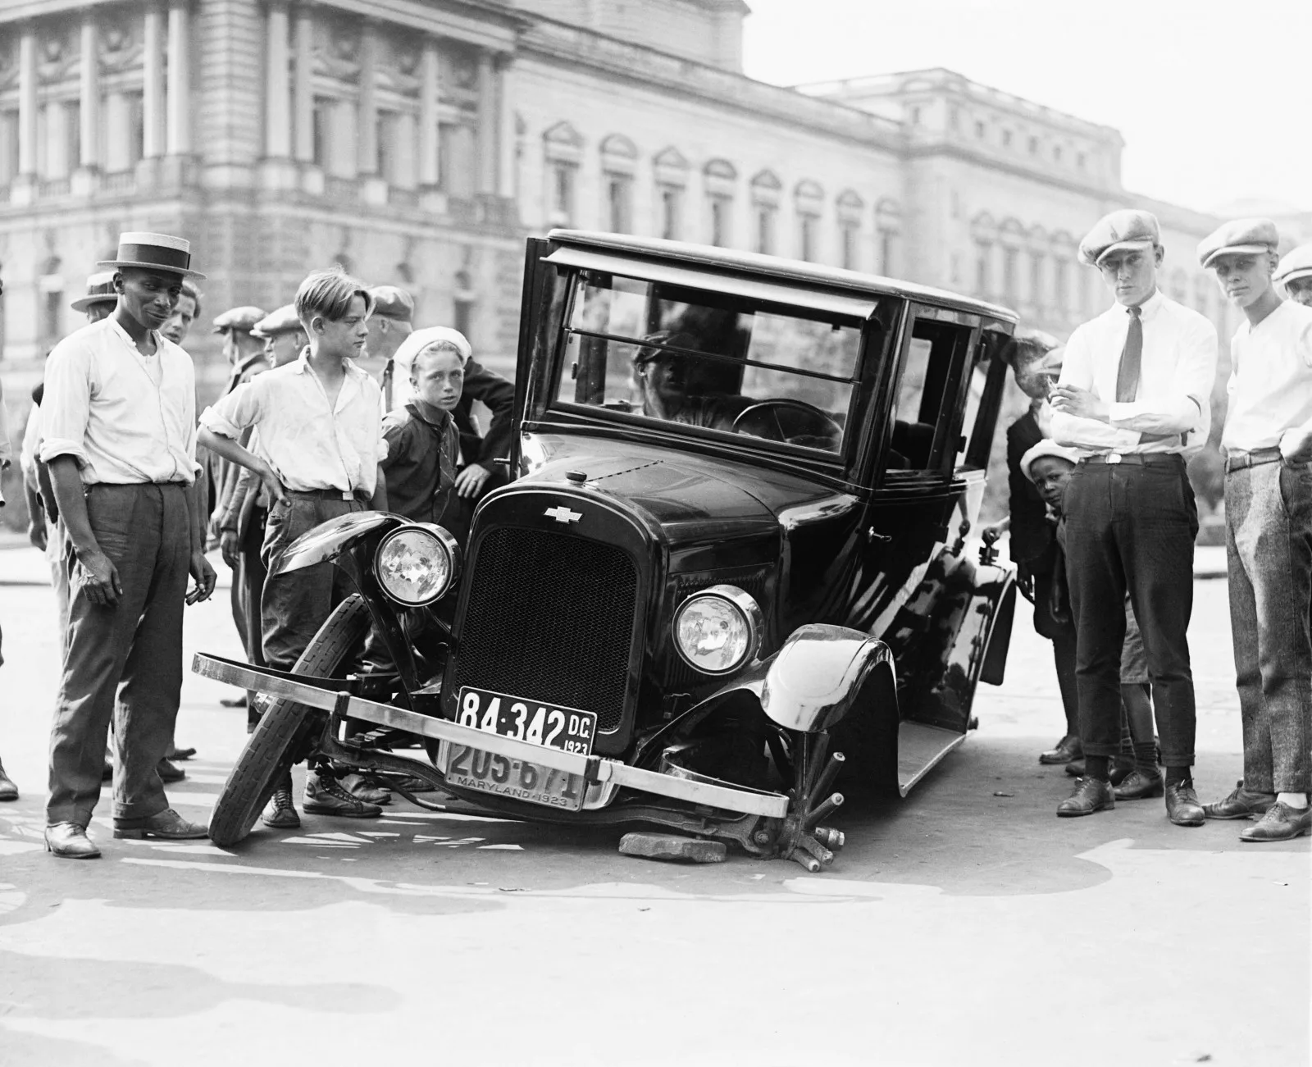
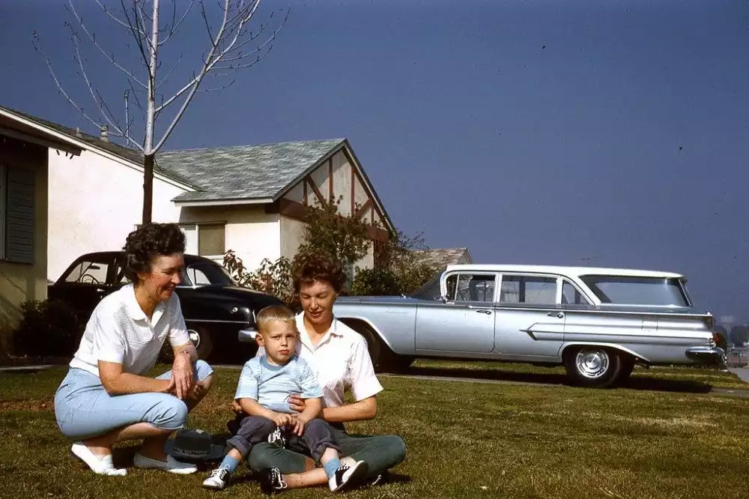
3. In both technical and social terms, the car represents progress. John Urry is convinced that the car forms a special culture. The car has become a way of self-expression.

Slide 10
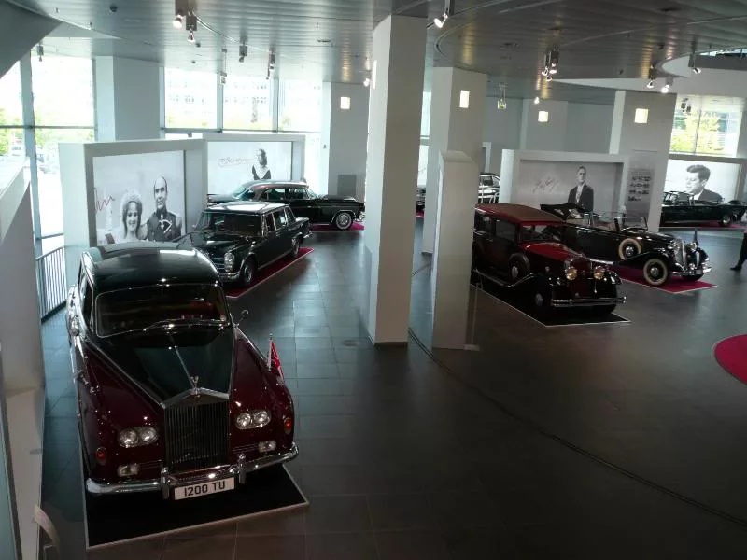
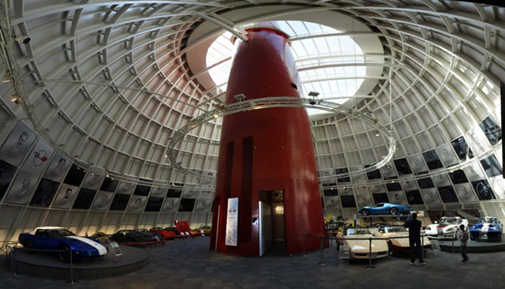
2) National Chevrolet Corvette Car Museum in Bowling Green, USA
4. 1) Peterson Automobile Museum in Los Andes, USA

Slide 11
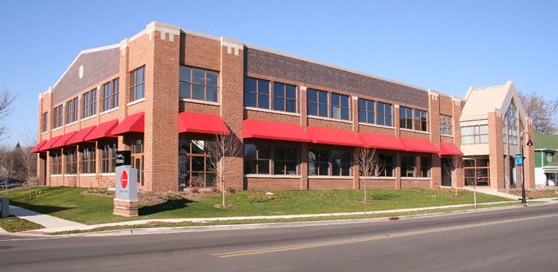
3) Studebaker National Automobile Museum in South Brand, USA
4) Henry Ford Museum in Detroit, USA

Slide 12
Has the car manufacturing quality improved at the moment?
90 %
Improved
2 %
Worsened
8 %
Difficult to answer
The results of the survey show that most people see the development of the automobile industry for the better and appreciate the merits of the developers.

Slide 13
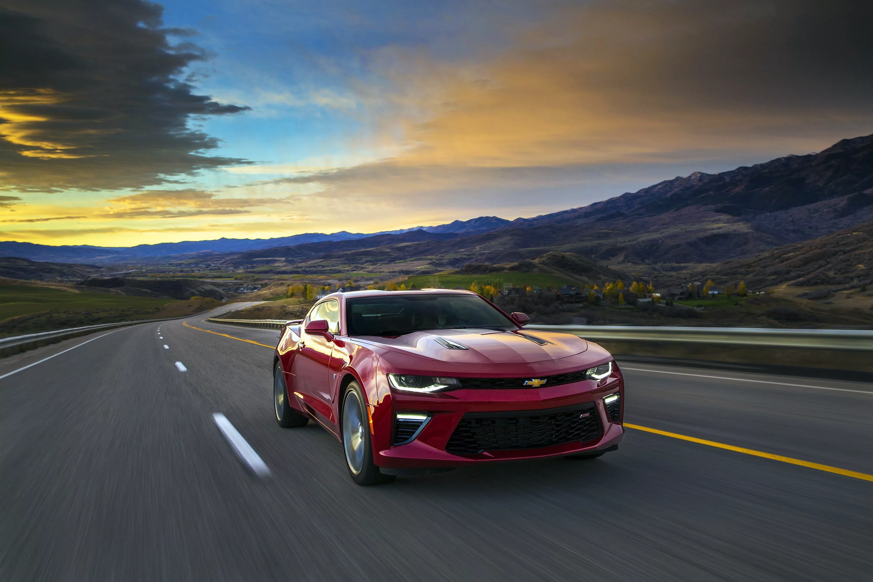
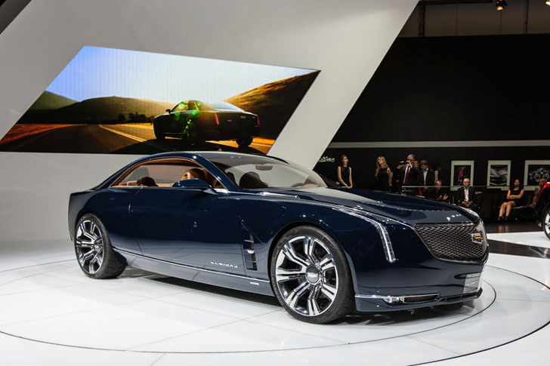
Research results
At the moment, everyone can afford to buy a good car thanks to the merits of Henry Ford, who laid the foundation in the automobile industry. He wanted to create a "people's car" and everyone supported this idea. Many Americans began their journey in the automobile industry, and with the enthusiasm of these people, we can see so many different cars nowadays.

Slide 14
List of sources
https://novate.ru/blogs/170515/31285/
https://zen.yandex.ru/media/id/5cd35c605bca0f00b018aeda/pervye-amerikanskie-avtomobili-s-chego-vse-nachinalos-5cd5644f9daa6300b389c0d2
https://fishki.net/auto/1499751-amerikanskaja-tehnika-nachala-20-veka.html
https://ru.m.wikipedia.org/wiki/%D0%90%D0%B2%D1%82%D0%BE%D0%BC%D0%BE%D0%B1%D0%B8%D0%BB%D1%8C%D0%BD%D0%B0%D1%8F_%D0%BF%D1%80%D0%BE%D0%BC%D1%8B%D1%88%D0%BB%D0%B5%D0%BD%D0%BD%D0%BE%D1%81%D1%82%D1%8C_%D0%A1%D0%A8%D0%90

Slide 15
Thanks for attention
2019

