Slide 1
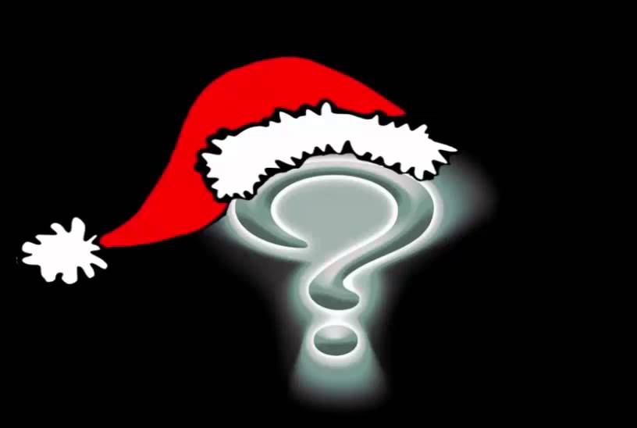
Christmas Is A Sad Season For The Poor

Slide 2
