Slide 1
Grade 5
Unit 6
Reading for pleasure

Slide 2
“Read to Me”
Read to me riddles and read to me rhymes
Read to me stories of magical times
Read to me tales about castles and kings
Read to me stories of fabulous things
Read to me pirates and read to me knights
Read to me dragons and dragon-book fights
Read to me spaceships and cowboys and then
When you are finished- please read them again.
by Jane Yolen

Slide 3
Theme: Reading for pleasure
Lesson objectives
Learn new words and use them in your speech
Read the story
Ask and answer the questions on the text
Write sentences connected with the text
Finish up the story

Slide 4
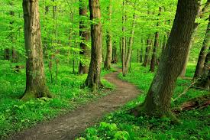
path

Slide 5
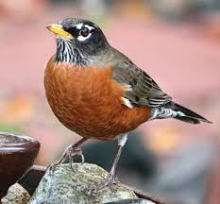
robin

Slide 6
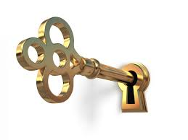
key and keyhole

Slide 7
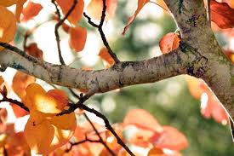
branch

Slide 8
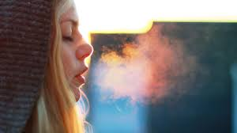
breath

Slide 9
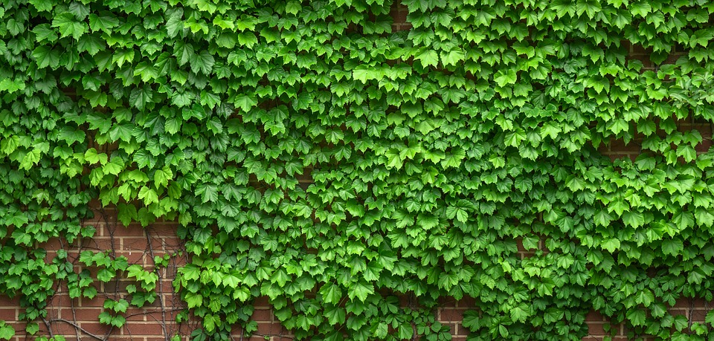
ivy

Slide 10
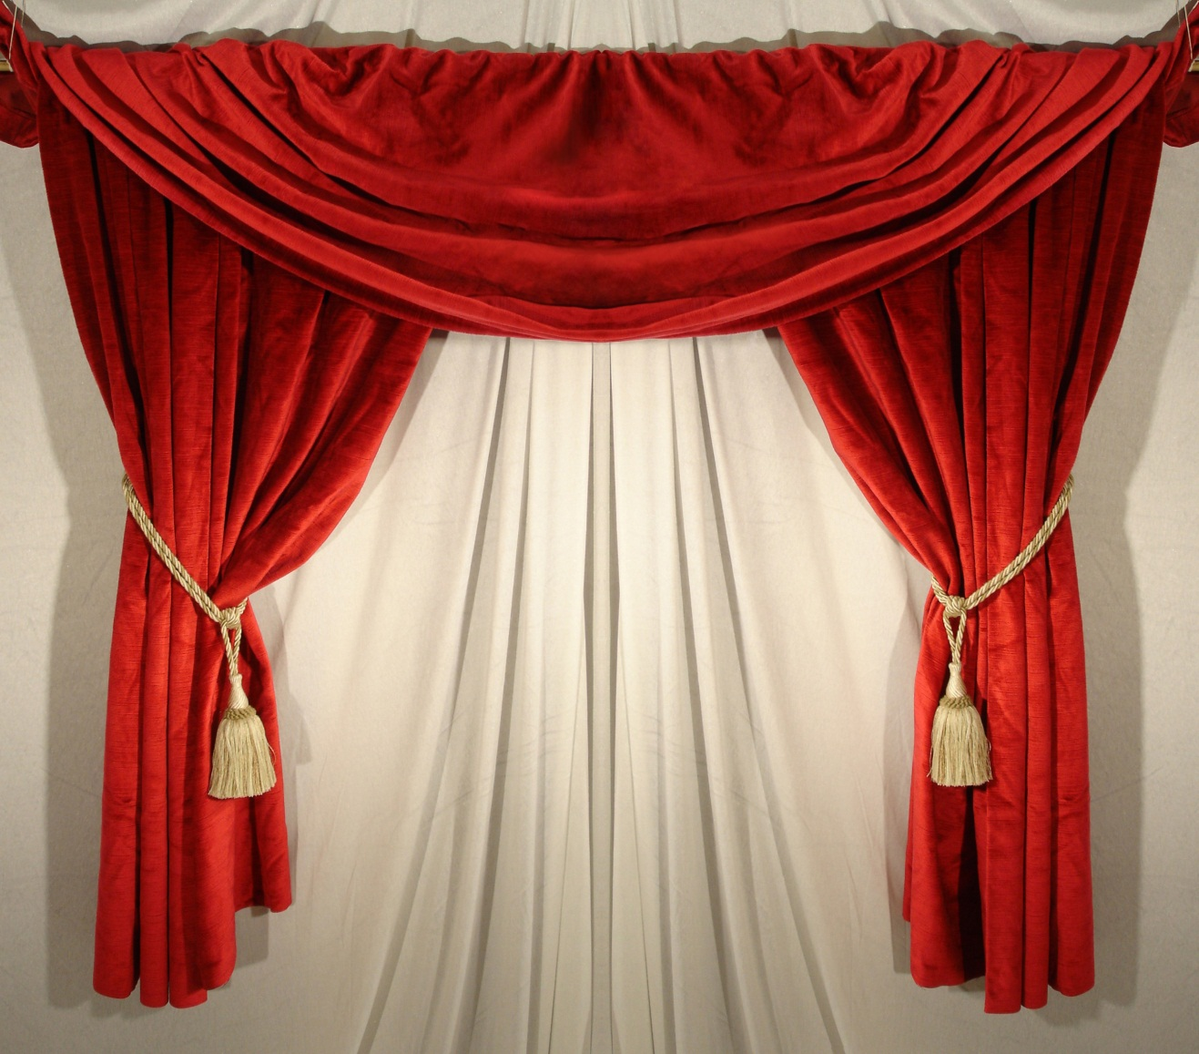
curtain

Slide 11
path
robin
key
keyhole
breath
ivy
curtain
branch

Slide 12
Ivy
Branch
Path
Robin
Curtain
Keyhole
Breath
Key
an evergreen plant that often grows up trees or buildings
a part of a tree
a small road in the forest or a field
a small brown bird with a red front
a piece of material that hangs across a window
a hole in a lock that you put a key into
the air that goes into and out of your lungs
a piece of metal that has been cut into a special shape and is used for opening or closing a lock

Slide 13
Where was Mary?
Who was she talking to?
Where did the girl turned out to be?

Slide 14
Who …..?
What.......?
When.......?
Where…..?
Why…….?

Slide 15
Draw the end of the story
Make up the end of the story
Role-play the end of the story.

Slide 16
I can remember: all / most of / some of the new words.
I can understand: all / most of / some of the events in the story.
I can ask and answer: all / most of / some of the questions.

