Slide 1
The United Kingdom

Slide 2
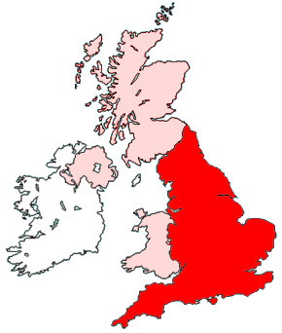
Scotland
N. Ireland
England
Wales

Slide 3
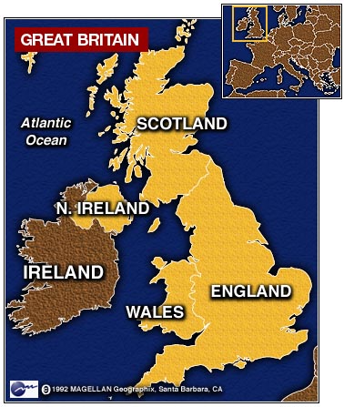

Slide 4
The thistle is a symbol of…
Scotland

Slide 5
The daffodil is a symbol of…
Wales

Slide 6
The Tudor rose is a symbol of…
England

Slide 7
The shamrock is a symbol of…
The Northern Ireland

Slide 8
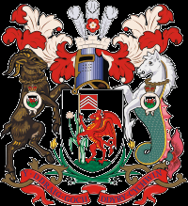
These are the coat of arms and the flag of…
Wales

Slide 9
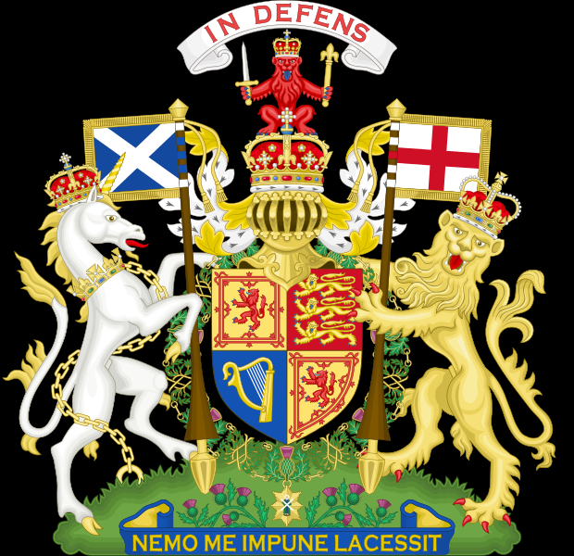
These are the coat of arms and the flag of…
Scotland

Slide 10
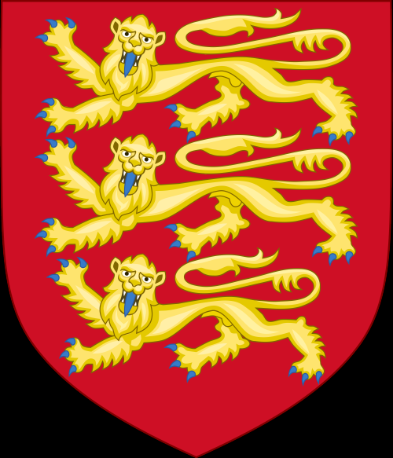
These are the coat of arms and the flag of…
England

Slide 11
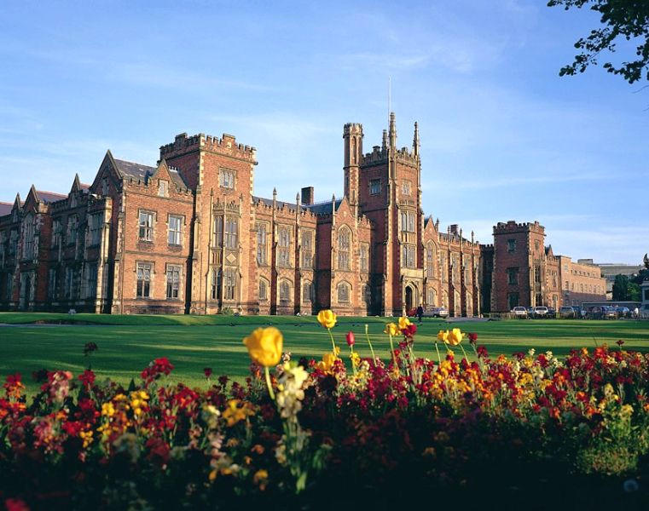
Belfast is the main city of…
The Northern Ireland

Slide 12
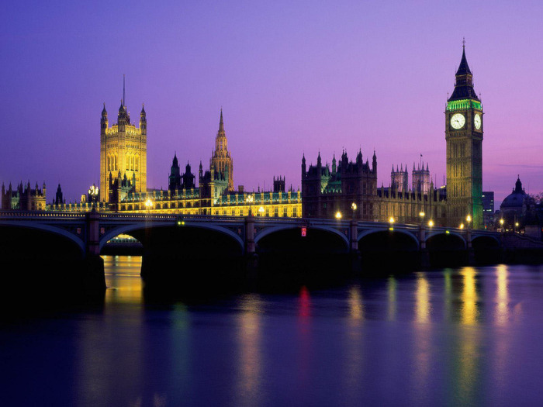
London is the main city of…
England

Slide 13
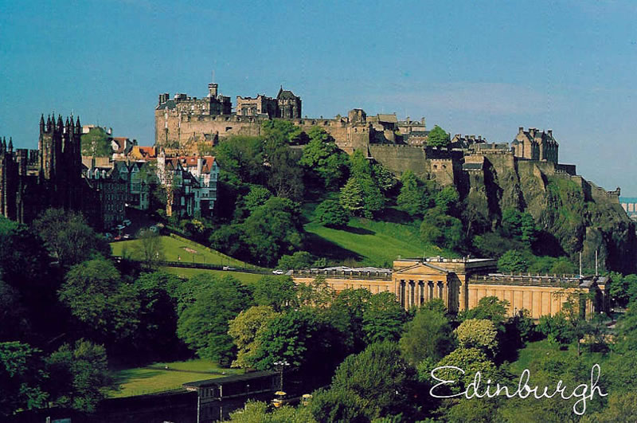
Edinburgh is the main city of…
Scotland

Slide 14
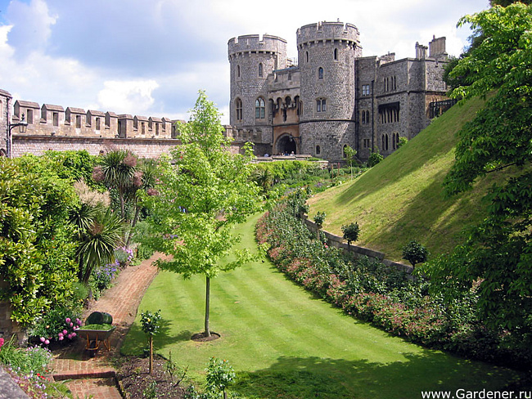
Cardiff is the main city of…
Wales

Slide 16
