Slide 1
TRAVELLING

Slide 2
Every country has its customs.
There is no place like home.
The wider we roam the welcomer home.
East or West, home is best

Slide 3
Adventure is necessary for us all.
It keeps people from growing stale and old.
It develops our imagination.
It gives us movement and change which are necessary to our life.

Slide 4
To discover new places
To know customs, traditions
To see the sights
To make friends
WHY?
To visit new places
To meet people
To learn a language
To know the history, culture

Slide 5
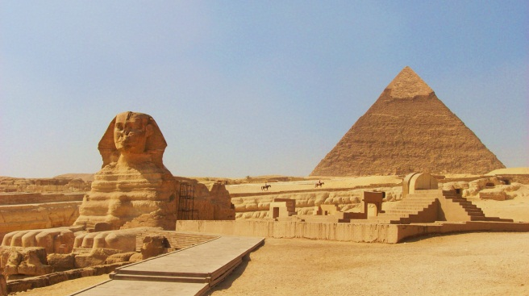
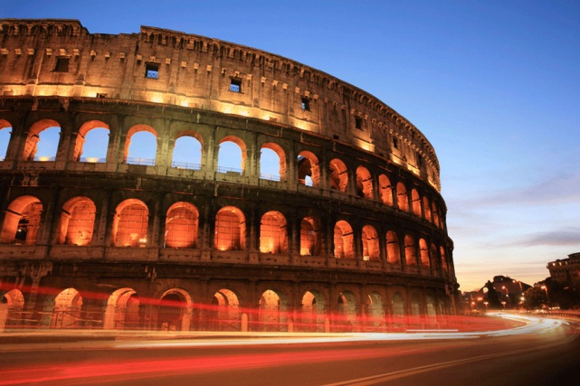
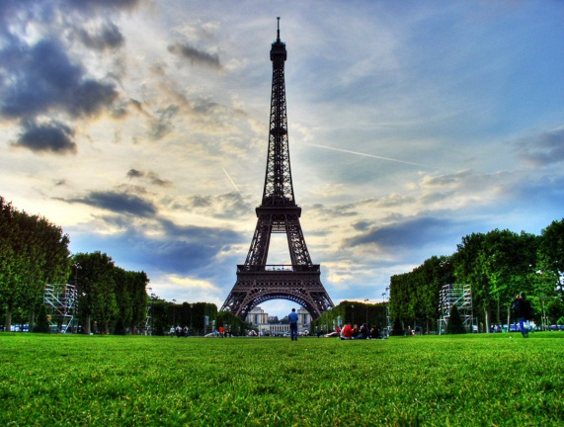
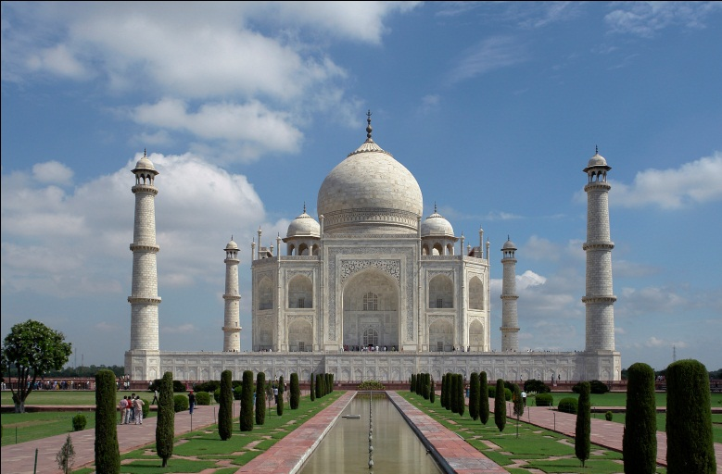
The pyramids in Egypt
The Coliseum in Rome
Eiffel Tower in Paris
Where do the tourists go for travelling?
Taj Mahal in India
The Great Wall in China
The pyramids in Egypt

Slide 6
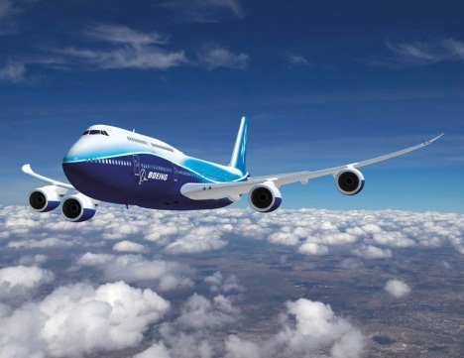
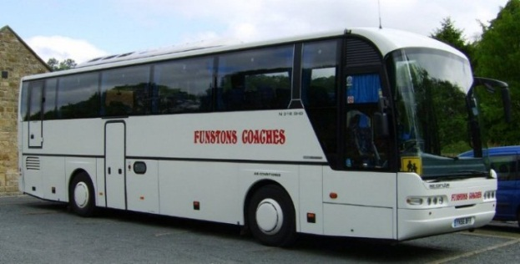
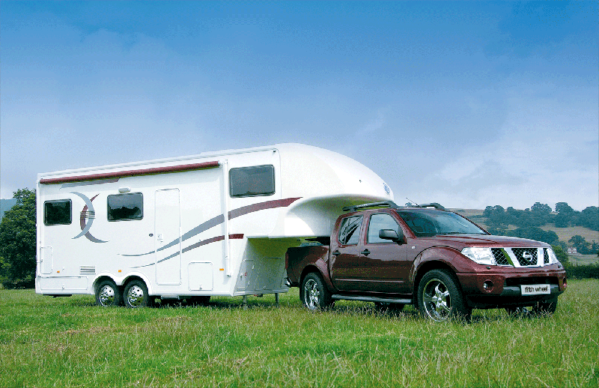
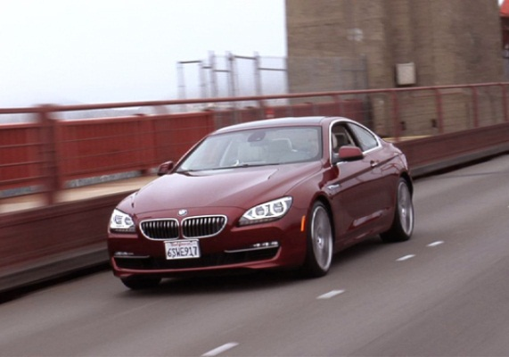
Ways of transportation
A. Plane
B. Coach
C. Car
D. Ship
F. Trailer
I travel by car
I go on foot
4
3
2
1
5

Slide 7
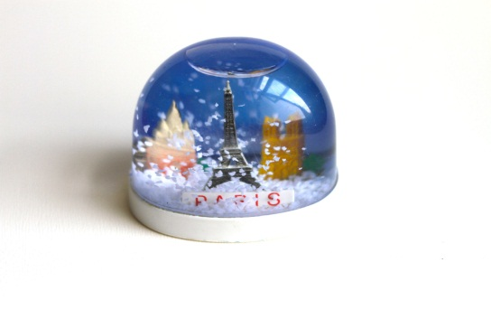
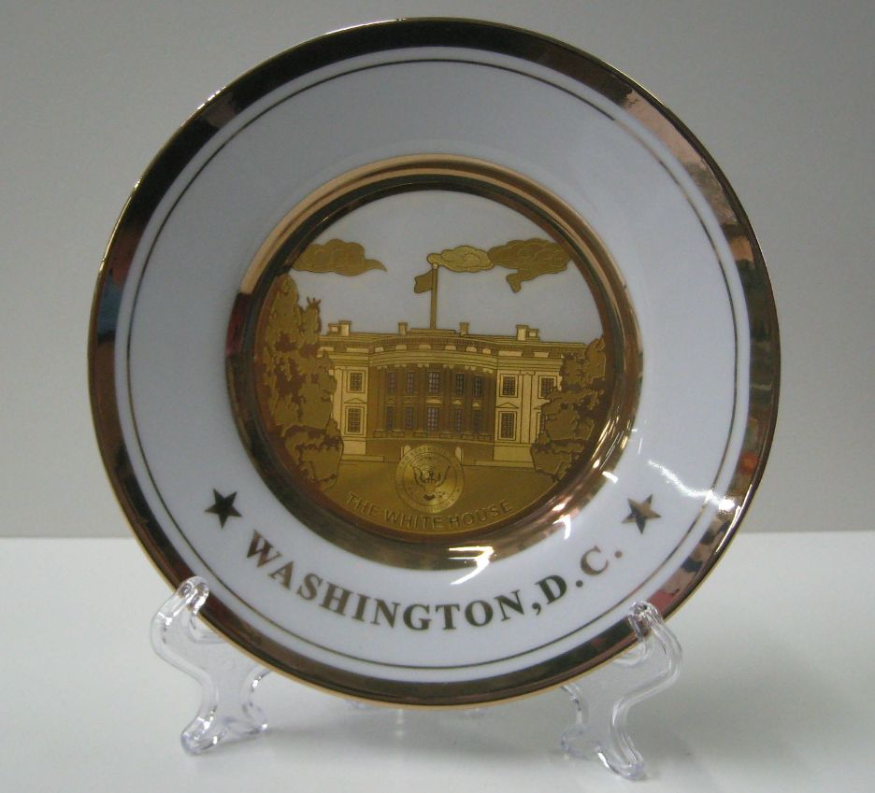
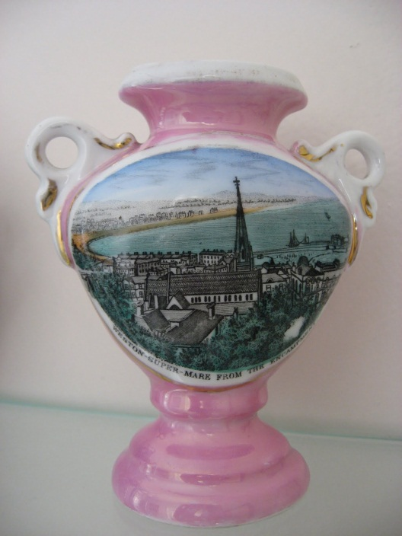
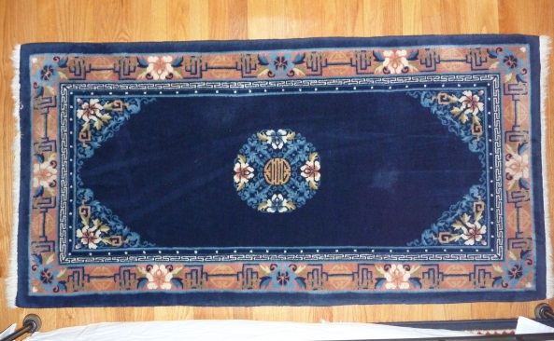
Souvenirs
Water globe
Sombrero
Plate
Carpet
Vase
Cup

Slide 8
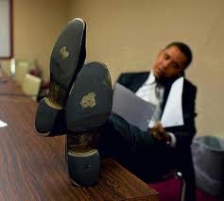
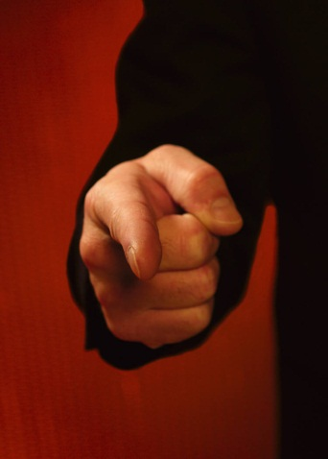
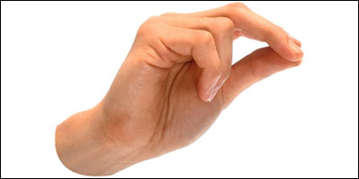
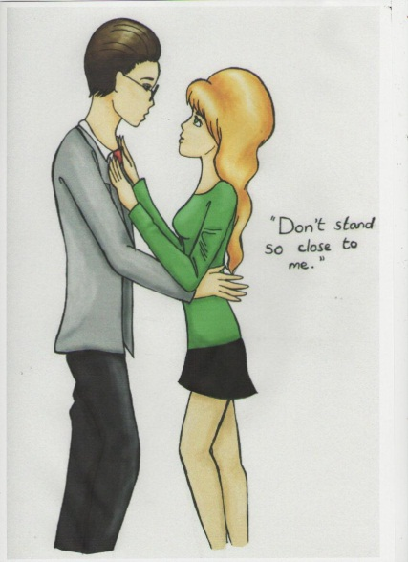
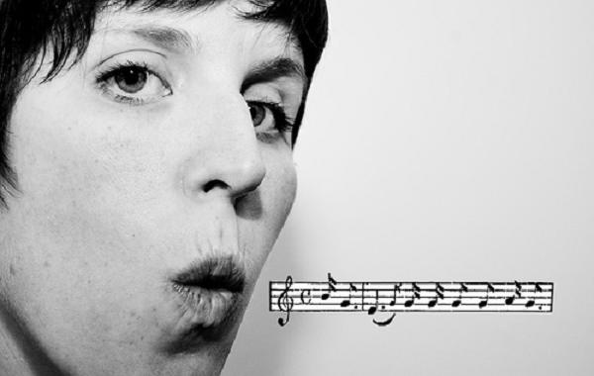
To show the soles of one’s shoes
To point the index finger
To snap the fingers
To whistle
To show excessive emotion
To stand close

Slide 9
Dear Helen,
I am in China on that business trip I told you about. Things going quiet well, yet there are some things that are very different from back home. For instance, my hosts keep asking me personal questions regarding my age, my marital status, my family, my job and even my income!
I also warned not to whistle, point my index finger, snap my fingers, or sit in a way that shows the soles of my shoes. I noticed that my hosts don’t stand too close to me. In fact, they don’t seem to like being touched at all.
Well, that’s all for now.
From your puzzled, but excited friend.
Peter.

Slide 10
Dos and Don’ts in China
 | DO | DON’T
To point the index finger
To stand close
To whistle in public
To ask personal questions
To touch strangers
To show excessive emotion
To show the soles of one’s shoes
V
V
V
V
V
V
V

Slide 11
Bulgaria
Italy
Japan
Greece
Finland
The Netherlands
Never leave the table in the middle of a meal. The other guests will think you are rude.
Smile at people even when they have done something that has disturbed you greatly.
Do not clear your throat, blow your nose, or yawn in public.
Don't pass the salt directly to the person who asked for it. Lay it on the table for the other person to pick up.
Move your head left and right to show that you mean "yes." To show that you mean "no," move your head up and down.
When greeting people, even for the first time, hug them and kiss them on the cheek.
The Netherlands
Greece
Japan
Finland
Bulgaria
Italy

Slide 12
USEFUL LANGUAGE
How to travel
The best way for us is traveling by ……
I think we can go there by car
We can take a train to go there
We’ll get to …. by ……
Where to travel
First of all we’ll go …..
As for us we go to …..
What to do there
We guess visiting museum will be useful for us
There is much to see and visit there
There are too many places of interest
We can make guided tour to ….
We shouldn’t forget to visit….
If we don’t visit ….. we won’t travel there any more
In our opinion ……
We will taste…..

