Slide 1

Цель урока:
Формирование и совершенствование языковой компетенции через обобщение знаний по теме:
«Travel time»

Slide 2

I. Мотивация к учебной деятельности
“Travel empties out everything you’ve into the box called your life, all the things you accumulate to tell you who you are”
― Claire Fontaine

Slide 3
Plan of the lesson
Vocabulary: travelling
Speaking: monologues/dialogues (in pairs/groups)
Reading: Top ten. Correct order/matching
Listening/watching: for gist

Slide 4
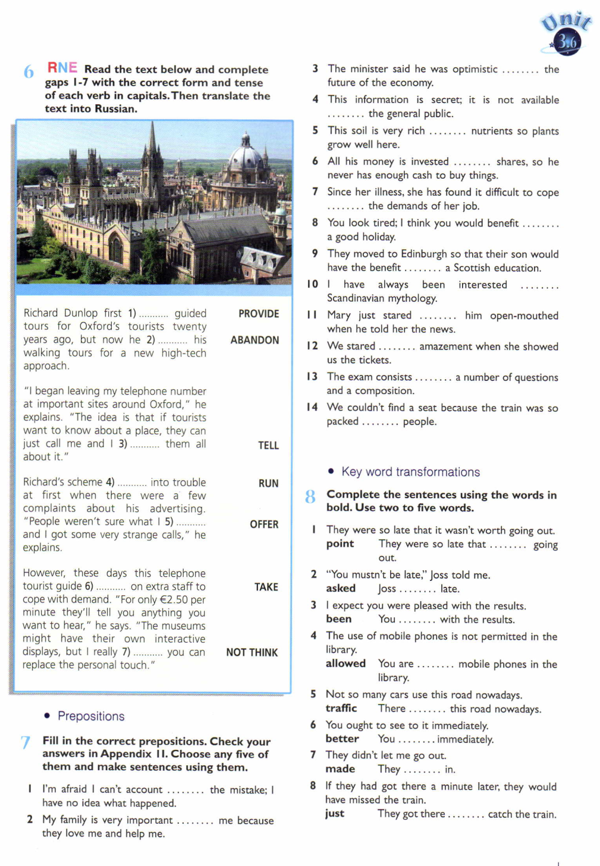
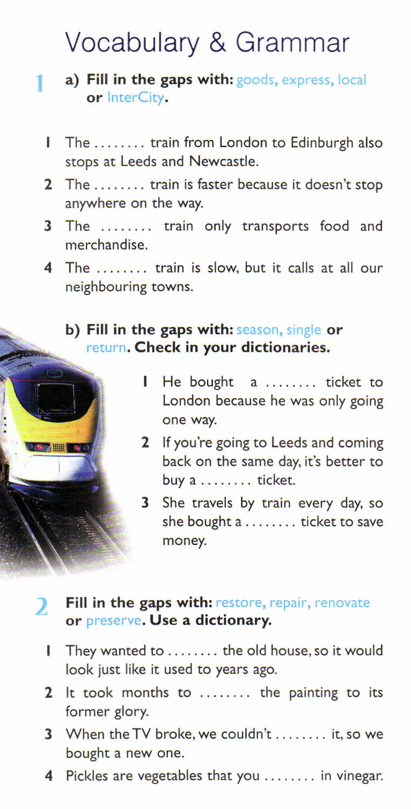
II.Проверка домашнего задания

Slide 5
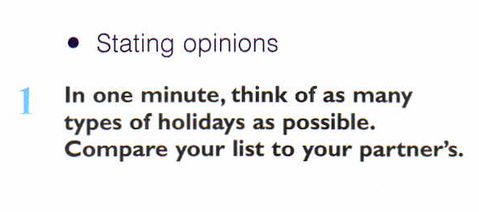
III. Актуализация субъектного опыта учащихся
P.80, ex.1

Slide 6
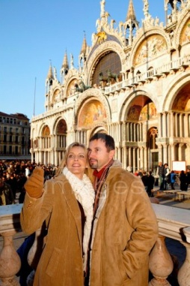
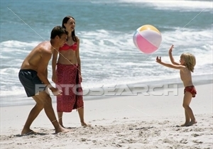
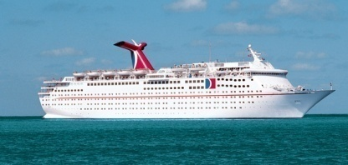

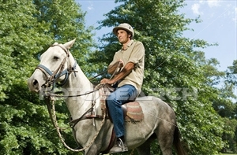
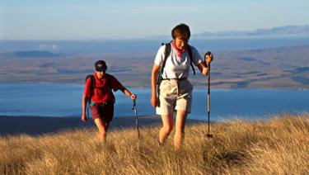
Types of holidays

Slide 7
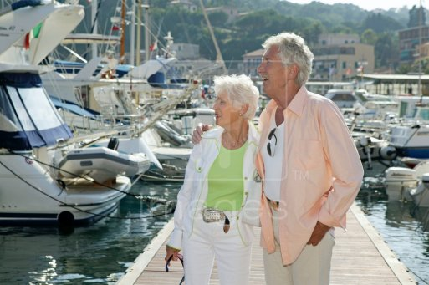
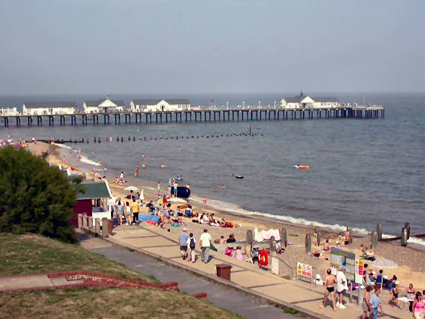
sunbathing
swimming
surfing
sea
tourist resorts
sun
pool
lying on the beach
Package holiday
hotel
travel agency
nightlife
flight
booking in advance
noise
clubbing

Slide 8

galleries
museums
culture
monuments
Sightseeing holiday
booking in advance
hotels
coaches
trying new food

Slide 9

sightseeing
expensive
ports
Cruise
scenery
luxury
new people
facilities
gym
taking it easy and relaxing
pool
restaurant
tennis court
dancing

Slide 10

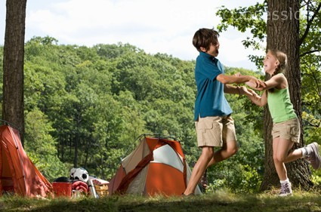
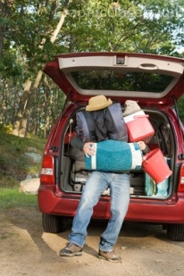
guitar
open air
campsite
boating
campfire
portable furniture
Camping holiday
canned food
tent
sleeping bag
mosquitoes
depends on weather

Slide 11
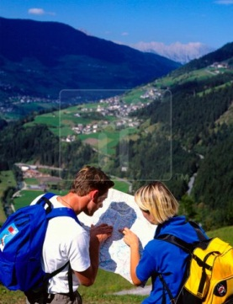
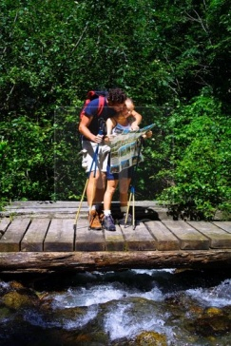
planning the trip
cheap
map
Backpacking holiday
hitchhiking
nature
tiring
rucksack
mountains
forests
rivers
walking in the countryside

Slide 12
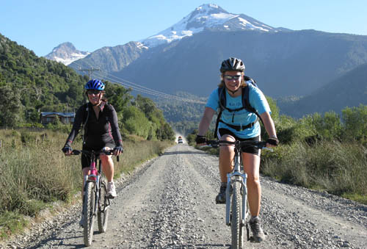
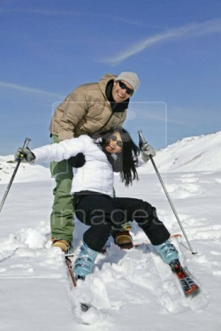
biking
snowboarding
horse riding
rock-climbing
diving
extreme sports
skills
special equipment
Adventure holiday
instructor
people sharing the same interest
exciting
dangerous

Slide 13
IV. Первичное закрепление материала
Pre-watching task:
Lexicon
Burma ['bɜːmə]
Geyser ['gaɪzə] Basins, Wyoming [waɪ'əumɪŋ]
Philippines ['fɪlɪpiːnz]
Sri Lanka [ˌsrɪ'læŋkə]
Ecuador [ˌekwə'dɔː]
Tanzania [tæn'zeɪnɪə]

Slide 14
Video

Slide 15

Correct order
Serengeti National Park, Tanzania. Found in both Kenya and Tanzania this park is home to an annual migration of over 2 million wildebeest, zebra, and gazelle which is the largest remaining animal migration in the world.
Great Barrier Reef, Australia. It is the world’s largest coral reef ecosystem and is composed of nearly 3,000 individual reefs. It is world’s largest single structure made of living organisms and can even be seen from space.
Sigiriya, Sri Lanka.This site is dominated by a massive rock that is over 200 meters high. It was on top of this rock that an ancient king built his palace.
Iguazu Falls, Brazil. With the second greatest annual flow of any waterfall in the world behind Niagara, Iguazu is a sight to behold.
Galápagos Islands, Ecuador. Made famous by the voyage of Charles Darwin, these islands have long captivated travelers and scientists with their biodiversity
Geyser Basins, Wyoming. With over 10,000 hot springs, Yellowstone’s is home to some of the world’s tallest and most colorful geysers.
Goreme National Park, Turkey. Famous for its breathtaking rock formations including the “fairy chimneys”, Goreme is also the name of the main city in the region which is nearly entirely carved out of rock.
Banaue Rice Terraces, Philippines . Carved into the mountainside nearly 2000 years ago many Filipinos consider these terraces to be the 8th wonder of the world.
Los Glaciares National Park, Argentina. This national park boasts the largest ice mantel outside of Antarctica.
Bagan City, Burma. Similar to Angkor Wat in Cambodia, this location is home to thousands upon thousands of temples. Due to Burma’s inner turmoil it isn’t nearly as crowded as other similar locations.

Slide 16
V. Применение изученного
Working in groups
(post-watching task):
In groups, choose the site(s) which you would recommend to everyone. Explain your choice.
A leaflet about travelling

Slide 17
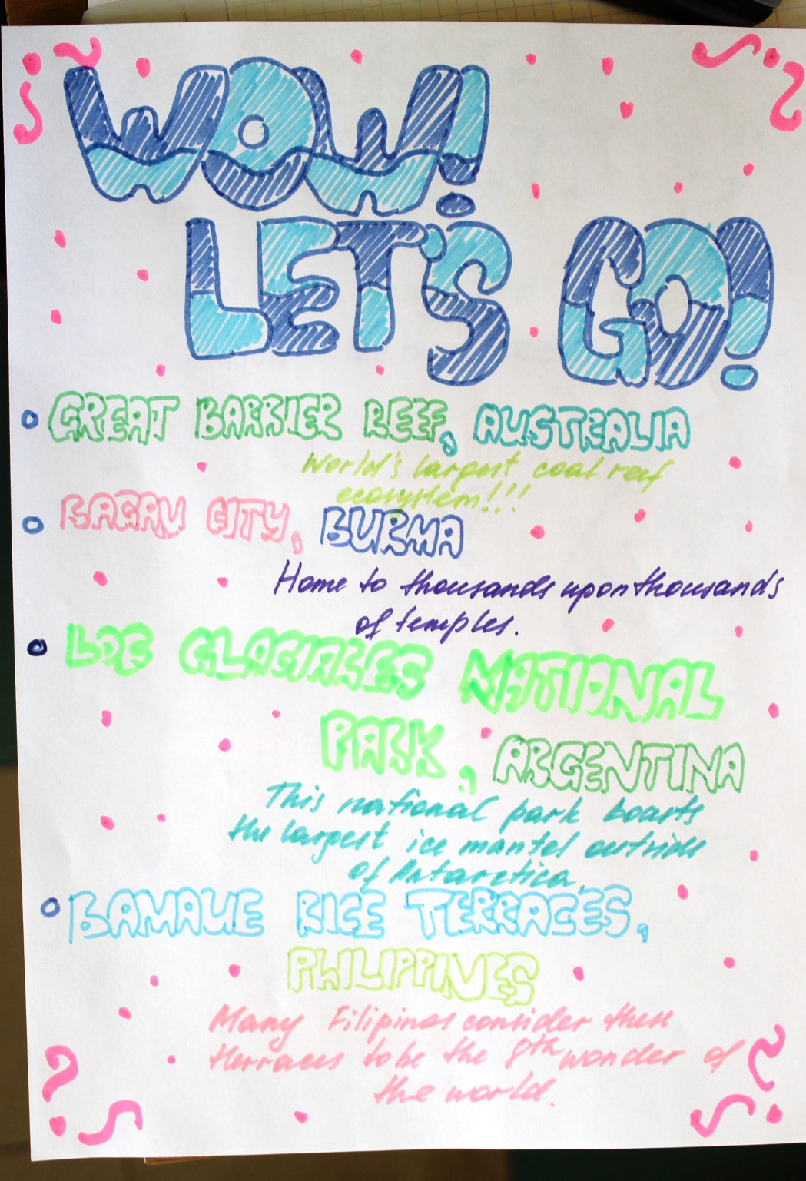
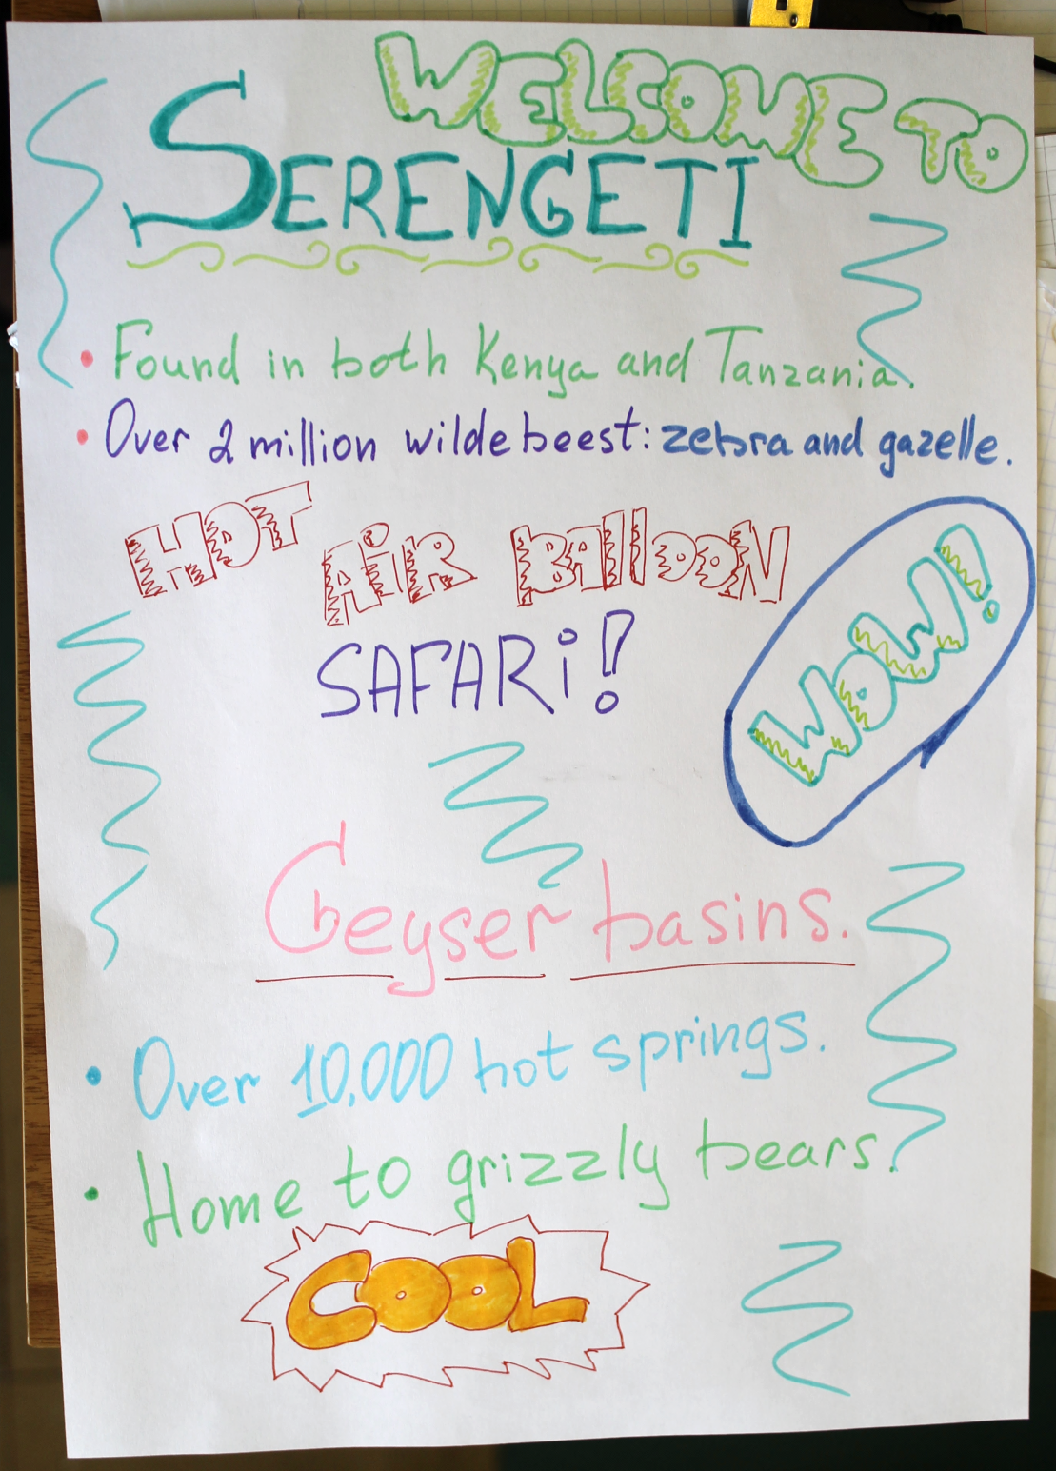

Slide 18
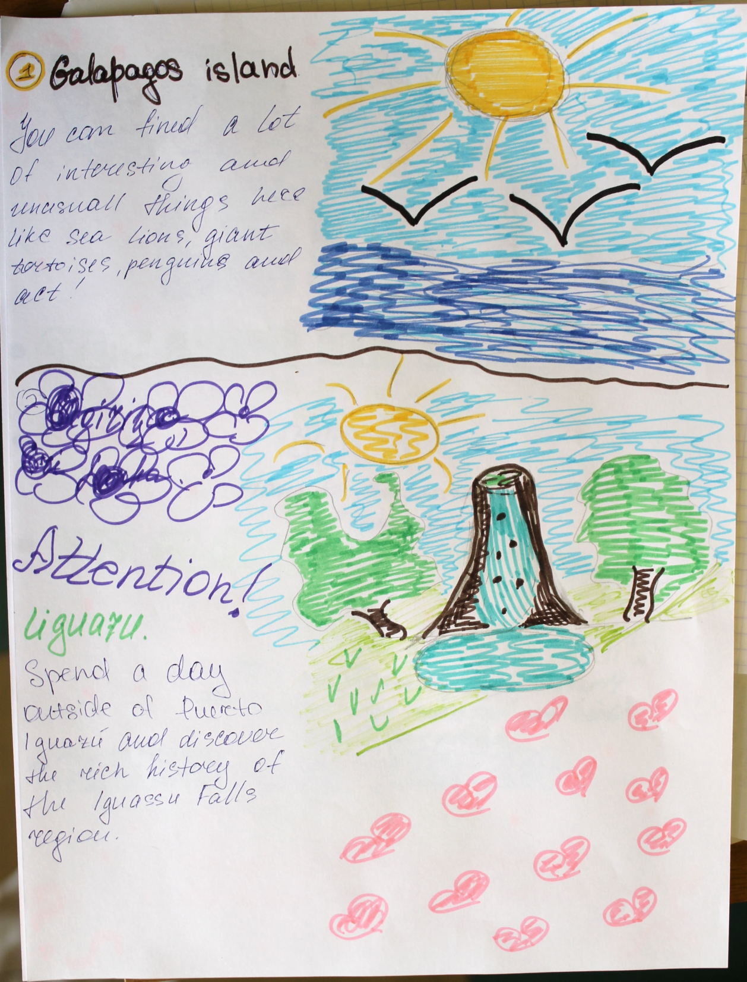

Slide 19
VI. Домашнее задание
Написание личного письма

Slide 20
Choose the task according to your preferences:
Projects
1.Top ten places of the world
2.My best holidays

Slide 21
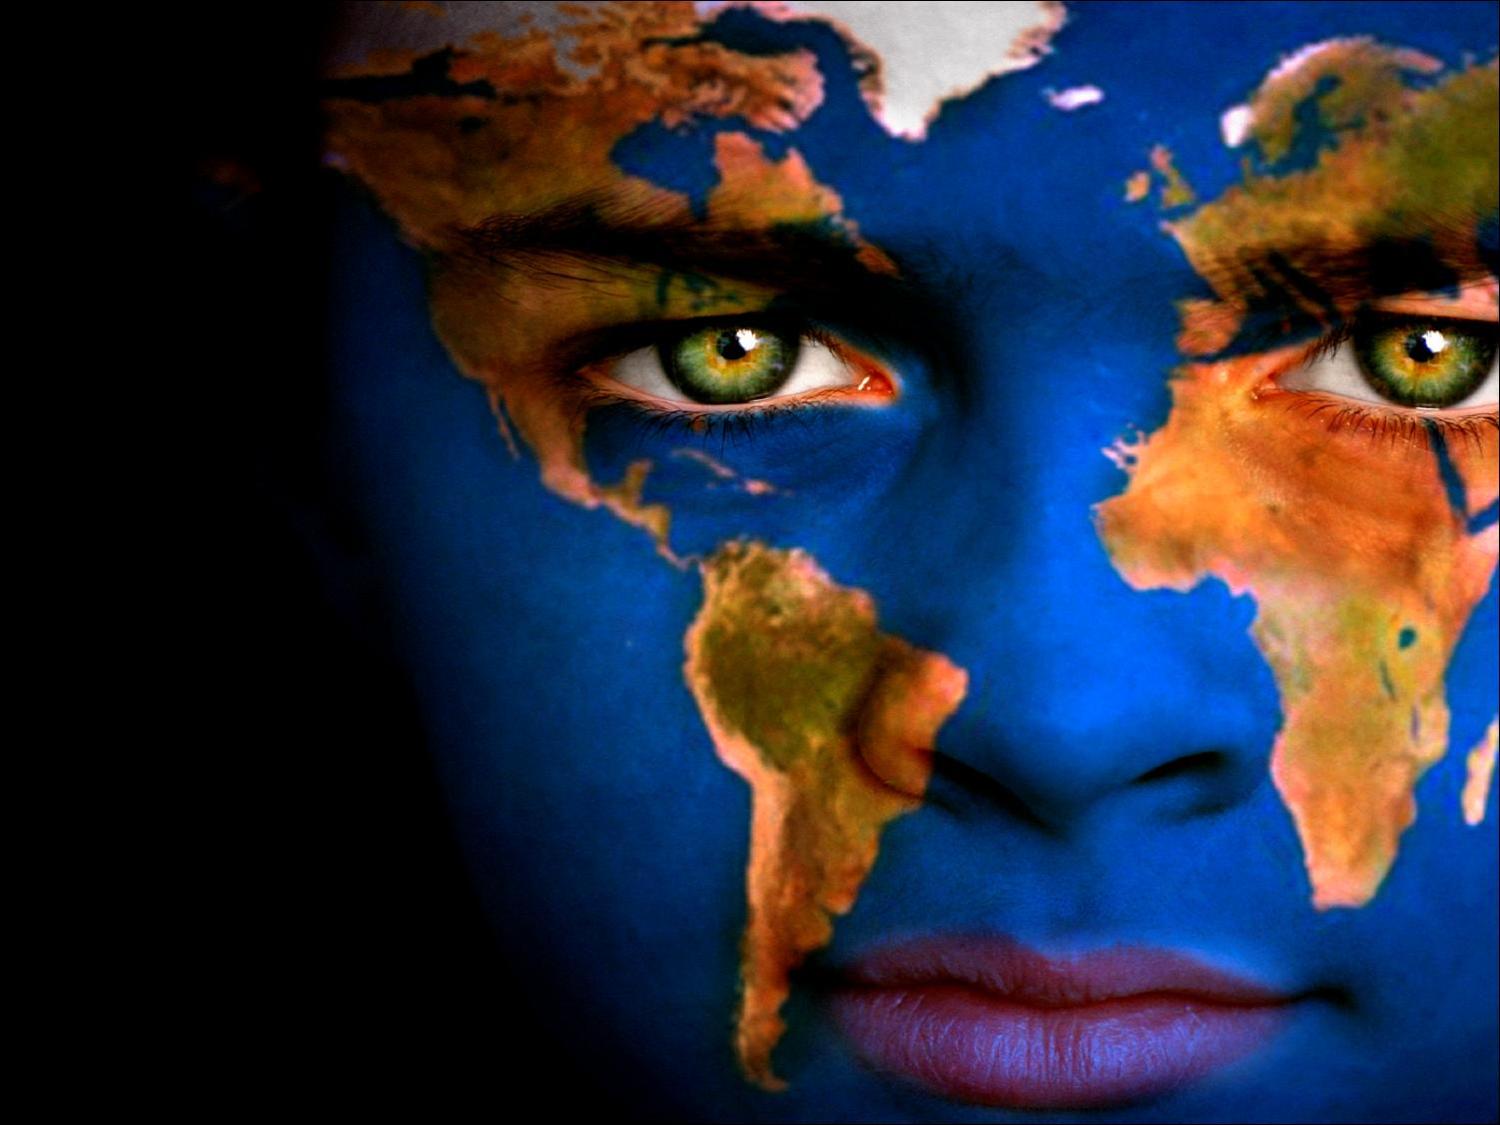
VII. Рефлексия

Slide 22
Подведение итогов урока
Обобщение и структуризация изученного материала (составление рекламной брошюры, мировые достопримечательности).

Slide 23
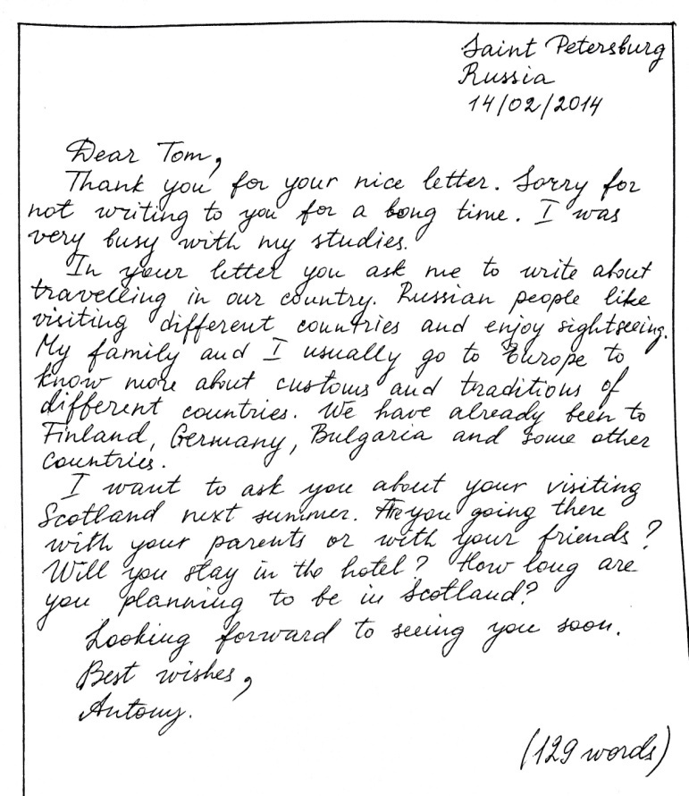
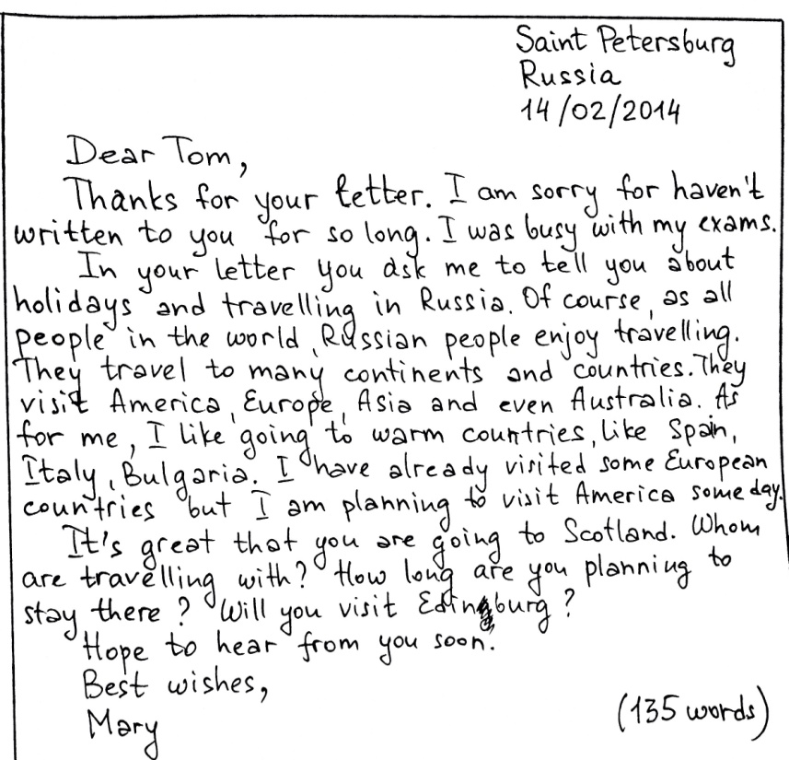
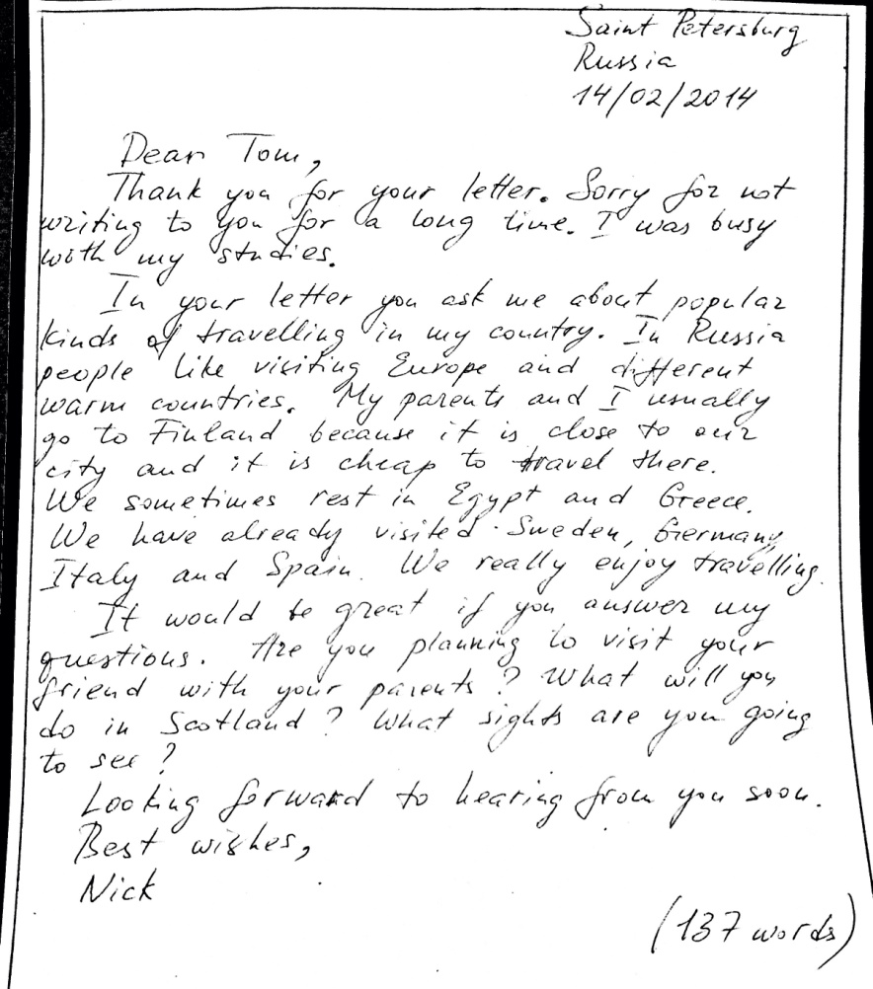
Personal letters

Slide 24
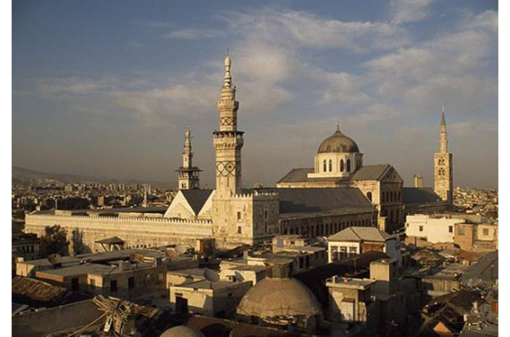
Ancient City of Damascus.
Form 10 a
Kelasieva K., Ragulina Evg.

Slide 25
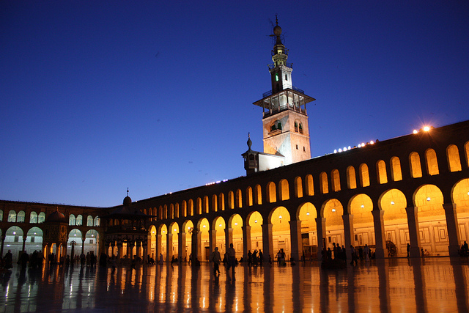
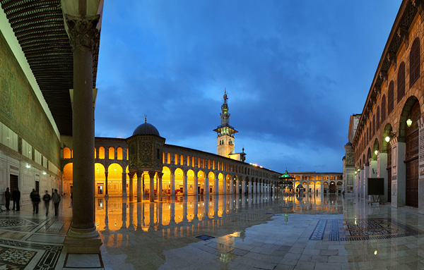
Great Mosque of the Umayyads.

Slide 26
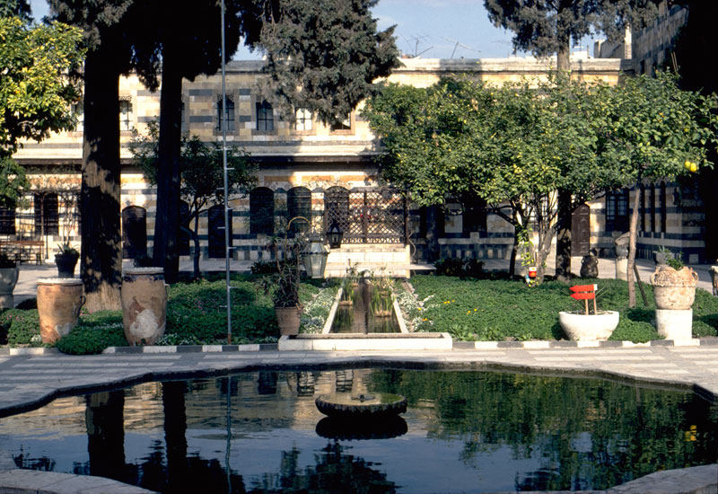
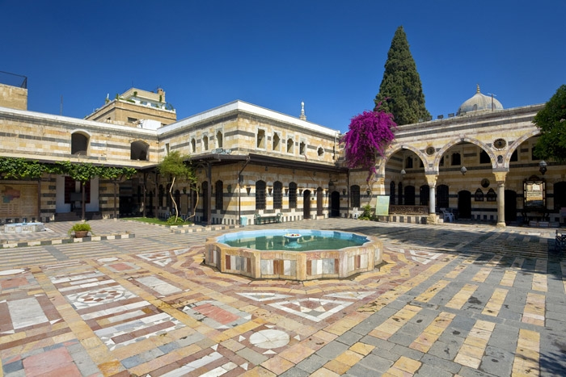
The Azem Palace.

Slide 27
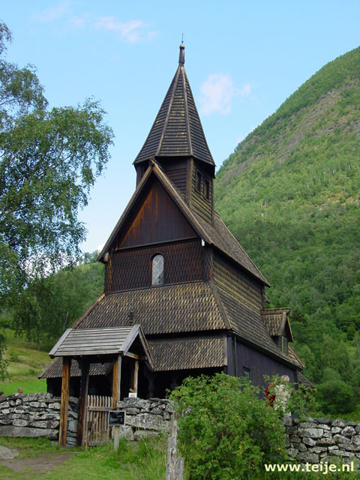
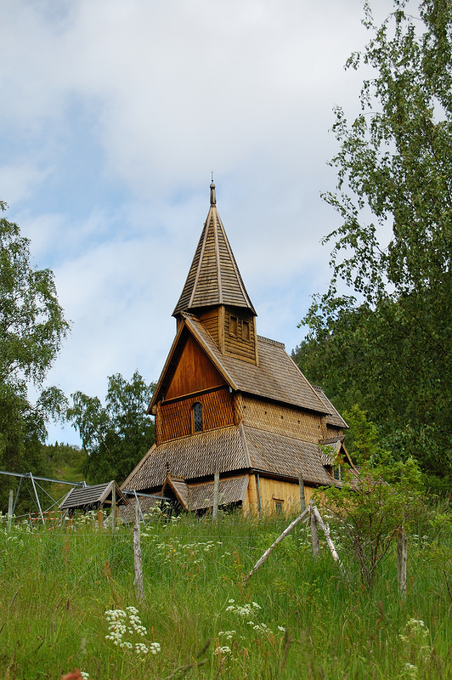
Smirnova Ann, Nekrasov Sergey
Urnes Stave Church

Slide 28
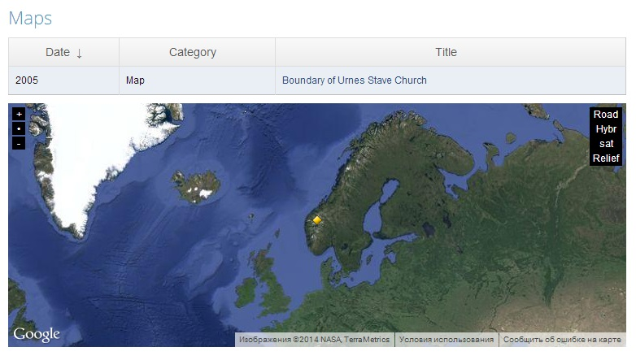
Location

Slide 29
