Slide 1
Welcome To Our Meeting!

Slide 7
Листья растения

Slide 8
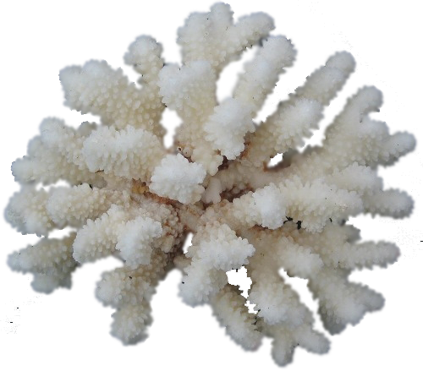

Slide 10
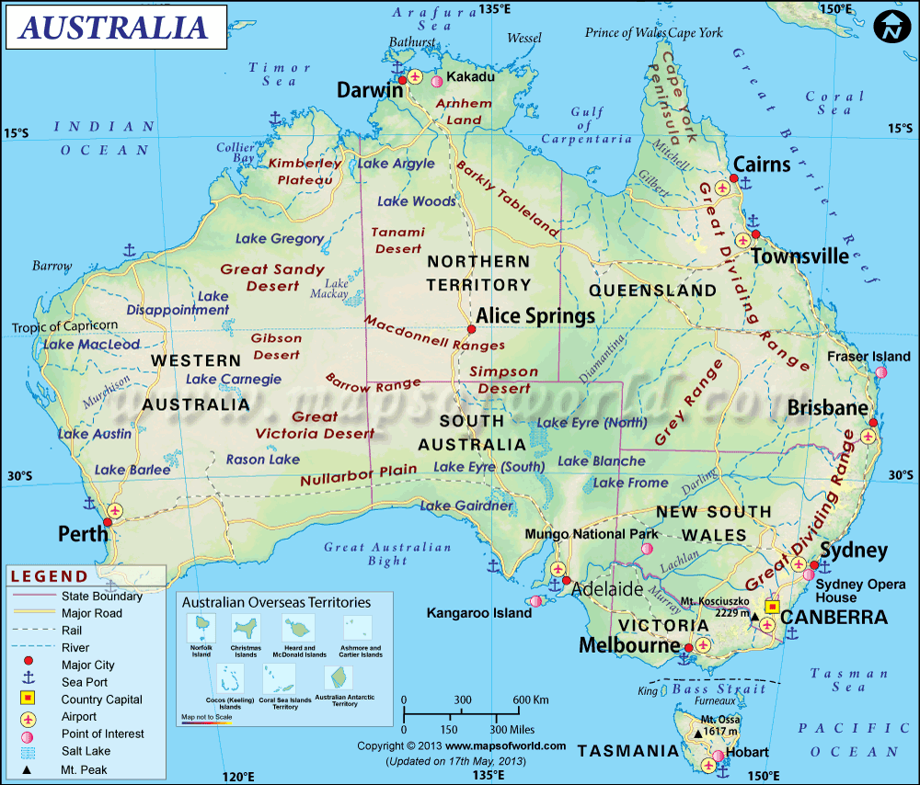

Slide 12
Британский мир

Slide 15
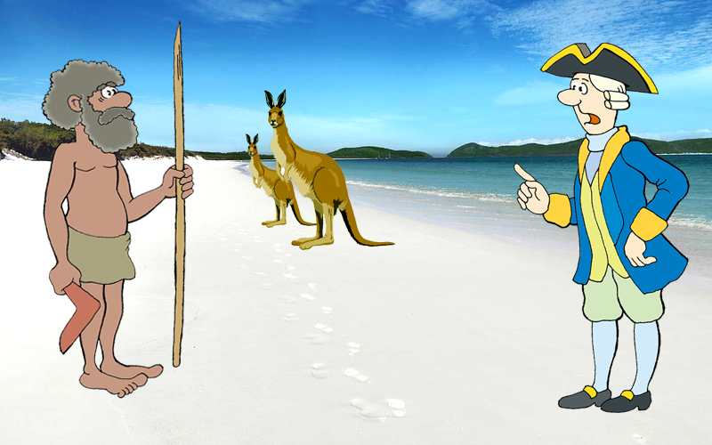
One day I saw a very strange animal

Slide 16
I asked an aborigine “ What is its name?”

Slide 17
He answered: “Kangaroo”
Я Вас не
понимаю!!?
What is its name?

Slide 18
1. Australia borders two oceans, the _____ and the _____.
a) Atlantic, Indian b) Indian, Pacific c) Japan, Pacific
2. ______ is the capital of Australia
a) Sydney b) Perth c)Canberra
3. Which of these words is often used in Australian names?
a) green b) great c)garden
4. Australia has ____ states.
a) 6 b) 25 c) 10
5. In Australia, Christmas is celebrated in ______.
a) Summer b) Winter c) Autumn
6. Australia has ____ deserts.
a) 5 b) 1 c) 6

Slide 19
http://www.youtube.com/watch?v=-7AbKe4ZZlU

Slide 20
I. Какова площадь Австралии?
а) 5,5 млн км2 б) 12 млн км2
в) 7,6 млн км2 г) 10 млн км2
II. Какое место в мире занимает Австралия по размеру своей территории?
Во сколько раз площадь Австралии больше площади: 1) Европы?
2) Соединенного Королевства?
IV. Австралия –самый сухой материк в мире. Сколько процентов территории материка занимает пустыня?
а) 9℅ б) 14℅
в) 90℅ г) 20℅

Slide 21
Водами каких океанов омывается Австралия?
Что такое Большой Барьерный риф? С какой стороны от Австралии он находиться? Какова его протяженность?
Какие полезные ископаемые добываются на территории Австралии?
VIII. Австралия имеет хорошо развитое животноводство. Какое домашнее животное является самым распространённым? Каково поголовье этих животных в Австралии?

Slide 22
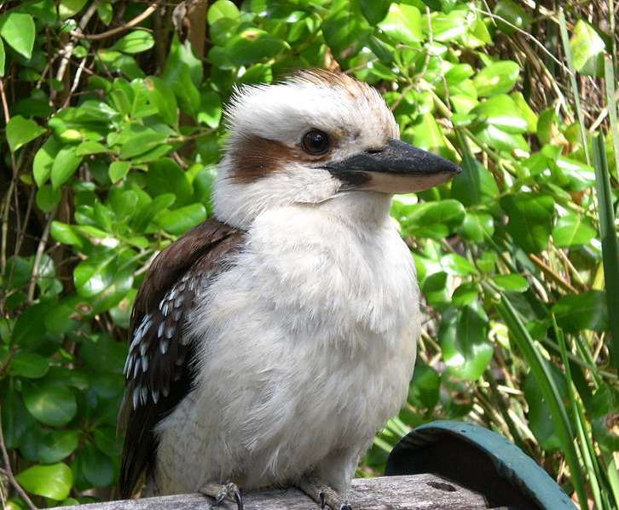
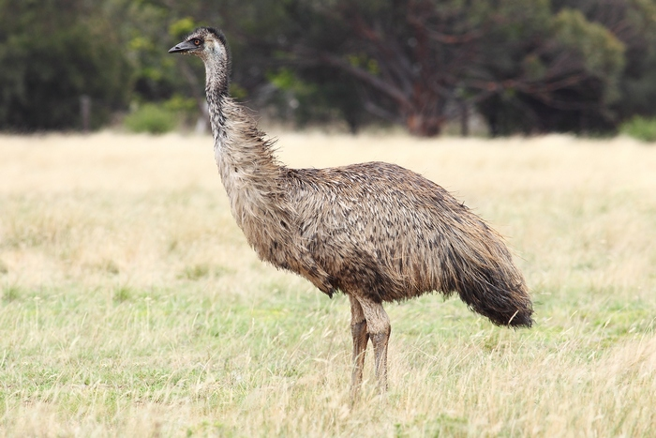
What animal is it?
1) It is a big bird. It lives in Australia. It can laugh like a man. This bird is a kookaburra.
2) It is a big bird. It has very long legs. It cannot fly. It can swim. the mother emu lays 8—10 big green eggs. This bird is an emu.

Slide 23
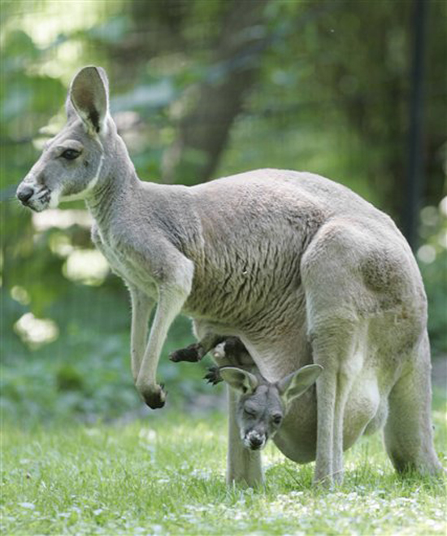
3) It has its baby in a pouch. A baby is very small — two centimeters long. It can jump very fast. This is a kangaroo.

Slide 24
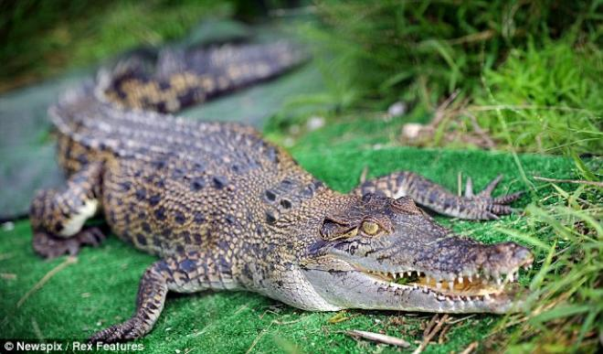
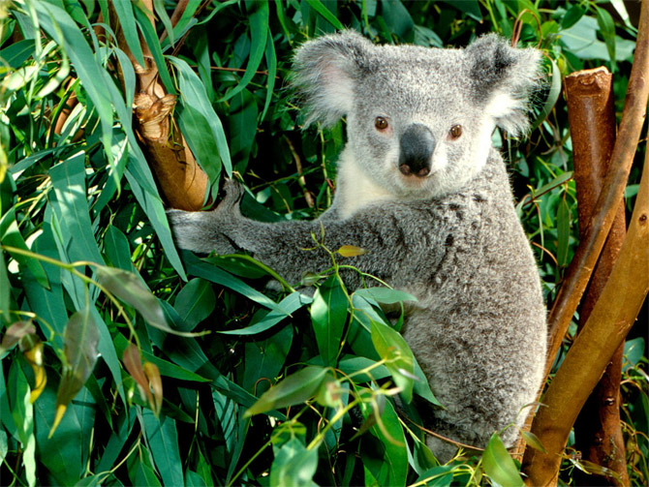
4) It lives in salt water. It can swim very well. It eats fish, birds, monkeys. It can eat a man. This is a crocodile.
5)It is an Australian animal, which looks like a teddy bear. It is very lazy animal, it sleeps about 20 hours a day. Its name comes from Aboriginal "no drink". This is a koala.

Slide 25
February hot Indian eastern Asia earth bottle tropics above December January 20 kangaroos
Australia is situated to the southeast of Asia. It is washed by the Timor Sea in the north, by the Coral and Tasman Seas in the east, and by the Indian Ocean in the south and west. Australia is the most droughty continent in the earth. It is an extremely hot country. Summer months are December, January and February. The average summer temperature is from 20 to 30 degrees above zero. Winter months are June, July and August. The average winter temperature is from 12 to 20 degrees above zero. The most part of the territory lies in tropics. Its southwestern territories lie in subtropics. As droughts are rather common and the amount of rainfall is rather small there are not many rivers in Australia. The largest rivers are the Darling and the Murray. The isolation of Australia from other continents explains much of the unusualness of Australian plant and animal life. There are forests in the southern and eastern parts of the country. The commonest tree of Australia is the eucalyptus. In those areas one can also find strange bottle trees. They preserve water in their trunks. Australian animals are also very unusual. Among them there are kangaroos, duck-bills, koala-bears, and others. Nine tenth of animal species of Australia do not exist in other parts of the world.

