Slide 1
BUCKINGHAM PALACE
MOROZOVA NATASHA 5A

Slide 2
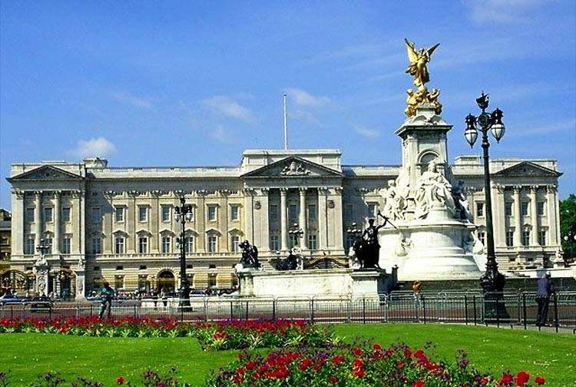
This is buckingham palace

Slide 3
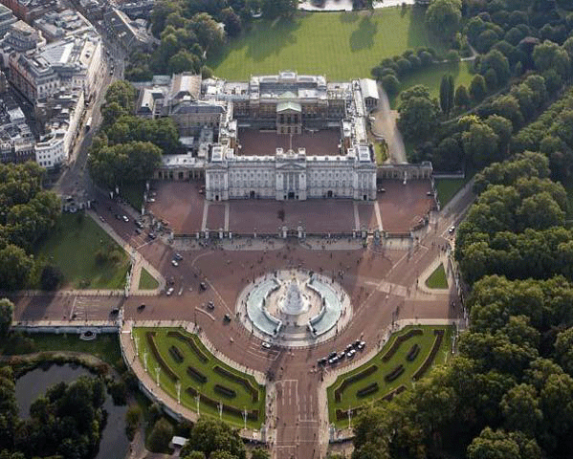
IN Summer palace is visitED by 30 000 people

Slide 4
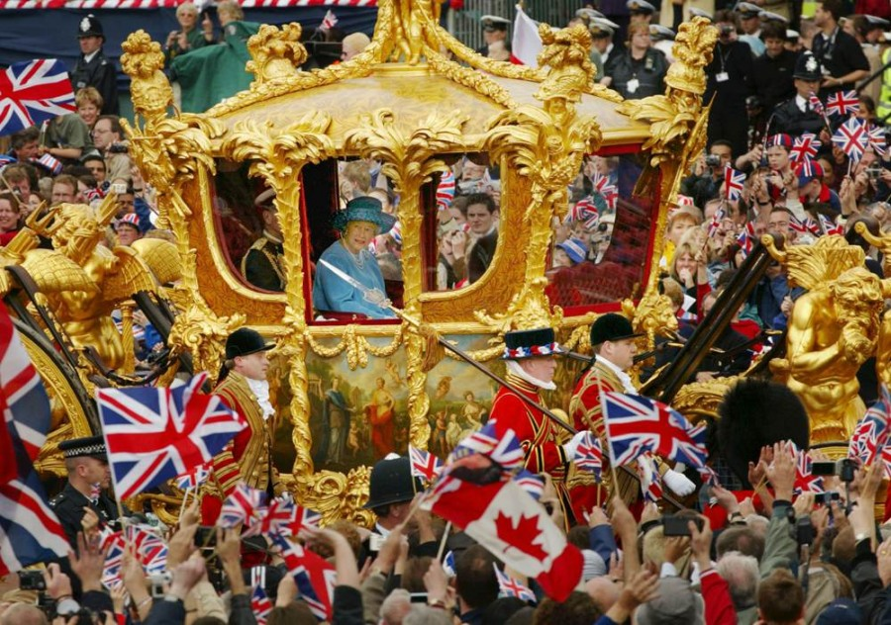
Queen elizabeth in a golden carriage

Slide 5
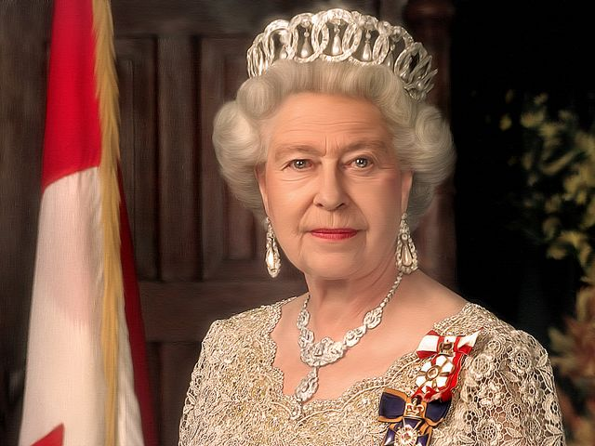
Queen elizabeth is
87 years old now

Slide 6
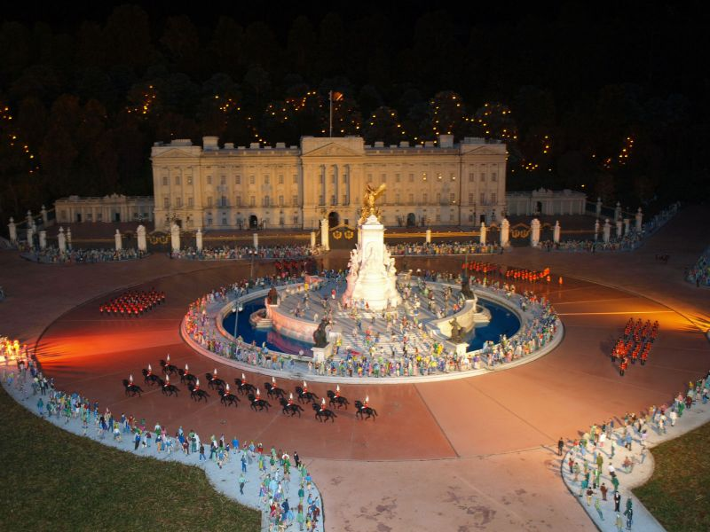
Celebration of queen’s birthday at buckingham palace

Slide 7
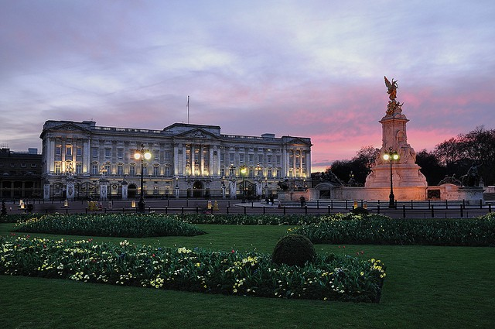
There are lakes and waterfalls
In the royal garden

Slide 8
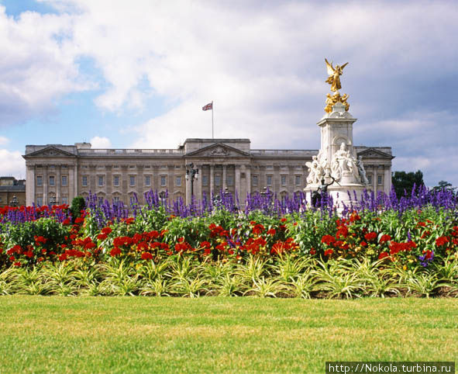
Buckingham Palace Has
775 rooms

Slide 9
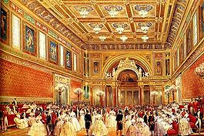
BALLROOM AT BUCKINGHAM PALACE

Slide 10

I HOPE YOU LIKED MY PReSeNTATION

Slide 11

THANKS FOR WATCHING!

