Slide 1
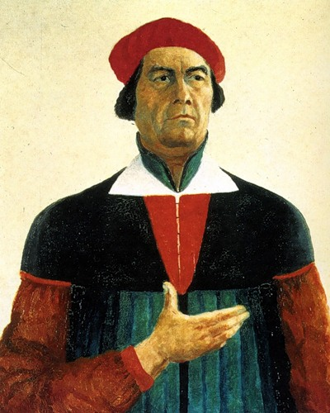
Kazimir Malevich
Kazimir Malevich (1879-1935) was a Russian avantgarde artist, philosopher, theorist of art and teacher, the founder of Suprematism.
Malevich was an active participant of exhibitions of the society "Bubnovy Valet".

Slide 2
The theme of World War I is reflected in his art. Malevich created a series of graphic works in the style of splint, which was very bright , easy to understand, with memorable pictures. His posters were close to the folk culture and folklore.

Slide 3
During the First World War, he designed posters for the publishing house " Today splint “.

