Slide 1
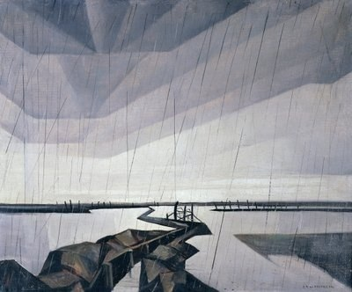
Christopher Richard Wynne Nevinson
13 August 1889 – October 1946

Slide 2
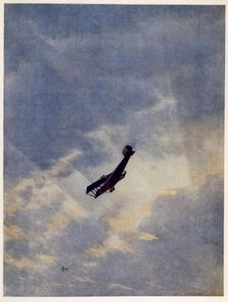
Richard Nevinson, one of the most famous war artists of World War I, the son of the war correspondent and journalist Henry Nevinson and the suffrage campaigner and writer Margaret Nevinson. Nevinson had served as a volunteer ambulance driver with the Friends' Ambulance Service on the Western Front in the early months of the First World War, from November 1914 to January 1915, and then returned to England.

Slide 3
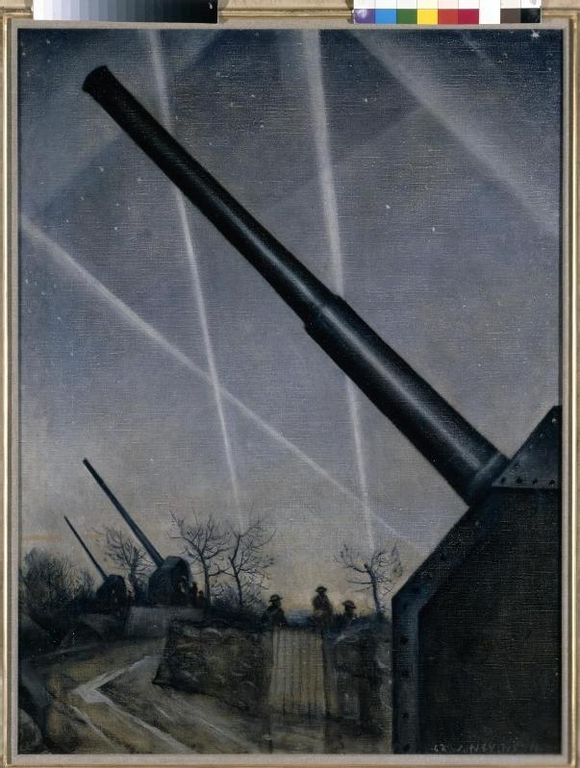
He served as an orderly in the Royal Army Medical Corps in London but was invalided out in late 1915 due to rheumatic fever. During this period he painted several paintings such as La Mitrailleuse (1915) and The Doctor (1916).

Slide 4
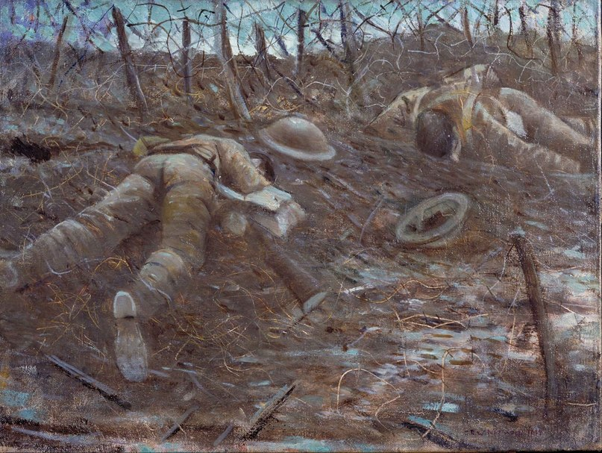
He was commissioned as a war artist in 1917 and was sent to France by the British War Propaganda Bureau. He adopted a Realistic style to depict the horror of the war, moved decisively away from his earlier styles of Modernism and Vorticism.

