Slide 1
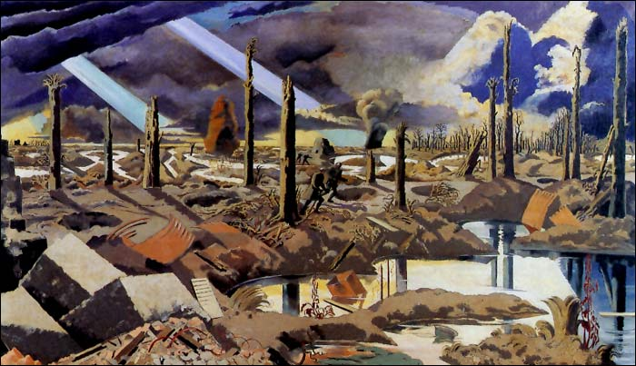
Paul Nash
During World War I Paul Nash was employed as an official war artist by the Ministry of Information and the Air Ministry. He produced the following paintings: the Battle of Britain, Totes Meer (Dead Sea), Over the top during this period.
At the time, war artists were not allowed to show dead people in their paintings, by order of the government. Nash used an apocalyptic landscape and surreal light to represent the annihilation of the young soldiers who were killed there.
The Menin Road (1919)

Slide 2
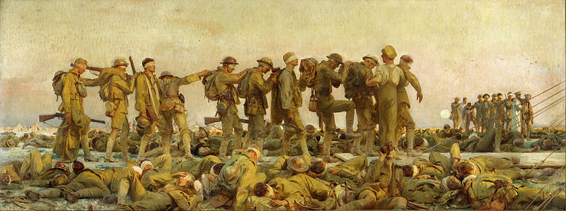
John Singer Sargent
Among the greatest artists who tried to capture essential elements of war in painting was the Society portraitist John Singer Sargent. In his large painting Gassed he presents a classical frieze of soldiers being led from the battlefield — alive, but changed forever by individual encounters with deadly hazard in war.
Gassed (1919)

Slide 3
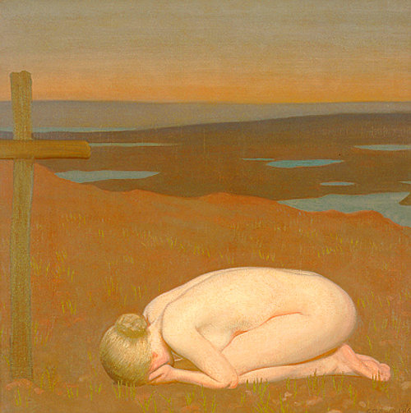
George Clausen
Clausen was no less immune to the tragedy war. Moved by the death of his daughter Katharine`s fiancé in 1915, he painted Youth Mourning. It saw the artist depart from his customary naturalism and return to earlier French Symbolist influence. The result was an intensely allegorical evocation of grief, with the hunched nude female figure and the featureless landscape symbolizing the emptiness and finality of death.
Youth Mourning (1916).

Slide 4
The First World War is considered to be the first occurrence of worldwide conflict and shaped the history of the world until the 20th century.
Around 40 countries worldwide were involved.
The War cost over 17 million people their lives.

