Slide 1
Nose art

Slide 2
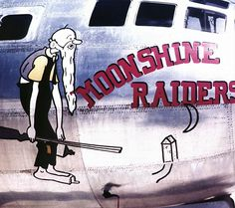
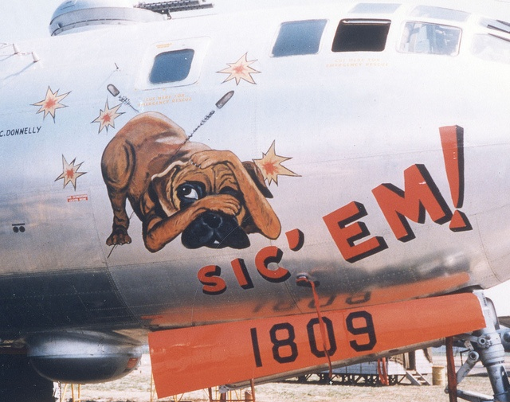
Nose art is a decorative painting or design on the fuselage of a military aircraft, usually chalked up on the front fuselage, and is a form of aircraft graffiti.

Slide 3
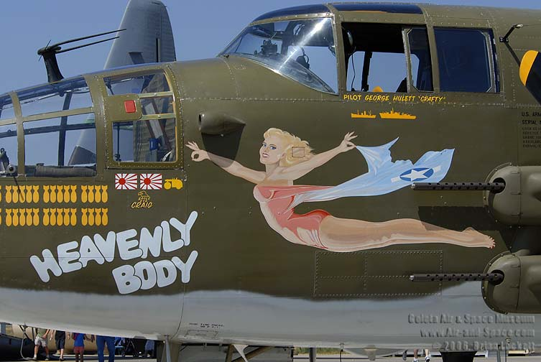
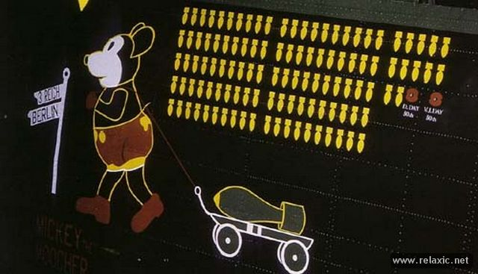
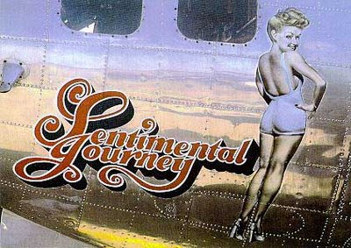
While begun for practical reasons of identifying friendly units, the practice evolved to express the individuality often constrained by the uniformity of the military, to evoke memories of home and peacetime life, and as a kind of psychological protection against the stresses of war and the probability of death. The appeal, however, coming from nose art was not officially approved, even when the regulations against it were not enforced.
c

Slide 4
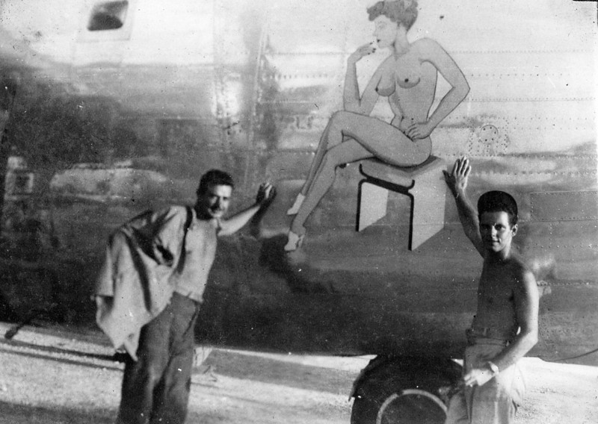
Because of its individual and unofficial nature, it is considered to be a kind of folk art. It can also be compared to sophisticated graffiti. In both cases, the artist is often anonymous, and the art itself is ephemeral. In addition, it relies on materials immediately available.

Slide 5
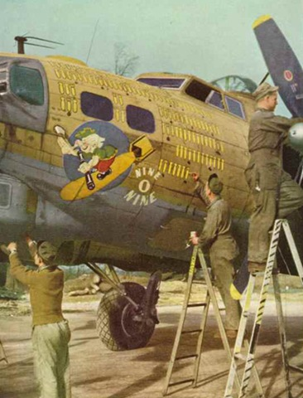
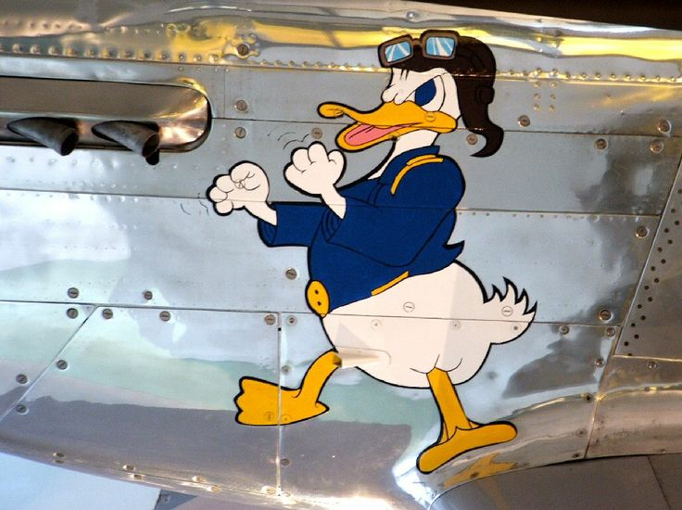
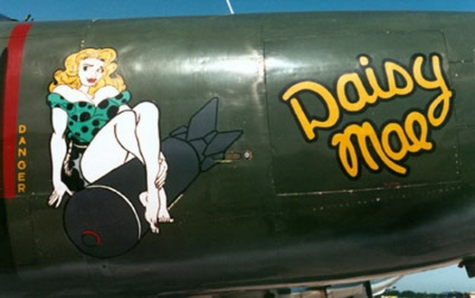
The work was done by professional civil artists as well as talented amateur servicemen.

Slide 6
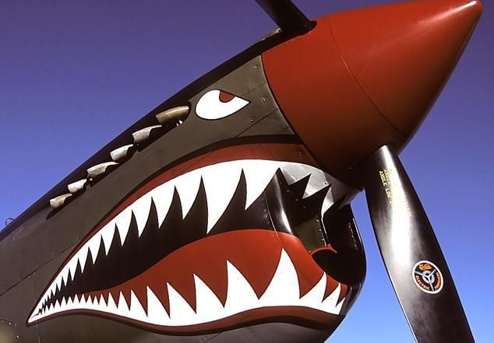
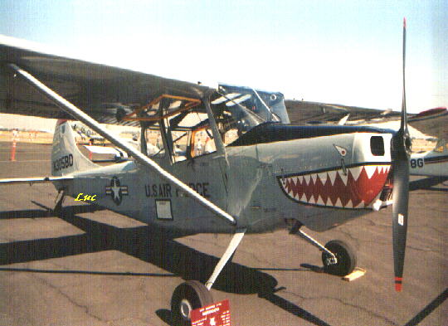
While World War I nose art was usually embellished or extravagant squadron insignia, true nose art appeared during World War II, which is considered by many observers to be the golden age of the genre, with both Axis and Allies pilots taking part. At the height of the war, nose-artists were in a very high demand in the USAAF and were paid quite well for their services.

