Slide 1
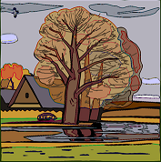
What's the season today?
Let's describe the weather in Autumn.
It's cloudy.
It's rainy
It's windy.
It's cold.
It's ... .
It's ... .

