Slide 1
University of California, Los Angeles

Slide 2
UCLA is one of the world’s greatest research universities, number 11 in London’s Times Higher Education rankings.

Slide 3
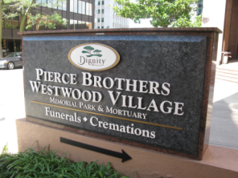
The University of California, Los Angeles (UCLA) is a public research university located in the Westwood neighborhood of Los Angeles, California, USA. It was founded in 1919 as the "Southern Branch" of the University of California and is the second oldest of the ten campuses. UCLA, considered to be one of the flagship institutions of the University of California system offers over 300 undergraduate and graduate degree programs in a wide range of disciplines and enrolls about 26,000 undergraduate and about 11,000 graduate students from the United States and around the world. Strengths in liberal arts and sciences and research strengths earned it membership in the Association of American Universities.
The university is organized into five undergraduate colleges, seven professional schools, and five professional Health Science schools.

Slide 4
UCLA has many faculties
Minors
Specializations
College of Letters and Science
Graduate School of Education and Information Studies
Henry Samuel School of Engineering and Applied Science
John E. Anderson Graduate School of Management
Meyer and Renee Luskin School of Public Affairs
School of the Arts and Architecture
School of Public Health
School of Theater, Film, and Television
Computing
Chemistry
Communication Studies
Ecology and Evolutionary Biology
Economics
Geography
Linguistics
Mathematics
Mathematics/Economics
Molecular, Cell, and Developmental Biology
Psychology
Sociology
International Relations

Slide 5
Admissions Information
When to Apply?
Most departments and schools have deadlines in November and early December for the following Fall term (nearly a year in advance).
Application Fees
$80.00: U.S. citizens and Permanent Residents
$100.00: All other applicants
If You are international student!
An international student whose post-secondary education is completed outside of the U.S. is expected to hold a degree representing completion of at least four years of study with above average scholarship from a university or university-level institution.
Online Application Form
www.ucla.edu

Slide 6
A Campus
Campus Information
Recreation and Campus Events
Sport team
Career Center
UCLA Restaurants
University Credit Union
UCLA Store
Campus Events Commission
Center for Student Programming
Central Ticket Office
UCLA Happenings
UCLA Radio
UCLA Recreation

Slide 7
UCLA Principles of Community
We believe that diversity is critical to maintaining excellence in all of our endeavors.
We are committed to ensuring freedom of expression and dialogue, in a respectful and civil manner, on the spectrum of views held by our varied and diverse campus communities.
We value differences as well as commonalities and promote respect in personal interactions.
We strive to build a community of learning and fairness marked by mutual respect.

Slide 8
Student life
The campus location in Los Angeles makes excursions to local museums, theaters, or other entertainment venues relatively quick and easy. UCLA offers classical orchestras, intramural sports, and over 800 student organizations.
The university has many traditions and annual events involving students, community, or the city. The school hosts events that usually require participation from more than just the student body, and competitions can occasionally involve celebrity judges and performers.
The school's sports teams are called the Bruins, with colors True Blue and gold.

Slide 9
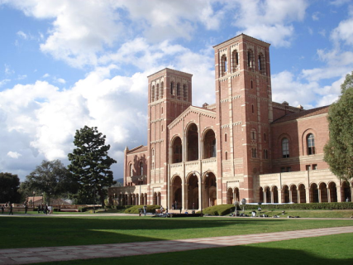
Inverted Fountain, UCLA
University of California, Los Angeles trademark.
Royce Hall, UCLA's landmark building.

Slide 10
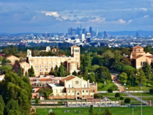
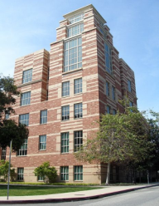
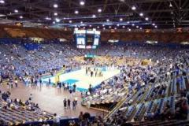
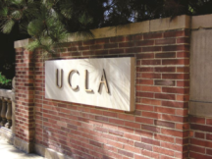
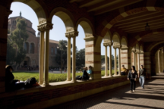
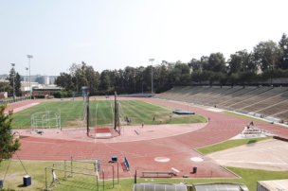
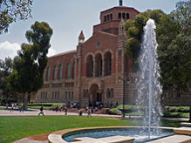

Slide 11
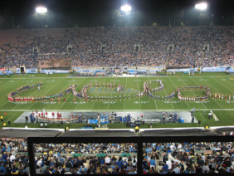
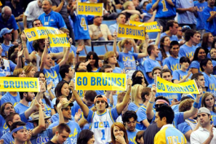
The main sources of information are
www. ucla.edu
and
wikipedia.org
The project was made by Maxim Shabanov.

