Slide 1
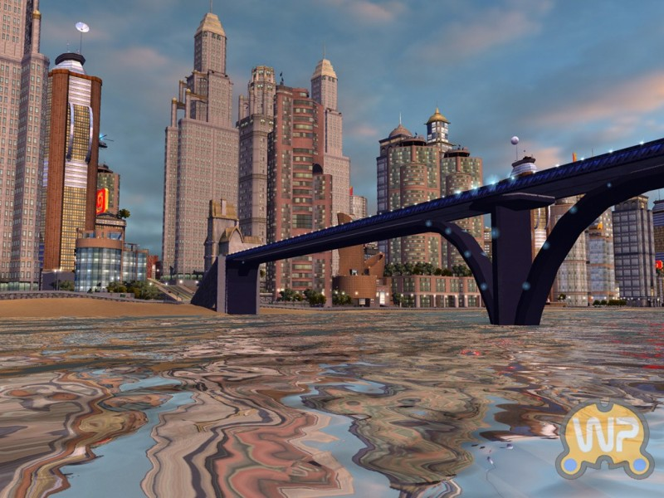
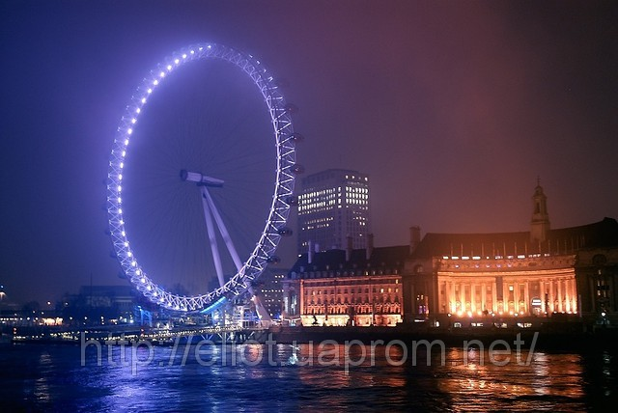
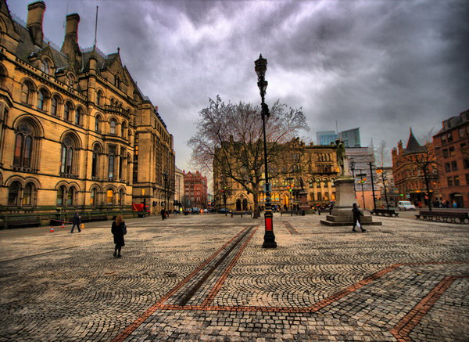
Views of the city

Slide 2
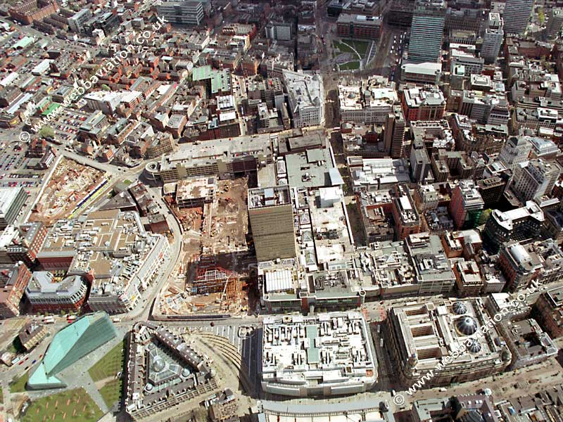
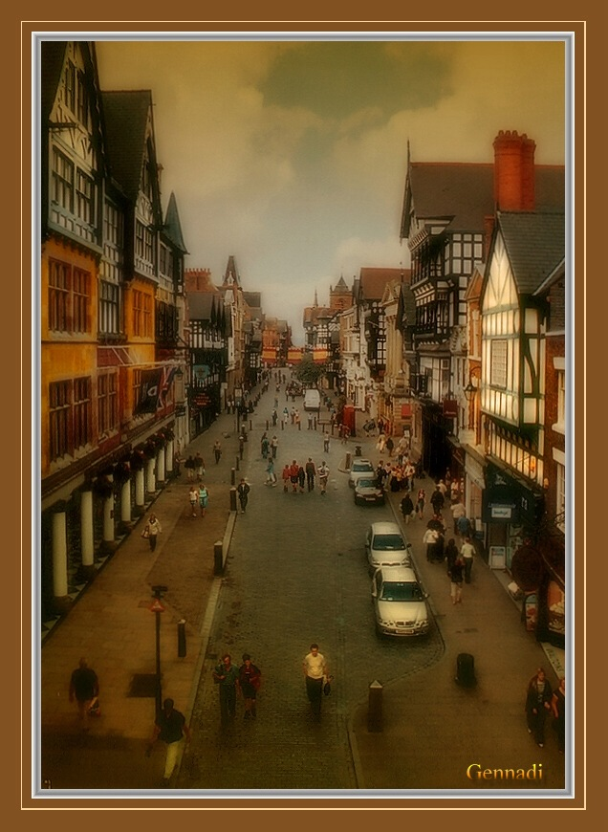
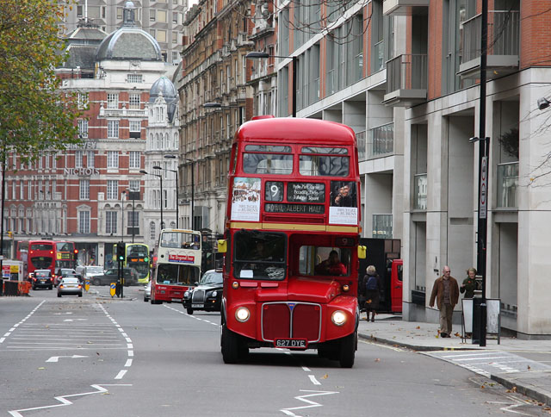
- Life in the city -

Slide 3
. Pronunciation
[ei] –decay, deprivation, major
[e] – dwellers, benefits
[i] – hostility
[ə:] – anti-urban, conurbations

Slide 4
Read three parts of the text and answer the questions:
Why have city dwellers cut all ties with the land?
What were famous English poets’ opinions about city life? Why?
Who broke the spell of the rural myth? Did he really like people’s life that he could see in English cities?
Who really loved the life in London? How do you understand his expression about London?

Slide 5
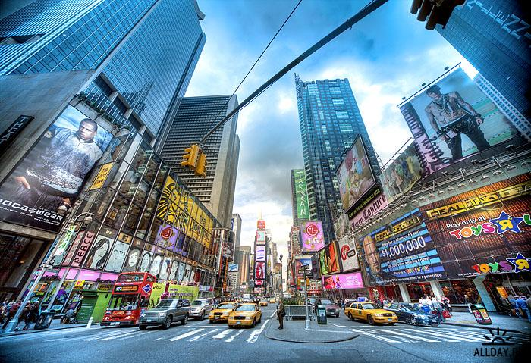
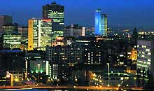
Where do people prefer to live nowadays?
What does the word combination “mega-cities” mean?
Can you explain the word ‘conurbation’?

Slide 6
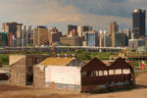
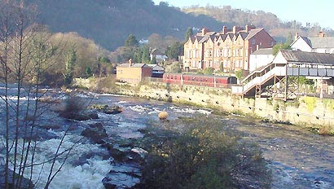
What meaning does the term “inner-cities” have?
What is the reason of existing such inner cities?

Slide 7
1. Give the English equivalents for the following:
Жители города,
плотно населенные части города, деревенский вид,
анти-городской,
пригород,
положительное отношение к,
процветать,
праздничная жизнь, загнивать,
по природе.

Slide 8
2. Give the Russian equivalents for the following:
As far as the British are concerned,
the circuit of schools or office,
a natural habitat,
hostility to the city,
conurbation,
a vicious circle of deprivation,
environmental benefits.

Slide 9
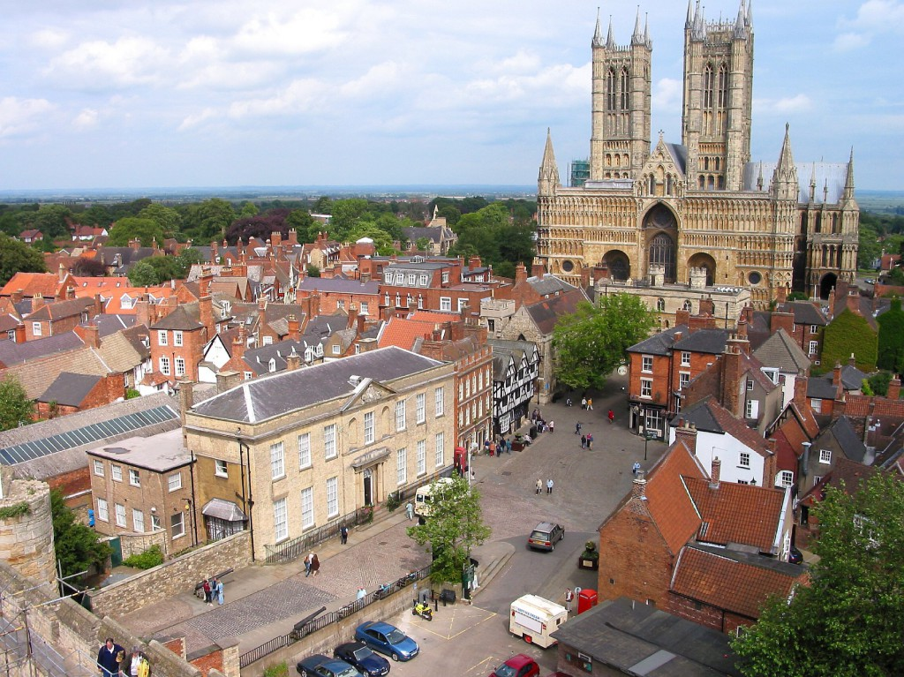
Talking point
Can you explain Keats’s words:
“To one who has been long in cities pent;
‘Tis very sweet to look into the fair
And open face of Heaven.”

Slide 10
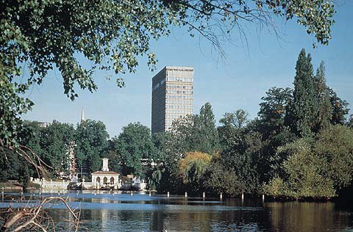
In your opinion
In your country, is the traditional view of cities positive or negative?
From your point of view what are the best and worst things about city life?

Slide 11
The growth of mega-cities seems to be natural. Is there any reason to limit their size?
What are inner cities like in your country? Do they have the same problems as in Britain?

Slide 12
Useful language:
I think …
In my opinion …
I don’t think ….
I’m afraid I’m not with you here …
I disagree with you ( on the point) ..
Frankly speaking, …
On the plus side, …
What is more ….
In addition, ….
However ….
On the other hand …

